Slide 1
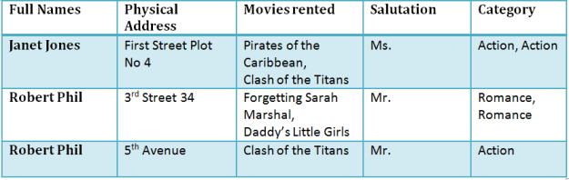
NORMALIZATION
Normalization is a database design technique which organizes tables in a manner that reduces redundancy and dependency of data.
It divides larger tables to smaller tables and links them using relationships.

Slide 2
Unnormalized form (UNF)
An unnormalized data model will suffer the pitfalls of data redundancy, where multiple values and/or complex data structures may be stored within a single field/attribute, or where fields may be replicated within a single table.
It is generally characterized as being a simple database data model lacking the efficiency of database normalization.

Slide 3
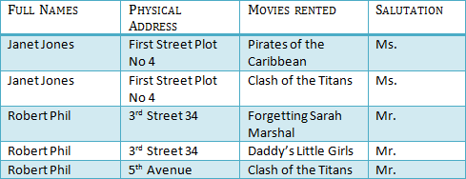
1NF (First Normal Form)
Rule 1- Each table cell should contain a single value.
Rule 2- Each record needs to be unique.

Slide 4

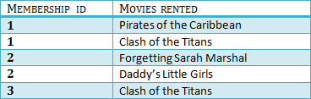
2NF (Second Normal Form)
Rule 1- Be in 1NF
Rule 2- Single Column Primary Key

Slide 5

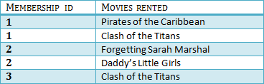

3NF (Third Normal Form) Rules
Rule 1- Be in 2NF
Rule 2- Has no transitive functional dependencies

Slide 6
Boyce-Codd Normal Form (BCNF)
Boyce-Codd Normal Form (BCNF) is one of the forms of database normalization.
A database table is in BCNF if and only if there are no non-trivial functional dependencies of attributes on anything other than a superset of a candidate key.
Sometimes is BCNF is also referred as 3.5 Normal Form.

