Slide 1
APPLICATION
Application is a program designed to perform a group of functions, tasks or activities for the benefit of the user.
Examples of an application include a word processor, a spreadsheet, an accounting application, a web browser, a media player, an aeronautical flight simulator, a console game or a photo editor.
There are many types of application like
Desktop application
Web application
Android application etc..

Slide 2
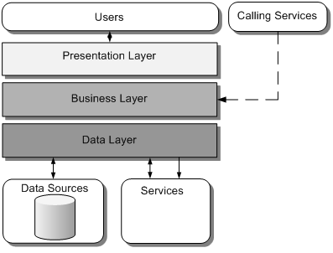
COMPONENTS OF APPLICATION
Presentation layer:
The presentation layer provides the application's user interface.
Business logic layer:
The business layer implements the business functionality of the application.
Data access layer:
The data layer provides access to external systems such as databases.

Slide 3
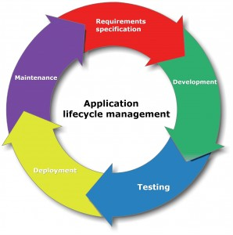

Slide 4
APPLICATION PROGRAM INTERFACE(API)
An application program interface (API) is code that allows two software programs to communicate with each other.
TYPES OF APPLICATIONS
Compiled | Interpreted
A compiled language is a programming language whose implementations are typically compilers translators that generate machine code from source code. | An interpreted language is a type of programming language for which most of its implementations execute instructions directly and freely, without previously compiling a program into machine-language instructions.
Example: C, C++ | Example: Java, C#

Slide 5
APPLICATION SECURITY
Application security is the use of software, hardware, and procedural methods to protect applications from external threats.
Attacks
SQL Injection
Cross-site scripting
Denial of Service
Session Hijacking

Slide 6
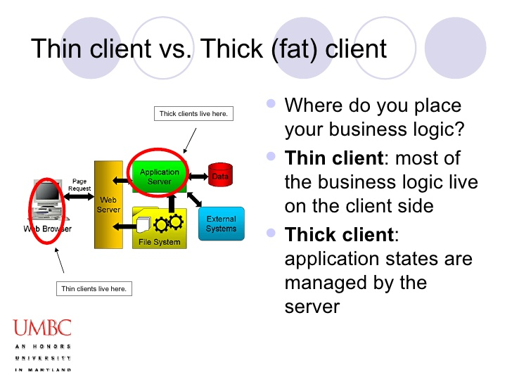
APPLICATION ARCHITECTURE TYPES

Slide 7
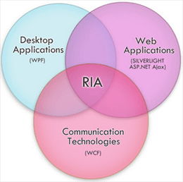
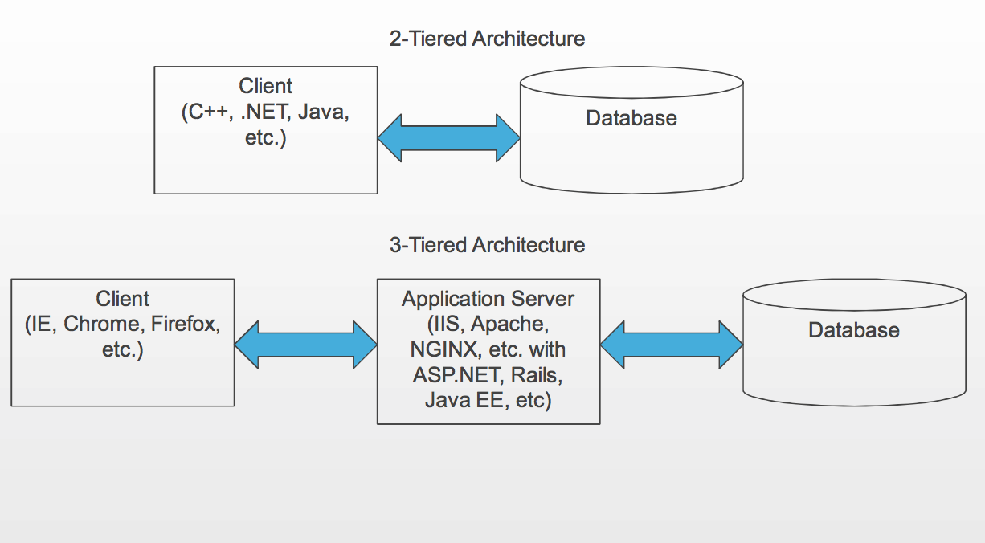
RICH INTERNET APPLICATION
TIER ARCHITECTURE

Slide 8
CHARACTERISTICS
ENTERPRISE APPLICATIONS
Enterprise applications are inherently complex.
Enterprise applications solve business problems.
This involves the safe storage, retrieval, and manipulation of business data.
Complex
Scalable
Component based
Distributed

Slide 9
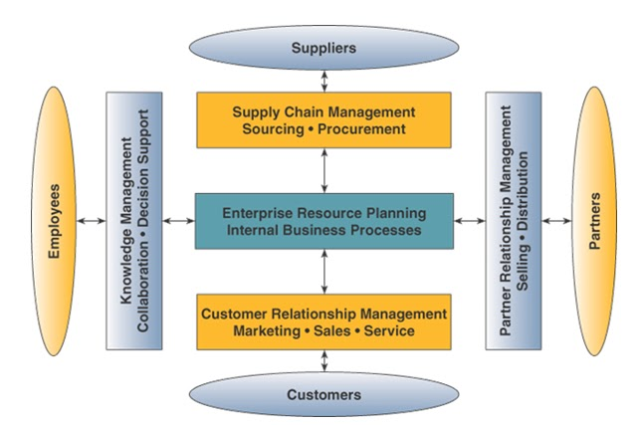
ARCHITECTURE OF ENTERPRISE APPLICATION

Slide 11
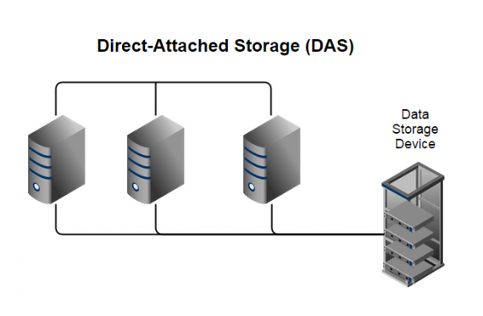
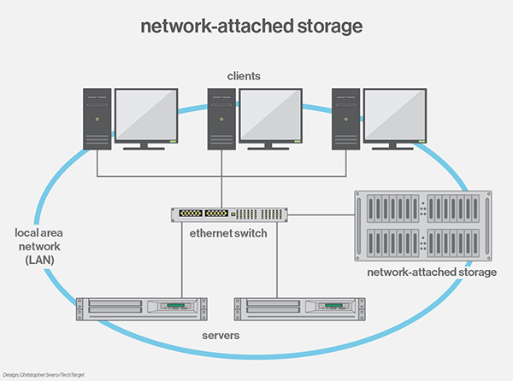
STORAGE

Slide 12
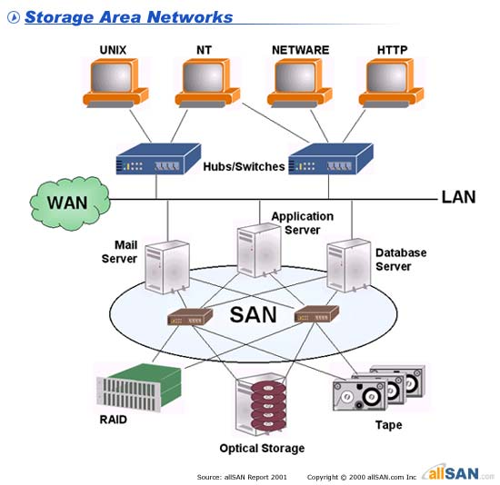
STORAGE AREA NETWORK

Slide 13
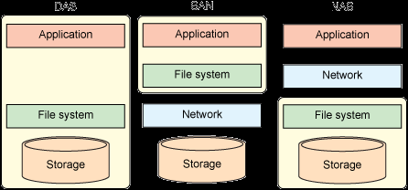
STORAGE TYPES
DAS
SAN
NAS

Slide 14
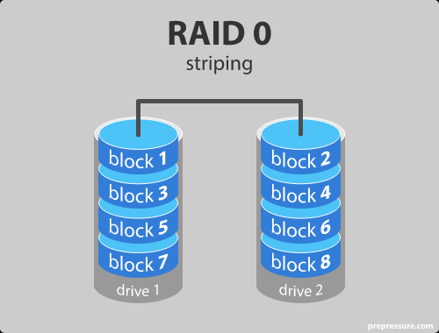
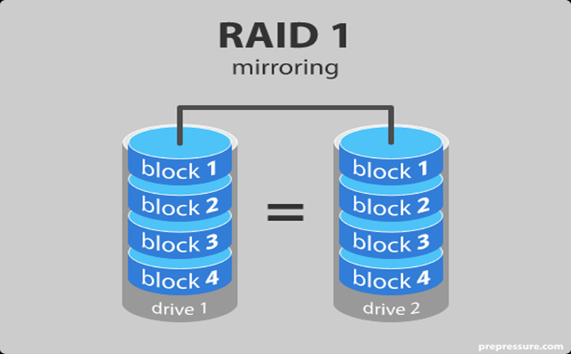
RAID
RAID is a technology that is used to increase the performance and/or reliability of data storage.
RAID LEVELS

Slide 15
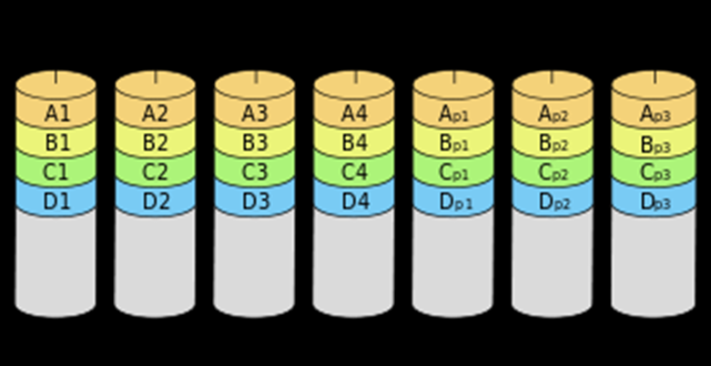
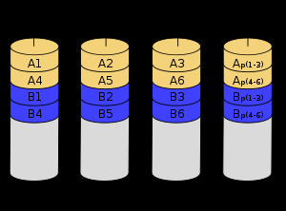
RAID LEVELS(Cont.)
RAID 2
Striping with BCC Checksum
RAID 3
Byte striping with parity

Slide 16
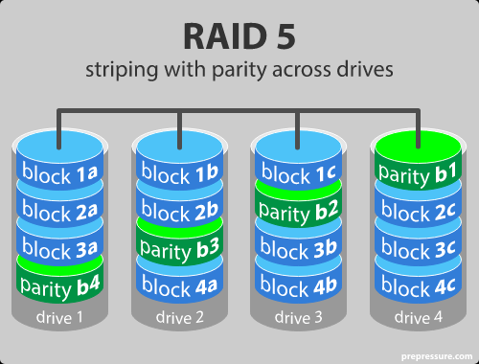
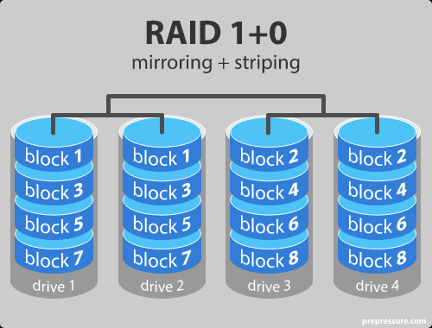
RAID LEVELS(Cont.)

