Slide 1
AXOVRIM
AI-Powered Toolkit Quality Inspection
Computer Vision • RGB-D Metrology • Industrial Inspection
S01
S02
S03
S04
S05
Smartlab students | Sanjivani University
Guide / Mentor: Dr. Arvind Mukundan
Project report dated 15 October 2026
Sockets numbered S01–SN along a PCA-ordered row
Notes:
Introduce AXOVRIM: an AI-assisted toolkit quality inspection prototype combining tool recognition, Excel-driven inventory checks and RGB-D socket measurement. Mention team, institution and guide.

Slide 2
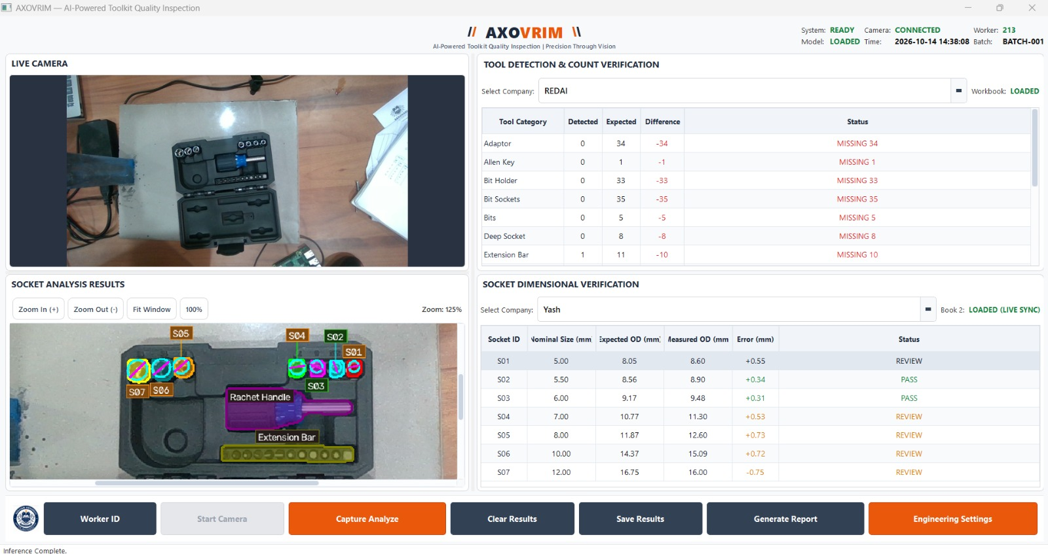
Project at a glance
14
4
2
S01–SN
tool categories detected by YOLO11-seg
operator dashboard panels
editable Excel reference workbooks
spatial socket IDs along one row
Compares detected tool counts with company-defined quantities (Book1.xlsx)
Estimates socket outer diameters with an Intel RealSense RGB-D camera and checks them against Book2.xlsx
Runs on a Raspberry Pi 5 station (.sh launcher) or a Windows laptop (AXOVRIM.exe)
Supervised decision support, not autonomous release authority
Notes:
Summarise the abstract. Stress that the value is structured and repeatable toolkit checking, not a claim of universal defect detection.

Slide 3
Problem statement
1
Reflective metal
Highlights and noisy depth complicate rim extraction
Core problem
Manual toolkit checks are slow, subjective and hard to trace. Build an operator-oriented system that identifies tools, compares quantities with company references, measures socket outer diameters and records outcomes.
Users: inspectors, maintenance staff, toolkit custodians and supervisors.
2
Detection order ≠ physical order
Raw instance IDs cannot label sockets sequentially
3
Multiple company references
Correct selection and live updates are required
4
Missing or displaced items
Reference-slot assignment becomes ambiguous
5
Deployable EXE
Must bundle AI libraries yet keep workbooks and reports writable
Notes:
Walk through the five engineering challenges. The sequence-numbering and reference-assignment issues are the ones that most distinguish this project.

Slide 4
Objectives
01
Acquire RGB-D data
Synchronised colour and depth from an Intel RealSense camera
02
Detect and segment tools
Classify items with the trained YOLO11-seg model
03
Verify inventory
Compare detected counts with Book1.xlsx company quantities
04
Measure socket OD
Extract rim geometry and estimate physical diameters from depth
05
Number and verify sockets
Assign S01–SN by spatial order; compare with Book2.xlsx
06
Decide, record, report
PASS / REVIEW / FAIL, Worker ID, history and reports on Pi 5 and laptop
Notes:
Six main technical objectives condensed from the report. Evaluation criteria: precision/recall, count agreement, socket-ID assignment, caliper-referenced OD error, inspection time and record integrity.

Slide 5
Existing approaches and the gap
Approach | Utility | Limitation here
Manual inspection | Simple, flexible | Operator dependent; little automatic traceability
Object detection | Class and count estimates | Bounding boxes are insufficient for rim metrology
Instance segmentation | Per-item masks | Masks may include body edges, not the true top rim
RGB-D sensing | Per-pixel depth | Specular metal and depth noise need calibration
Spreadsheet checks | Editable company rules | Reference quality and identity matching are critical
Gap addressed
One operator interface that joins instance segmentation, geometric socket ordering, depth-assisted metrology and two independent company reference workflows. Comparative superiority still needs controlled testing.
Notes:
Position AXOVRIM against manual inspection and generic detectors. Be careful: the report does not claim superiority without controlled testing.

Slide 6
Proposed system: key functions
1
2
3
Live RGB-D capture
YOLO11-seg detection
Independent company selection
Camera display and frame capture for analysis
Instance masks for a 14-category toolkit class set
Separate references for inventory and socket checks
4
5
6
Guarded socket identification
Reviewable decisions
Records and reports
Works without Excel; uncertainty is flagged, not hidden
Automatic verdicts plus controlled manual status review
Saved inspection data, toolkit and batch reports
Differentiator: geometric sequence identification is kept separate from spreadsheet matching, so observed sockets are never renumbered just to fit a reference.
Notes:
Six key functions. Highlight the design rule that sequence IDs come from geometry, not from Excel matching. Scope: tool-and-socket inspection only, not general surface-defect detection.

Slide 7
System architecture
1
Capture
2
Detection
3
Socket geometry
4
Metrology
RealSense RGB + aligned depth, intrinsics
YOLO11-seg: classes, masks, confidence
Rim centres and ellipse candidates
Calibrated depth gives physical OD
5
Sequence
6
Reference check
7
Presentation
8
Persistence
PCA row order and S01–SN
Book1 counts and Book2 dimensions
Four dashboard panels and review actions
Worker ID, records and reports
Logical architecture (schematic), not a hardware wiring diagram. The layers wrap from row one to row two.
Notes:
Eight layers from capture to persistence. Read left to right, then continue on the second row.

Slide 8
Methodology: end-to-end workflow
1 Set up
2 Capture
3 Detect
4 Measure
5 Review
Register Worker ID
Load model and Excel references
Aligned RGB + depth frames
Platform calibration
YOLO11-seg instances
Counts vs Book1 company
Rim ellipse from masks
Depth gives physical OD
PCA order, S01–SN
Compare with Book2; save report
Decision safeguards
Invalid depth, an unreliable ellipse, an ambiguous endpoint, a missing item or an uncertain reference match is shown explicitly and never silently turned into PASS. Operator review is tracked while the raw measurement and automatic verdict stay traceable.
Notes:
Five phases summarising the ten-step sequence in the report. Emphasise the safeguards: REVIEW is distinct from PASS.

Slide 9
Input data and preparation
Input | Purpose
RGB frames | Detection masks, rim analysis
Aligned depth | Base plane, height, metric OD
Camera intrinsics | Back-projection to 3D geometry
Book1.xlsx | Expected tool counts per company
Book2.xlsx | Socket IDs, nominal sizes, reference ODs
Calibration files | Measurement setup geometry
Preparation steps
Fit a reference plane from about 30 empty-platform depth frames
Reject implausible depth; flag noisy points
Crop padded socket regions, blur and edge-filter
Fit and validate the top outer rim ellipse
Validate workbooks: blank IDs, duplicates, units
Data note: archived experiment counts and benchmarks are not equated with the current model weights, and a verified dataset manifest should be audited before reporting split sizes.
Notes:
Two classes of input: camera observations and editable reference workbooks. The report is explicit that a verified current-model training manifest was not supplied.

Slide 10
Models and algorithms
1
2
3
YOLO11 instance segmentation
RGB-D depth metrology
PCA socket numbering
Per-instance masks, classes and confidence
Masks feed socket rim extraction
Loading a model is not evidence of accuracy
Back-project pixel (u, v) at depth Z:
X = (u − cx)·Z / fx
Y = (v − cy)·Z / fy
Rim points give physical OD; unstable depth is flagged
Project rim centres on the principal axis
Smaller reliable endpoint becomes S01
Not sorted globally by diameter
Ambiguous endpoint ⇒ review
Per socket: signed OD error = measured OD − reference OD. Acceptance thresholds come from the configured inspection rules.
Notes:
Three algorithm blocks. Mention that thresholds must be verified in the software and company reference rather than assumed.

Slide 11
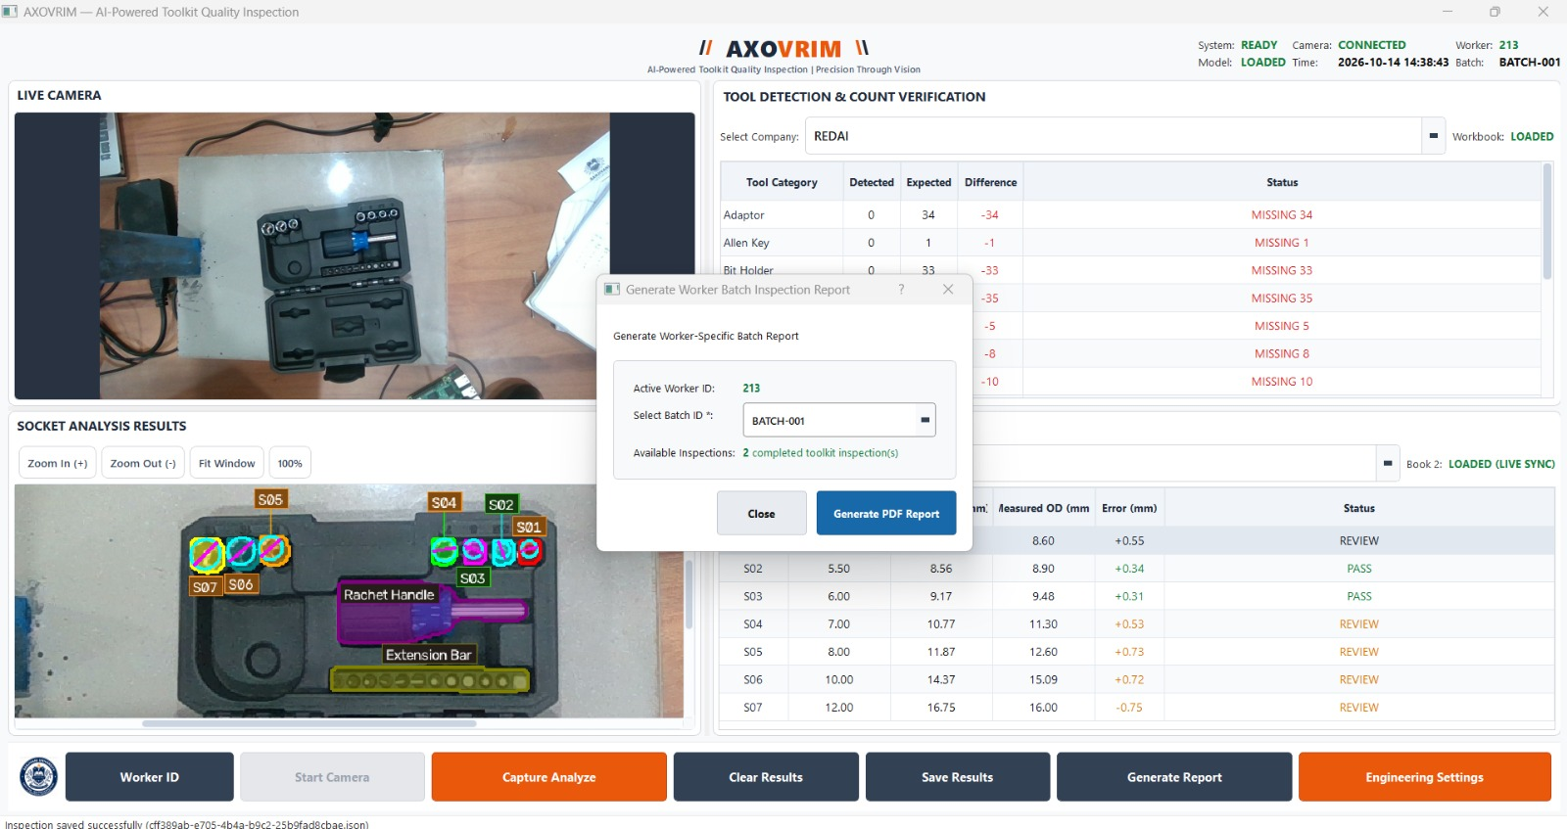
Implementation and hardware
Four-panel operator interface (PyQt5)
Raspberry Pi 5 station
Attached screen and USB 3 RealSense camera
Existing Linux .sh launcher
Needs ARM64 PyTorch, PyQt5, Ultralytics, RealSense
Windows laptop
PyInstaller one-directory build: AXOVRIM.exe
Copy the whole folder, not the EXE alone
Workbooks and reports stay editable
Dashboard with the batch report dialog open after saving an inspection
Controls: Worker ID, Start Camera, Capture Analyze, Clear Results, Save Results, Generate Report, Engineering Settings
Python (main.py), Ultralytics/PyTorch, OpenCV, openpyxl, RealSense SDK. Each platform needs its own validation.
Notes:
Show the real dashboard and the two deployment targets. The .sh launcher is a launcher, not proof of a self-contained package, and cannot run the Windows EXE.

Slide 12
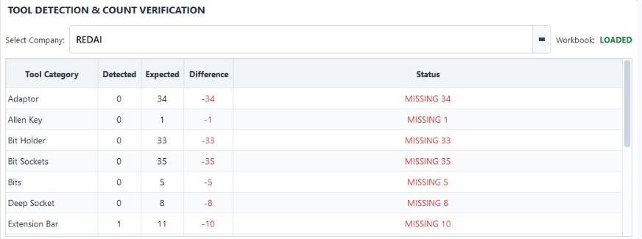
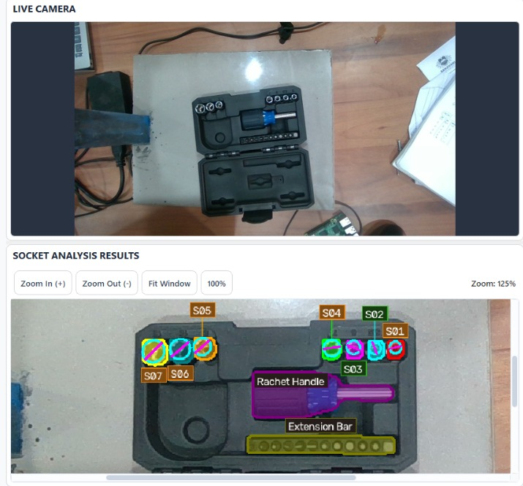
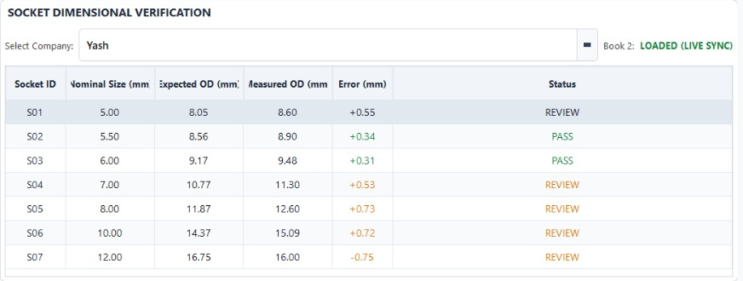
Prototype in action
Tool counts vs Book1 (REDAI); socket OD vs Book2 (Yash): PASS / REVIEW
Live camera and segmented sockets labelled S01–S07
Notes:
Real screenshots from the application. Left: tool-count check and socket OD verification. Right: live camera view and socket analysis with S01 to S07 numbering. Note that the count table shows MISSING because only one small kit was in view.

Slide 13
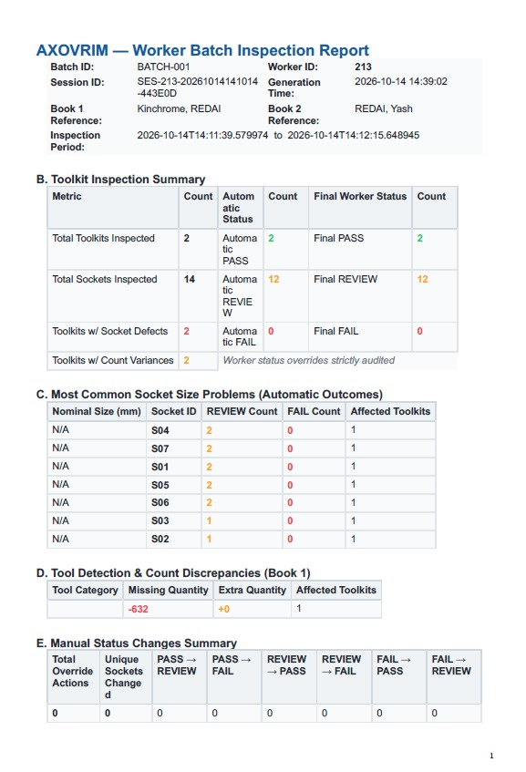
Results and evaluation status
Area | Evidence | Status
EXE startup | Onedir build launched | Reported
Model + Excel | Loading checks | Reported
Socket order | PCA / endpoint tests | Tested
RealSense run | No target-laptop trial | Pending
Accuracy | No production benchmark | Not set
183
regression tests passed, 3 skipped
developer-reported; re-verify on current release
Recommended protocol: labelled toolkits with caliper-traced ODs; report precision/recall, mean absolute OD error, repeatability across lighting and devices, and inspection time.
Generated worker batch report (PDF)
Notes:
Be transparent: these are software-assembly checks, not an industrial accuracy benchmark. The report image shows 2 toolkits and 14 sockets inspected in BATCH-001, mostly flagged REVIEW. Detection accuracy, measurement uncertainty and multi-device portability remain to be validated.

Slide 14
Advantages and limitations
Advantages
Limitations
Counts and socket dimensions in one operator workflow
Editable company references, no hard-coded quantities
Spatial socket numbering separate from detection order
Worker-linked records and reviewable decisions
Pi 5 station and Windows laptop options
Reflective metal gives unstable depth and rim edges
PCA ordering fits a single row, not grids or L-shapes
A missing socket can shift visible labels
OD alone cannot confirm drive condition or surface integrity
No verified accuracy or portability benchmark yet
Notes:
Treat AXOVRIM as a decision-support prototype. Retain original measurements, distinguish REVIEW from PASS, and check critical items manually when no reliable match exists.

Slide 15
Future scope and conclusion
Next steps
Conclusion
AXOVRIM shows a practical architecture that brings tool recognition, reference inventory checks and depth-assisted socket measurement into one inspection interface.
Industrial-grade accuracy, precision and portability should be claimed only after comprehensive validation.
Thank you | Smartlab, Sanjivani University
1
Validate on a versioned, representative toolkit dataset
2
Quantify OD repeatability against traceable calipers
3
Add layout registration for missing slots and non-linear arrangements
4
Improve robustness to reflections, lighting and occlusion
5
Verify Pi 5 speed, power and RealSense; test the EXE separately
6
Add supervisor workflows and signed report exports
Notes:
Close with the immediate milestone: validate the packaged EXE independently, test RealSense on representative hardware, verify calibration and collect quantitative results. Invite questions.

