Slide 1

Smart India Hackathon 2026 | SIH26031
ONION AI INSPECTION SYSTEM
Quality assessment and grading of onions
Theme: Smart Automation | Category: Software
Scan for the GitHub repo
Team CepaMetric | Team ID 167398
GitHub: github.com/SMARTLAB-SU/SIH-CepaMetric-26031

Slide 2
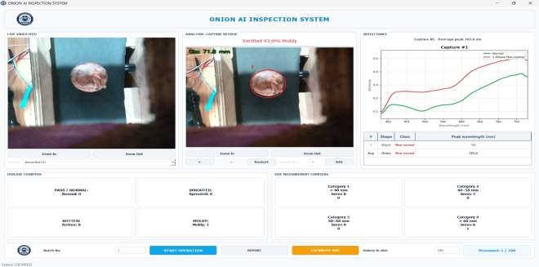
Project Overview
What the system does, for whom, and why it matters
What it does: grades onions on a conveyor by true size in mm and judges their health with 3D vision and deep learning.
Who will use it: farmers and FPOs, mandi traders and exporters, processors and cold storage.
Main outcome: each onion is dropped into a size bin (<40, 40-50, 50-60, >60 mm) or the reject bin.
Why it matters: manual grading is subjective and varies across procurement centers, causing disputes.
This project helps procurement centers grade onions consistently by using depth-based 3D vision and a 5-CNN ensemble to produce size grades, health classes and automatic sorting.

Slide 3
Problem Statement
Subjective, inconsistent grading across procurement centers
Quality assessment and grading of onions are often subjective.
Grading varies across procurement centers, resulting in disputes and inconsistencies.
Manual inspection is slow, inconsistent and difficult to scale on a conveyor or packing line.
Inspectors must assess disease, count onions without duplication, estimate size, assign a grade and keep batch records while product keeps moving.
Problem Statement ID: SIH26031
Theme: Smart Automation
PS Category: Software
Team: CepaMetric (ID 167398)
What an automated system must do
Combine reliable image classification with stable physical tracking and measurement, and expose evidence for operators to review incorrect or uncertain decisions.

Slide 4
Objectives
Turning the grading problem into clear goals
Replace slow, subjective manual grading and disease checks with consistent, automated decisions.
Measure each onion's true diameter in mm and sort it into four size grades.
Classify health into four classes with a 5-model stacked ensemble.
Explain disease calls with Grad-CAM.
Remove moldy and rotten onions early so infection does not spread through stored lots.
Four health classes
Moldy
Normal
Visible mold-related deterioration
No targeted visible defects
Rotten
Sprouted
Visible rot or decay
Visible sprouting

Slide 5
Proposed Solution
A hybrid of classical 3D vision and deep learning
1
Capture: Onions travel on a conveyor under an Intel RealSense D455f RGB-D camera.
Before
Slow, subjective manual grading and disease checks.
2
Detect, measure, track: Classical 3D vision finds each onion, measures its diameter in mm and tracks it with a unique ID.
Classify and explain: 5 CNNs and a stacking meta-classifier give 4 health classes; Grad-CAM shows why.
After
Consistent, automated decisions.
3
4
Sort: An Arduino drives servos or pneumatic pushers into the size bins or the reject bin.
Innovation
Hybrid design: 3D depth finds where and how big; deep learning only judges health
True sizing in mm from 3D deprojection, not pixel counts
5-model stacked ensemble with Grad-CAM for explainable calls
Hyperspectral check against the average of 3000 normal onions

Slide 6
System Architecture
From camera to sorted bin
Input
Detect + verify
Size + track
Classify
Output
RealSense D455f RGB + depth over the conveyor (or simulator)
Canny edges + depth jump >12 mm isolate each onion; contours, circularity and moments confirm it is round
3D deprojection gives diameter in mm; persistent ID per onion
Crop resized to 224 or 299 px; 5 CNNs; meta-classifier on 20 features; Grad-CAM
PyQt5 dashboard; Arduino serial payload drives pushers into size bins or reject bin
→
→
→
→
Lane B: deep learning runs on the cropped onion only to decide healthy or diseased. Tools: RealSense D455f, OpenCV / NumPy / SciPy, Keras, PyQt5, pySerial to Arduino.

Slide 7
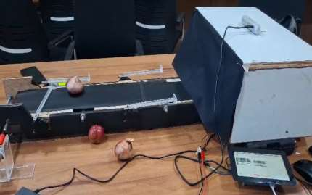
Technology Stack
Tools used to build and run the project
1
Programming: Python with OpenCV, NumPy and SciPy
2
AI / ML: TensorFlow / Keras: ConvNeXt-Tiny, EfficientNetV2-B0, DenseNet121, ResNet50V2, Xception; stacking meta-classifier; Grad-CAM
3
Application: PyQt5 dashboard with QThread workers
4
Hardware and I/O: Intel RealSense D455f (pyrealsense2 with pinhole-model fallback); Arduino servo / pneumatic pushers via pySerial (COM3, 9600 baud)
Working prototype setup: conveyor belt with camera enclosure.
5
Storage and deployment: CSV measurement output; model weights via Git LFS; GitHub, requirements.txt, README

Slide 8
Dataset / Input Data
Source, classes and what is still to be confirmed
Source: Onion Dataset Combined (Kaggle), referenced in the Xception notebook.
Classes: molded (Moldy), normal, rotten, sprouted.
Preprocessing: tracked onion crop resized to 224 or 299 px.
Hyperspectral reference: average reflectance of 3000 normal onions.
In the repo: no raw dataset is copied; Dataset/README.md covers access and verification.
Application label | Notebook label
Moldy | molded
Normal | normal
Rotten | rotten
Sprouted | sprouted
Data limitations
Dataset statistics (sample counts, split) and license details require confirmation. The Moldy / molded spelling differs between app and notebook.

Slide 9
Methodology / Working Flow
Nine steps from capture to sort
Classical 3D vision
1
Capture
2
Segment
3
Verify
4
Size + Track
RealSense D455f RGB + depth over the conveyor
Canny edges + depth jump >12 mm isolate each onion
Contours, circularity and moments confirm a round onion
3D deprojection gives diameter in mm; persistent ID
Lane B: deep learning on the cropped onion only
5
Crop ROI
6
5 CNNs
7
Meta-classifier
8
Grad-CAM
Tracked onion resized to 224 or 299 px
ConvNeXt, EfficientNetV2, DenseNet121, ResNet, Xception
5 x 4 probabilities = 20 features give final class
Heatmap shows pixels behind Moldy or Rotten calls
9 Sort: Arduino firmware receives the serial payload and actuates pushers: size bins <40, 40-50, 50-60, >60 mm and a reject bin for diseased onions.

Slide 10
Model / Algorithm Details
Five CNNs, a stacking meta-classifier and an ensemble mode
Meta-classifier: 5 x 4 = 20 probabilities give the final class.
Ensemble mode: averages the five probability vectors; no separate checkpoint.
Training (Xception notebook): 300 epochs, ImageNet transfer learning, class weights, optional focal loss, AdamW, validation Macro-F1 checkpointing.
Evaluation described: balanced accuracy, per-class metrics, confusion matrix.
Why this method: the stacked ensemble with Grad-CAM gives accurate, explainable disease calls.
Model | Input | Output
ConvNeXt-Tiny | 224 x 224 | 4 probs
EfficientNetV2-B0 | 224 x 224 | 4 probs
DenseNet121 | 224 x 224 | 4 probs
ResNet50V2 | 224 x 224 | 4 probs
Xception | 299 x 299 | 4 probs
Stacking | 20 values | 4 classes
Hyperspectral double check
Each onion's reflectance is compared with the average of 3000 normal onions; a large deviation rejects it directly.

Slide 11
Key Features
Six strongest features of the system
Live and simulated input
True size in mm
5 models + stacking
RealSense D455f camera or simulated camera mode for testing without hardware.
Depth-based diameter from 3D deprojection, graded into four size bins.
Five selectable base models, a stacking meta-classifier and an ensemble mode.
Persistent IDs
On-demand Grad-CAM
Counters + sorting
Each onion keeps its ID, reducing duplicate counting.
Visual explanation of model decisions, with capture-history navigation.
Batch and slot counters, disease and size counters, Arduino-driven pushers.

Slide 12
Results & Performance
Diameter measurement: actual vs app
94%
1.6 mm
Size grade accuracy
Mean absolute error
Classification metrics
Overall accuracy, Macro-F1 and confusion matrix are not yet reported in the repo and are to be recomputed on the confirmed dataset split.

Slide 13
Demo Screenshots
Dashboard and working prototype
Working prototype: conveyor belt with camera enclosure, onions on the belt.
Dashboard: live video feed, capture review with size and class, reflectance plot, disease and size counters, batch controls.

Slide 14
GitHub Repository Structure
Folders for dataset notes, models, source, screenshots and documentation
README explains setup, running and testing.
requirements.txt lists dependencies.
Model files are large and use Git LFS.
Dataset folder holds access notes, not the raw data.
Grad-CAM overlays are kept under Screenshot/Screenshots/XAI_GradCAM.
MIT license included.
SIH-CepaMetric-26031/
├── Dataset/
├── Model/Classification/
├── SRC/
│ ├── Classification_App/
│ ├── Detection_App/
│ └── Hardware/
├── Screenshot/
├── Documentation/
├── LICENSE
├── requirements.txt
└── README.md
Run: python SRC/Classification_App/main.py

Slide 15
Conclusion & Future Scope
Achieved and impact
Current limitations
Future scope
Thank You
Working prototype: 3D sizing, tracking, 5-model AI and dashboard are built.
Size grade accuracy 94%; mean absolute diameter error 1.6 mm.
Consistent grading and early removal of moldy and rotten onions.
Overall classification metrics not yet supplied.
Sizing accuracy depends on calibration and scene geometry.
Hardware defaults are hard-coded; no installer yet.
Recompute accuracy, Macro-F1 and confusion matrix on the confirmed split.
Build and test an installer for deployment.
Extend to other round produce.
Scan for the GitHub repo
github.com/SMARTLAB-SU/SIH-CepaMetric-26031
Team CepaMetric | Team ID 167398

