Slide 1
SPECTRUM
See beyond RGB. Turn any camera into a hyperspectral sensor.
Hyperspectral Analysis System | ML-powered 401-band spectra (380–780 nm), in real time
Team / Department / University / Lab
SUGGESTED VISUAL
Project logo + repo QR code
GitHub: github.com/username/SPECTRUM
Notes:
Welcome. SPECTRUM turns an ordinary RGB camera feed into 401-band hyperspectral data in real time.
Suggested visual: a full-bleed rainbow spectrum strip fading from a webcam image, plus logo and QR code to the repo. Replace the team name and GitHub link before presenting.

Slide 2
SPECTRUM | Hyperspectral Analysis System
What Is Hyperspectral Analysis?
Seeing color the way physics does.
Full spectrum: light measured as a continuous curve, not just red, green and blue.
Material fingerprint: every surface reflects light in a unique spectral signature.
Hidden insight: reveals ripeness, composition and quality the eye cannot see.
The catch: traditional hyperspectral cameras are costly, bulky and slow.
RGB gives 3 numbers per pixel. Hyperspectral gives hundreds.
SUGGESTED VISUAL
Side-by-side: 3 RGB bars vs. a smooth 380–780 nm spectral curve over a rainbow gradient
SPECTRUM — RGB to 401-band spectra, in real time
02
Notes:
Set the stage: hyperspectral imaging measures how much light a material reflects at every wavelength.
Suggested visual: Side-by-side: 3 RGB bars vs. a smooth 380–780 nm spectral curve over a rainbow gradient

Slide 3
SPECTRUM | Hyperspectral Analysis System
The Problem: RGB Is Not Enough
Standard cameras throw away most of the spectrum.
3-channel limit: an RGB camera collapses hundreds of wavelengths into three values.
Metamerism: different spectra can produce identical RGB colors.
Blind spots: subtle material, ripeness or coating differences go undetected.
Cost barrier: dedicated hyperspectral hardware is expensive and hard to deploy.
Two surfaces. One identical RGB value. Two completely different spectra.
SUGGESTED VISUAL
Two identical color swatches on the left; two clearly different spectral curves on the right
SPECTRUM — RGB to 401-band spectra, in real time
03
Notes:
Metamerism is the core pain point: colors that match in RGB but differ physically.
Suggested visual: Two identical color swatches on the left; two clearly different spectral curves on the right

Slide 4
SPECTRUM | Hyperspectral Analysis System
Our Solution: Introducing SPECTRUM
A machine-learning transfer model from RGB to full spectrum.
Reconstruct: ML model predicts 401 bands (380–780 nm) from each RGB pixel.
Real time: runs on live camera feeds, no capture-and-wait workflow.
Low cost: works with standard webcams and embedded cameras.
All-in-one: analyze, compare and export spectra in one desktop app.
Before: 3 channels. After: 401 bands, from the same camera.
SUGGESTED VISUAL
Before/after split: a plain webcam frame transforming into a live spectral graph
SPECTRUM — RGB to 401-band spectra, in real time
04
Notes:
This is the one-line pitch: hyperspectral insight from commodity hardware.
Suggested visual: Before/after split: a plain webcam frame transforming into a live spectral graph

Slide 5
SPECTRUM | Hyperspectral Analysis System
Key Features
Built for fast, hands-on spectral analysis.
Real-Time Analysis
ROI Tools
Live Spectral Graphs
Live RGB-to-spectrum conversion on every frame.
Point, rectangle, ellipse and polygon selection.
Interactive plots update as the scene changes.
Spectral Metrics
Smart Comparisons
Data Export
Peak wavelength, energy and warm/cool class.
Metameric similarity and CCT in Kelvin.
CSV and multi-sheet Excel workbooks.
From camera frame to spectral insight, inside a single desktop app.
SPECTRUM — RGB to 401-band spectra, in real time
05
Notes:
Walk through the six pillars of the app.
Suggested visual: small icon on each tile (camera, graph, selection tool, export).

Slide 6
SPECTRUM | Hyperspectral Analysis System
Core Technology
How RGB becomes a 401-band spectrum.
RGB Pixel
R, G, B values
Polynomial Expansion
Non-linear color terms
PCA Basis
Compact spectral components
401-Band Spectrum
380–780 nm output
→
→
→
Polynomial color expansion: captures the non-linear link between RGB and spectra.
PCA: reduces spectra to a few components, keeping prediction fast and stable.
Transfer model: trained on paired RGB and spectral data (see /Data set).
Small model, big payoff: lightweight enough for real-time inference.
SUGGESTED VISUAL
Mini chart: PCA variance explained vs. components
SPECTRUM — RGB to 401-band spectra, in real time
06
Notes:
Explain the pipeline left to right: expand the color features, project through a PCA spectral basis, reconstruct the spectrum.
Suggested visual: the flow diagram above, with a small spectral curve under the final block.

Slide 7
SPECTRUM | Hyperspectral Analysis System
Hardware Integration
Bring your own camera. No special sensor required.
OpenCV
Standard Webcams
Picamera2
GStreamer
Standard webcams and video capture devices.
Plug-and-play USB cameras on desktop.
Raspberry Pi camera modules for edge use.
Flexible pipelines for embedded and streaming sources.
Same app, same model, any supported camera: from a laptop webcam to a Raspberry Pi in the field.
SUGGESTED VISUAL
Photo strip of supported devices
SPECTRUM — RGB to 401-band spectra, in real time
07
Notes:
Stress the cost advantage: any supported camera becomes a spectral sensor.
Suggested visual: row of device photos (USB webcam, Raspberry Pi with camera module, embedded board).

Slide 8
SPECTRUM | Hyperspectral Analysis System
Real-Time Spectral Metrics
Instant numbers that summarize what the spectrum says.
Peak Wavelength
Spectral Energy
Warm / Cool Class
The wavelength (nm) where the region reflects most strongly: a quick read on dominant color.
Total intensity across 380–780 nm: how much light the region carries overall.
Classifies the spectral balance of the region as warm or cool at a glance.
Live readouts update on every frame, so changes in the scene show up as they happen.
SUGGESTED VISUAL
Spectral plot with peak marker and warm/cool badge
SPECTRUM — RGB to 401-band spectra, in real time
08
Notes:
These update live as the ROI or scene changes.
Suggested visual: a spectral plot with the peak marked, and a warm/cool badge beside it.

Slide 9
SPECTRUM | Hyperspectral Analysis System
ROI Annotation Tools
Select exactly the region you want to analyze.
Point
Rectangle
Ellipse
Polygon
Sample the spectrum at a single location.
Quick box selection for uniform areas.
Round or oval regions such as fruit and spots.
Free-form masks for irregular shapes.
Each mask feeds the same live spectrum, metrics and comparison tools.
SUGGESTED VISUAL
Screenshot of all four ROI tools drawn on a sample image
SPECTRUM — RGB to 401-band spectra, in real time
09
Notes:
Four mask types cover everything from a single pixel to irregular shapes.
Suggested visual: screenshot of each tool drawn on a fruit or leaf image.

Slide 10
SPECTRUM | Hyperspectral Analysis System
Advanced Comparisons
Go beyond color: compare what the light is really doing.
Metameric similarity: test if two regions match in RGB but differ spectrally.
CCT in Kelvin: estimate correlated color temperature of any ROI.
Overlay graphs: plot ROI spectra together for instant visual comparison.
Decision support: quantified scores replace guesswork and "looks the same".
Metamerism is the problem. SPECTRUM turns it into a measurable result.
SUGGESTED VISUAL
Overlaid spectra for two ROIs with a similarity score and a CCT readout (e.g. 5,600 K)
SPECTRUM — RGB to 401-band spectra, in real time
10
Notes:
Show how two look-alike samples are separated by their spectra. Replace the example CCT value with a real reading from the app.
Suggested visual: Overlaid spectra for two ROIs with a similarity score and a CCT readout (e.g. 5,600 K)

Slide 11
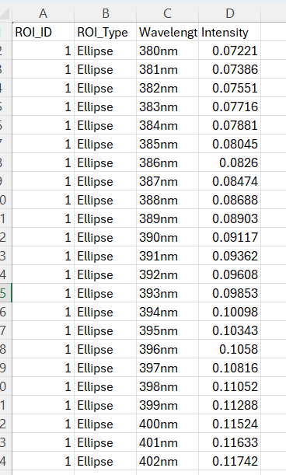
SPECTRUM | Hyperspectral Analysis System
Data Management
Take your spectra anywhere.
CSV export: wavelength-by-intensity tables for any ROI.
Multi-sheet Excel: one workbook, one sheet per ROI.
Organized output: files and graphs saved to the /Output folder.
Analysis-ready: open in Excel, Pandas, MATLAB or your own pipeline.
One click turns a live observation into a shareable, reproducible dataset.
Real export: ROI ID, type, wavelength and intensity per band (380–780 nm).
SPECTRUM — RGB to 401-band spectra, in real time
11
Notes:
Emphasize reproducibility: every measurement can be exported and revisited.
Screenshot: real Excel export showing ROI_ID, ROI_Type, Wavelength and Intensity columns.

Slide 12
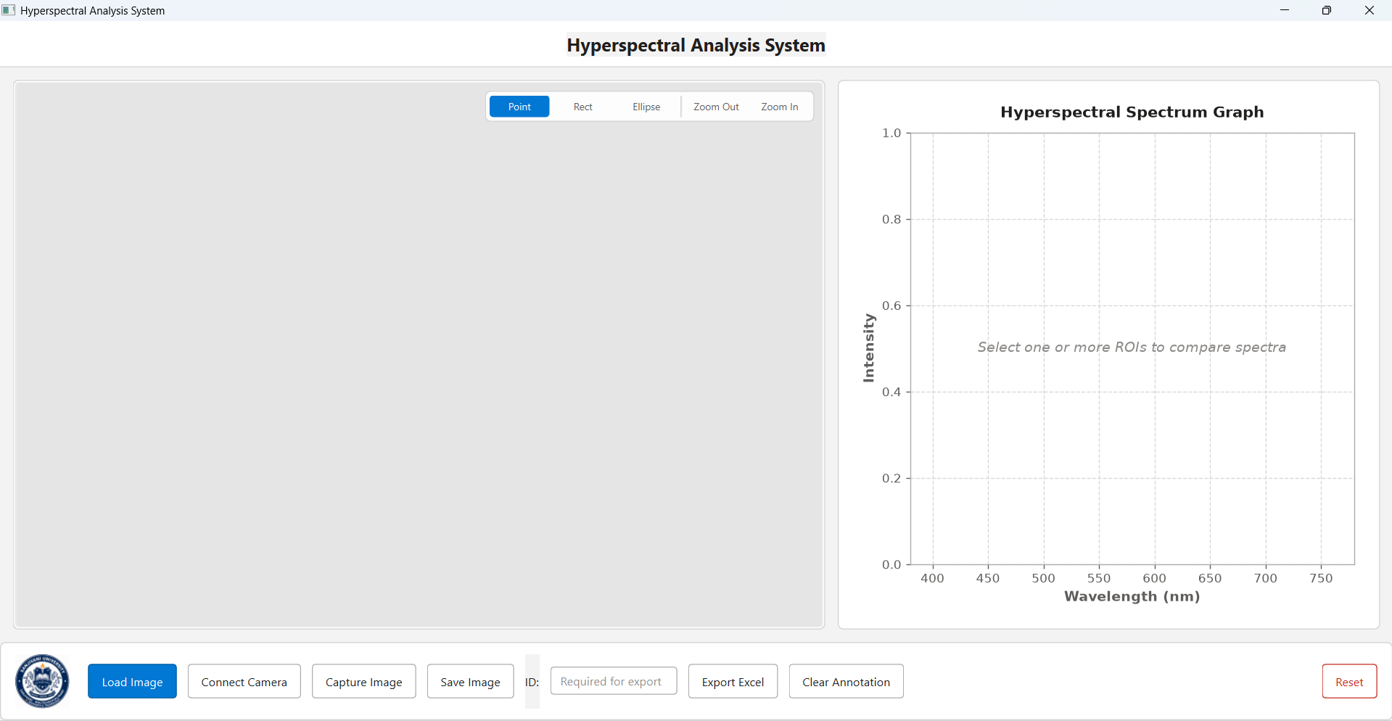
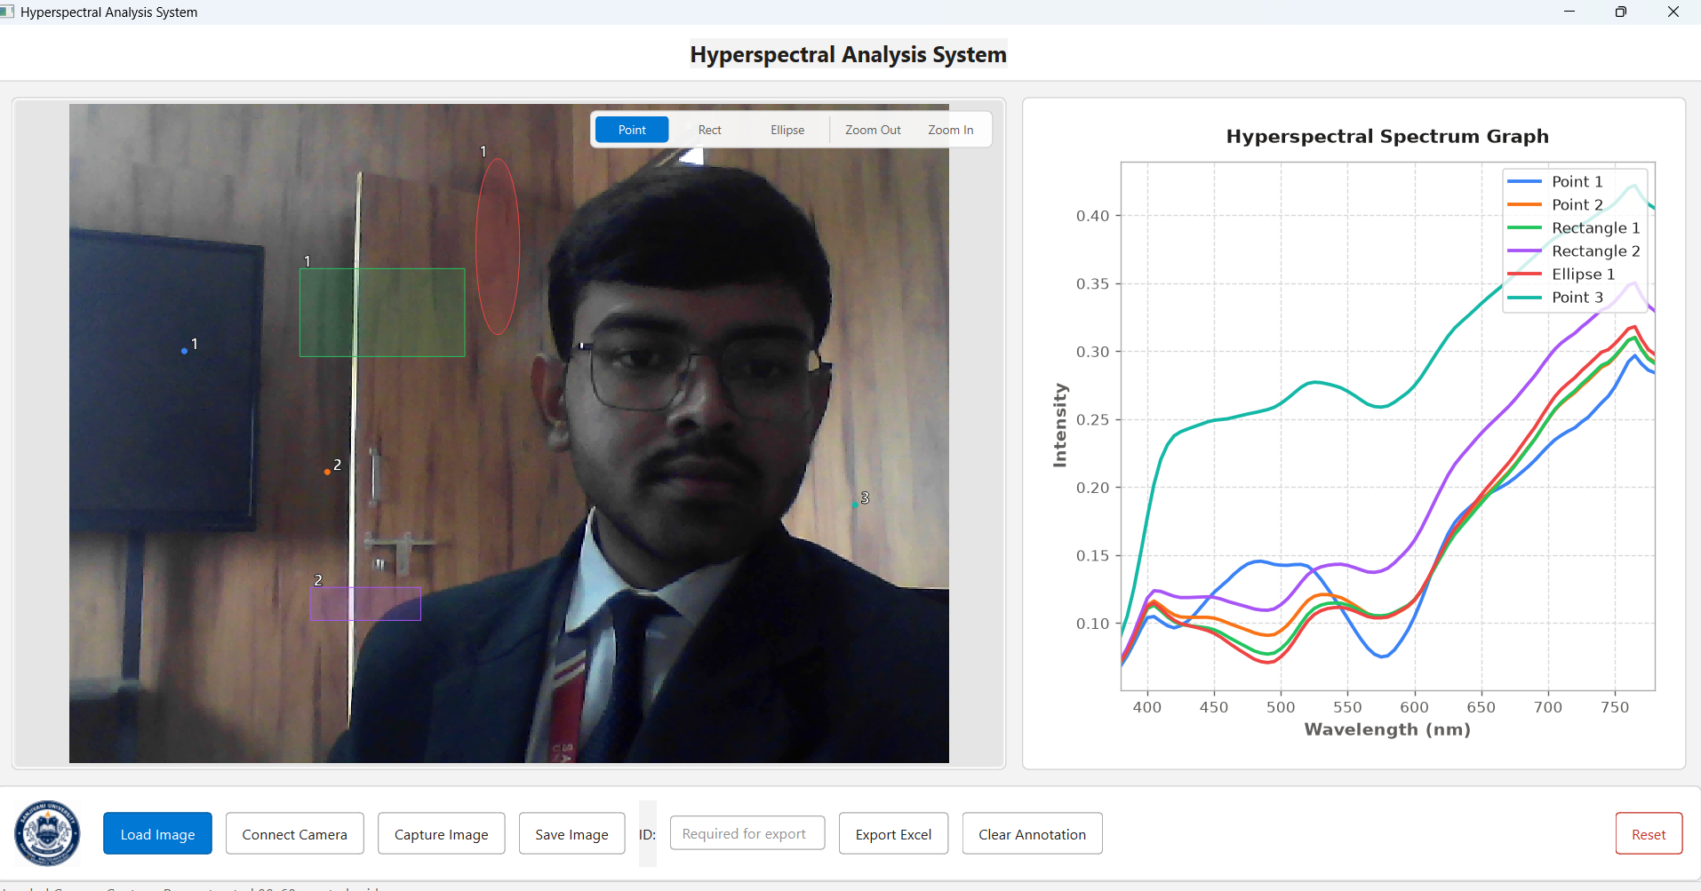
SPECTRUM | Hyperspectral Analysis System
User Interface
Clean desktop experience built with PyQt6 + Matplotlib.
Ready state: load an image or connect a camera
Live analysis: multiple ROIs and their spectra
Live view: camera feed with ROI overlays drawn on the image.
Real-time plots: Matplotlib spectra refresh as ROIs change.
One-click tools: Point, Rect, Ellipse, zoom, capture, save and Excel export.
Simple workflow: pick a region, read its spectrum in seconds.
SPECTRUM — RGB to 401-band spectra, in real time
12
Notes:
Left: the app ready for input (Load Image / Connect Camera). Right: live analysis with Point, Rectangle and Ellipse ROIs and their spectra plotted side by side.
If you have a live demo, switch to it here.

Slide 13
SPECTRUM | Hyperspectral Analysis System
Open Source & Repository Structure
Modular organization for rapid development and deployment.
/App/
Core Python source (spectrum_app.py) and UI assets.
SPECTRUM/
├── App/
│ └── spectrum_app.py
├── Data set/
├── Evaluation/
├── Output/
├── installer/
└── Requirement.txt
/Data set/
Training and validation data for the ML transfer model.
/Evaluation/
Scripts and notebooks validating RGB-to-spectrum accuracy.
/Output/
Default folder for exported CSV/Excel data and saved graphs.
/installer/
Scripts and binaries to package a standalone executable.
Requirement.txt
PyQt6, OpenCV, Matplotlib, Pandas, NumPy.
SPECTRUM — RGB to 401-band spectra, in real time
13
Notes:
Walk the repo top to bottom. Mention that dependencies are in Requirement.txt.
Suggested visual: screenshot of the GitHub repo file list, or the tree on the left.

Slide 14
SPECTRUM | Hyperspectral Analysis System
Use Cases & Applications
Spectral insight wherever color alone is not enough.
Agriculture
Manufacturing
Food Quality
Assess crop health, detect stress early and gauge ripeness without lab tests.
Spot coating, material and color inconsistencies that look identical in RGB.
Check freshness, ripeness and composition non-destructively on the line.
One affordable camera, one software stack, many industries.
SPECTRUM — RGB to 401-band spectra, in real time
14
Notes:
Pick the vertical most relevant to your audience.
Suggested visual: one photo per card (crop field, production line, fruit/produce).

Slide 15
SPECTRUM | Hyperspectral Analysis System
Conclusion & Q&A
Hyperspectral insight, from the camera you already own.
Problem: RGB cameras hide the spectrum and fall for metamerism.
Solution: ML converts RGB to 401 bands (380–780 nm) in real time.
Toolkit: ROI tools, live metrics, comparisons, CSV/Excel export.
Open source: modular repo, easy to extend and deploy.
Next: broader datasets, more cameras, deeper evaluation.
Thank You
Questions?
github.com/username/SPECTRUM
SUGGESTED VISUAL
QR code linking to the GitHub repo
SPECTRUM — RGB to 401-band spectra, in real time
15
Notes:
Recap the three takeaways, then open for questions.
Suggested visual: dark closing card with the repo QR code. Replace the GitHub link before presenting.

