Slide 1
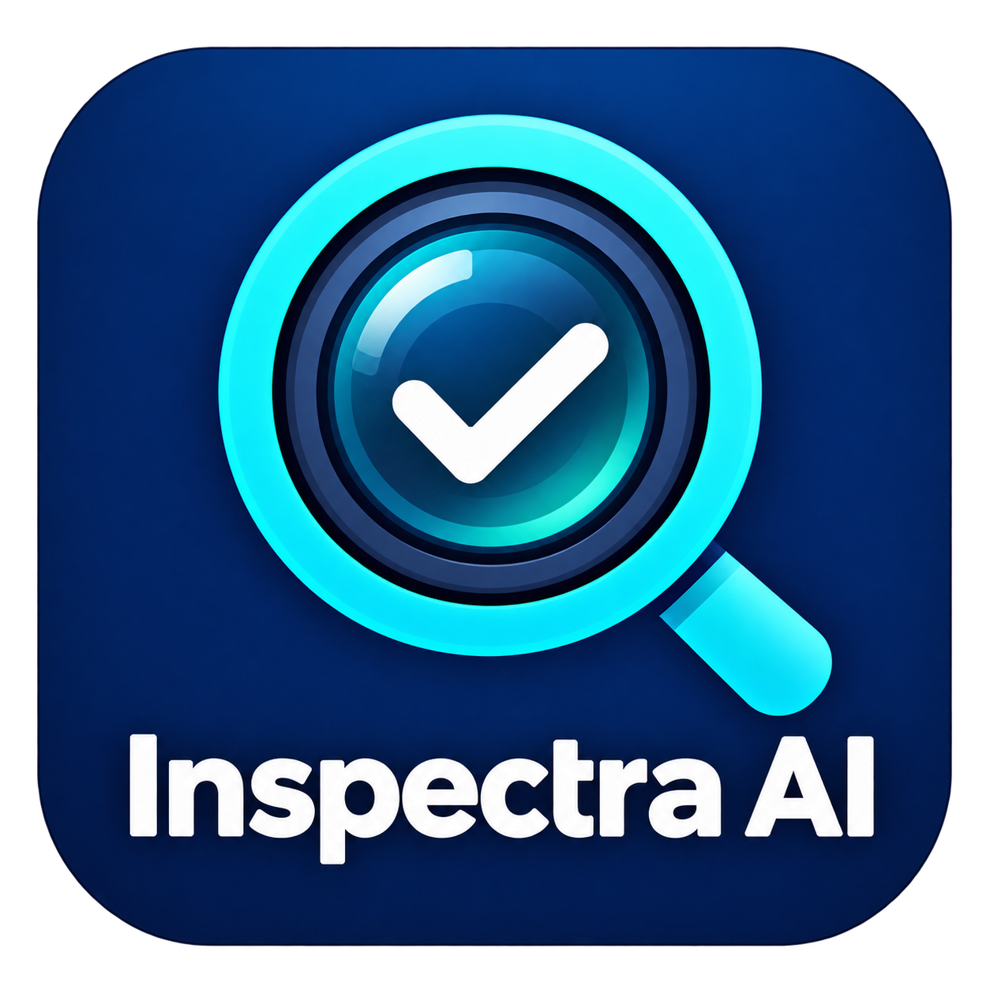
Inspectra AI
Image restoration and
industrial defect inspection
Final project presentation
October 2026
Inspectra AI
01 / 10
Notes:
Current integrated release. Sources: Inspectra AI app.py, README.md, installer script and installed_app_selftest.json. The report distinguishes earlier DefectVision AI and AI Restoration Studio results from this release.

Slide 2
The inspection problem
Image quality
Inspection records
Noise and limited resolution obscure small structures. Enhancement can also alter a real defect boundary.
Each sample needs traceable IDs, an inspection result, and a clear decision status in the batch summary.
Project objective
Connect enhancement, pixel-level localization, human review, and collective reporting in one desktop workflow.
Inspectra AI
02 / 10
Notes:
Sources: Defectx_PS02.pptx slides 2-7; AI_Restoration_Studio_Project_Presentation.pptx slides 2-4; Final_Project_Report.pdf pp.5 and 28; current app.py. Drift correction is future scope.

Slide 3
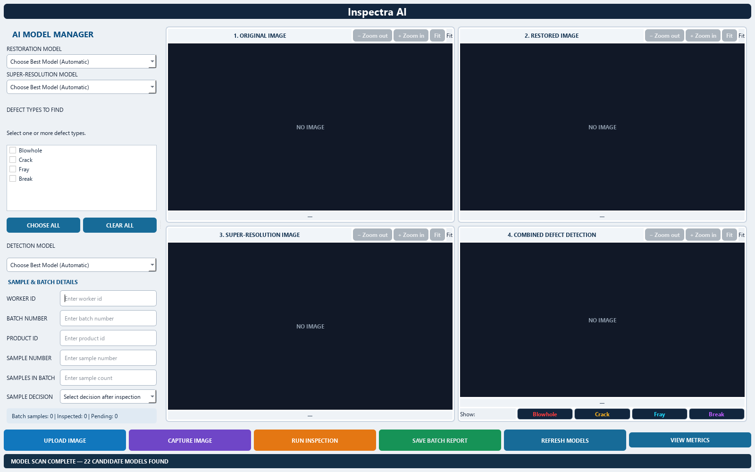
Integrated processing workflow
01 Register sample
02 Restore when selected
03 Upscale when selected
04 Detect chosen defects
05 Review and report
Detection uses the latest successful stage: super-resolution, restoration, or original.
Inspectra AI
03 / 10
Notes:
Source: current app.py, pipeline selection, MainWindow layout and batch/report methods. Screenshot captured from the current source build with no image loaded. It demonstrates layout, not detection performance.

Slide 4
Current model inventory
22 bundled checkpoints across three processing tasks
Task | Model families | Checkpoints
Restoration | MIRNet v2, MPRNet, NAFNet | 3
2x super-resolution | ESRGAN, RCAN, SRCNN, SwinIR | 4
Defect segmentation | SegFormer, DeepLabV3+, HRNet, U-Net++ | 15
Defect classes: Blowhole, Crack, Fray, Break
U-Net++ covers Crack, Fray, and Break in the supplied collection.
Inspectra AI
04 / 10
Notes:
Sources: current model inventory, app.py and installed_app_selftest.json. Four checkpoints each for SegFormer, DeepLabV3+ and HRNet, plus three U-Net++ checkpoints. Earlier Attention U-Net, Restormer and EDSR experiments do not represent bundled current weights.

Slide 5
Automatic model selection
Enhancement
Defect detection
Aligned clean reference
Highest SSIM wins
No clean reference
Lowest BRISQUE wins
Run available candidates for each class.
Select the highest area-weighted detected-region confidence.
Automatic mode compares every candidate. Confidence ranking is an estimate and does not establish defect accuracy.
Inspectra AI
05 / 10
Notes:
Source: app.py run_enhancement and choose_defect_outcome. Confidence score = sum(region confidence x region area) / sum(region area), or zero when no region exists. Different architectures may have different calibration. Changing references requires rerunning selection.

Slide 6
Historical research evidence
4,158 SEM sources support two separate paired tasks
Earlier study | Reported result | Interpretation
EDSR super-resolution | 29.355 dB PSNR 0.9819 SSIM | Historical SEM benchmark
Restormer denoising | 20.814 dB PSNR 0.4085 LPIPS | Historical SEM benchmark
These earlier models are not bundled current enhancement candidates.
The source report flags inconsistent SSIM implementations across some notebooks.
Inspectra AI
06 / 10
Notes:
Sources: AI_Restoration_Studio_Project_Presentation.pptx slides 3-6; Final_Project_Report.pdf pp.7, 13, 19, 22 and 28. Source split: 2910 training, 831 validation, 417 test. Historical PSNR/SSIM/LPIPS are source reported and have not been remeasured here. No current end-to-end accuracy claim follows.

Slide 7
Sample decisions and batch control
Before inspection
After inspection
Required worker, batch, and product IDs
Positive batch capacity
One or more chosen defect types
Accepted, Rejected, or Needs Review
Reinspection updates the same sample
A full inspected batch saves its PDF and advances automatically
New launches start counting from zero. Archived records remain available on disk.
Inspectra AI
07 / 10
Notes:
Source: app.py BatchStore, metadata validation, inspector decision and rollover_completed_batch. Capacity locks after collection. Completion depends on saved results, so a completed batch can still include awaiting-decision samples. Decisions are manual. A 100-sample batch is an example capacity, not a fixed system limit.

Slide 8
Quality metrics and reference images
Measurement | Reference needed | Meaning
PSNR and SSIM | Yes | Agreement with aligned clean target
MSE and MAE | Yes | Pixel error against the target
BRISQUE | No | Image-quality estimate
Sharpness, entropy, contrast | No | Descriptive image properties
Region confidence | No paired target | Model score, not a confidence interval
N/A is expected when a clean reference is missing or mismatched.
The degraded original is not automatically ground truth.
Inspectra AI
08 / 10
Notes:
Sources: app.py image_quality_metrics and BRISQUE implementation; Final_Project_Report.pdf metric discussion. Images normalize grayscale values to [0,1]. Reference dimensions must match the stage output. LPIPS belongs to the historical study and is not a current runtime metric.

Slide 9
Reports and Windows deployment
Two-page batch summary
Self-contained installation
Sample and decision totals
Defect region counts and mean confidence
Average image quality and upscaling
No image appendices
Inno Setup installer with application icon
Bundled models and Python runtime
PDF-only runtime outputs folder
Separate internal session storage
Inspectra AI
09 / 10
Notes:
Sources: current app.py write_batch_pdf and storage configuration, InspectraAI.iss and build spec. Installer is about 1.25 GB. It installs per user and preserves reports/internal data on uninstall. Finite valid N governs metric means. The batch PDF is distinct from the twenty-page project report.

Slide 10
Verification and next steps
Verified installed workflow
Next validation stage
22 checkpoint forward passes
Synthetic inspection and two-page PDF
Batch rollover and PDF-only exports
Installation and uninstallation
Held-out production defect masks
Calibrated detection thresholds
Measured cycle time and recovery
Separate Drift-Sense integration
Functional integration is verified. Production accuracy and closed-loop drift recovery require further evidence.
Inspectra AI
10 / 10
Notes:
Sources: installed_app_selftest.json and installer logs; current app.py; Defectx_PS02.pptx future integration scope; Final_Project_Report.pdf limitations. The smoke test is not a labeled accuracy benchmark or line-rate guarantee.

