Slide 1
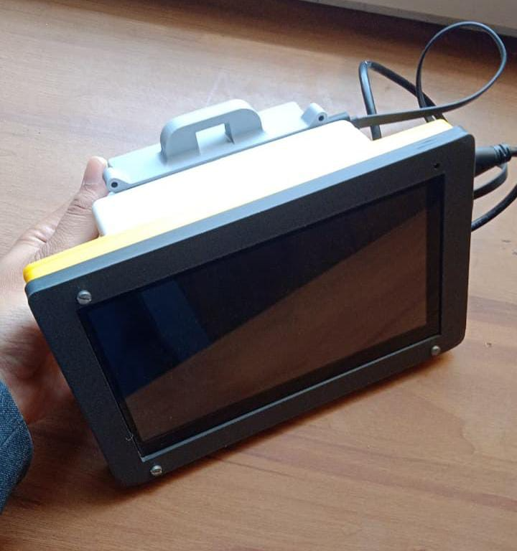
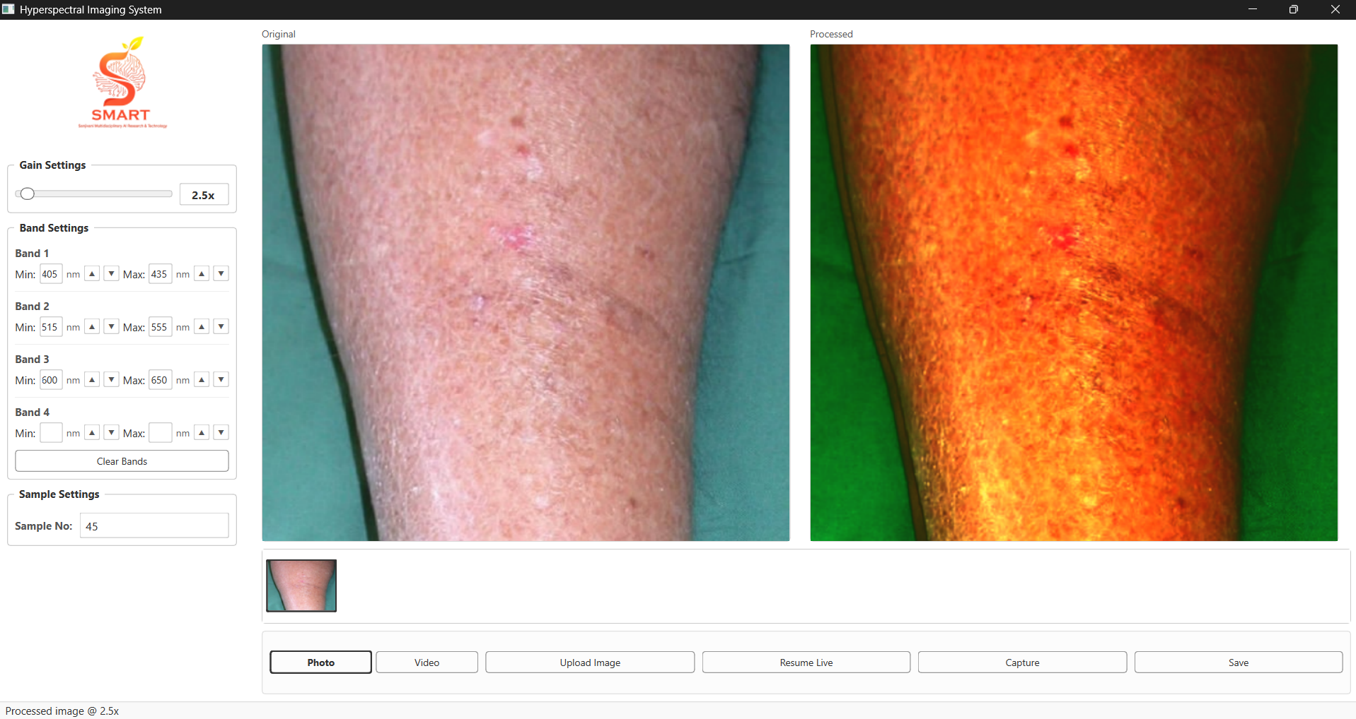
LOW-COST
HYPERSPECTRAL
IMAGING SYSTEM
RGB → HSI spectral reconstruction
with selectable wavelength bands
Portable prototype • Integrated display • Real-time processed view

Slide 2
Project Overview
Convert ordinary RGB/white-light images into useful spectral information.
• Captures an RGB/white-light image using a compact imaging setup.
• Applies spectral reconstruction and band-selection processing to generate an HSI-style representation.
• Provides adjustable gain and wavelength bands for interactive inspection.
• Displays original and processed views and supports capture/save operations.
• Designed as a lower-cost, portable alternative for experimentation with spectral imaging.
What the project does
Transforms visible-light image information into a spectral representation using calibration and reconstruction.
Who can use it
Students, researchers and prototype developers working with imaging, computer vision and spectral analysis.
Main outcome
A portable hardware + software system that produces a processed spectral view from an RGB input.
Low-Cost Hyperspectral Imaging System • 02

Slide 3
Problem Statement
Conventional hyperspectral systems can be difficult to access for low-cost prototyping.
• Dedicated hyperspectral cameras and spectrometers can be expensive and specialized.
• Large or laboratory-oriented systems are less convenient for portable experimentation.
• RGB cameras are widely available, but they do not directly provide a full spectral cube.
• Researchers need a practical way to explore wavelength-dependent information without a complex imaging setup.
• A compact system should combine acquisition, processing and visualization in one device.
Core gap
Affordable hardware is available for RGB imaging, but spectral information is harder to obtain directly.
Need
A portable, software-assisted approach that reconstructs spectral information and exposes selected bands.
Target
Lower-cost spectral imaging experimentation without depending on a dedicated HSI camera.
Low-Cost Hyperspectral Imaging System • 03

Slide 4
Objectives
Translate the problem into measurable system goals.
01 Build
Develop a compact end-to-end imaging prototype combining hardware and software.
02 Reconstruct
Generate spectral/HSI-style information from RGB or white-light input.
03 Control
Allow gain and wavelength-band selection from the application interface.
04 Visualize
Show original and processed images side-by-side for immediate comparison.
05 Validate
Use calibrated color data and image-quality metrics to evaluate reconstruction.
Low-Cost Hyperspectral Imaging System • 04

Slide 5
Proposed Solution
A compact imaging unit connects image capture, spectral reconstruction and visualization.
IMAGE INPUT
CALIBRATION
RECONSTRUCTION
OUTPUT
RGB / white-light camera
Color correction + normalization
PCA + regression / band selection
HSI-style processed image
Before
After
Standard RGB image contains three visible-light channels.
Selected spectral bands can be visualized and compared with the original image.
Low-Cost Hyperspectral Imaging System • 05

Slide 6
System Architecture
Hardware and software form one acquisition-to-output pipeline.
Camera / Sensor
Preprocess
Spectral Engine
Display
Image capture
Normalize + calibrate
PCA + regression + band selection
Original + processed output
Hardware layer
Processing layer
User layer
Compact imaging enclosure, camera/imaging module and integrated display.
RGB normalization, color calibration and spectral reconstruction.
Gain, band limits, sample number, capture, upload, resume live and save.
Low-Cost Hyperspectral Imaging System • 06

Slide 7
Technology Stack
Core technologies used in the prototype and spectral reconstruction workflow.
1 Imaging
RGB / white-light camera — Acquires the input image.
2 Processing
Python + image processing — Handles acquisition, preprocessing and visualization.
3 Spectral method
PCA + multiple regression — Reconstructs spectral information from calibrated RGB data.
4 Calibration
CIE XYZ + color correction — Maps camera response toward spectrometer-derived color information.
5 Interface
Desktop imaging application — Gain, band selection, live view, capture and save.
Low-Cost Hyperspectral Imaging System • 07

Slide 8
Dataset / Input Data
Calibration and validation are based on controlled color and image data.
• 24-color Macbeth Color Checker (X-Rite Classic) is used for color calibration.
• Camera RGB images are converted to CIE 1931 XYZ for calibration against spectral measurements.
• Spectral reflectance data are organized at 1 nm intervals over approximately 380–780 nm.
• The study also evaluates endoscopic / VCE image examples for reconstruction and NBI-style simulation.
• For the prototype demo, live camera input or an uploaded image can be processed through the application.
Calibration target
24 standardized color patches provide known color references.
Spectral range
The source study uses reflectance spectra from about 380–780 nm at 1 nm intervals.
Prototype input
RGB image / live camera feed / uploaded image.
Low-Cost Hyperspectral Imaging System • 08

Slide 9
Methodology / Working Flow
From image capture to calibrated spectral visualization.
1 Capture
2 Normalize
3 Calibrate
RGB / WLI image
sRGB → linear RGB
RGB → XYZ + camera correction
4 Reconstruct
5 Select
6 Display
PCA + regression → spectral estimate
Choose wavelength bands
Processed HSI-style output
Application controls
Gain adjustment • Band 1–4 limits • Sample number • Upload • Capture • Save
Low-Cost Hyperspectral Imaging System • 09

Slide 10
Model / Algorithm Details
The core engine combines calibration, dimensionality reduction and reconstruction.
1. Camera calibration
4. Band selection
Normalize sRGB values, linearize them using gamma correction, then map to CIE XYZ.
Select useful wavelength regions for the processed visualization.
2. PCA reduction
5. NBI-style simulation
The source study reports six principal components capturing 99.64% of the information.
The source study uses selected bands including 415 nm and 540 nm, with additional spectral regions for the simulated NBI output.
3. Multiple regression
Why this method
Use calibrated variables and spectral data to estimate the spectral representation.
It reduces the spectral reconstruction problem while retaining the most informative components from the calibration data.
Low-Cost Hyperspectral Imaging System • 10

Slide 11
Key Features
Short, benefit-focused capabilities of the low-cost prototype.
Portable form
RGB → spectral
Adjustable gain
Compact imaging enclosure with integrated display.
Produces an HSI-style processed representation from RGB/WLI input.
Interactive gain control is available in the application.
Band selection
Live + upload
Capture + save
User can define wavelength ranges for selected bands.
Supports live operation and uploaded images.
Processed results can be captured and saved for later use.
Low-Cost Hyperspectral Imaging System • 11

Slide 12
Results & Performance
Validation results reported in the SAVE source study.
99.64%
0.056
0.75
10.76 → 0.63
Information captured by 6 PCs
Mean spectral RMSE
Average color difference
Mean chromatic aberration
NBI color calibration
Image similarity
Average CIEDE 2000 color difference after correction: 2.79 for the 24-color checker.
Reported average SSIM: 90.68% for VCE and 93.99% for Olympus in the cited comparison.
Important interpretation
These are validation results of the underlying SAVE reconstruction study; they should not be presented as measured accuracy of the current portable hardware unless separately tested.
Low-Cost Hyperspectral Imaging System • 12

Slide 13
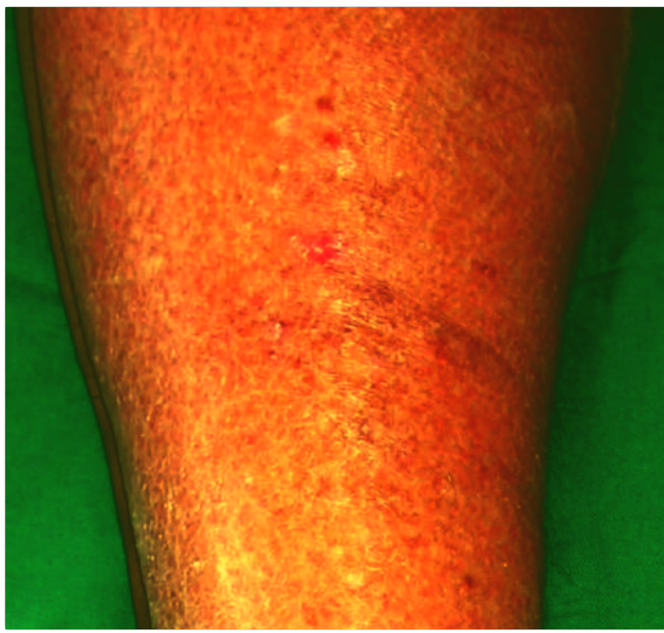
Demo Screenshots
Current prototype: software interface + physical hardware.
Software interface: original and processed views with gain and band controls.
Hardware prototype: compact enclosure with integrated display.
Processed view: selected bands produce an enhanced spectral visualization.
Low-Cost Hyperspectral Imaging System • 13

Slide 14
Conclusion & Future Scope
• Demonstrates a compact approach for converting RGB information into a spectral representation.
• Combines calibration, reconstruction, selectable bands and a practical user interface.
• Current validation evidence comes from the SAVE study; dedicated hardware benchmarking is the next step.
• Future: improve spectral fidelity, add more calibrated bands, optimize real-time performance and validate on more application-specific datasets.
Thank You
Low-cost spectral imaging
for accessible experimentation
GitHub: SMARTLAB-SU/Hyperspectral-Imaging
Future direction
Application-specific detection + stronger hardware calibration.
Low-Cost Hyperspectral Imaging System • 15

