Slide 1
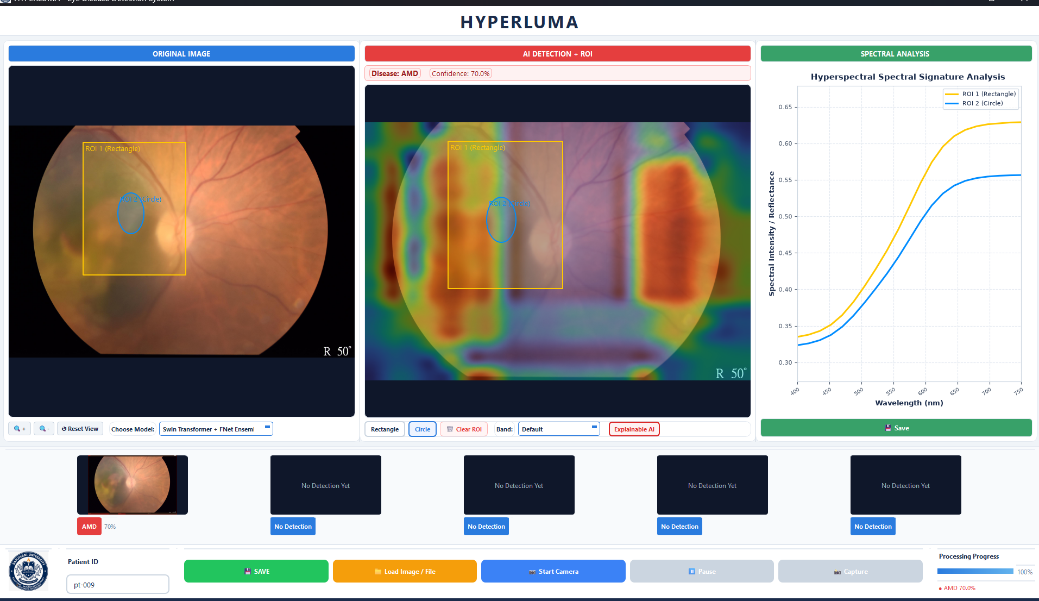
HYPERLUMA
AI-Powered Retinal Screening
Fundus Imaging • Hyperspectral Imaging • Deep Learning • Explainable AI
RESEARCH
PLATFORM
RGB
HSI
XAI

Slide 2
The Challenge in Retinal Healthcare
KEY CHALLENGES
THE NEED
Limited availability of ophthalmologists in rural regions
Conventional screening can be specialist-dependent
Large-scale screening is time-consuming
Subtle retinal abnormalities may be difficult to identify
Standard RGB imaging provides limited spectral information
Advanced imaging infrastructure can be difficult to deploy
A portable, AI-assisted system that can analyze retinal images and provide interpretable screening information.
CURRENT
AI-ASSISTED
Fundus image
→ Specialist
→ Interpretation
Fundus image
→ AI analysis
→ Screening support
Goal: improve accessibility and efficiency without replacing professional clinical judgment.
HYPERLUMA / VisionAI • SMART
2

Slide 3
Introducing HYPERLUMA
An integrated retinal imaging and AI research platform
FUNDUS
IMAGING
HYPERSPECTRAL
IMAGING
DEEP
LEARNING
EXPLAINABLE
AI
EDGE
COMPUTING
Conventional retinal visualization
Spatial + wavelength information
Multi-class image analysis
Visual model interpretation
Potential portable deployment
Core concept: Capture → Analyze → Explain → Screen
HYPERLUMA / VisionAI • SMART
3

Slide 4
Six Screening Categories
Experimental classification categories used by the AI pipeline
AMD
Cataract
Dementia
Age-Related Macular Degeneration
Included as an image-classification category
Retinal microvascular biomarker research category
Diabetic Retinopathy
Glaucoma
Normal
Diabetes-associated retinal changes
Retinal / optic-nerve-related abnormalities
Healthy / control retinal images
Clinical note: HYPERLUMA is an AI-assisted screening/research system, not a replacement for professional diagnosis.
HYPERLUMA / VisionAI • SMART
4

Slide 5
HYPERLUMA System Architecture
01 IMAGE ACQUISITION
Fundus camera • RGB image • Hyperspectral imaging
02 IMAGE PROCESSING
Quality processing • Resize • Normalize • Spectral preprocessing
03 FEATURE ANALYSIS
Retinal structures • Vessels • Lesions • Spectral characteristics • ROI
04 AI MODELS
Swin • EfficientNetV2-S • ResNeXt50 • FNet • Perceiver IO • Ensembles
05 EXPLAINABLE AI
Grad-CAM • Attention visualization • Important-region highlighting
06 OUTPUT
Predicted class • Confidence • Visual explanation • Screening report
HYPERLUMA / VisionAI • SMART
5

Slide 6
RGB + Hyperspectral Imaging
Combining conventional retinal visualization with wavelength-dependent information
RGB FUNDUS IMAGING
HYPERSPECTRAL IMAGING (HSI)
Conventional retinal imaging provides spatial and color information.
• Retinal structure
• Vessel appearance
• Lesion visibility
• Macular characteristics
Captures information across multiple wavelengths, producing a 3D spectral cube containing spatial + spectral information.
• Wavelength-dependent characteristics
• Spectral signatures
• ROI-based analysis
Richer information for AI-based retinal research
HYPERLUMA / VisionAI • SMART
6

Slide 7
Hyperspectral Data & Spectral Analysis
ROI
SPECTRUM
CURVE
Select region
Extract reflectance
Plot spectral response
HYPERLUMA / VisionAI • SMART
7

Slide 8
Dataset & Data Preparation
From raw collection to curated experimental dataset
1,086
Raw fundus images
SSIM
Deduplication / similarity analysis
BALANCE
Minority-class augmentation
974
Curated images
DATASET SPLIT
TRAIN
VALIDATION
TEST
70%
15%
15%
Preprocessing: resizing • normalization • augmentation • class balancing • train/validation/test separation
HYPERLUMA / VisionAI • SMART
8

Slide 9
Deep Learning Model Benchmark
MODEL
ARCHITECTURE
TEST ACC.
ROLE
Swin Transformer
Hierarchical Vision Transformer
99.33%
Best-performing model
EfficientNetV2-S
CNN
94.63%
Efficient / edge inference
ResNeXt50
CNN
87.92%
Baseline comparison
FNet
Fourier Mixing
—
Alternative token mixing
Perceiver IO
Latent Attention
—
Alternative attention
Hybrid Ensemble
Weighted Soft Voting
94.6–95.9%
Combined prediction
Best experimental result: Swin Transformer — 99.33% test accuracy
Reported experimental results are not a substitute for external clinical validation.
HYPERLUMA / VisionAI • SMART
9

Slide 10
AI Prediction Pipeline
From retinal image to AI-assisted screening
01
02
03
04
05
06
07
IMAGE
ACQUISITION
PRE-
PROCESSING
RGB +
HSI
DEEP
LEARNING
PREDICTION
XAI
SCREENING
OUTPUT
AI output can include predicted class + confidence + visual explanation + report.
CLINICAL POSITIONING
The system is designed for AI-assisted screening and decision support — not replacement of ophthalmological diagnosis.
HYPERLUMA / VisionAI • SMART
10

Slide 11
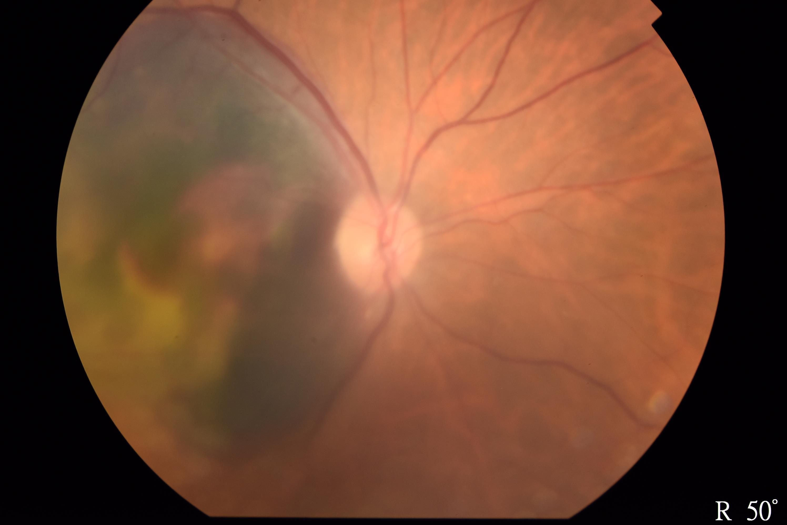
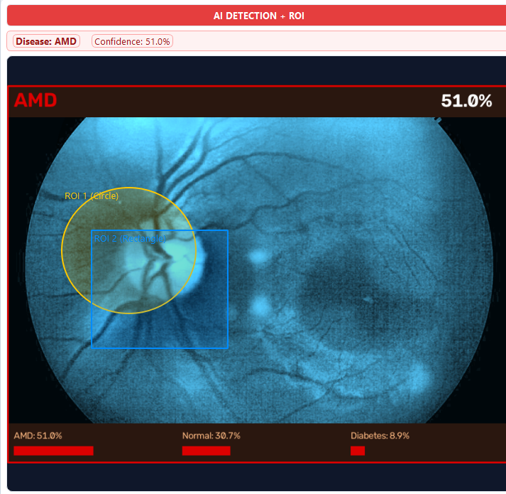
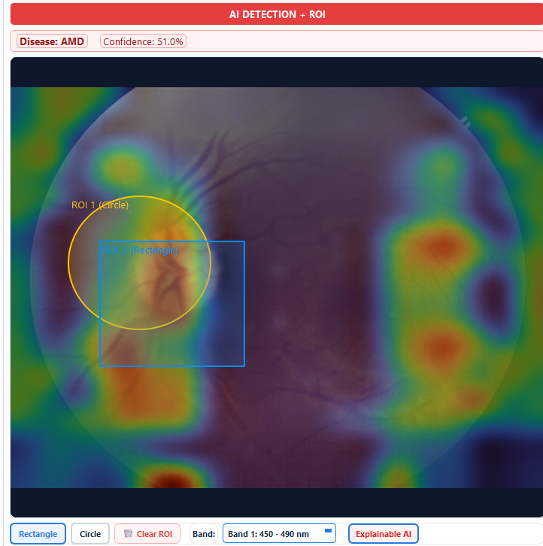
Explainable AI
Making model predictions visually interpretable
1 ORIGINAL FUNDUS
2 HSI BAND AND ROI
3 EXPLAINABLE AI
XAI can improve transparency, support research inspection, and help identify potential model errors.
HYPERLUMA / VisionAI • SMART
11

Slide 12
HYPERLUMA / VisionAI Application
Desktop interface concept for practical retinal image analysis
HYPERLUMA
Patient ID: P-001
APPLICATION FEATURES
• Patient ID management
• Fundus image upload
• Live camera / video input
• AI model selection
• Disease classification
• Confidence visualization
• XAI heatmaps
• Screening report generation
MODEL
Swin Transformer
XAI
Generate attention heatmap
Light clinical interface • Desktop deployment
HYPERLUMA / VisionAI • SMART
12

Slide 13
Portable Retinal AI Screening
Edge deployment concept using Raspberry Pi 5
FUNDUS
CAMERA
RASPBERRY
PI 5
7-INCH
TOUCHSCREEN
PORTABLE
ENCLOSURE
↓ Portable AI Screening Station ↓
PORTABLE
EDGE AI
INTERACTIVE
Transportable to screening camps and remote locations
Potential for local inference and reduced cloud dependency
Touchscreen-based user interaction
Future direction: model optimization and quantization for efficient edge inference.
HYPERLUMA / VisionAI • SMART
13

Slide 14
Results, Impact & Future Scope
99.33%
94.63%
87.92%
94.6–95.9%
Swin Transformer
EfficientNetV2-S
ResNeXt50
Hybrid Ensemble
POTENTIAL IMPACT
FUTURE SCOPE
• Preliminary retinal screening
• Rural/community screening research
• Biomedical AI research
• Retinal image analysis
• AI-assisted healthcare workflows
• Portable screening research
01 Larger and more diverse datasets
02 Advanced image quality assessment
03 Improved retinal segmentation
04 Lesion localization
05 Hyperspectral-AI integration
06 Edge optimization + external validation
Results are experimental; clinical deployment requires external validation and appropriate regulatory/clinical evaluation.
HYPERLUMA / VisionAI • SMART
14

Slide 15
HYPERLUMA
From Retinal Images to Explainable AI-Assisted Screening
FUNDUS
IMAGING
HYPERSPECTRAL
IMAGING
DEEP
LEARNING
EXPLAINABLE
AI
EDGE
COMPUTING
AI-assisted retinal screening for more accessible and interpretable healthcare research
IMAGE → SPECTRAL + VISUAL INFORMATION → AI → EXPLANATION → SCREENING SUPPORT
KEY MESSAGE
HYPERLUMA / VisionAI • SMART
15

