Slide 1
IMDB MOVIE ANALYSIS
Created by: Aravind D R

Slide 2
PROJECT DESCRIPTION
In this project, you have provided data set of imdb movies.
There are numerous questions in these areas.
First and foremost is the what do you see is happening? The answer t this question is: I could see the list of movies has given rating based on the user and critic rating and reviews. In this there is no need for the facebook likes. Its of no use.
It will be much impacted on stakeholders, with these fb likes the stakeholders mindset will change and leads to financial loss of the movie.

Slide 3
APPROACH & INSIGHTS

Slide 4
CLEANING THE DATA
In this section, I have removed null values using filter options in excel
Then I have also removed the unwanted columns, and deleted the duplicate rows.
Then I have made a bar graph having the original dataset and the cleaned dataset, so that it could be easily understood how many duplicates and null values are present in the dataset.

Slide 5
MOVIES WITH HIGHEST PROFIT
My 2nd assignment is to plot profit vs budget and observe the outliers using appropriate chart type. So I have used Scatter chart type and enabled the trendline to find the outliers.
Then I have found the top 10 movies with highest profit and listed out in the form of graph.

Slide 6
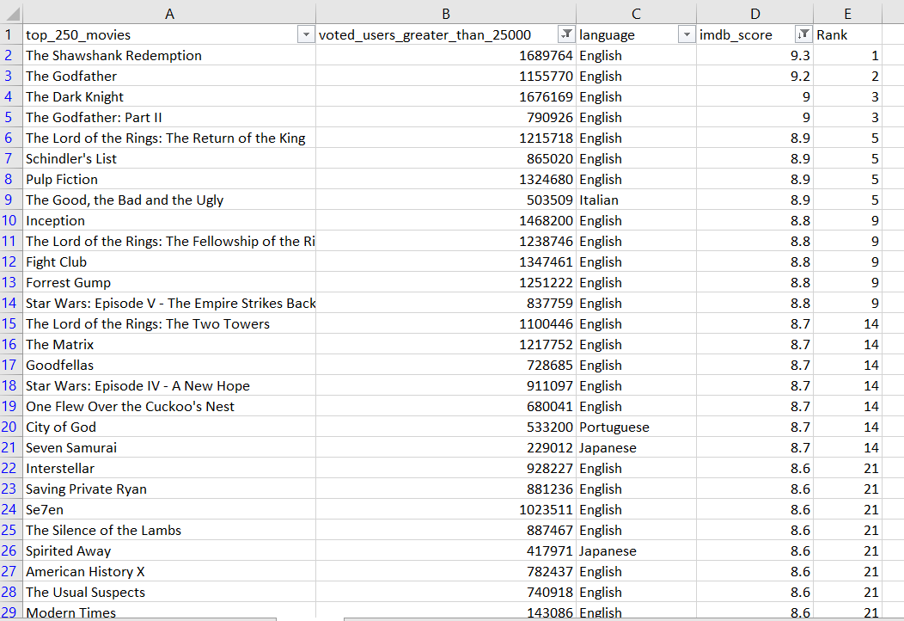
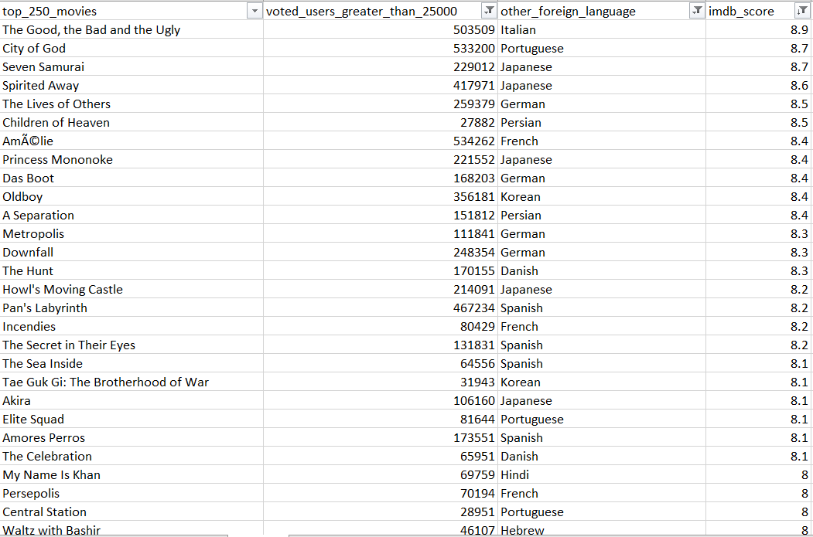
TOP 250
In this segment I have to find the top 250 movies based on the imdb score in which the voted number of people should be greater than 25000.
I have filtered out the 250 movies in desc order of imdb score and also filtered out the voted users greater than 25000 and as you have said I have ranked it.
Then according to your 2nd question, I have filtered out other languages and arranged based on the highest imdb score.

Slide 7
TOP 10 DIRECTORS
Here my task is to find the best directors in the dataset based on imdb score.
So I have used averageif formula and cleared all the duplicate names after finding the average of imdb score of each director.
Then I have filtered out the top 10 directors based on imdb score and used graph to show the results.
The formula used here is:
=AVERAGEIF(C:C,C2,D:D)

Slide 8
POPULAR GENRES
In order to find the popular genres, I must count the number of genres in the dataset.
The result is shown in form of clustered bar graph for easy understanding.

Slide 9
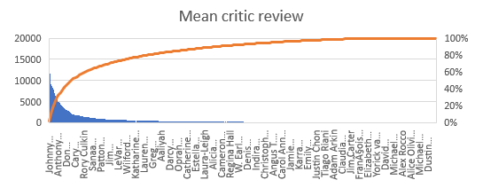
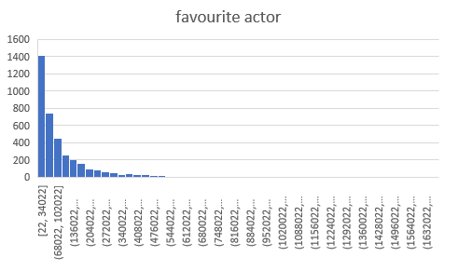
CHARTS
To find the mean critic review, I must find the average of critic review and user review
Then I must plot the graph using mean and actor name.
Then I must find the favourite actor.
So that I must find the mean votes for a decade and plot the values in the graph.

Slide 10
Tech Stack Used
Microsoft Excel
Microsoft Power point
Microsoft One drive

Slide 11
Result
In this project I have answered all the questions asked by understanding the data set and plotted the graph.
I have gained more knowledge in excel graph sheets.
I have gained knowledge on imdb movie rating techniques.

