Slide 1
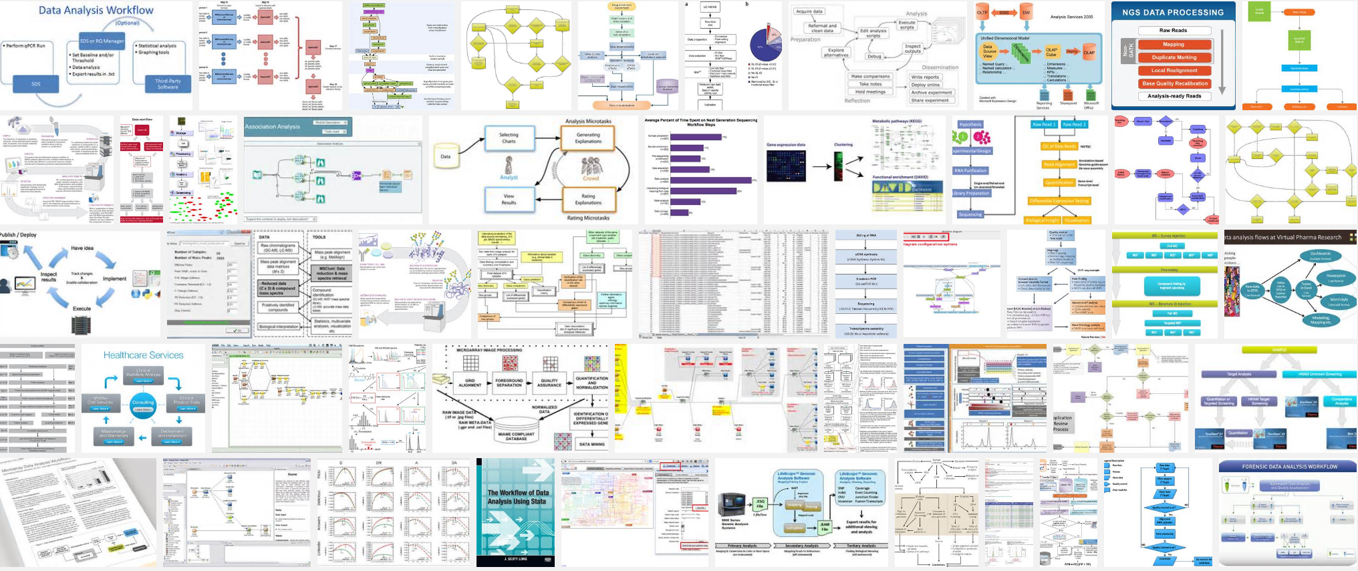
Workflows Everywhere

Slide 2
Typical Workflow
Raw Data
Pre-processing
Knowledge!
Analysis

Slide 3
“Nothing - not the careful logic of mathematics, not statistical models and theories, not the awesome arithmetic power of modern computers - nothing can substitute here for the flexibility of the informed human mind...”
– John W. Tukey & Martin B. Wilk, Data Analysis & Statistics, 1966
"The greatest value of a picture is when it forces us to notice what we never expected to see."
- John Tukey

Slide 4
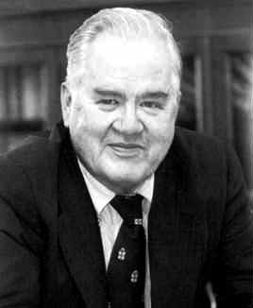
Interactive Data Analysis
Raw Data
Preprocessing
Analysis
Subject matter experts

Slide 5
install.packages("devtools")
devtools::install_github("rafalab/dslabs")
library(dslabs)
data(outlier_example)
mean(outlier_example)
sd(outlier_example)

Slide 6
Demographic Summary
Average: 6.1 feet
Standard Deviation: 7.8 feet

