Slide 1
Energy Consumption Forecasting
Prof. Guidolin Academic year 2021/2022
Arvin Rastegar Project

Slide 2
Introduction
Forecasting with XGBoost

Slide 3
Dataset
Hourly power consumption data which comes from PJM’s website and are in megawatts (MW).

Slide 4
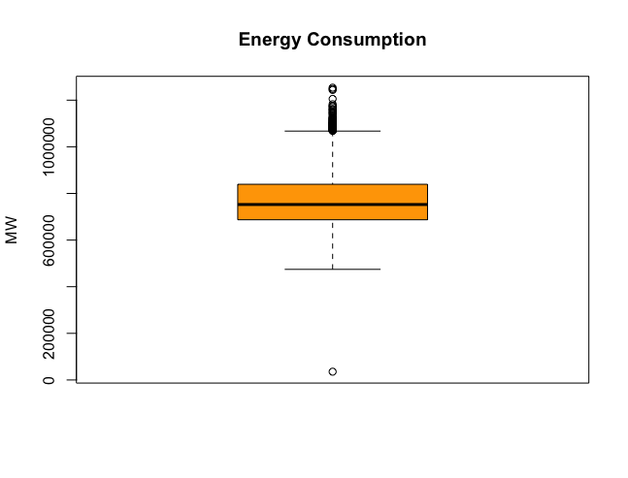
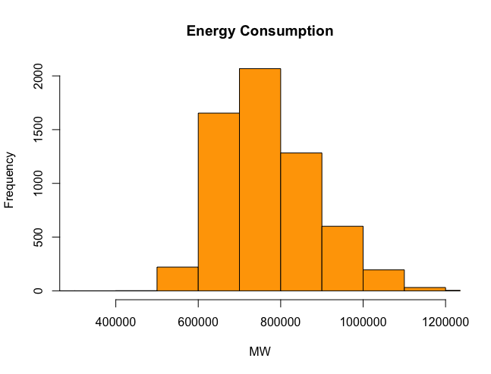

Slide 5
Exploring
We decompose by the additive model as shown in the figure on the next page.
Yt = Tt + St + et
Yt is the observed values, Tt is the trend, St is the seasonality and et is the random values in the decomposition.

Slide 6
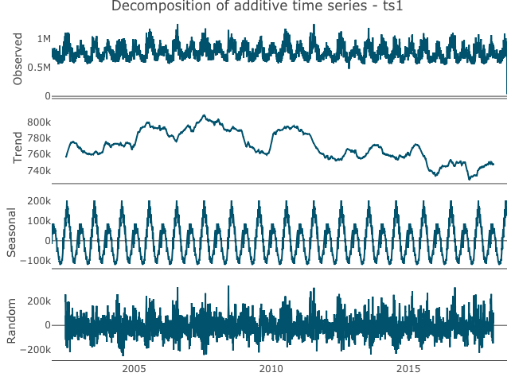
A downtrend in consumption and a clear correlation between seasons and electricity usage is observable.

Slide 7
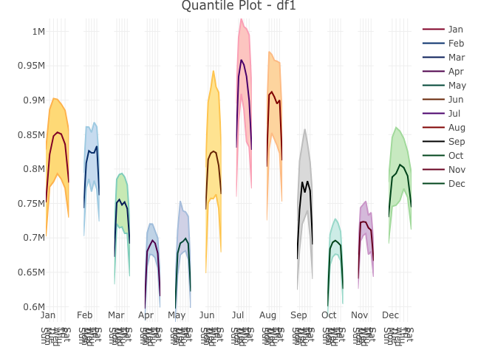

Slide 8
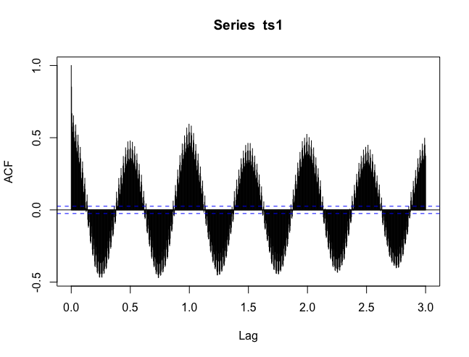

Slide 9
Pre-processing and Feature engineering

Slide 10
Methods
linear regression model
XGBoost model

Slide 11
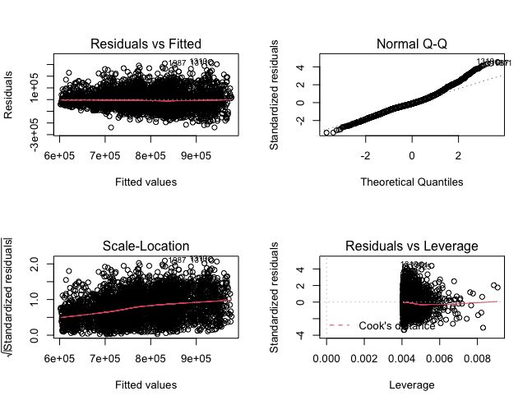
Linear regression model

Slide 12
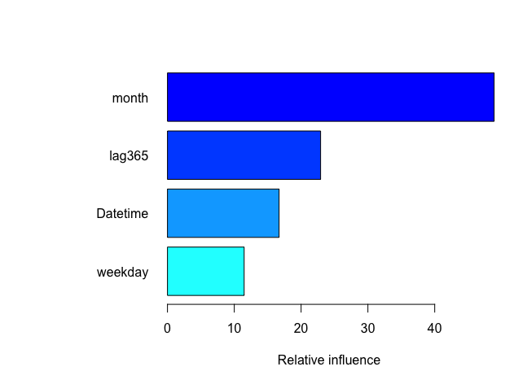
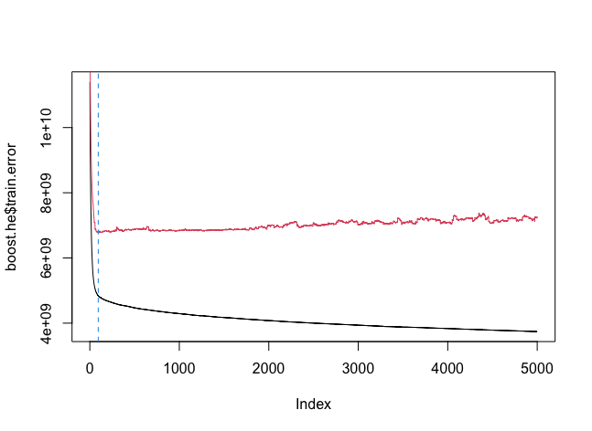
XGBoost model

Slide 13
Models’ performances
Depth | Shrinkage | Iterations | Min Test Error
1 | Null | 88 | 6786110751
4 | Null | 35 | 6962399594‬
1 | 0.01 | 1987 | 6791631725
4 | 0.01 | 478 | 6963849366
Linear | Null | 0 | 6963849366

Slide 14
Conclusion
XGBoost outperforms linear regression in this dataset.

