Slide 1
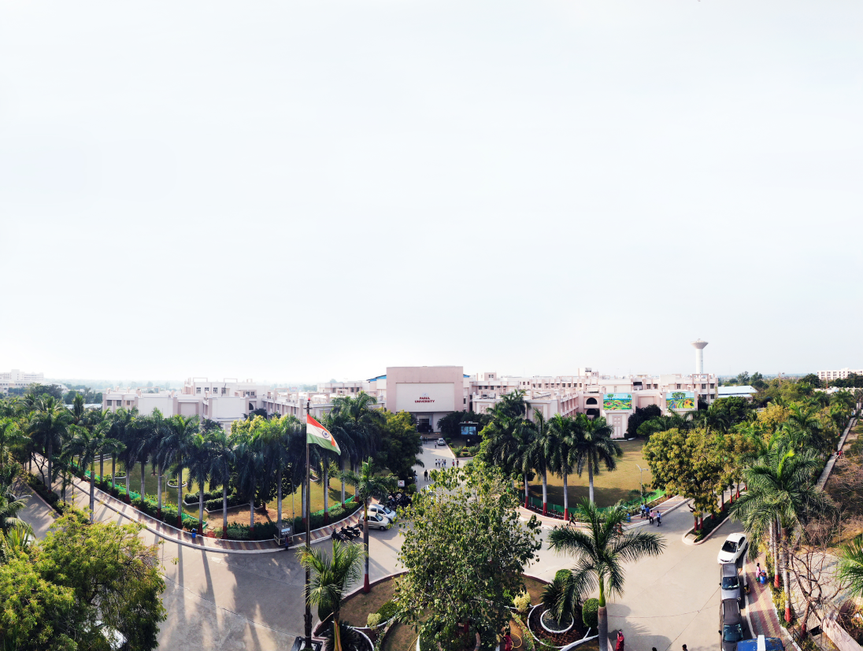


PARUL INSTITUTE OF ENGINEERING & TECHNOLOGY
FACULTY OF ENGINEERING & TECHNOLOGY
PARUL UNIVERSITY
Database Management System
Introduction and Application of DBMS, File Processing System and its Limitations
Computer Science & Engineering
Vrutti H Tandel (Asst. Professor, PIET-CSE)

Slide 2
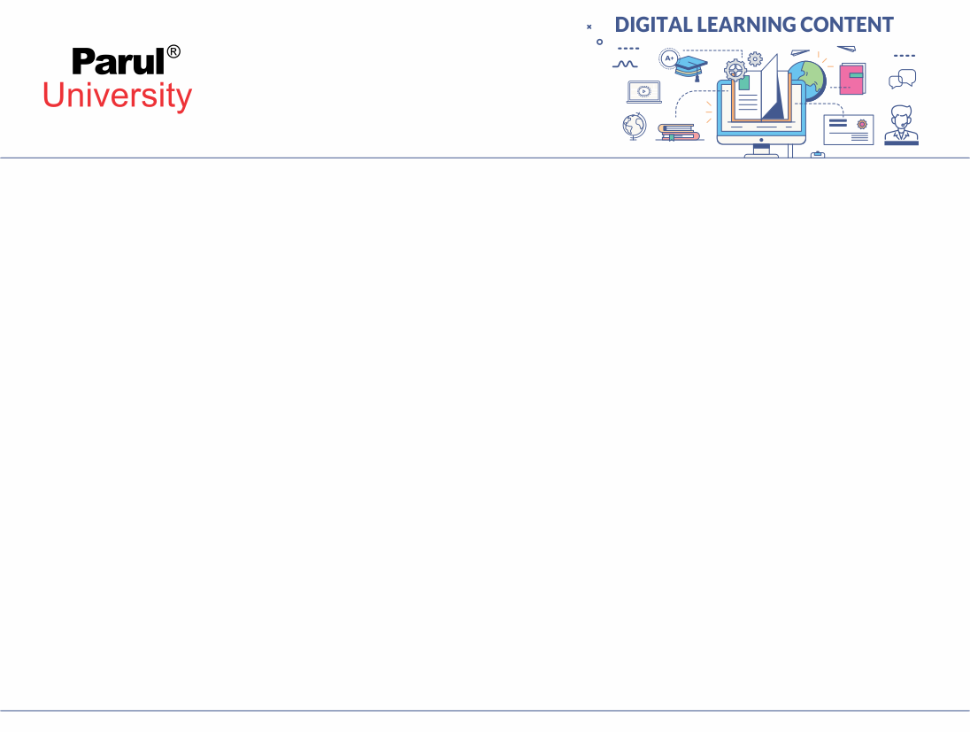


Outline
Introduction of DBMS
Applications of DBMS
Advantages of DBMS
File Processing System
Three levels ANSI SPARC database system
Data Abstraction in DBMS
Mappings and data independence
Database users and DBA
Database system architecture

Slide 3



Basic Terms
What is Data?
Data
Fact that can be recorded or stored.
Data is raw, unorganized and isolated facts that need to be processed to produce required information. It is simple and apparently random and useless until it is organized.
Example: Person Name, Age, Gender and Weight etc.
What is this?

Slide 4
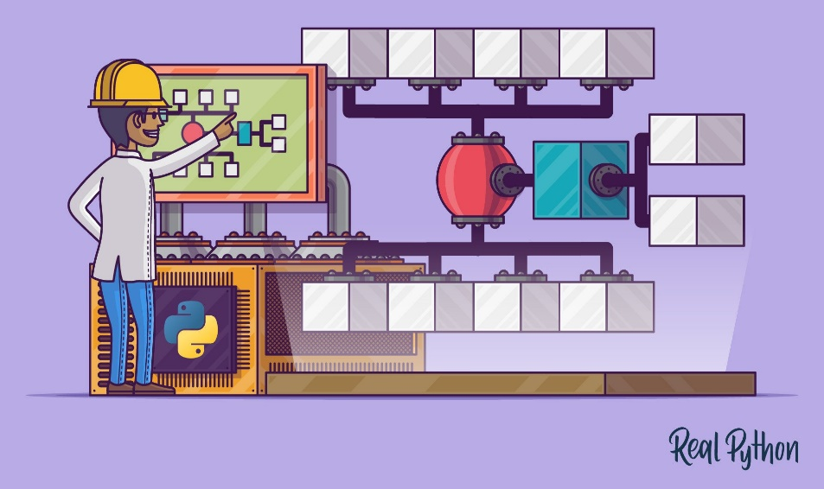
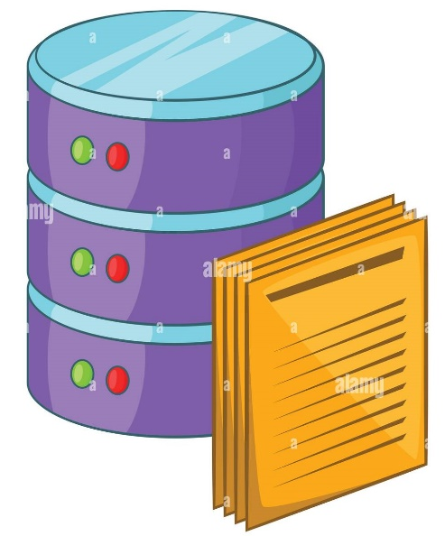
Basic Terms
Then! What is Information?
When data is processed, organized, structured or presented in a given context so as to make it useful, it is called information.
Data: Each student's test score is one piece of data
Information: The class’s average score or the school's average score is the information that can be concluded from the given data.
Example: Table of students information.

Slide 5
Basic Terms
Metadata
Metadata is data about data.
Data such as table name, column name, data type, authorized user and user access privileges for any table is called metadata for that table.
Metadata of above table is:
Table name such as Faculty
Column name such as Emp_Name, Address, Mobile_No, Subject
Datatype such as Varchar, Decimal
Access privileges such as Read, Write (Update)
Faculty
Emp_Name | Address | Mobile_No | Subject
Prof. Ajay Shah | Rajkot | 9876543210 | PPS

Slide 6
Basic Terms
Data dictionary
A data dictionary is an information repository which contains metadata.
Table Name – Faculty
Column Name – EmpName, Address, Mob, Subject, Salary
Data type – Varchar, Decimal
Access Privileges – Read, Write (Update)
Data warehouse
A data warehouse is an information repository which stores data.
Faculty
Emp_Name | Address | Mobile_No | Subject
Prof. Ajay Shah | Rajkot | 9876543210 | PPS
Prof. Ajay Patel | Surat | 0123456789 | DBMS

Slide 7
Basic Terms
Field
A field is a character or group of characters that have a specific meaning.
Example: the value of Emp_Name, Address, Mobile_No etc are all fields of Faculty table.
Faculty
Emp_Name | Address | Mobile_No | Subject
Prof. Ajay Shah | Rajkot | 9876543210 | PPS
Prof. Ajay Patel | Surat | 0123456789 | DBMS
Fields
Prof. Ajay Shah
Rajkot
9876543210

Slide 8
Basic Terms
Record / Tuple
A record is a collection of logically related fields.
E.g, the collection of fields (Emp_Name, Address, Mobile_No, Subject) forms a record for the Faculty.
Faculty
Emp_Name | Address | Mobile_No | Subject
Prof. Ajay Shah | Rajkot | 9876543210 | PPS
Prof. Ajay Patel | Surat | 0123456789 | DBMS
Prof. Ajay Shah | Rajkot | 9876543210 | PPS
Record / Tuple
Prof. Ajay Patel | Surat | 0123456789 | DBMS

Slide 9
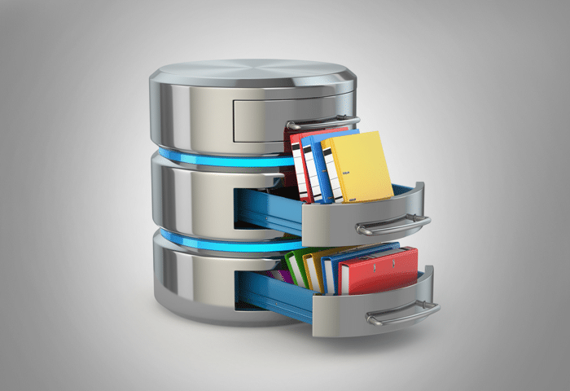
Introduction
Some important terms to know :
Database
A Database is a collection of inter-related (logically-related) data.
E.g. Books Database in Library, Student Database in University etc.
Management
Manipulation, Searching and Security of data
e.g. Viewing result in GTU website, Searching exam papers in GTU website etc.
System
Programs or tools used to manage database
e.g. SQL Server Studio Express, Oracle etc.
DBMS
A Database Management System is a software for creating and managing databases.
Database Management System (DBMS) is a software designed to define, manipulate, retrieve and manage data in a database.
e.g. MS SQL Server, Oracle, My SQL, SQLite, MongoDB etc.

Slide 10
Applications of DBMS
DBMS is a computerized record-keeping system.
DBMS is required where ever data need to be stored.
E-Commerce (Flikart, Amazon, Shopclues, eBay etc...)
Online Television Streaming (Hotstar, Amazon Prime etc...)
Social Media (WhatsApp, Facebook, Twitter, LinkedIn etc...)
Banking & Insurance
Airline & Railway
Universities and Colleges/Schools
Library Management System
Human Resource Department
Hospitals and Medical Stores
Government Organizations

Slide 11
Advantages of DBMS
Reduce data redundancy (duplication)
Avoids unnecessary duplication of data by storing data centrally.
Remove data inconsistency
By eliminating redundancy, data inconsistency can be removed.
Data isolation
A user can easily retrieve proper data as per his/her requirement.
Guaranteed atomicity
Either transaction executes 0% or 100%.
Allow implementing integrity constraints
Business rules can be implemented such as do not allow to store amount
less than Rs. 0 in balance.

Slide 12
Advantages of DBMS
Sharing of data among multiple users
More than one users can access same data at the same time.
vii. Restricting unauthorized access to data
A user can only access data which is authorized to him/her.
viii. Providing backup and recovery services
Can take a regular auto or manual backup and use it to restore the database if it corrupts.

Slide 13
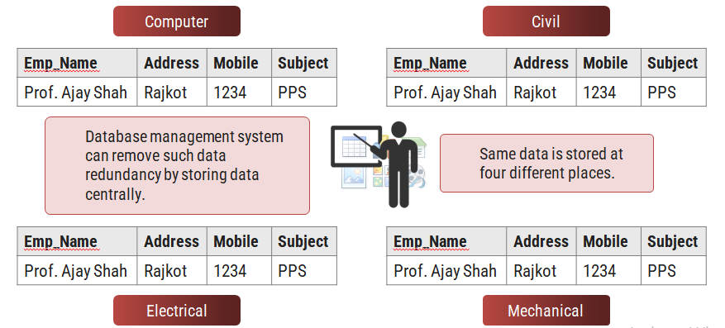
1. Reduce data redundancy (duplication)

Slide 14
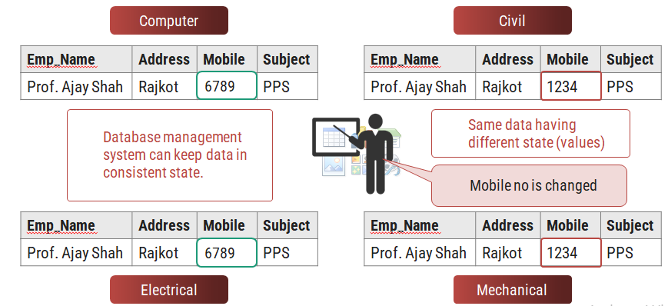
Remove data inconsistency

Slide 15
Data isolation
Data are scattered in various files.
Files may be in different formats.
Difficult to retrieve the appropriate data.
File - 1
Emp_Name | Address | Mobile | Subject
Prof. Ajay Shah | Rajkot | 1234 | PPS
DBMS allow us to access (retrieve) appropriate data easily.
File - 2
Emp_Name | Post | Salary | Load
Prof. Ajay Shah | Lecturer | 50,000 | 15
Data isolation is a property that determines when and how changes made by one operation become visible to other concurrent users and systems.
This issue occurs in a concurrency situation.
File - 3
Emp_Name | Teaching | Knowledge | Rating
Prof. Ajay Shah | Good | Excellent | 9

Slide 16
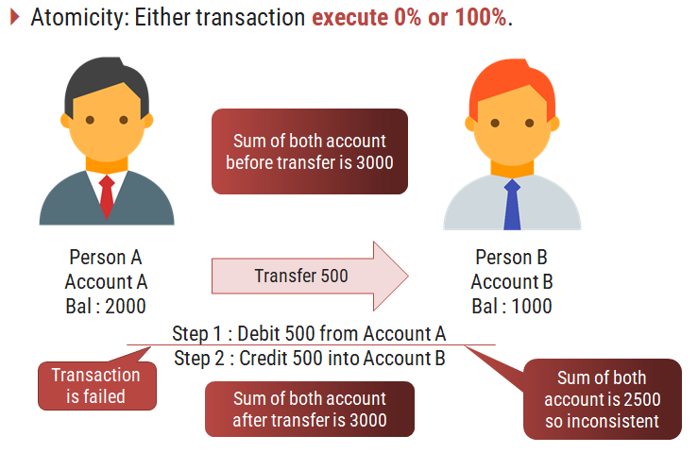
Guaranteed atomicity

Slide 17
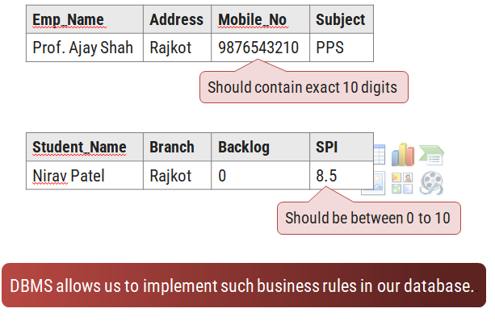
Allow to implement integrity constraints

Slide 18

Sharing of data among multiple users
Want to access
Computer
Civil
Emp_Name | Address | Mobile | Subject
Emp_Name | Address | Mobile | Subject
Prof. Ajay Shah | Rajkot | 1234 | PPS
Prof. Ajay Shah | Rajkot | 1234 | PPS
Want to access
Database management system allows more than one user to access same data simultaneously.
Emp_Name | Address | Mobile | Subject
Emp_Name | Address | Mobile | Subject
Prof. Ajay Shah | Rajkot | 1234 | PPS
Prof. Ajay Shah | Rajkot | 1234 | PPS
Electrical
Mechanical

Slide 19

Restricting unauthorized access to data
File - 1
Emp_Name | Address | Mobile | Subject
Wants to access
Prof. Ajay Shah | Rajkot | 1234 | PPS
Faculty of other college
File - 2
Emp_Name | Post | Salary | Load
Prof. Ajay Shah | Lecturer | 50,000 | 15
Wants to access
Darshan Faculty
File - 3
Emp_Name | Teaching | Knowledge | Rating
Prof. Ajay Shah | Good | Excellent | 9
DBMS prevents unauthorized user to access data.

Slide 20
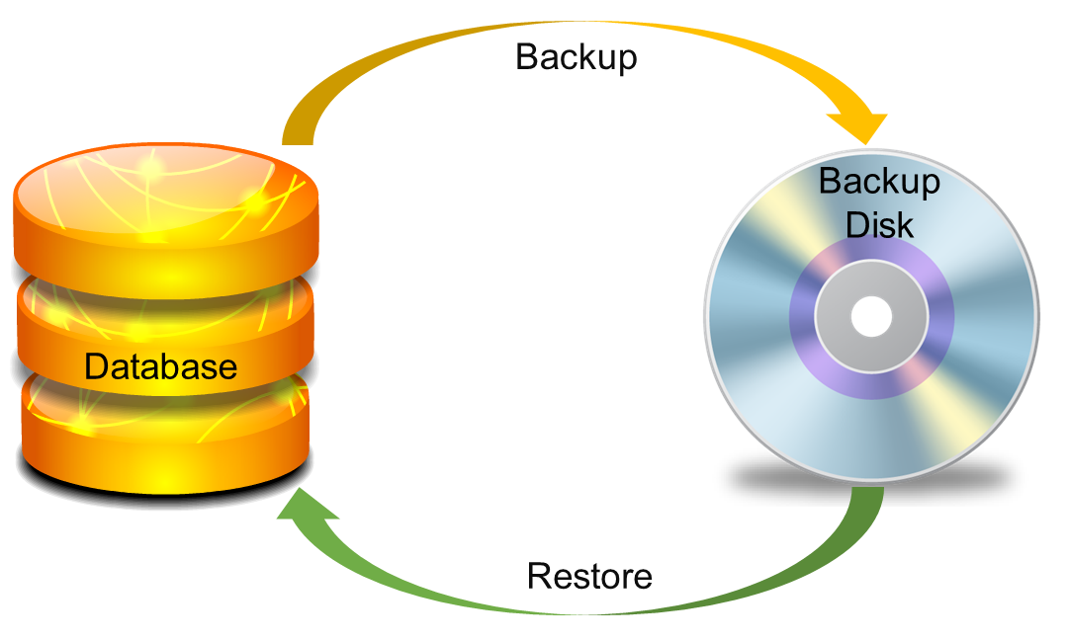
Providing backup and recovery services
Provides facilities to backup and restore the database in case of failure.

Slide 21
File Processing System and its limitations

Slide 22
File Processing System
File system is basically a way of arranging the files in a storage medium like hard disk. File system organizes the files and helps in retrieval of files when they are required.
File systems consists of different files which are grouped into directories. The directories further contain other folders and files.
File system performs basic operations like management, file naming, giving access rules etc.
Example: NTFS(New Technology File System), EXT(Extended File System).
A file system is a software that manages and organizes the files in a storage medium, whereas DBMS is a software application that is used for accessing, creating, and managing databases.
The file system doesn't have a crash recovery mechanism on the other hand, DBMS provides a crash recovery mechanism.

Slide 23
File Processing Approach
-Each user maintains separate files—and programs to manipulate these files—because each requires some data not available from the other user's files.
-This redundancy in defining and storing data results in wasted storage space and in redundant efforts to maintain common up-to-date data
-In traditional file processing, data definition is typically part of the application programs themselves; hence, these programs are constrained to work with only one specific database, whose structure is declared in the application programs

Slide 24
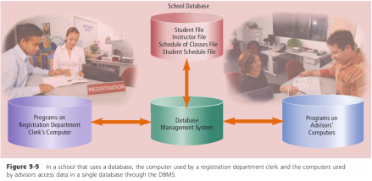
Database Approach
-A single repository maintains data that is defined once and then accessed by various users repeatedly through queries, transactions, and application programs
When an organization uses the database approach, many programs and users share the data in the database. The database does secure its data, however, so that only authorized users can access certain data items. While a user is working with the database, the DBMS resides in the memory of the computer.

Slide 25
DBMS vs. File System
1. | File system is a software that manages and organizes the files in a storage medium within a computer. | DBMS is a software for managing the database.
2. | Redundant data can be present in a file system. | In DBMS there is no redundant data.
3. | It doesn’t provide backup and recovery of data if it is lost. | It provides backup and recovery of data even if it is lost.
4. | There is no efficient query processing in file system. | Efficient query processing is there in DBMS.
5. | There is less data consistency in file system. | There is more data consistency because of the process of normalization.
6. | It is less complex as compared to DBMS. | It has more complexity in handling as compared to file system.
7. | File systems provide less security in comparison to DBMS. | DBMS has more security mechanisms as compared to file system.
8. | It is less expensive than DBMS. | It has a comparatively higher cost than a file system.

Slide 26
Limitations of the File Processing System
Separated and Isolated Data
Duplication of data
Data Dependence
Difficulty in representing data from the user’s view
Data Inflexibility
Incompatible file formats
Data Security
Transactional Problems
Concurrency problems
Poor data modeling of real world

Slide 27
Thank You!!!

Slide 28




www.paruluniversity.ac.in

