Slide 1

Pre Placement Project - Esports
K. ARVIND

Slide 2
PROBLEM STATEMENT
Develop a comprehensive analysis of esports data to identify key trends, player generated earnings and genres of games with maximum earnings/players/tournaments in order to be a guide to investors, optimize game development, enhance player performance, and boost overall esports industry growth."

Slide 3
BUSINESS OBJECTIVES
Has the Total Earnings increased through the years?
Which Genre has the highest and Lowest Total Earnings?
Among the top 5 Genres, which has the highest earnings in 2022?
Which Games have the highest offline earnings?
Which Games have the highest online earnings?
Does the number of players have an impact on the Total Earnings?
How has the Covid-19 pandemic affected the number of games released each year?
Has the online earnings increased post Covid?

Slide 4
BUSINESS OBJECTIVES
Which genre has contributed to the Total Earnings the most in the past decade?
Which genres have hosted the most tournaments in the past decade?
Among the top 5 genres, which has had an increase in Total Earnings post Covid?
In which year was the maximum number of games released?
Games with the highest earnings in the last decade
Total Earnings generated per player for the top 10 games
Total Offline Earnings generated per tournament for the top 10 games

Slide 5
PROJECT ABSTRACT
Identify the business objectives to provide an insight based on the available data
Data Analysis Goals
Understand the requirements
Points to be noted
The Esports data trends can vary drastically due to the recent technological developments
Checkpoints
Data cleaning and filtration
Analyze influencing factors
Plots and Visualizations
Identify the various patterns in the given data
Establish relationship between various factors
Analyze factors influencing revenue generated
Business Objective
The impact of Covid-19 pandemic can also be analysed

Slide 6
PROBLEM SOLVING METHODOLOGY
Data Collection
Collected data from the source
Load GeneralEsports CSV file
Data Cleaning
Checked for null values
Data Transformation
Filter and extract required data
Transform data to do analysis and visualization
Data Analysis and Plotting
Do exploratory data analysis
Analyze data based on the business objectives identified
Visualization using suitable plots
Replaced null with appropriate data
Calculated and added a column for Online Earnings

Slide 7
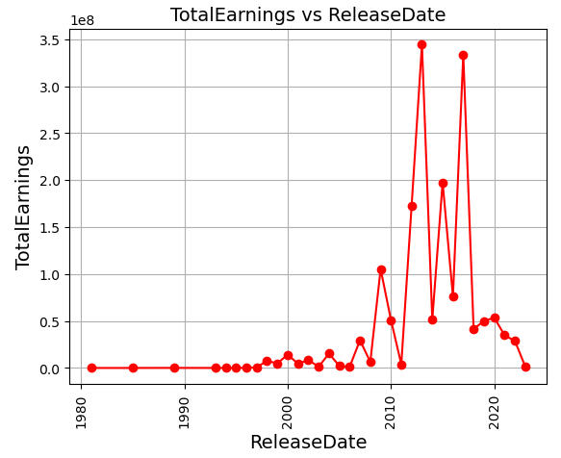
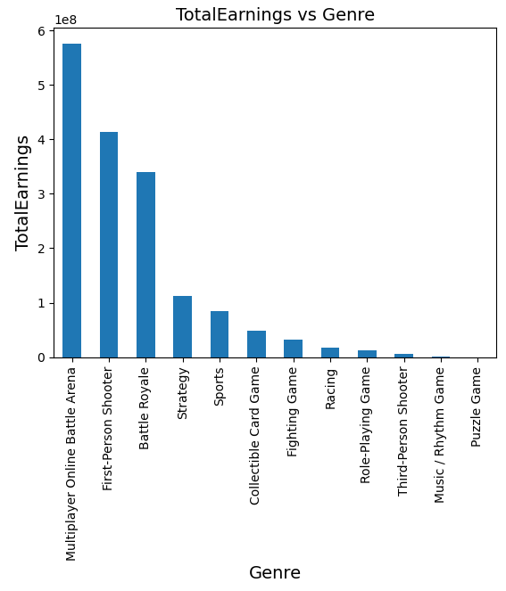
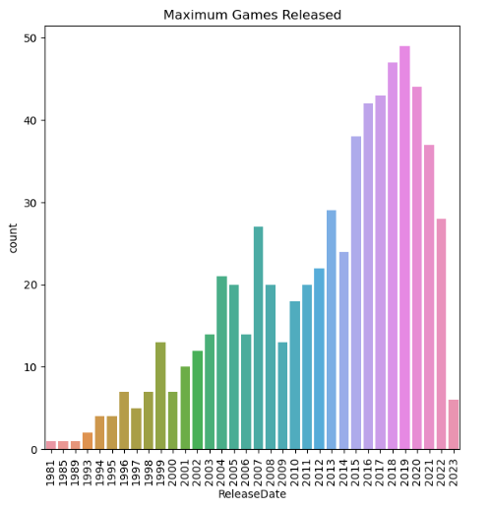
COMPLETE DATA ANALYSIS
THE MAXIMUM NUMBER OF GAMES WERE RELEASED IN 2019
TOTAL EARNINGS HAS SPIKED IN YEARS 2013 AND 2017.
MULTIPLAYER ONLINE BATTLE ARENA AND PUZZLE GAME HAVE HAD THE HIGHEST AND LOWEST TOTAL EARNINGS RESPECTIVELY.

Slide 8
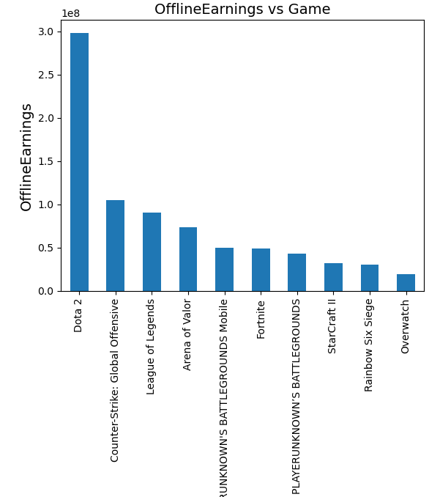
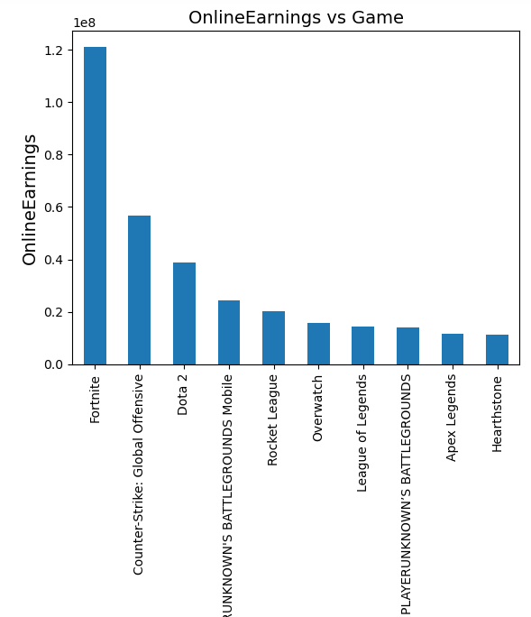
REVENUE ANALYSIS
DOTA 2 IS THE GAME WITH HIGHEST OFFLINE EARNINGS
FORTNITE IS THE GAME WITH HIGHEST ONLINE EARNINGS

Slide 9
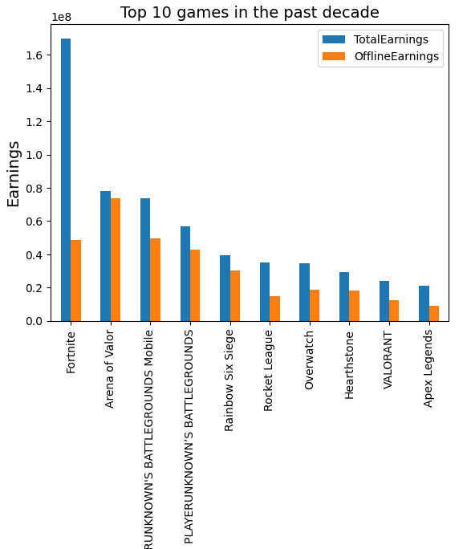
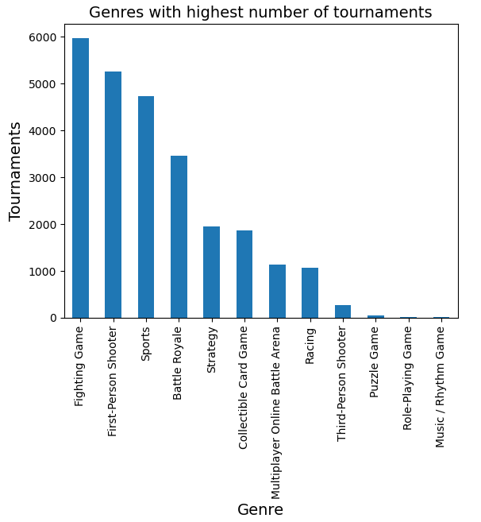
PAST DECADE ANALYSIS
FORTNITE HAS THE HIGHEST EARNINGS IN THE PAST DECADE
FIGHTING GAMES HAVE HELD THE MOST NUMBER OF TOURNAMENTS IN THE PAST DECADE.

Slide 10
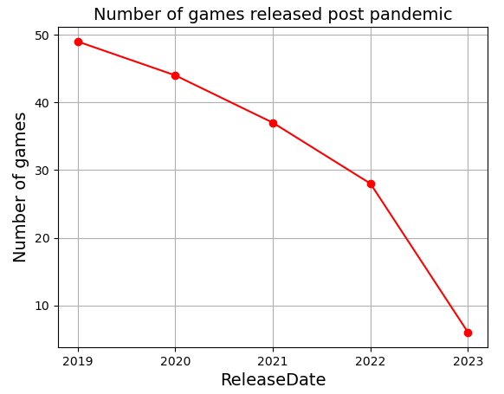
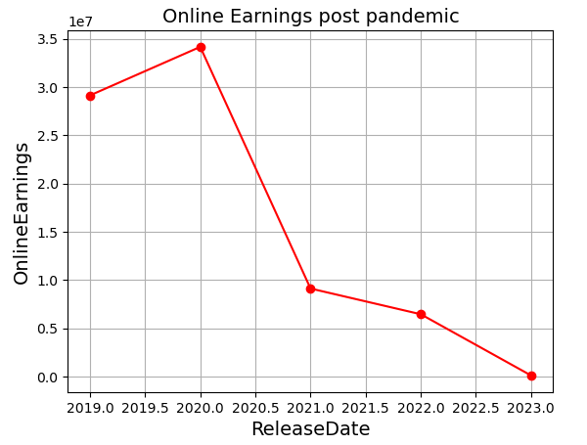
POST PANDEMIC ANALYSIS
THE NUMBER OF GAMES RELEASED EACH YEAR HAS DECLINED POST COVID.
THERE HAS BEEN A STEEP DROP IN ONLINE EARNINGS FROM 2020 TO 2021 AND THEN A GRADUAL DECREASE TO 2023.

Slide 11

FINAL INTERPRETATION
General Analysis:
Genre with highest earnings: Multiplayer Online Battle Arena.
Maximum number of games were released in 2019
Past Decade:
Highest earning game: Fortnite
Highest earning genre: Battle Royale
Post-Pandemic:
The number of games released each year has declined
Online Earnings are gradually improving
First-person shooter games are consistently earning during COVID

Slide 12
THANK YOU

