Slide 1
Mini Project
On
“Color Detection”

Slide 2
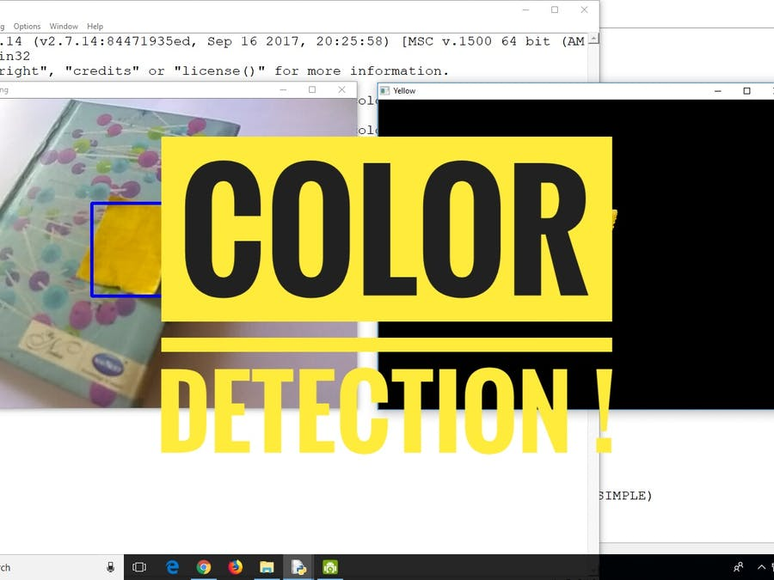

Slide 4
INTRODUCTION TO OPEN CV
OpenCV is Open Computer Vision Library. It was initially launched in 1999 by Intel. With more
updates, it has been modified since then to aim for the real-time computer vision. This library has been written under programming languages like C and C+. It can be easily run on operating systems Windows and Linux. This library can be easily interface with programming languages like Python, MATLAB, Ruby and others as well. Along with Numpy and Python image processing (color detection) can be performed at ease.

Slide 5
Why Python?
Advantages for using Python as fundamental
language for Color Detection are:
Open Source.
User friendly Data structures.
Productivity & Speed.
Simple and elegant Object-oriented
programming.
Third Party Modules present.
Extensive Support Libraries.
More choices in graphics packages and toolsets.

Slide 6
What is Color Detection?
Color detection is the process of detecting the name of any color. Well, for humans this is an extremely easy task but for computers, it is not straight forward. Human eyes and brains work together to translate light into color. Light receptors that are present in our eyes transmit the signal to the brain. Our brain then recognizes the color. Since childhood, we have mapped certain lights with their color names. We will be using the somewhat same strategy to detect color names.

Slide 7
Flowchart For Color Detection
Read Image
Color Detection
Pixel Detection

Slide 8
COLOR DETECTION:
Here we take a colored image of 3 channel (RED,GREEN,BLUE). So each pixel has a RED value, GREEN and BLUE value. Our aim is to retrieve these values from an image to determine the color of the pixel.
EXAMPLE:
RED pixel means RED =255,GREEN=0, BLUE=0 in a pure red pixel. However in reality there will be green and blue components too.
Some basic commands:
• Create a window:
cv2.NamedWindow("Color Detector")
• Load an image:
img_path = "img.jpg"
img = cv2.imread(img_path)
• Display an image:
cv2.imshow("Color detector", img)
• Close a window:
cv2.destroyAllWindows()

Slide 9
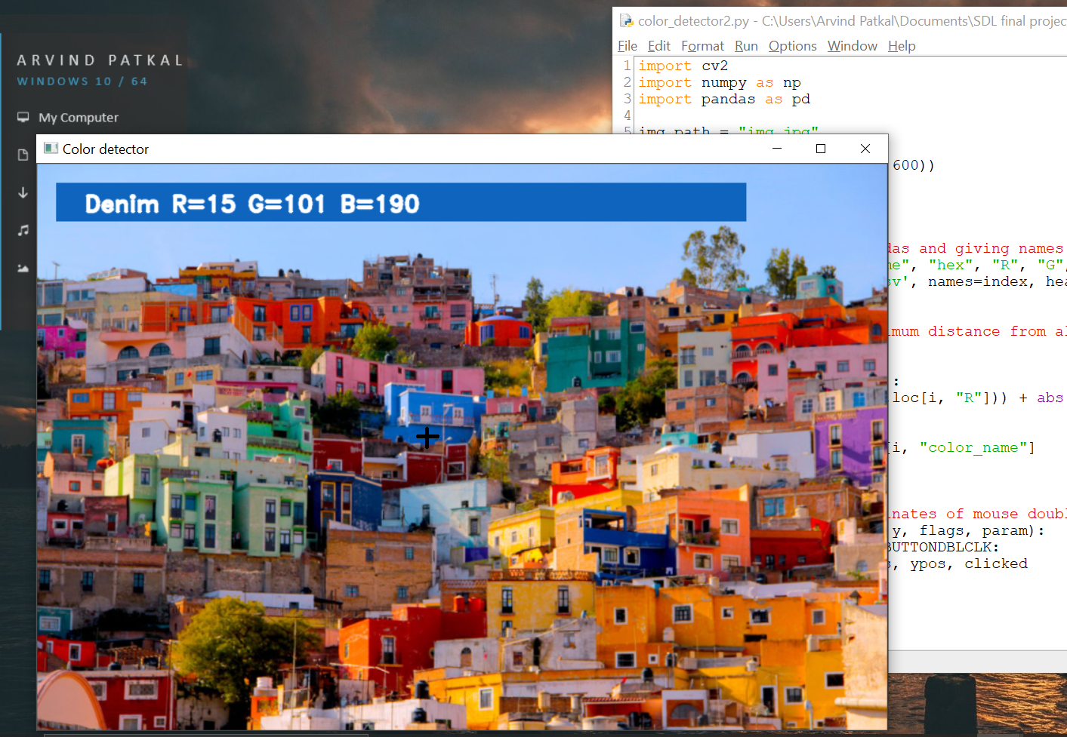
OUTPUT

Slide 10
Thank You…
Presented By-
Yash Golawar (T150234259)
Yashkumar Sawarkar (T150234369)
Arvind Patkal (T150234225)
Guided by-
Prof. Sakeeb Sheikh

