Slide 1
My Introduction
I am Arvind Kumar from Rajasthan (India) I have Done My College graduation in Bachelor of Computer Application(BCA) From Mohanlal Sukhadia University of Udaipur in 2018.
Certification Courses –
- Programming with Python(NIIT Mumbai)
- SQL Server DBMS (NIIT Mumbai)
- PGD In Data Science (IMS Proschool Mumbai)
Technical Skill – Programming with Python,Text Mining with Python,Stastical Analysis,ML Algorithm,Data Structure,Web Scrapping

Slide 2

Time Series
Time series analysis comprises methods for analyzing time series data in order to extract meaningful statistics and other characteristics of the data. Time series forecasting is the use of a model to predict future values based on previously observed values.
Time series are widely used for non-stationary data, like economic, weather, stock price, and retail sales in this post. We will demonstrate different approaches for forecasting retail sales time series. Let’s get started!

Slide 3

Should Have Knowledge of
Time Series Concept
Python Programming
Python Libraries(Pandas,Numpy,Matplotlib,Statesmodels)
Note :
In This Case Study Will Forecast Superstore Dataset.
There is Three Categories Furniture,Office Supply, Technology
We will Use Furniture Category Sales Data and Forecast Future Sales

Slide 4
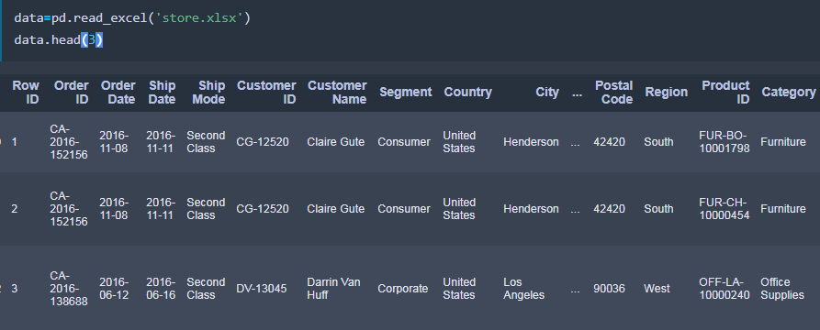
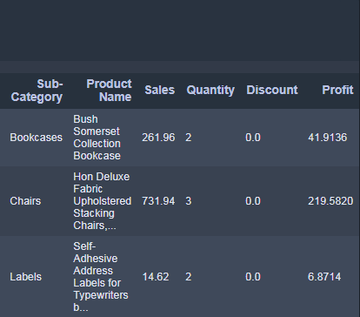
Data Look like There is many Columns But we will use only two columns ‘Order Date’ and Sales Of Furniture Category.

Slide 5

Case Study Approached
1. Import Libraries
2. Filter Data By Categories
3. Check Range of Data
4. Remove Unnecessary Columns
5. Sort Values By Date
6. Check Missing Values
7. Grouping the Data
8. Set Index Date
9. Resampling
10. Visualize The Our Category
11. Visualize with Decomposition
12. ARIMA Model
13. Model Parameters
14. Find The Optimal Parameters
15. Fitting ARIMA Model
16. Model Diagnostics
17. Validate/Test The Model
18. Calculate MSE
19. Calculate RMSE
20. Produce and Visualize Forecasts

Slide 6
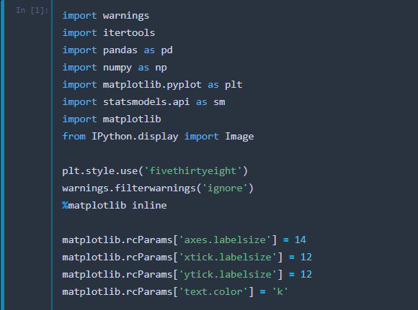
1. Import Libraries

Slide 7
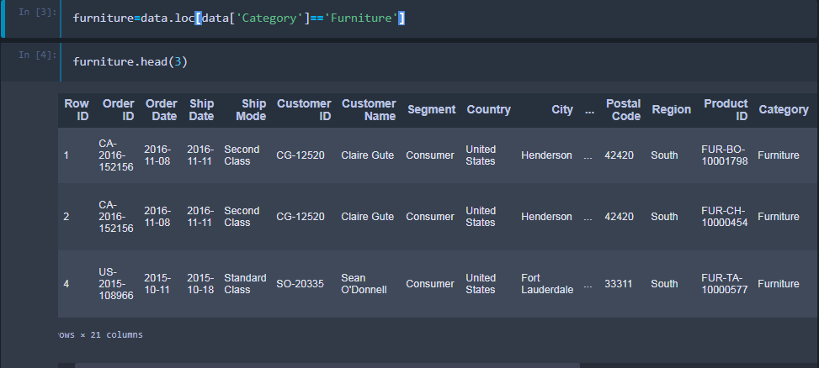
2. Filter Data By Categories
There are several categories in the Superstore sales data, we start from time series analysis and forecasting for furniture sales

Slide 8

3. Check Range of Data
We have a good 4-year furniture sales data.
Timestamp(‘2014–01–06 00:00:00’) To Timestamp(‘2017–12–30 00:00:00’)

Slide 9


4. Remove Unnecessary Columns 5. Sort Values By Date
This step includes removing columns we do not need . After Removed Now we have Two
Columns ‘Order Date’ and ‘Sales’. And also Sort Order Date.

Slide 10
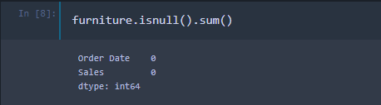
6. Check Missing Values
Now we have Two Columns ‘Order Date’ and ‘Sales’.
Let’s Check Missing Values .
We Don’t Have Missing Values That’s Good.

Slide 11
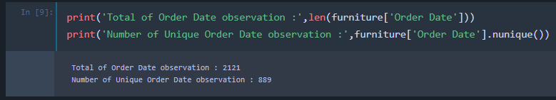
7. Grouping the Data
In this Step First we print total Observation in Oder Date Column and Second we print Number of Unique Values. We Found Duplicate values in Order Date Column. We Grouped Data By Order Date Column and sum of Sales Data.

Slide 12
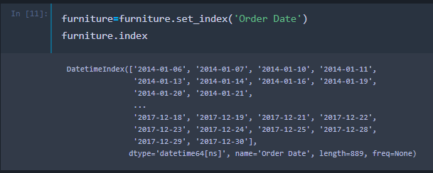
8. Set Index Date
After Grouped data we will set index Our ‘Order data’ Column.

Slide 13

9. Resampling
Our current datetime data can be tricky to work with, therefore, we will use the averages daily sales value for that month instead, and we are using the start of each month as the timestamp.

Slide 14
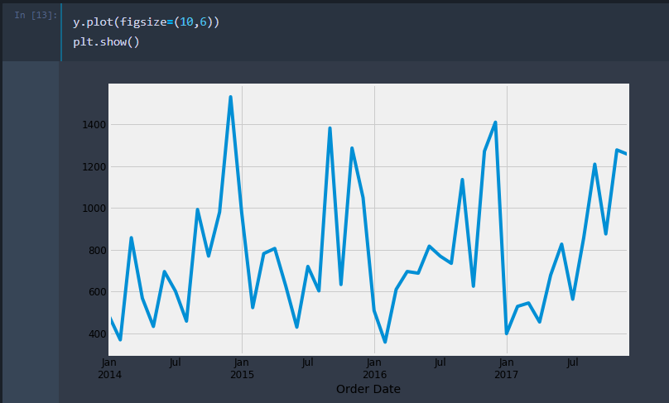
10. Visualize The Our Category
Some distinguishable patterns appear when we plot the data. The time-series has seasonality pattern, such as sales are always low at the beginning of the year and high at the end of the year. There is always an upward trend within any single year with a couple of low months in the mid of the year.

Slide 15
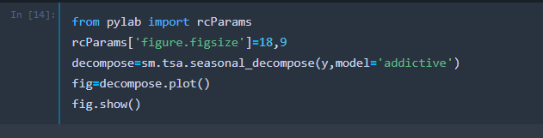
11. Visualize with Decomposition
We can also visualize our data using a method called time-series decomposition that allows us to decompose our time series into three distinct components: trend, seasonality, and noise.

Slide 16
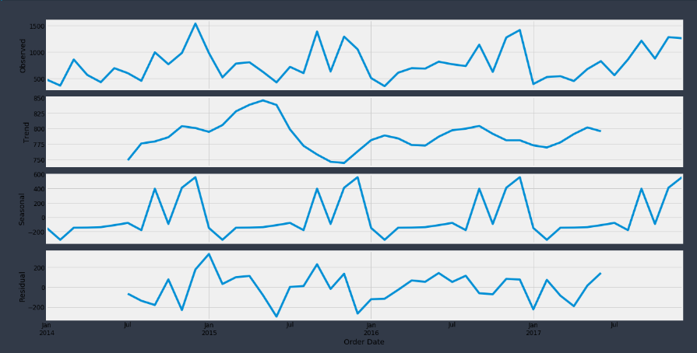
The plot above clearly shows that the sales of furniture is unstable, along with its obvious seasonality.

Slide 17
12. ARIMA Model
We are going to apply one of the most commonly used method for time-series forecasting, known as ARIMA, which stands for Autoregressive Integrated Moving Average.
ARIMA models are denoted with the notation ARIMA(p, d, q). These three parameters account for seasonality, trend, and noise in data.

Slide 18
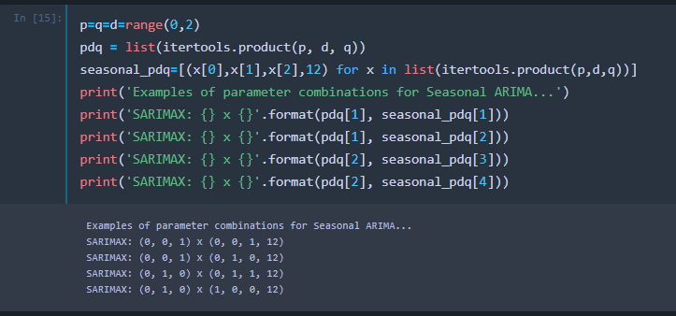
13. Model Parameters
ARIMA models are denoted with the notation ARIMA(p, d, q). These three parameters account for seasonality, trend, and noise in data

Slide 19
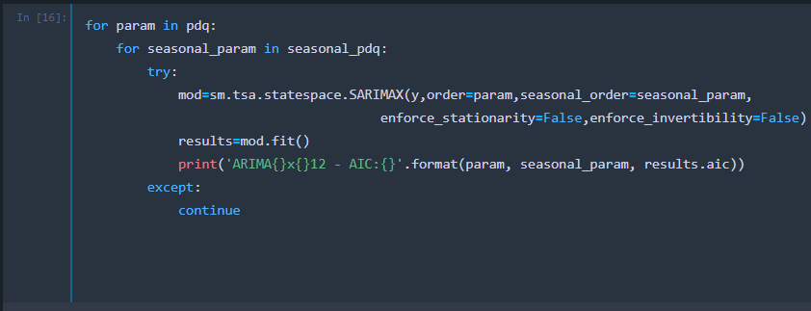
14. Find The Optimal Parameters
This step is parameter Selection for our furniture’s sales ARIMA Time Series Model. Our goal here is to use a “grid search” to find the optimal set of parameters that yields the best performance for our model

Slide 20
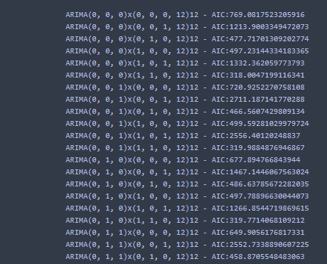
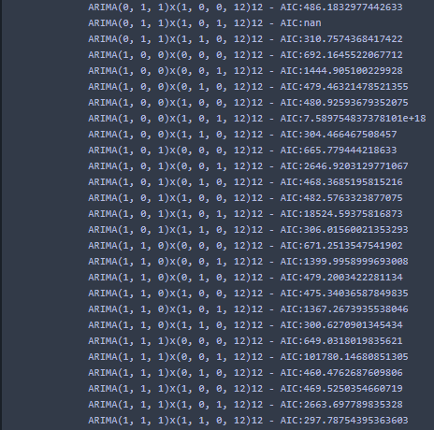
Output

Slide 21
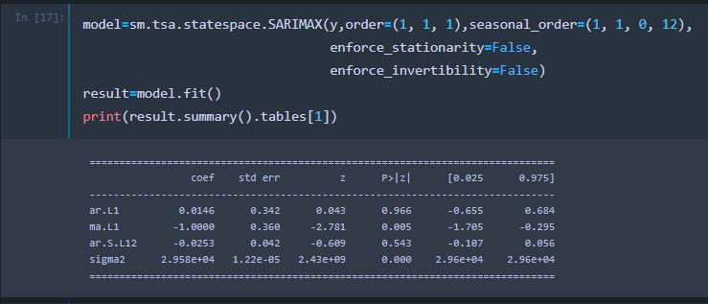
15. Fitting ARIMA Model
Output suggests that SARIMAX(1, 1, 1)x(1, 1, 0, 12) yields the lowest AIC value of 297.78. Therefore we should consider this to be optimal option.

Slide 22
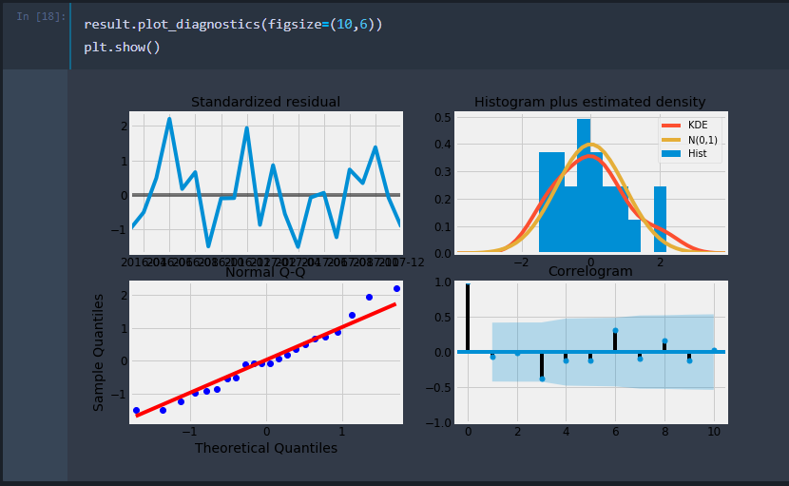
16. Model Diagnostics
We should always run model diagnostics to investigate any unusual behavior.
It is not perfect, however, our model diagnostics suggests that the model residuals are near normally distributed.

Slide 23
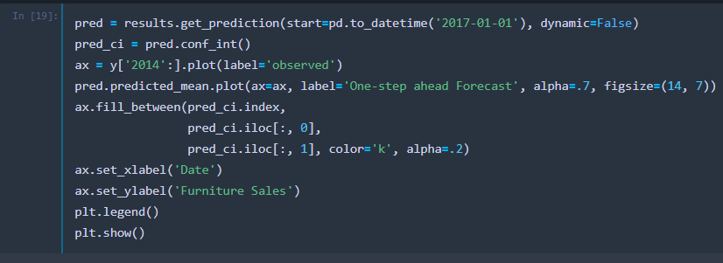
17. Validate/Test The Model
It is help us understand the accuracy of our forecasts, we compare predicted sales to real sales of the time series, and we set forecasts to start at 2017–01–01 to the end of the data.

Slide 24
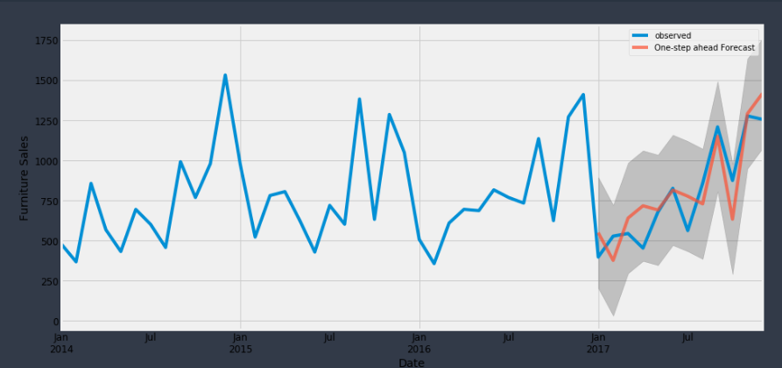
The line plot is showing the observed values compared to the rolling forecast predictions. Overall, our forecasts align with the true values very well, showing an upward trend starts from the beginning of the year and captured the seasonality toward the end of the year.

Slide 25
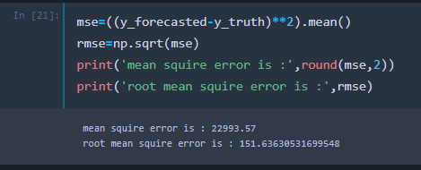
18. Calculate MSE -In statistics, the mean squared error (MSE) of an estimator measures the average of the squares of the errors — that is, the average squared difference between the estimated values and what is estimated. The MSE is a measure of the quality of an estimator — it is always non-negative, and the smaller the MSE, the closer we are to finding the line of best fit. 19. Calculate RMSE - Root Mean Square Error (RMSE) tells us that our model was able to forecast the average daily furniture sales in the test set within 151.64 of the real sales. Our furniture daily sales range from around 400 to over 1200. In my opinion, this is a pretty good model so far.

Slide 26
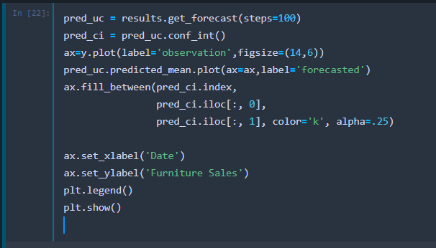
20. Produce and Visualize Forecasts

Slide 27
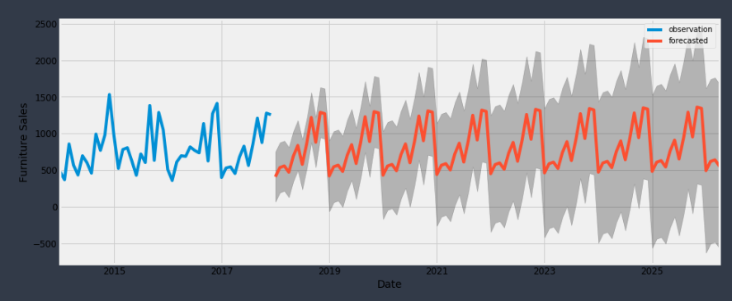
Our model clearly captured furniture sales seasonality. As we forecast further out into the future, it is natural for us to become less confident in our values. This is reflected by the confidence intervals generated by our model, which grow larger as we move further out into the future.

