Slide 1
Beyond Stated Preferences
16.5%
Building a Better Match Predictor for Dating Apps
mutual match rate
Columbia Speed Dating Dataset • 551 participants • 8,378 encounters • 21 waves
Can we do better?
Arvind B. — March 2026

Slide 2
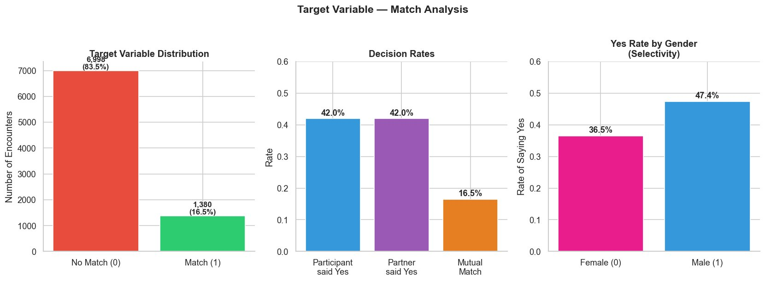
The Business Problem
A dating app's match rate has declined to 16.5% — but its recommendation engine
still relies on what users say they want, not what they actually choose.
Q1
Q2
Q3
Do stated preferences predict actual choices?
Do users who overestimate themselves match less?
Can we predict mutual matches from behavioral signals?

Slide 3
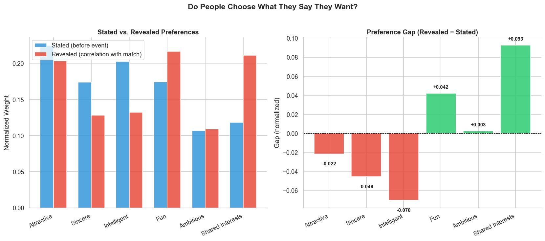
Finding 1 — Stated Preferences Are Unreliable
ρ = 0.37
p = 0.47
Spearman rank correlation
between stated & revealed
preference rankings
Statistically indistinguishable from random.
Stated preferences do not
predict revealed choices.
Overestimated
Overestimated
Underestimated
Underestimated
Intelligence +20% stated vs +13% revealed
Sincerity +17% stated vs +13% revealed
Fun +17% stated vs +22% revealed
Shared Interests +12% stated vs +21% revealed

Slide 4
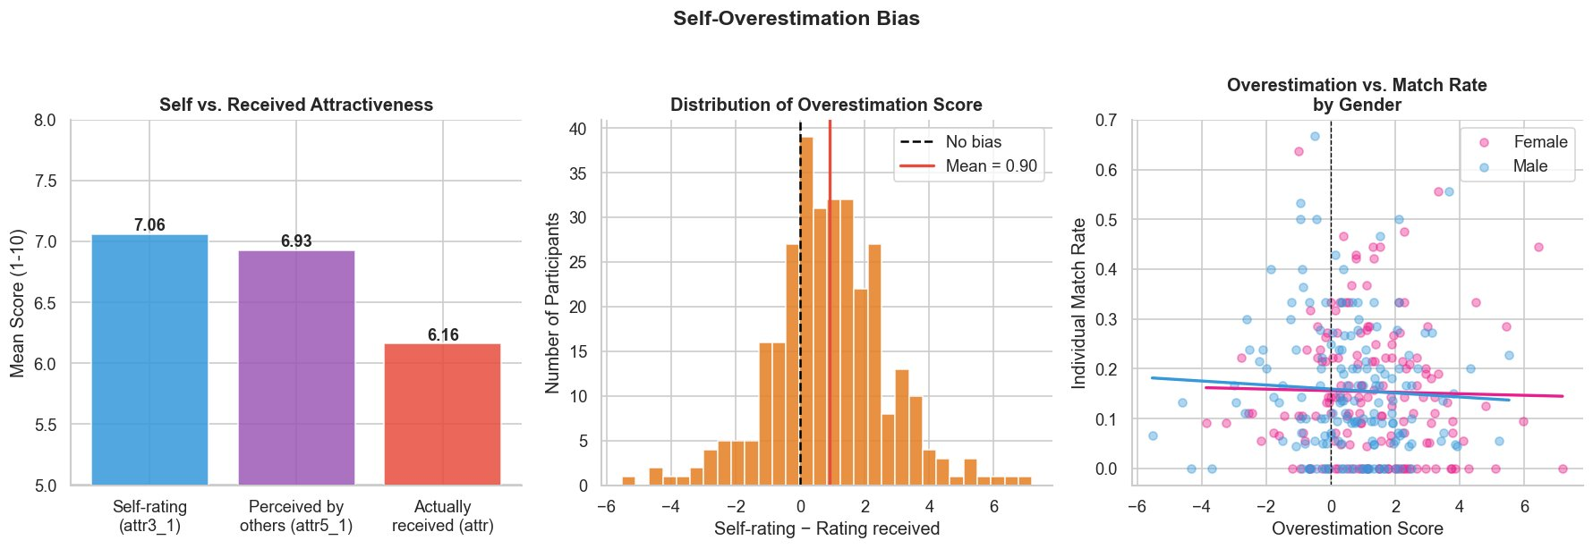
Finding 2 — 71% of Users Overestimate Themselves
7.06
6.16
0.90
71%
Mean self-rating
Mean rating received
Average gap
Overestimate
Business implication: Misaligned expectations drive early churn — independently of actual match rates.

Slide 5
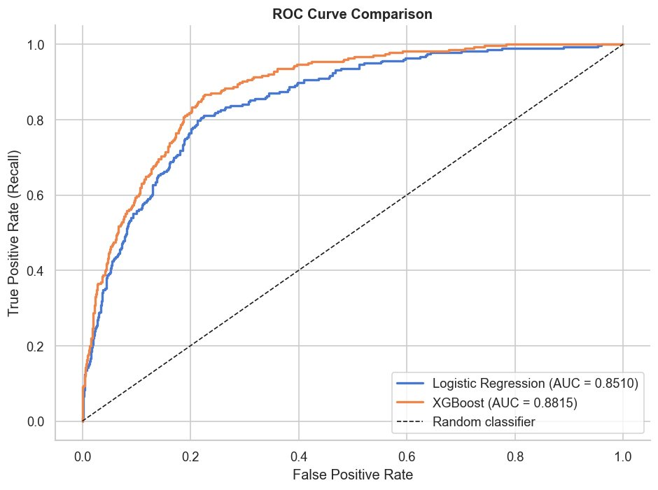
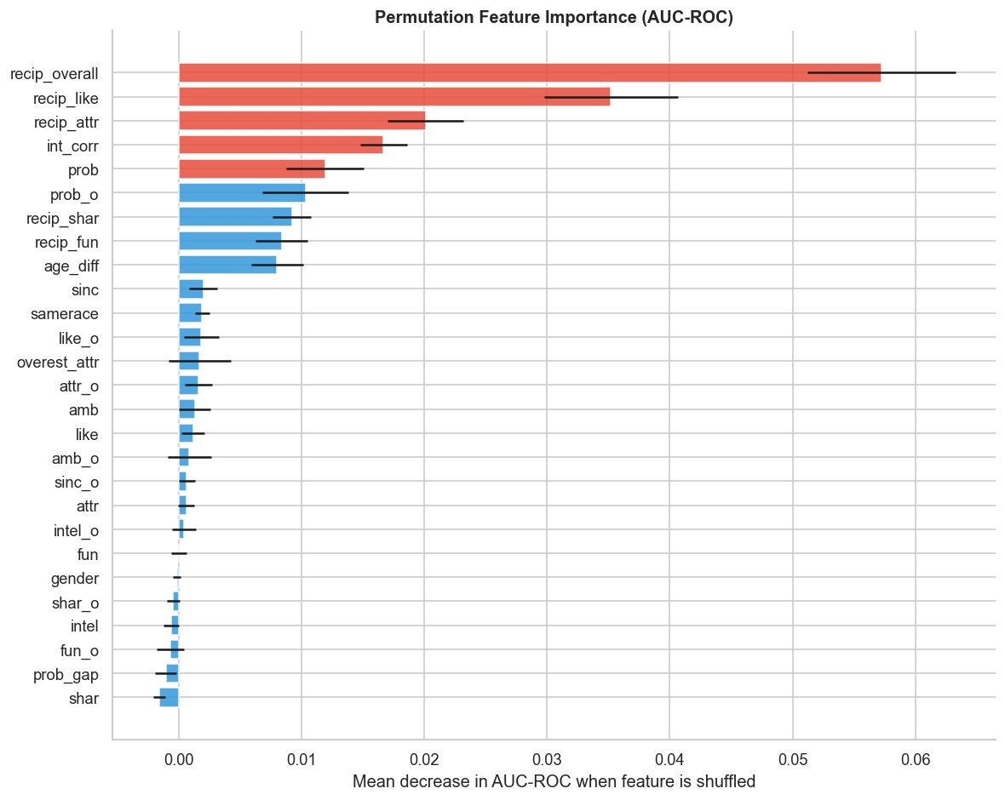
Finding 3 — Reciprocity Predicts Matches, Not Individual Scores
0.881
0.819
0.580
XGBoost
threshold = 0.40
class_weight via scale_pos_weight
AUC-ROC
Recall
F1-Score
ROC Curve Comparison
Permutation Feature Importance

Slide 6
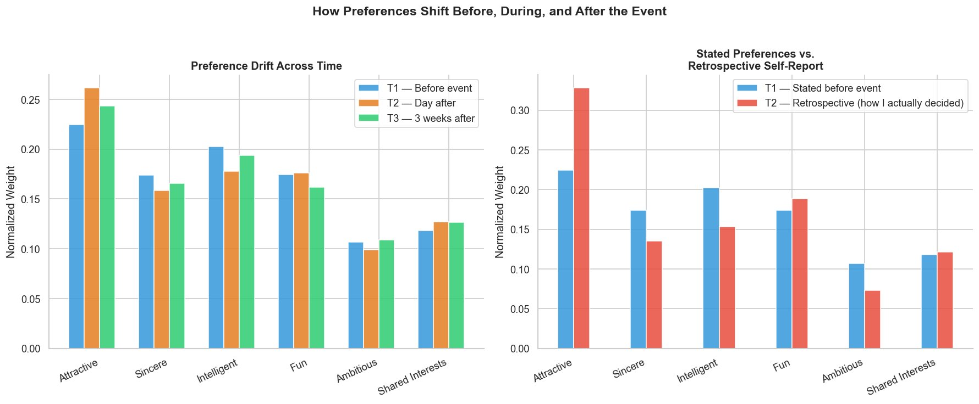
Bonus Finding — People Admit the Truth the Day After
Stated before event:
Attractiveness = 22.5%
Retrospective (day after):
Attractiveness = 32.8% (+10.3 pts)

Slide 7
3 Product Recommendations
Replace stated preferences with reciprocity signals
Expected impact:
Higher match rates from day one of deployment
01
recip_overall drives 0.057 AUC drop alone.
Build reciprocity scores from behavioral signals:
mutual likes, mutual views, response symmetry.
Redesign onboarding around interest mapping
Expected impact:
Better cold-start matching for new users
02
int_corr (objective interest correlation) outperforms
every individual rating score.
Replace attribute weighting with rich interest profiles.
Add expectation calibration to reduce churn
Expected impact:
Reduction in week-1 churn
03
71% of users overestimate themselves by 0.90 pts.
Show anonymized performance benchmarks during onboarding
to set realistic first-week expectations.

Slide 8
Limits & Next Steps
Limits
Next Steps
Graduate students at Columbia (2002-2004) — limited generalizability
Reciprocity features require simultaneous ratings — production proxy needed
Correlation, not causation — feature weights need recalibration on live data
Dating behaviors have changed significantly since 2004
A/B test reciprocity-based matching vs. stated preference engine
Instrument app to collect behavioral reciprocity proxies
Retrain model on contemporary app data
Add user segmentation layer (intent, age group, activity level)
Build real-time reciprocity scoring system
Beyond Stated Preferences • Arvind B. • github.com/ArvindB75/speed-dating-match-prediction

