Slide 1
Whiteboard Infrastructure Modernization
Legacy Infrastructure
AWS Cloud Migration
Modernized Infrastructure
Scalability, security, and performance issues
Transform infrastructure into cloud architecture
Scalable, secure, and high-performance

Slide 2
Existing Infrastructure Setup
Storage
Localized storage systems with manual backups
Networking
Database Layer
Flat network design with minimal segmentation
Single database instance with limited redundancy
Monitoring
Application Layer
Basic server health checks with limited logging
Monolithic application hosted on dedicated servers

Slide 3
Current Infrastructure Challenges: Unveiling the Hidden Depths
Scalability Challenges
High Operational Cost
Limited Availability
Security Risks
Backup & Recovery Limitations
Monitoring Gaps

Slide 4
Infrastructure Challenges Impact Business
Reduced Productivity
Slower workflows, missed deadlines
Delayed Collaboration
Slower response times, missed opportunities
Increased Downtime
Infrastructure Challenges
More frequent, longer outages
Poor Experience
Reduced productivity, increased downtime
Frustrated users, lost customers
Compliance Concerns
Audit failures, legal issues
High Recovery
Longer recovery times, data loss

Slide 5
Whiteboard's Digital Collaboration Platform
Secure Communication
Real-time Collaboration
Ensures confidential and protected communication channels for teams.
Enables seamless teamwork and idea sharing across distances.
Whiteboard Digital Collaboration Platform
Project Management
Data Sharing
Facilitates secure and efficient data exchange among distributed teams.
Provides centralized control and organization for project workflows.

Slide 6
Whiteboard modernizes infrastructure with AWS cloud.
Traditional Infrastructure
Modern AWS Architecture
Scalability, cost, and security issues.
Scalability, cost savings, and enhanced security.

Slide 7
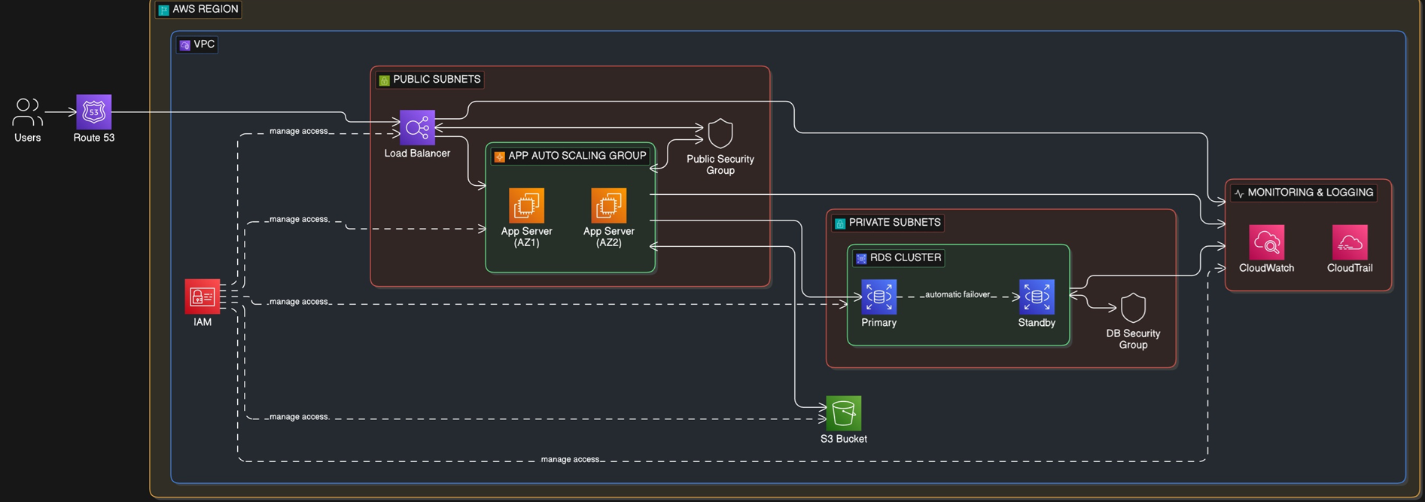

Slide 8
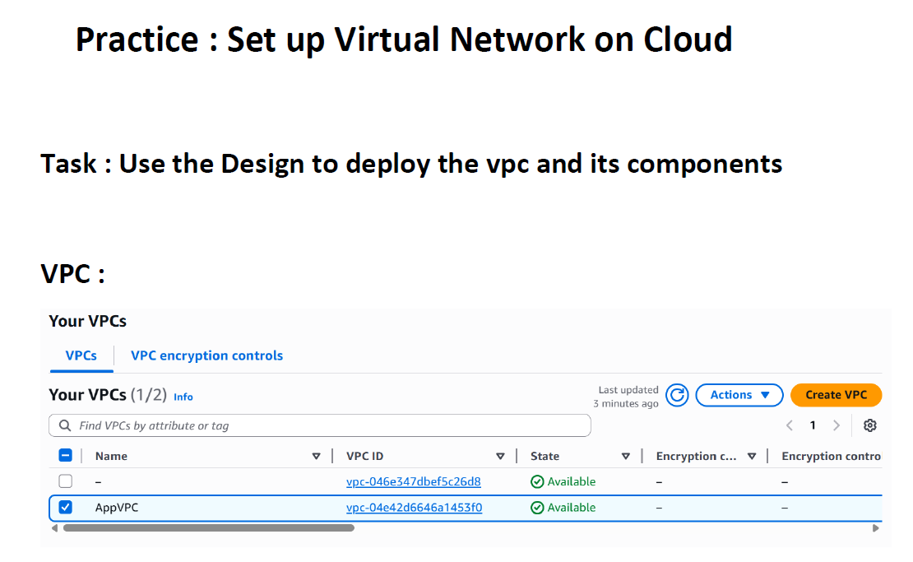
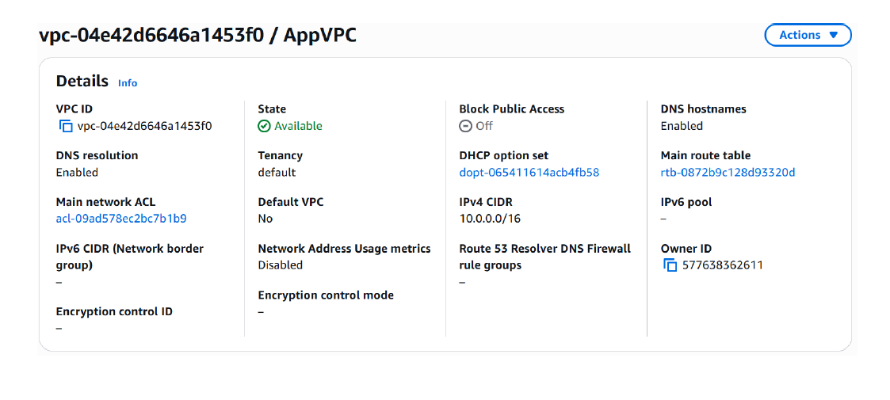

Slide 9
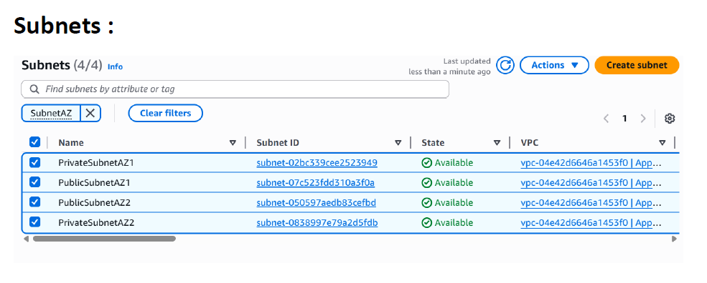

Slide 10
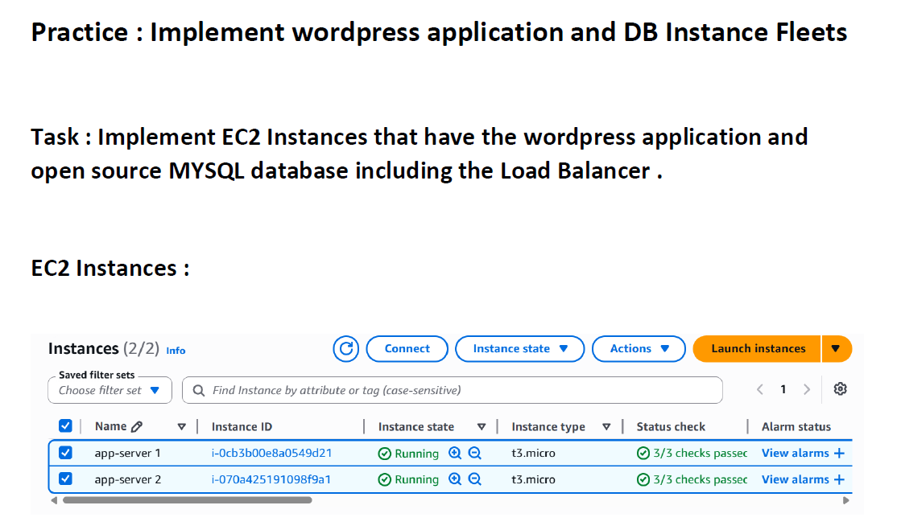
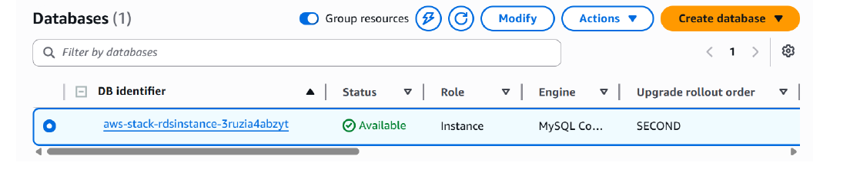

Slide 11
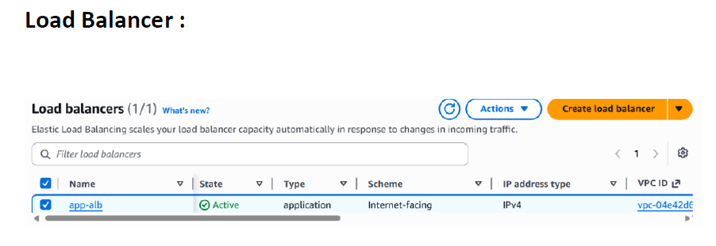
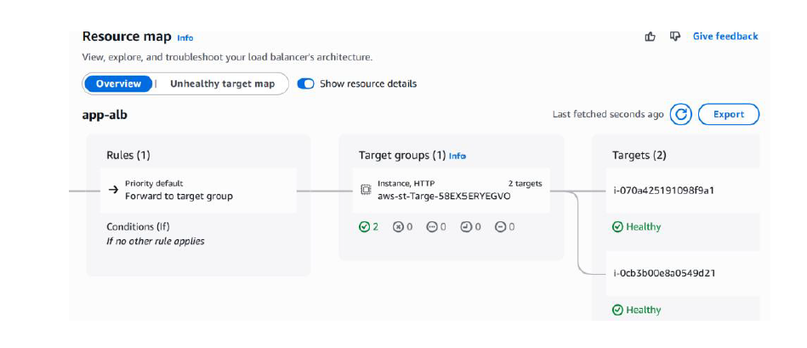

Slide 12
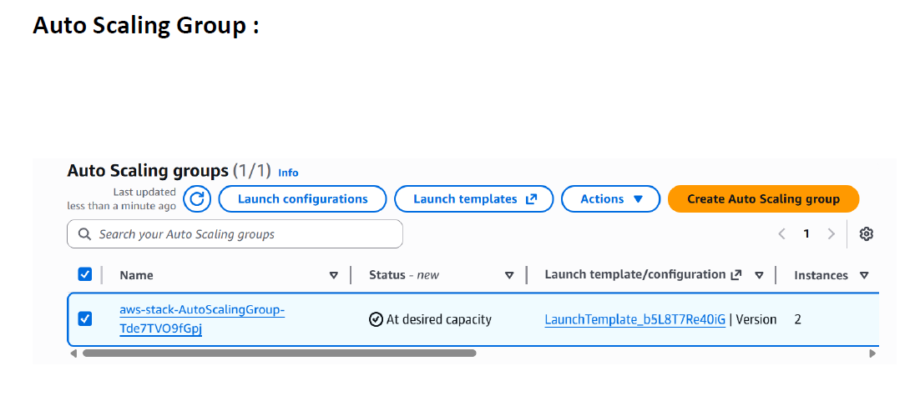

Slide 13
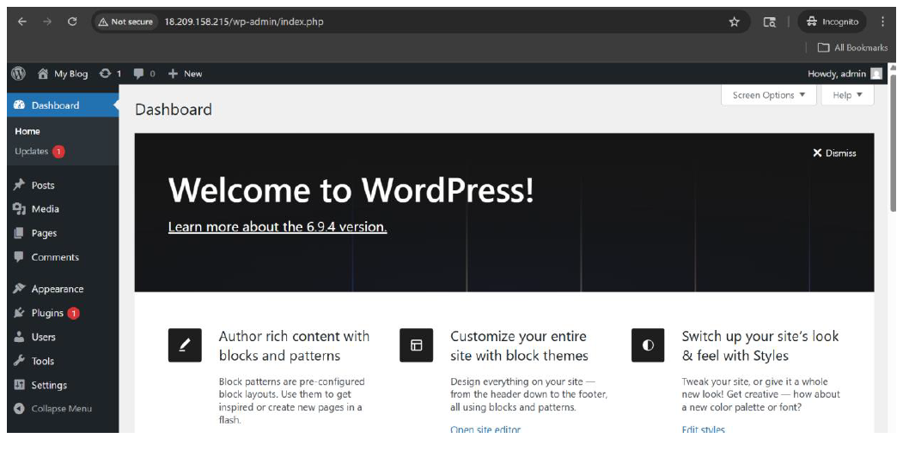

Slide 14
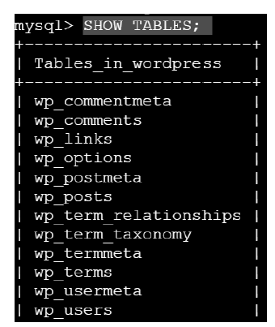
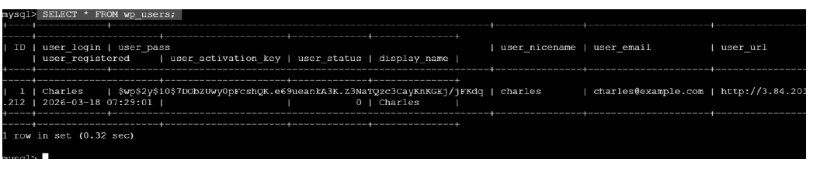

Slide 15
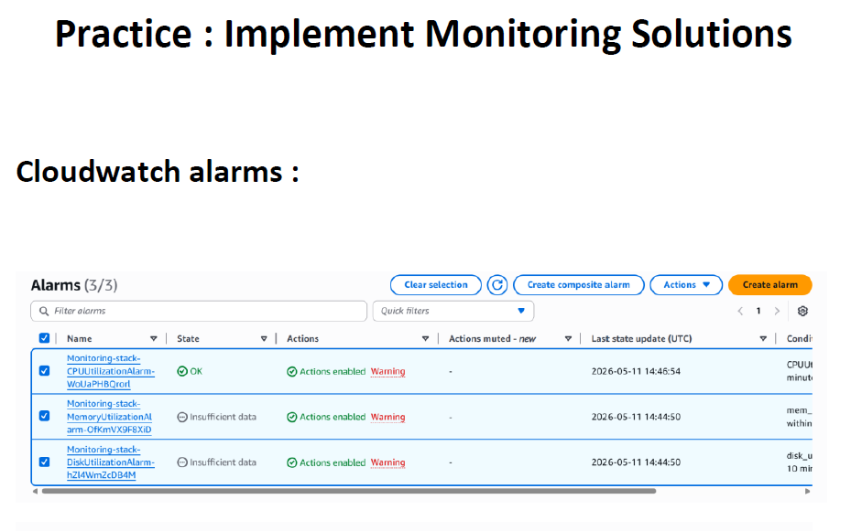
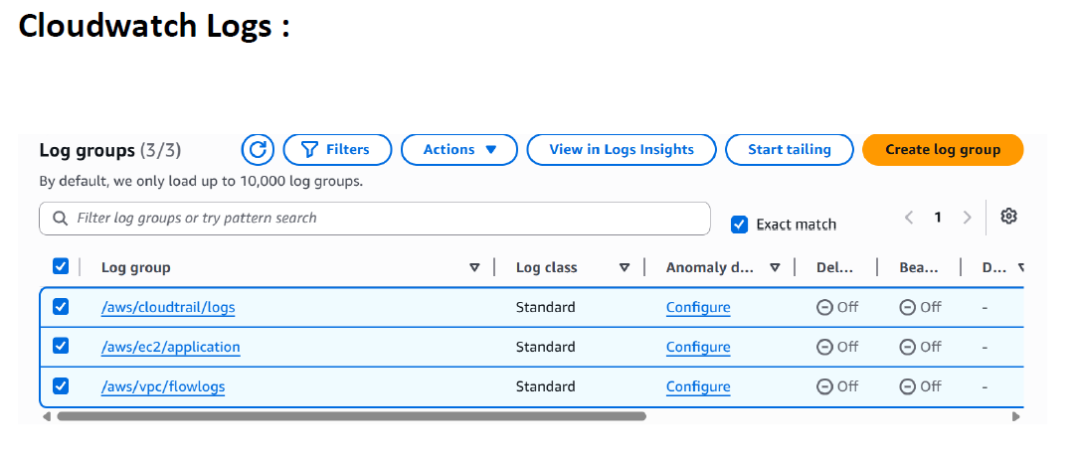

Slide 16
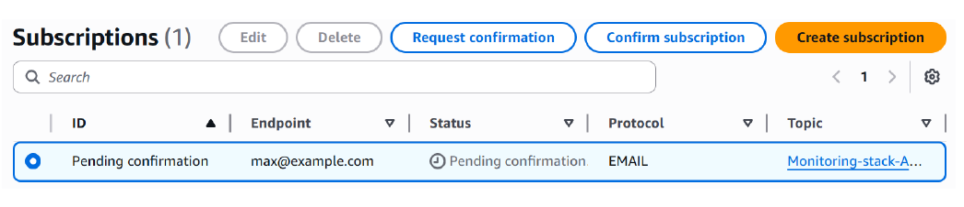
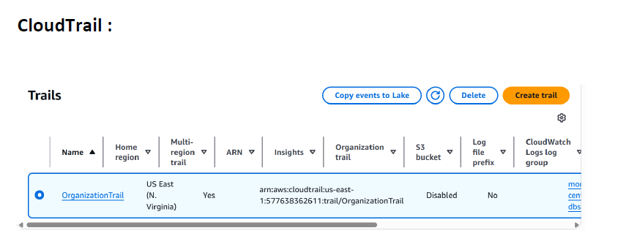

Slide 17
Public Subnet Components and Traffic Flow
Receives HTTP/HTTPS Traffic
Application Load Balancer (ALB)
Performs Health Checks
Distributes Traffic
SSL Termination
Hosts Application Code
Public Subnet Components
Serves APIs/Web Pages
EC2 Application Servers
Processes Business Logic
Accesses RDS & S3
Internet
Traffic Flow
ALB
EC2 Instances

Slide 18
Unveiling the Multifaceted Benefits of AWS Architecture
Faster Recovery
Monitoring
Automated disaster recovery workflows for rapid restoration.
Proactive issue detection for timely intervention.
Cost Optimization
Security
Pay-as-you-go resource utilization for efficient spending.
Enterprise-grade protection against threats and vulnerabilities.
High Availability
Scalability
Fault tolerance across Availability Zones for continuous operation.
Automatic resource scaling for fluctuating demands.

Slide 19
AWS Cloud Migration Roadmap
Infrastructure Deployment
Testing & Optimization
Application Migration
Set up AWS resources and services
Test applications and optimize performance
Move applications to the cloud
Assessment & Planning
Security Hardening
Monitoring Configuration
Evaluate current infrastructure and needs
Implement security controls and best practices
Set up monitoring and observability tools

Slide 20
Key Outcomes of Whiteboard's AWS Cloud Transformation
Resilience Assured
Guarantee uninterrupted operations in case of disruptions
Business Continuity
Future-Ready
Adapt to growing demands and expand business
Scalability
Secure Environment
Security Compliance
Meet industry security standards and protect data
Enhanced Uptime
Improved Reliability
Ensure consistent and dependable service delivery
Streamlined Processes
Operational Excellence
Achieve efficient and optimized business operations

Slide 21


