Slide 1

SREE AYYAPPA EDUCATION CENTRE (CBSE)
QUIZ COMPETITION
“NATIONAL SPACE DAY”
23rd AUGUST 2024

Slide 2
1. What does the acronym ISRO stands for?
International space research organisation
Indian space research organisation
Indian stars research organisation
Interstellar space research organisation

Slide 3
2. What is the name of the Indian mission that aimed to study the sun?
Chandrayaan – 1
Chandrayaan – 2
Chandrayaan – 3
Aditya – L1

Slide 4
3. What does MOM stands for?
Mangalyaan orbiter mars
Mars orbiter Mangalyaan
Mangalyaan orbiter mission
Mars orbiter mission

Slide 5
4. Who is the father of Indian space program?
Vikrant Ramakrishnan
Satish Dhawan
Vikram Sarabhai
A.P.J Abdul Kalam

Slide 6
5. What is the launch date for Chandrayaan 3 mission?
23rd August 2023
24th July 2023
14th July 2023
4th July 2023

Slide 7
6. The Chandrayaan 3 mission’s rover is known as
Vikram
Aditya
Pragyaan
Dhruv

Slide 8
7. The mission life of the lander and the Rover is equal to
14 earth days
24 earth days
30 earth days
15 earth days

Slide 9
8. What name is given to the Chandrayaan 3 landing spot?
Shiva – shakti point
Shiva – bhakti point
Shathi – point
Shiva – pragyaan point

Slide 10
9. Who is the current chairman of ISRO?
10. What is the name of the first female robot that will be a part of India’s manned mission?

Slide 11
11. What is the name of the Indian satellite system for communications?
12. What is METSAT – 1 renamed as?

Slide 12
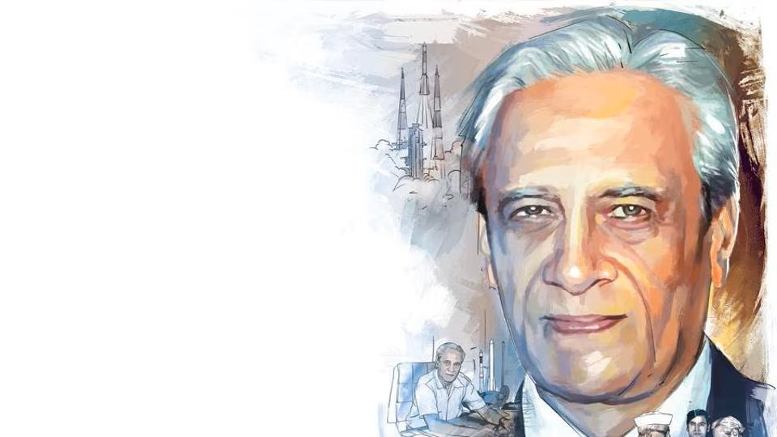

Slide 13
