Slide 1
HACKATHON DEMO
AI Shopping Decision Assistant
The Problem
The Solution
Choice overload — hundreds of options, zero clarity
Information scattered across reviews, specs, prices
Black-box recommendations with no reasoning
Search → Filter → Compare → Explain → Recommend
Personalized recommendations based on your needs, budget, and preferences — with full transparency.

Slide 2
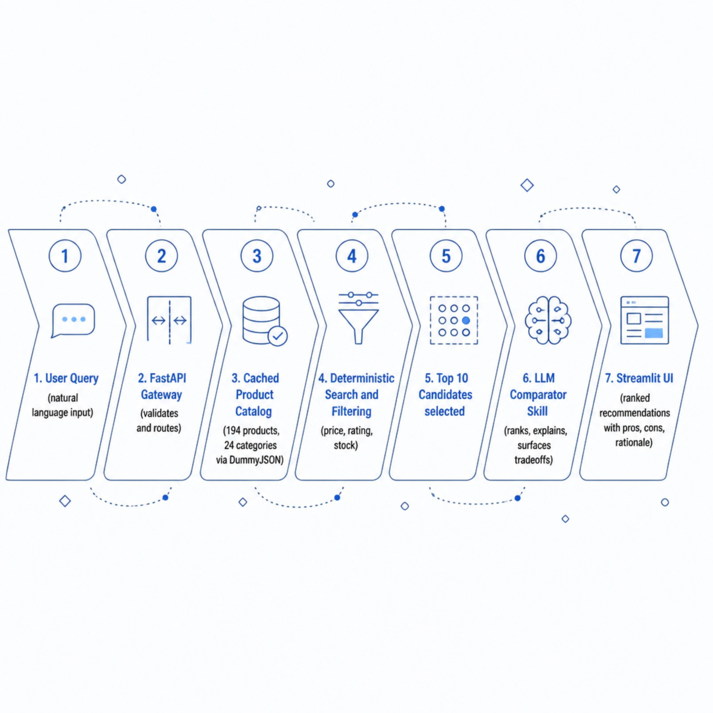
ARCHITECTURE
How It Works
Key Innovation
Deterministic retrieval and LLM reasoning are fully separated — fast, predictable search feeds a focused AI comparison layer.
Catalog: 194 products · 24 categories · fetched once, cached locally

Slide 3


AI INTELLIGENCE LAYER
The LLM Comparator
Structured Prompt + Strict JSON Output
Ranking by Intent + Hard Constraints
Price, Rating, Stock & Return Policy
Explainable Reasons & Tradeoffs
Follow-up Questions Re-rank Results
Example: "Running shoes under $120, 4★+, wide feet" → Top pick scored, rationale explained, tradeoffs surfaced.

Slide 4




TRUST & SAFETY
Security · Privacy · Reliability
Security
Privacy
Reliability
Prompt-injection filtering
Input validation + rate limiting
API keys in environment variables
No persistent personal profiles
PII stripped from reviews
Session-scoped data only
No private data in logs
Strict JSON output validation
Recommendation integrity checks
Cached catalog fallback
Raw search results if LLM fails
Trace ID
Search
Retrieve
Validate
Recommend
Every recommendation is traceable end-to-end for full auditability.

Slide 5
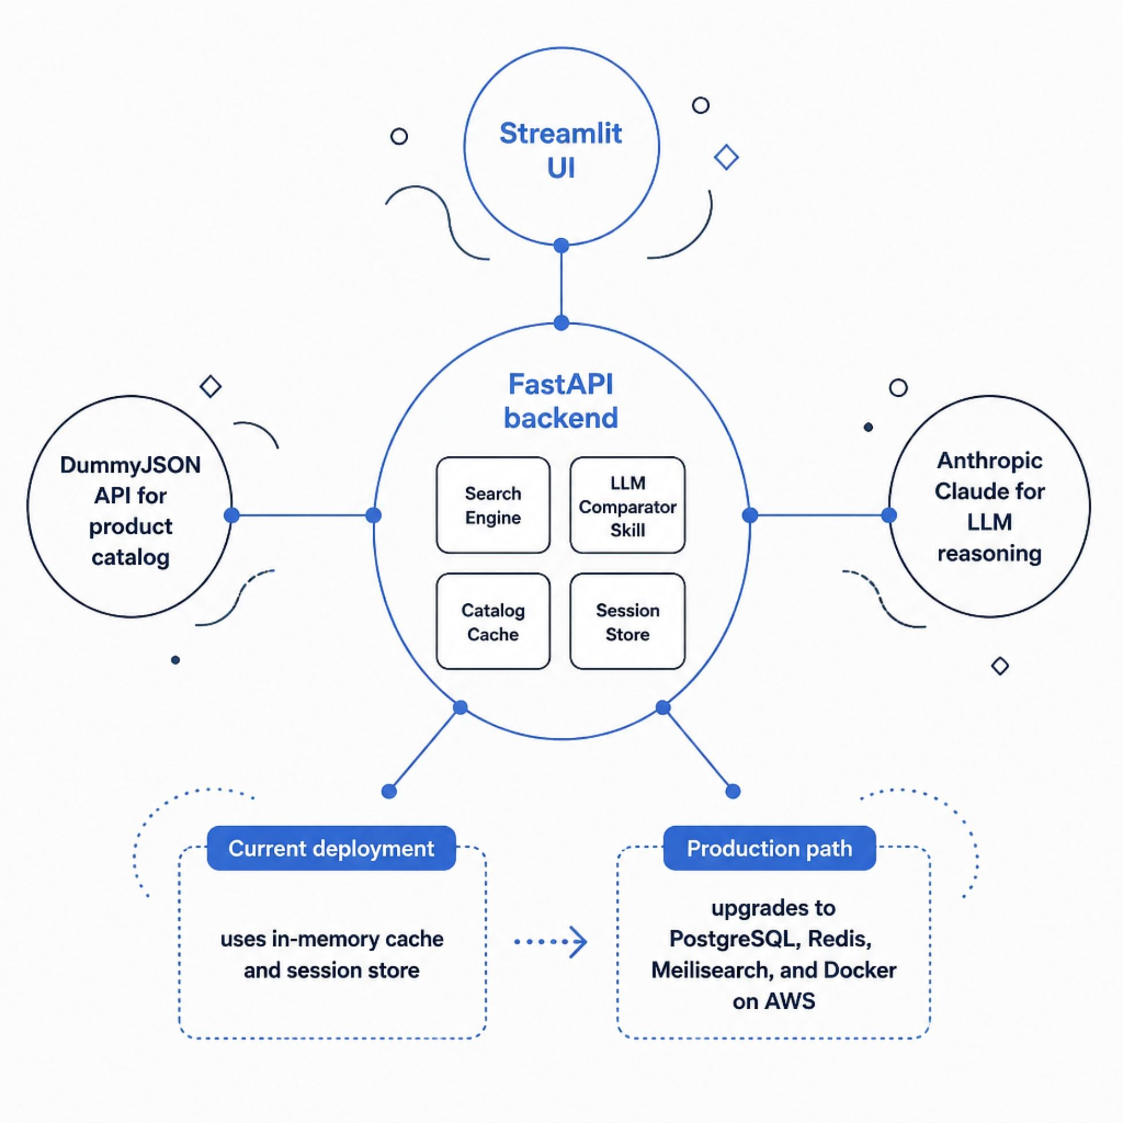
ARCHITECTURE
Technical Architecture & Scalability
Performance Targets
Search
LLM Response
<500ms p95
<5s p95
Scale Path
10 demo → 1,000+ users
Production stack: PostgreSQL · Redis · Meilisearch · Docker / AWS

Slide 6
IMPACT & ROADMAP
Business Value & What's Next
🎬 Live Demo Flow
💼 Business Value
🚀 Future Roadmap
Search → Filter → AI Recommendation → Follow-up Chat → Fallback
Faster purchase decisions
Higher recommendation trust
Potentially lower returns
Reduced support load
E-commerce / marketplace / B2B
Persistent preference profiles
Live review sentiment analysis
Price-drop alerts
Image-based product search
Real product APIs + A/B testing
Not just a product search engine — an explainable AI decision layer for shopping.

