Slide 1


Introduction to
Robotic Process Automation
Real time Football Score Tracker
Your Register No.220701030
Name: Arvindh.V
Guide Name: Mrs.J.JINU SOPHIA
Designation and Department: ASSISTANT PROFESSOR(SG)
COMPUTER SCIENCE AND ENGINEERING

Slide 2
Abstract
The Real-Time Football Score Tracker leverages Robotic Process Automation (RPA) with UiPath to automate the process of fetching, processing, and delivering live football match updates. The system scrapes match data from external sources, updates an Excel sheet with real-time scores, and sends automated email notifications to stakeholders. By integrating UiPath’s RE Framework, the solution ensures structured workflows, efficient data handling, and robust error management. The automation streamlines the tracking of live matches, reduces manual effort, and ensures accurate, timely updates for users, making it a powerful tool for football analysts, fans, and other stakeholders.

Slide 3
Need for the Proposed System
The Real-Time Football Score Tracker system addresses the need for accurate, real-time match updates, replacing time-consuming and error-prone manual tracking. By utilizing UiPath’s RPA capabilities, the system automates data scraping, Excel updates, and email notifications, ensuring real-time accuracy and reducing human error. It is scalable for handling multiple matches simultaneously, making it ideal for tournaments, and enhances user experience by providing instant updates to fans, analysts, and broadcasters.

Slide 4
Advantages of the Proposed System
Real-Time Accuracy: Ensures up-to-date football match scores, teams, and venue information without delays.
Efficiency: Automates data collection, saving time and resources while reducing manual work.
Error Reduction: Minimizes human errors, ensuring consistent and reliable match updates.
Scalability: Can handle multiple matches simultaneously, ideal for tournaments and live events.
Enhanced User Experience: Provides instant notifications, keeping users engaged and informed.

Slide 5
Main Objective
The main objective of the Real-Time Football Score Tracker project is to develop an automated system that continuously tracks and updates live football match scores. The system will extract real-time match data from reliable sources using data scraping or APIs and display the scores for multiple matches in a user-friendly interface. By automating this process, the project aims to reduce manual tracking errors, ensure timely updates, and provide users with accurate, real-time information. The system can be integrated with email notifications to alert users about score changes, enhancing the overall user experience

Slide 6
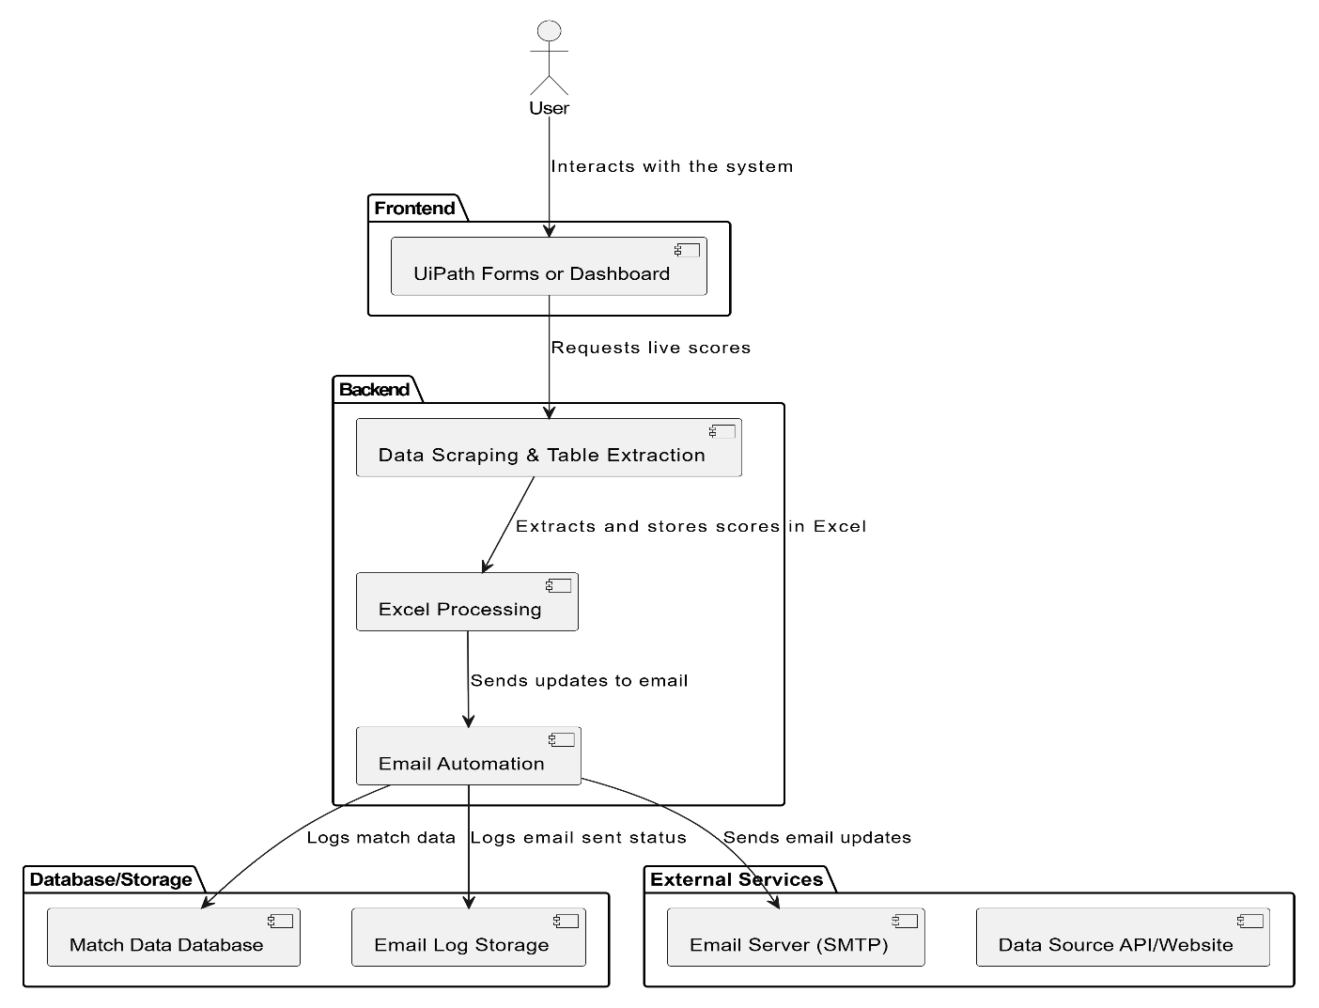
Architecture
The Architecture Diagram outlines the system's components:
Frontend: Displays real-time scores and updates (e.g., dashboard).
Backend: Handles data scraping for live scores, updates Excel, and automates email notifications.
Database/Storage: Stores historical match data, scores, and logs for analysis.
External Services: Utilizes SMTP to send real-time score updates via email.

Slide 7
System Requirements
Hardware Requirements:
Processor: Intel i5 or higher
RAM: 8 GB or more
Storage: 256 GB SSD (minimum)
Network: Stable internet connection for real-time updates and email dispatch
Display: 1366x768 resolution or higher
Software Requirements:
Operating System: Windows 10 or higher
Automation Tool: UiPath Studio (Community/Enterprise Edition)
Framework: .NET Framework 4.7.2 or higher
Email Services: SMTP server configuration (e.g., Gmail, Outlook)
Excel: Microsoft Excel (2016 or later) or equivalent tool for data processing
Browser: Chrome or Edge with UiPath extensions installed for data scraping.

Slide 8
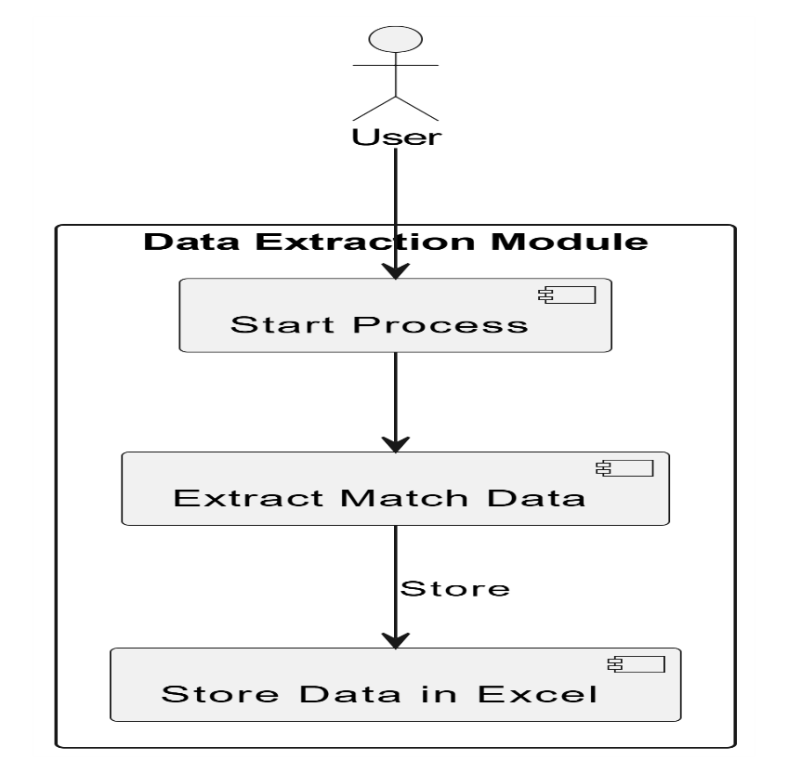
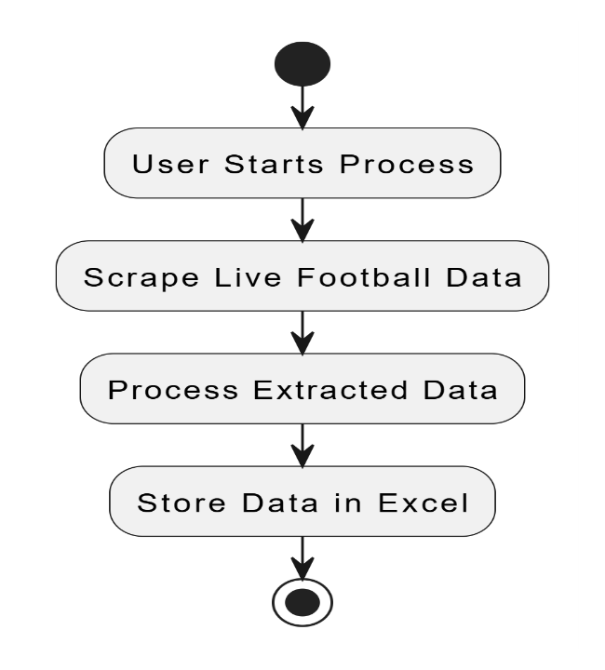
Functional Description
Module 1: Data Extraction Module
Short Description: This module scrapes live football match data, including scores, teams, and venues, and stores the processed data into an Excel sheet.

Slide 9
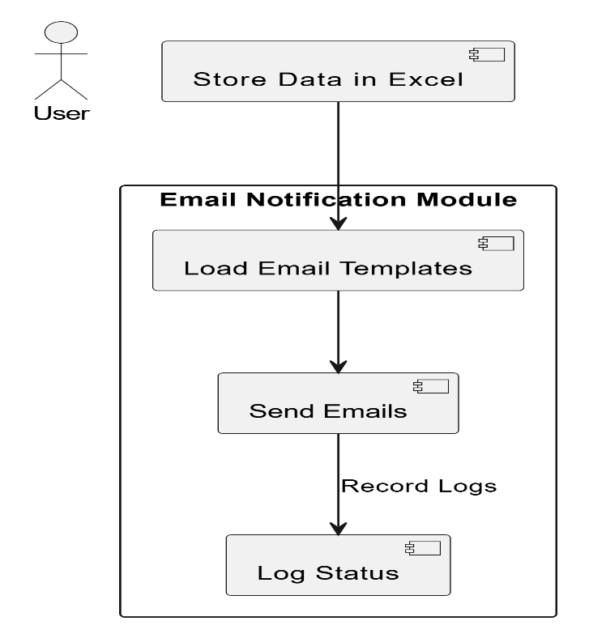
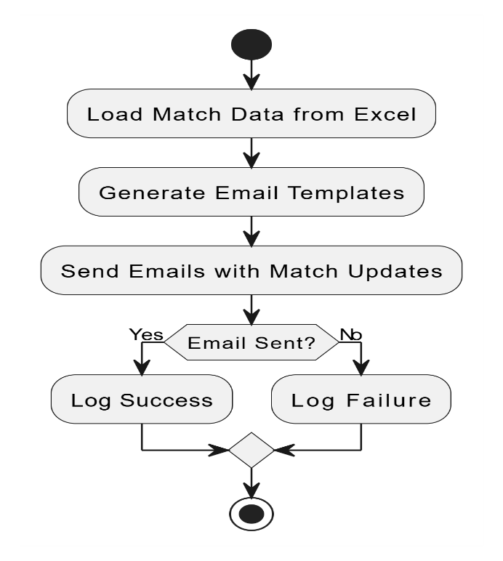
Functional Description
Module 2: Email Notification Module
Short Description: This module automates the process of sending email notifications to users, containing live match updates such as scores and venues.

Slide 10
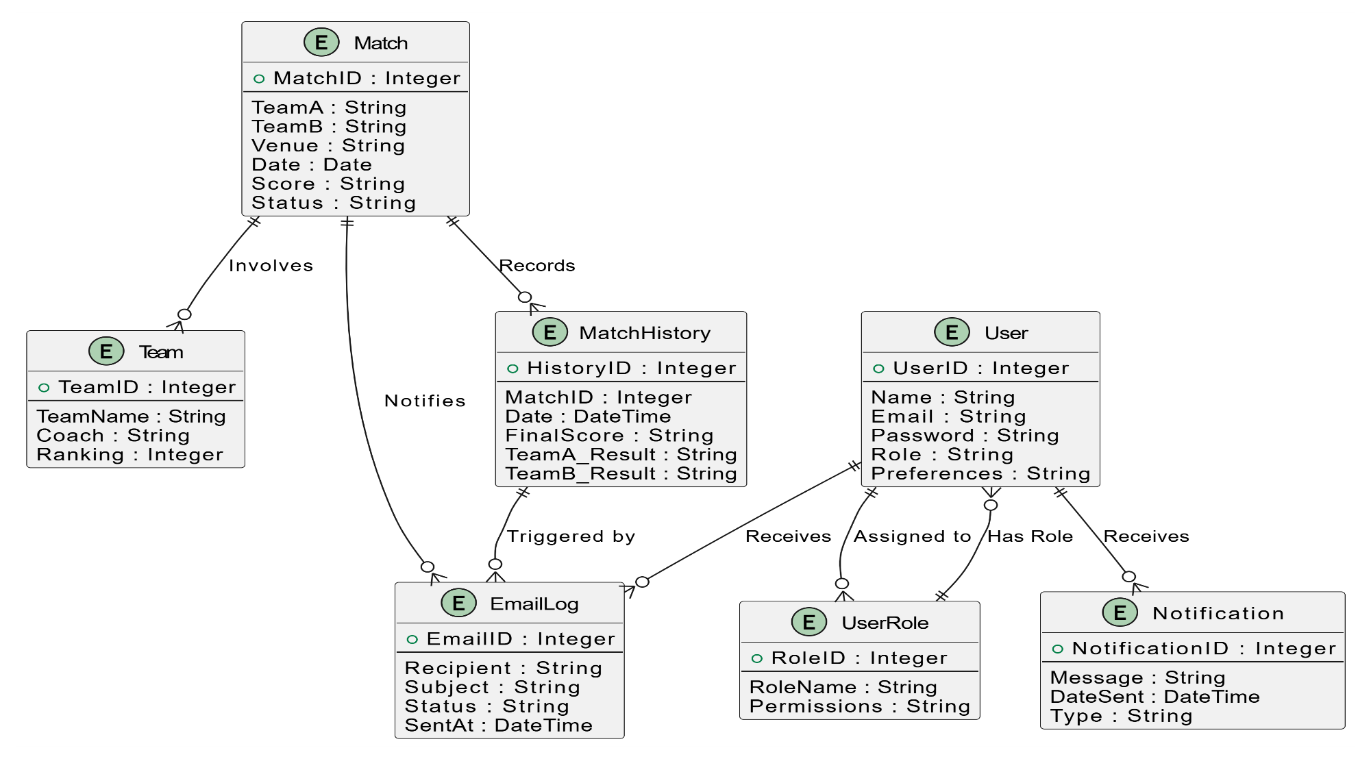
Table Design
Entity relationship diagram

Slide 11
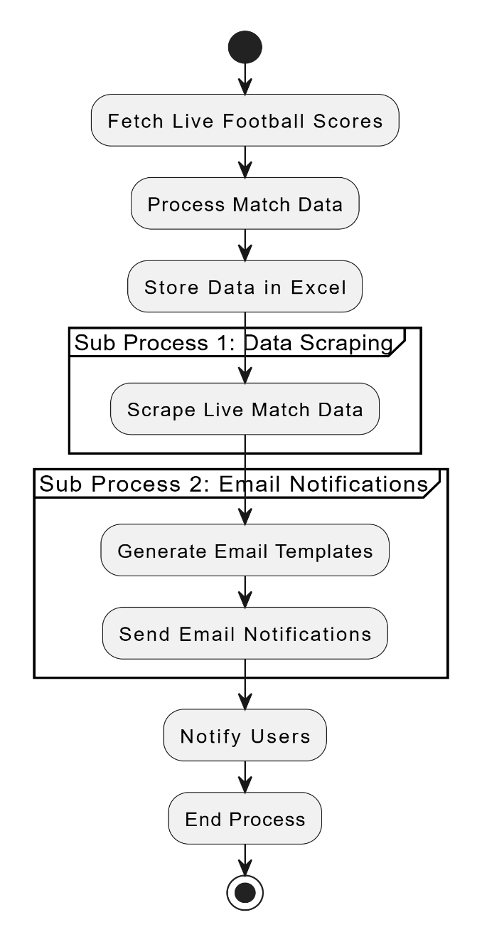
Process Design
Main Process:
Fetch live football scores.
Process match data (e.g., extracting and calculating scores).
Store the processed data in Excel.
Sub Processes:
Sub Process 1: Data Scraping: Scrapes live match data from external sources (website/API).
Sub Process 2: Email Notifications: Generates and sends email updates to users.
Flow Control:
The main process flows through these steps, with sub-processes handling specific tasks like data scraping and email notifications.
End Process:
The process ends once the email notifications are sent.

Slide 12
Implementation
Implementation of Module 1: Data Extraction
Module 1 focuses on scraping live football match data from an external source (e.g., a website or API). The module extracts important match details such as team names, scores, and venue information. This data is processed and stored in Excel for further use
Implementation of Module 2: Email Notification
Module 2 handles email notifications to users, informing them about live football match updates. After processing the data in Module 1, the system generates personalized emails and sends them to users, ensuring they are updated on real-time match scores.

Slide 13
Testing
Testing is a crucial part of the Real-Time Football Score Tracker project, ensuring that each module functions as intended and delivers accurate results.
Data Scraping: Test if live match data is correctly fetched from the source.
Data Processing: Ensure the data is processed and stored accurately in Excel.
Email Notification: Verify emails are generated and sent with correct match updates.
Integration Testing: Ensure seamless data flow between scraping and email notification.
Performance Testing: Check system performance with multiple real-time match updates.

Slide 14
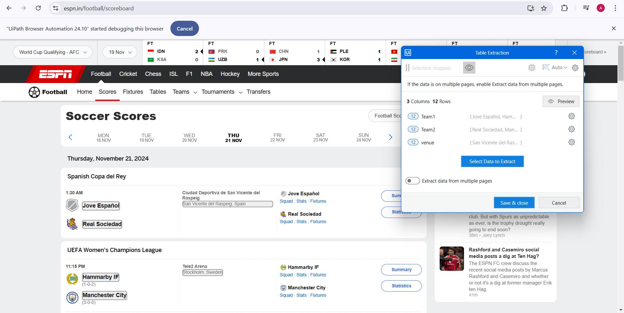
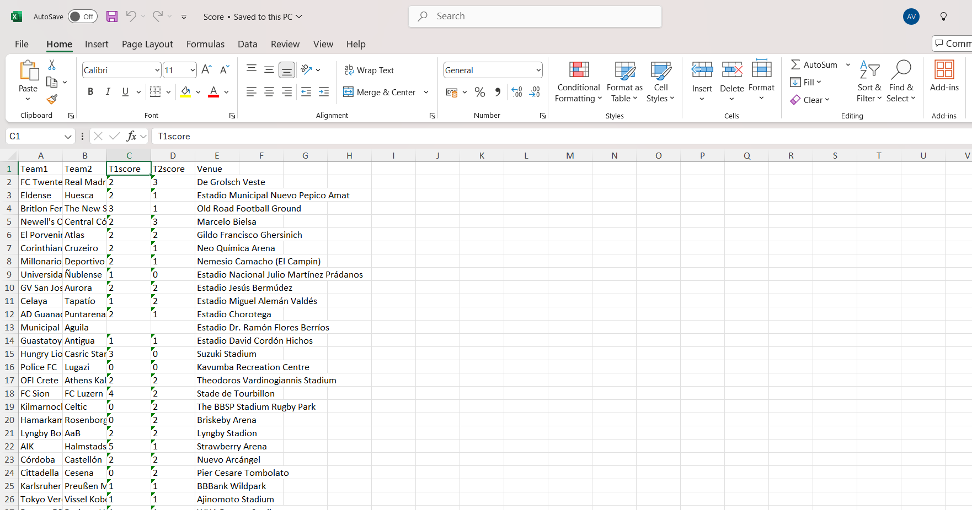
Screenshots

Slide 15
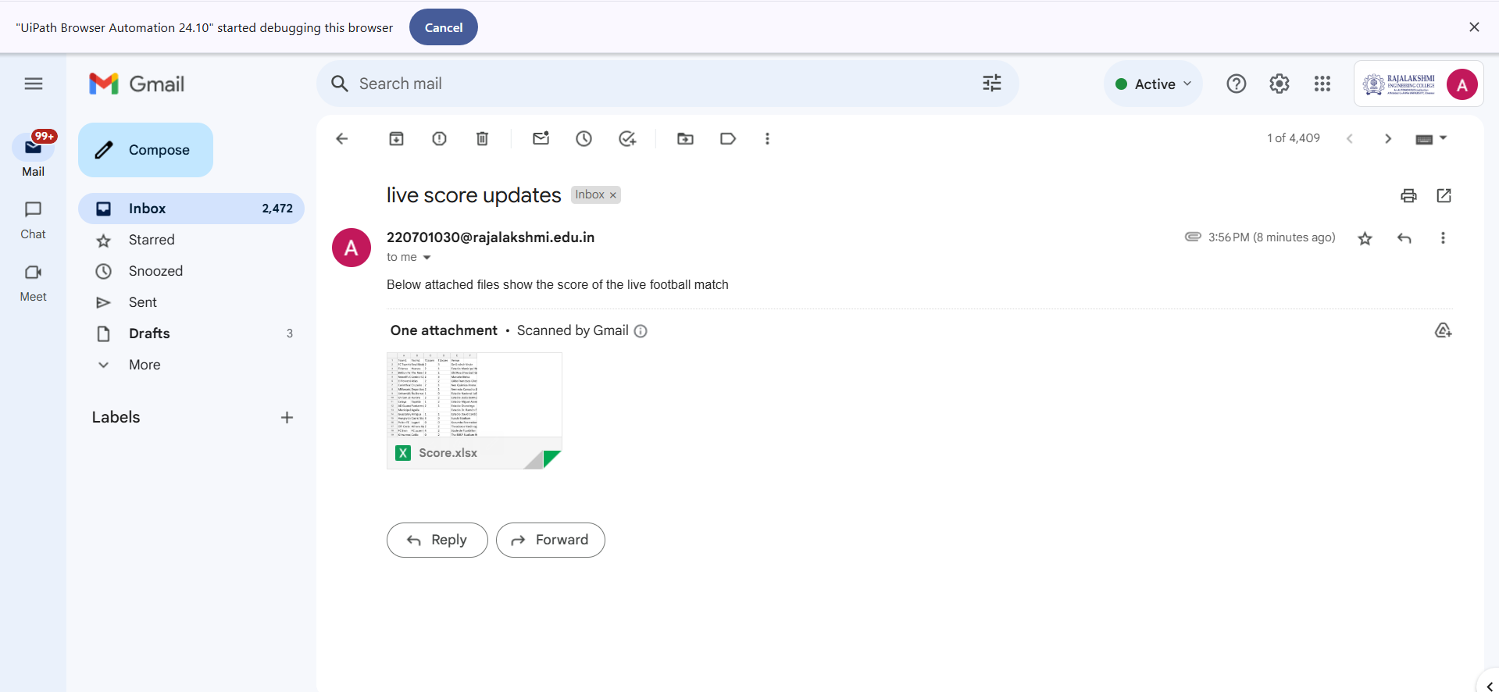
Screenshots

Slide 16
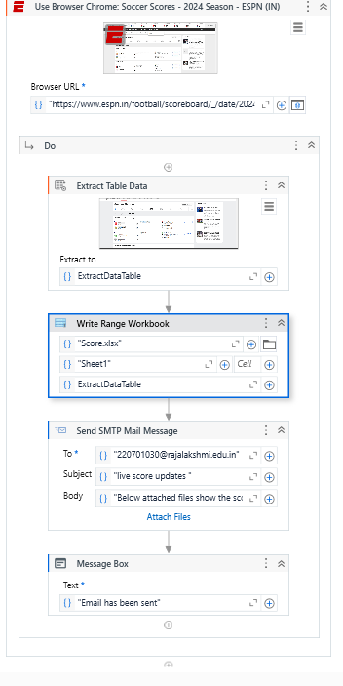
Workflow screenshot

Slide 17
Conclusions
The Real-Time Football Score Tracker automates the retrieval, processing, and notification of live football scores, improving efficiency and accuracy. Using UiPath's RPA, it reduces manual effort, minimizes errors, and provides real-time updates to users, ensuring a reliable and scalable solution for tracking scores. This system enhances user experience by delivering timely, accurate match information to stakeholders.

Slide 18
Future Enhancement
Trigger Integration: Implement triggers to automatically fetch match data and send notifications based on specific events, such as score changes or match start/end times, without manual initiation.
Advanced Analytics: Incorporate advanced analytics to track match statistics, team performance, and user engagement, providing deeper insights and personalized notifications to users.

Slide 19
References
Lacity, M. C., & Willcocks, L. P. (2016). A Survey on Robotic Process Automation in Business. Journal of Information Technology, 31(2), 174-183.
Goudar, R. H., & Soni, M. P. (2017). AutomationAvasarala, V. (2019). Robotic Process Automation: The Next Transformation in Digital Transformation. International Journal of Advanced Research in Computer Science, 10(3), 5-12.
and Monitoring in Cloud Computing Systems. Journal of Cloud Computing: Advances, Systems, and Applications, 6(1), 23-36.
Gupta, S., & Sharma, A. (2018). A Comprehensive Study on RPA and its Application in Business Automation. International Journal of Computer Applications, 181(9), 1-6.
Kumar, S., & Kaur, A. (2020). Real-Time Data Scraping and Processing using Robotic Process Automation. International Journal of Innovative Technology and Exploring Engineering, 9(3), 10-14.

Slide 20
Queries

Slide 21
Demonstration

Slide 22
Thank You

