Slide 1




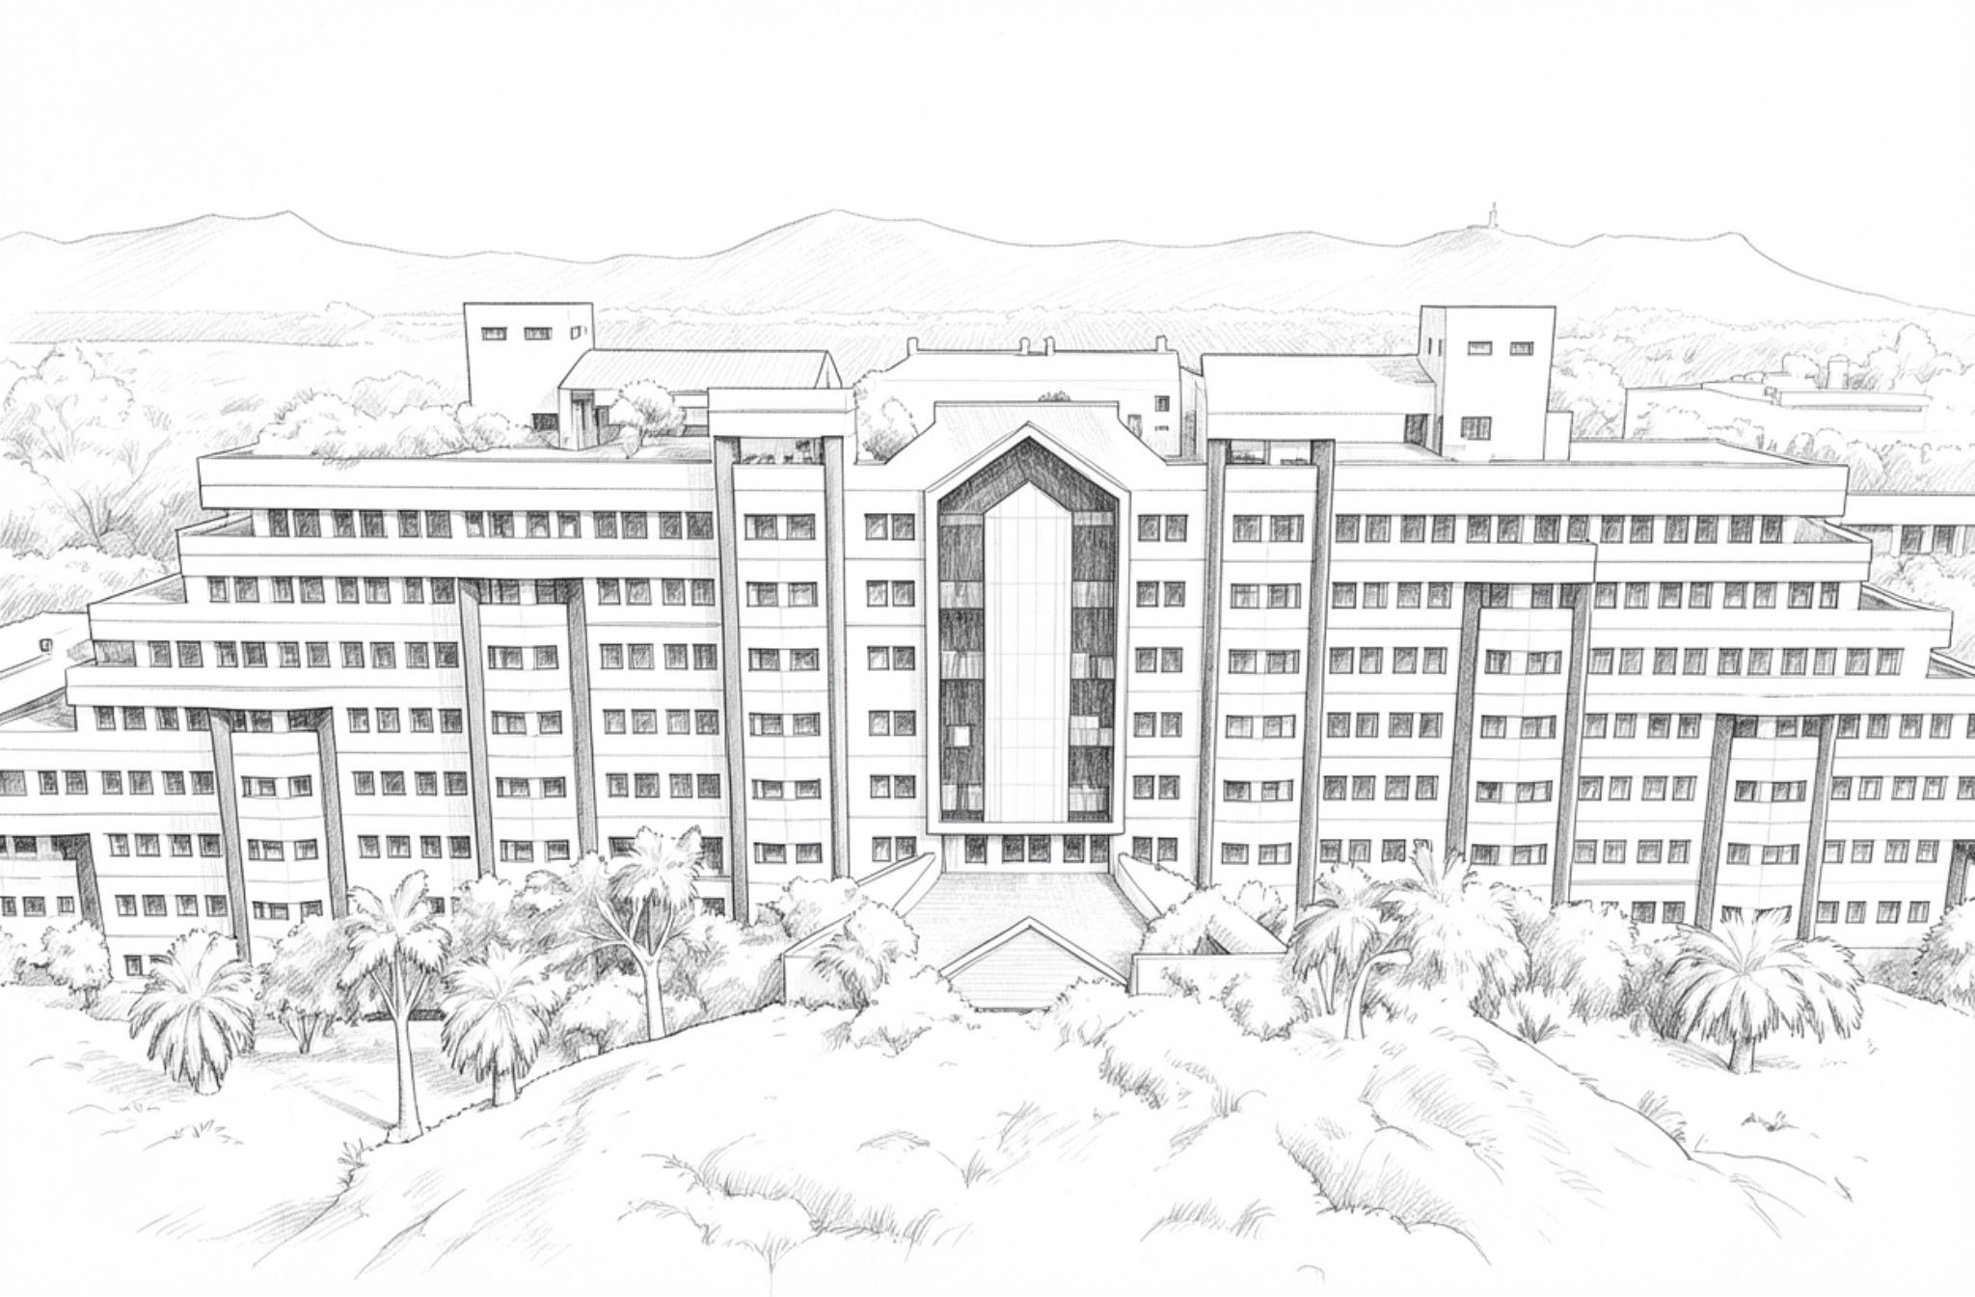
INNOHACK 2.0
KHOJ
A leaderless rescue swarm that finds people it cannot see.
“Other swarms search together. KHOJ finds the invisible.”
0.0% mesh packet loss
Measured across five ESP32 boards on real hardware.
< 2 s to detect a dead drone
Every surviving board concludes it independently — no leader.
TRACK
[YOUR TRACK NAME]
PROBLEM STATEMENT
DIOT-01 — Autonomous Drone Swarm for Search and Rescue Operations
Aligned SDGs 9 · 11 · 16
TEAM [TEAM NAME]
[MEMBER 1 — REG NO.] · [MEMBER 2 — REG NO.] [MEMBER 3 — REG NO.] · [MEMBER 4 — REG NO.]
4-5 / 5 survivors found in simulation
A camera-only baseline manages 3-4, and never the hidden one.
Notes:
One line: a leaderless drone swarm that finds victims cameras cannot see, by cooperatively locating their phone's radio signal.

Slide 2
INNOHACK 2.0
PROBLEM STATEMENT
When a building collapses, the victims who most need finding are exactly the ones nobody can see — buried under slab, trapped in voids, unconscious and silent.
Search-and-rescue drones today are camera-based. If the camera cannot see you, the drone cannot find you.
Why it matters
▪ The golden 72 hours — survival falls steeply with every hour under rubble. Speed is the whole outcome.
▪ Disaster zones have no infrastructure by definition: no network, no guaranteed GPS, no reliable power.
▪ A false positive costs a rescue team three minutes. A false negative costs a life. No current system treats those differently.
01 Blind to the buried
Aerial cameras find only visible victims. Occluded and half-buried survivors are invisible to the entire fleet.
02 Fragile coordination
One ground station computes every trajectory and needs RTK-GPS plus a live uplink — the first things a disaster destroys.
03 The threshold trap
Lower the detector threshold and responders drown in false alarms. Keep it high and half-buried people are discarded as noise.
Notes:
Three failures. The third is the one nobody talks about: detection thresholds force a choice between missing victims and flooding responders.

Slide 3
INNOHACK 2.0
PROPOSED SOLUTION
A leaderless drone swarm that finds people cameras cannot see — by cooperatively locating a trapped victim’s phone from its radio signal.
1. Cooperative RF localization — the hero
Several drones share signal-strength readings over their own mesh and climb the gradient to a phone none of them can see. One reading is meaningless; four readings from four positions point at a person.
2. The re-observation loop — the spine
A 0.41-confidence sighting is too strong to ignore and too weak to trust. The swarm turns that doubt into an auctioned task: another drone flies a different angle, and the two independent looks are fused into a confirm or a dismissal.
WHAT MAKES IT INNOVATIVE
The swarm bids in information gain, not area.
Searching empty ground, re-checking an uncertain sighting, and triangulating an invisible phone all collapse into the same question:
“Where will my next move most reduce what the swarm does not yet know?”
That is why this is one system and not three features — and it answers the hardest question a judge can ask:
“Why is this a swarm and not five drones with a shared to-do list?”
Because a to-do list divides work. KHOJ divides doubt.
Notes:
Lead with the hero. The judge decides whether they care in 30 seconds: a hidden phone found by drones that cannot see it.

Slide 4
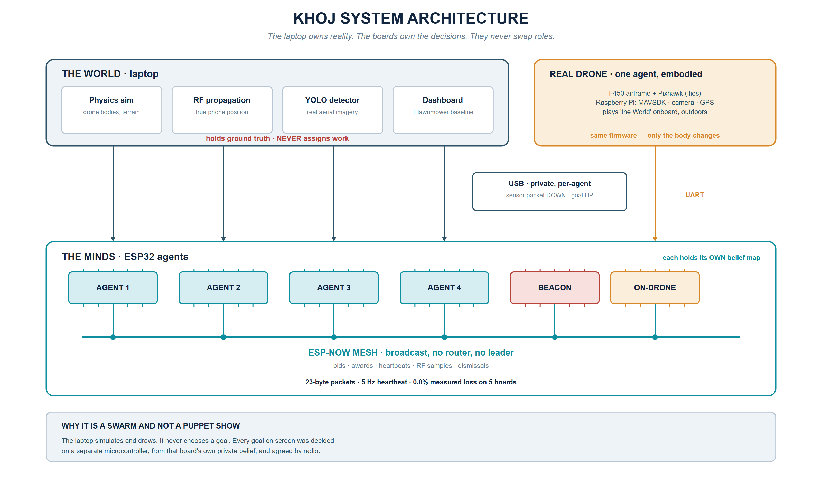
INNOHACK 2.0
SYSTEM ARCHITECTURE
Five ESP32s, one laptop, and two links that never mix — with a real F450 dropping in as one more agent.
Notes:
The laptop simulates and draws but never chooses a goal. Every goal on screen was decided on a separate microcontroller and agreed by radio.

Slide 5
INNOHACK 2.0
SOFTWARE STACK · THE ALGORITHMS
Runs on the laptop. Holds ground truth, simulates the world, and provides the reference implementation of every decision rule.
Built and unit-tested
▪ Belief map — 32×32 survivor-probability grid per agent, drained multiplicatively over searched ground
▪ Unified auction — one bid function across all four task types
▪ Log-odds fusion — Bayesian confirm / dismiss on fused confidence
▪ Hive-Mind — broadcast dismissals so no drone repeats a ruled-out lead
▪ World simulator — physics, RF path-loss, low-threshold detector
▪ Lawnmower baseline + metrics harness
▪ YOLO perception on real aerial imagery, dashboard
Remaining: integration — binding the modules into one live loop and onto the serial contract.
Python 3 stdlib only, zero dependencies
The core runs headless on any machine — no install step to fail on demo day.
4-5 / 5 survivors confirmed in simulation
Against an identical world, the camera-only baseline manages 3-4.
Reference for the firmware port
The same auction is being ported to C so the boards and the simulator provably agree.
Notes:
Software is feature-complete at module level; integration is the remaining work. Be precise about that distinction.

Slide 6
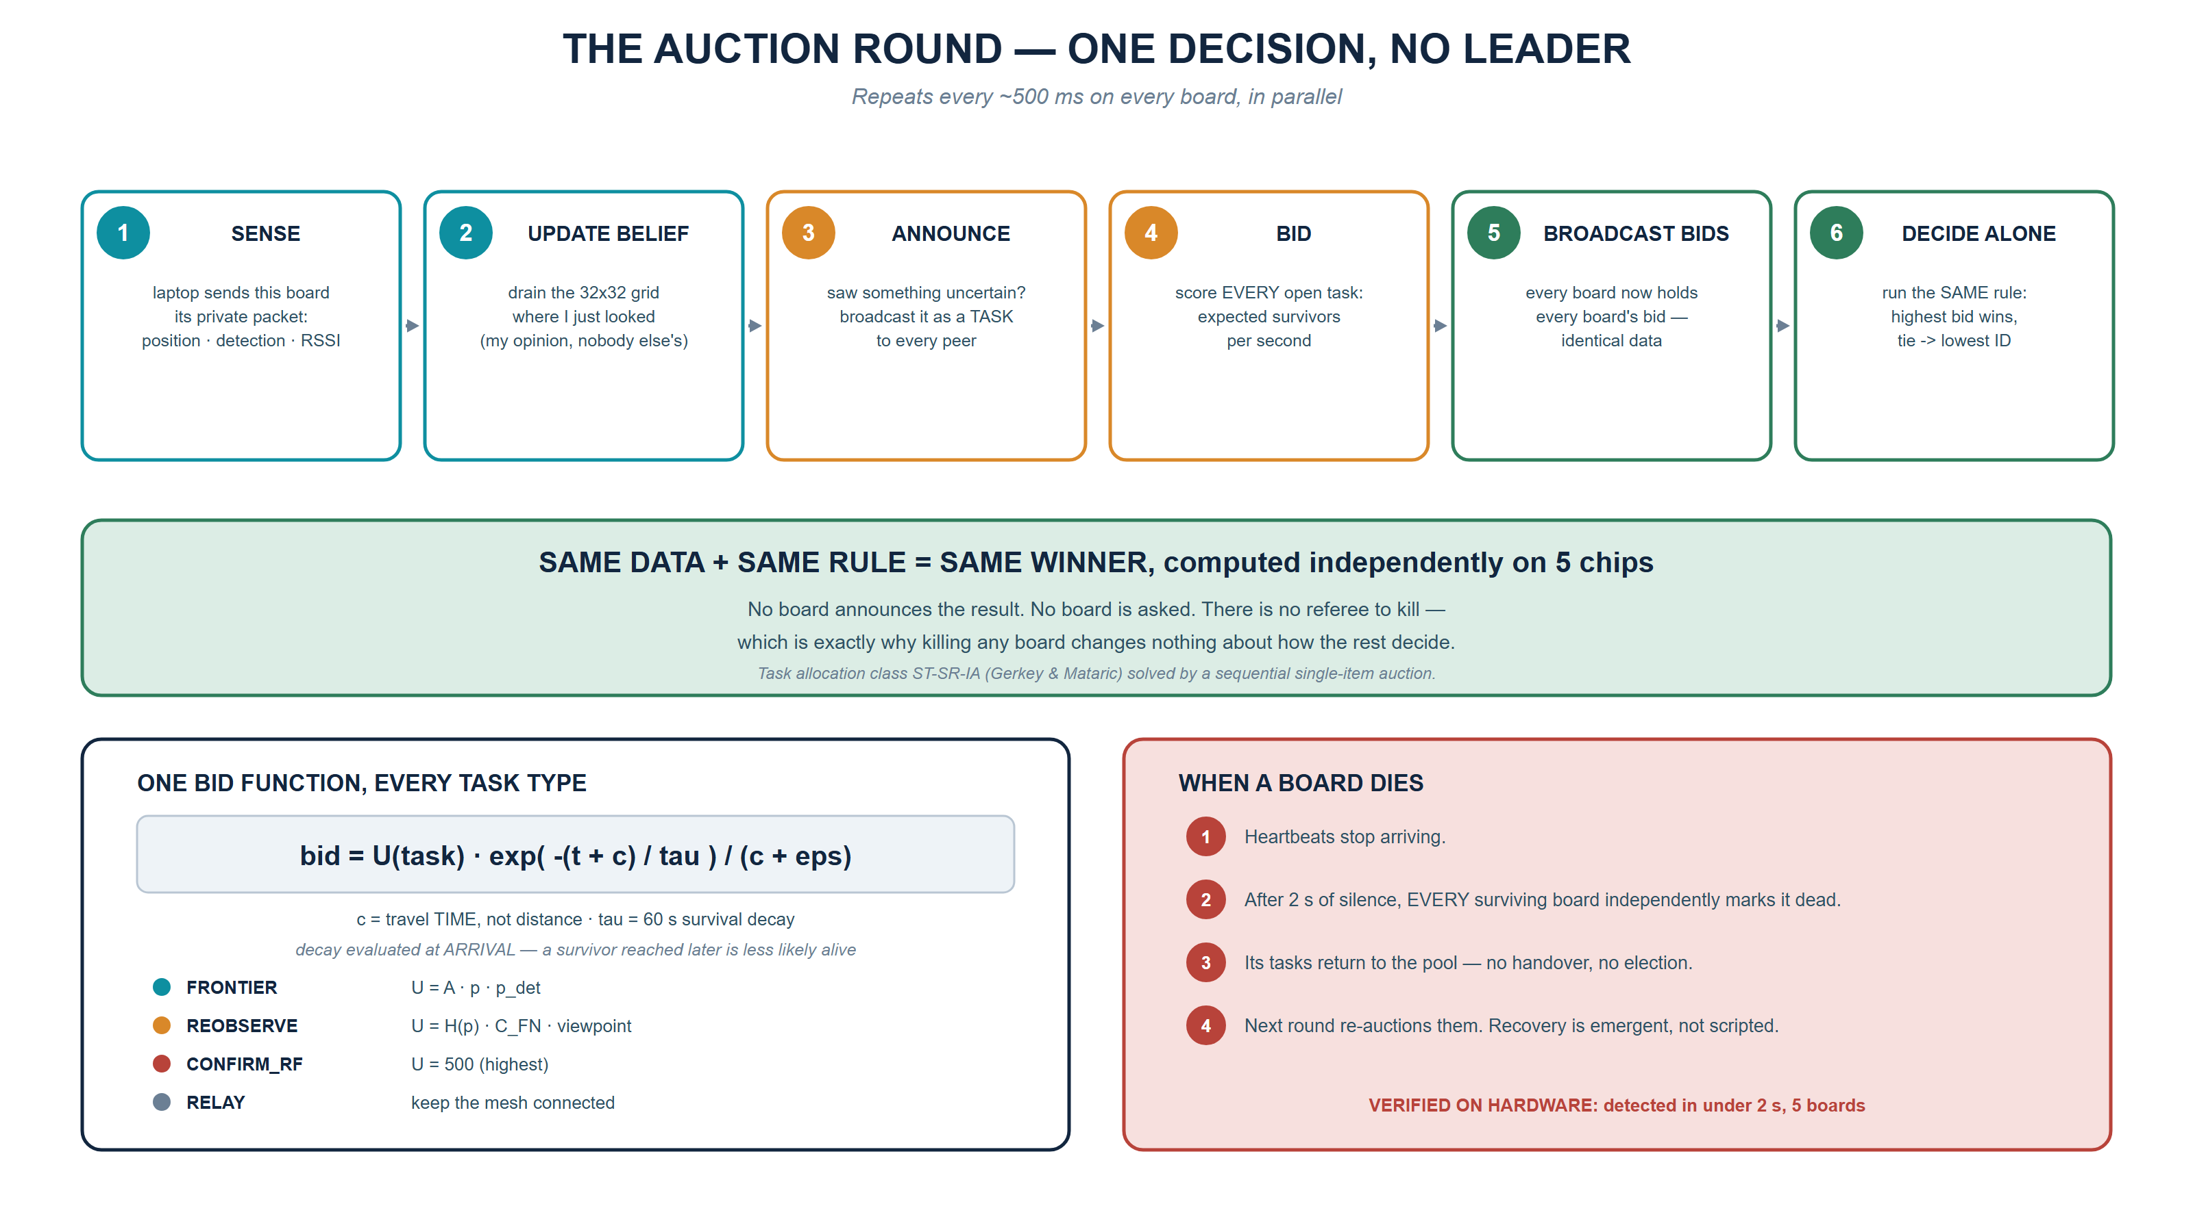
INNOHACK 2.0
THE AUCTION · LEADERLESS CONSENSUS
Every board runs the same rule on the same data — so all five reach the same winner with no referee.
Notes:
Same data plus same rule equals same winner, computed independently on every chip. There is no referee to kill.

Slide 7
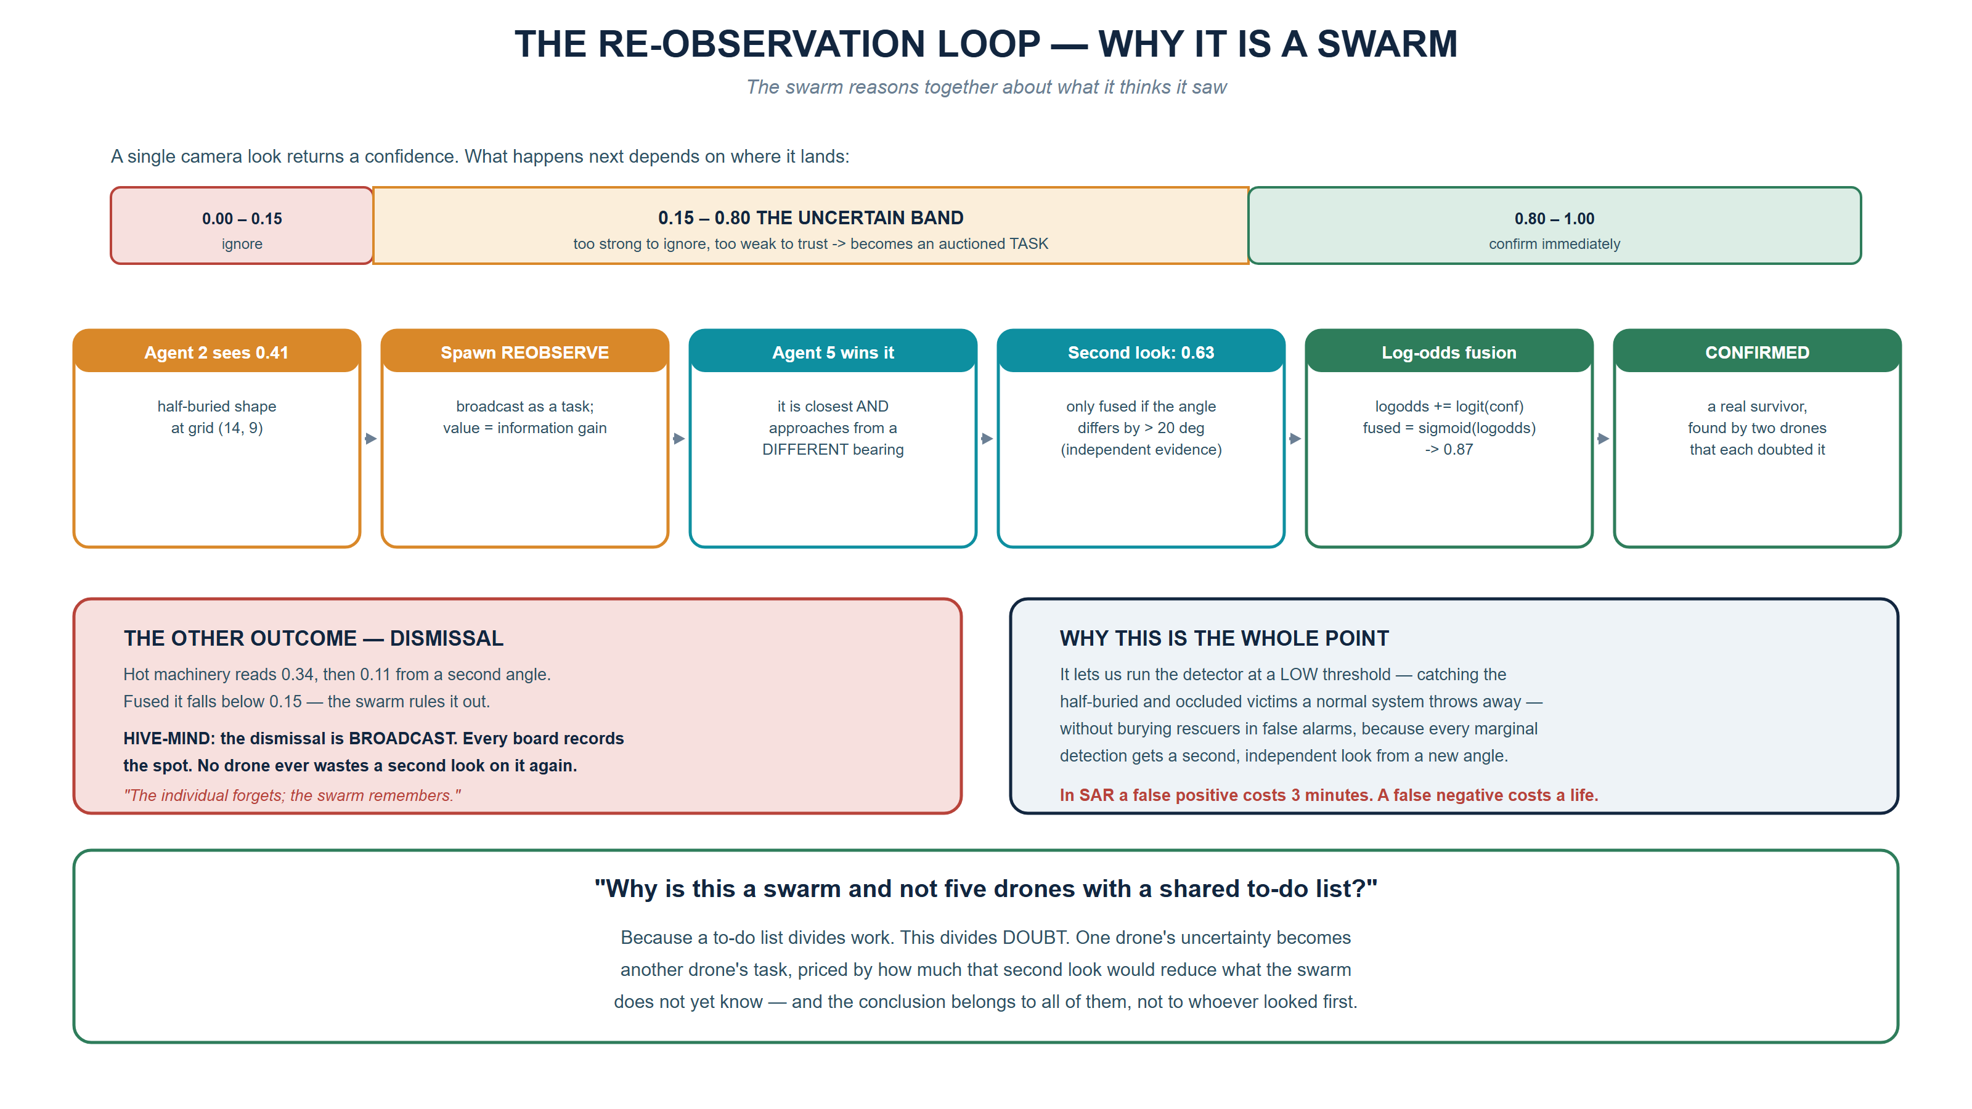
INNOHACK 2.0
RE-OBSERVATION · WHY IT IS A SWARM
Run the detector at a low threshold to catch half-buried victims — then cancel the false alarms with a second look.
Notes:
This is the intellectual spine. It lets us run the detector at a low threshold without flooding responders with false alarms.

Slide 8
INNOHACK 2.0
HARDWARE STACK · THE DECENTRALIZED MESH
Runs on the boards. Five ESP32s negotiating peer-to-peer over their own radio, with no router, no pairing and no leader.
Working on real hardware
▪ ESP-NOW broadcast mesh — 23-byte packets at 5 Hz, all five boards
▪ Live peer table — every board independently tracks who is alive
▪ Failure detection — silence for 2 s and the peer is dropped everywhere
▪ Per-agent RSSI capture straight from the receive callback
▪ Byte-verified USB contract, proven both directions
▪ MAC-derived identity — one binary flashes to every board
Remaining: port the auction on-device, then share RF samples across the mesh.
0.0% measured packet loss
Across five boards on the bench — computed from gaps in each sender’s sequence numbers, not estimated.
< 2 s to detect a dead drone
Every surviving board reaches that conclusion independently. Recovery is emergent, not scripted.
-23 to -72 dBm live signal range
Per-agent RSSI working on hardware — the measurement the entire RF hero demo depends on.
Notes:
These are measured numbers from our own bench, not datasheet figures. Loss is computed from sequence-number gaps.

Slide 9
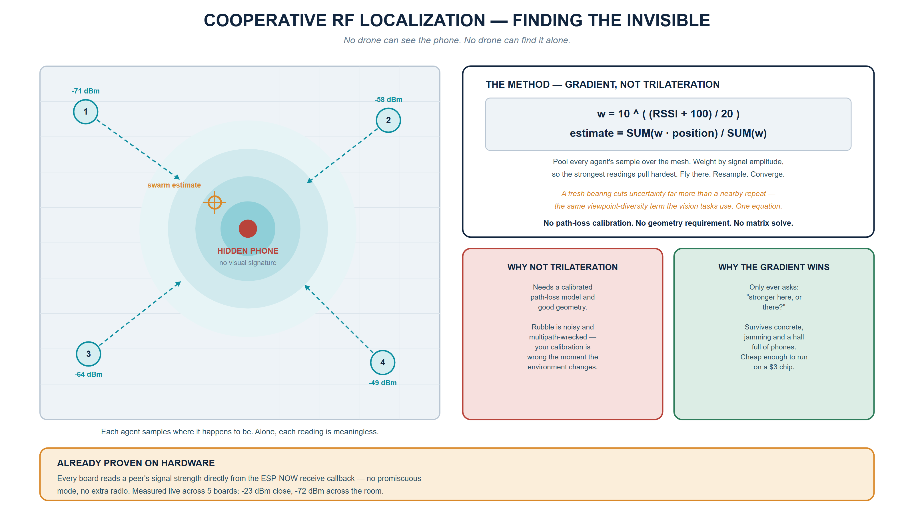
INNOHACK 2.0
COOPERATIVE RF LOCALIZATION · THE HERO
Gradient-seeking, not trilateration — it never needs calibration, only “stronger here, or there?”
Notes:
Gradient-seeking, not trilateration. It never needs absolute distance — only 'stronger here or there', which is what survives rubble.

Slide 10
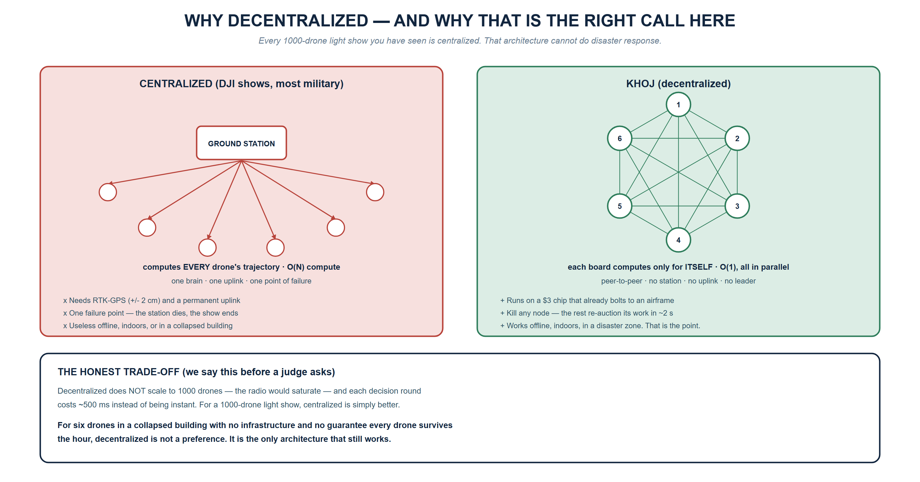
INNOHACK 2.0
WHY DECENTRALIZED
O(1) per drone instead of O(N) on a ground station — which is exactly why a $3 chip is enough.
Notes:
State the trade-off before the judge finds it: this does not scale to 1000 drones. For six drones with no infrastructure it is the only thing that works.

Slide 11
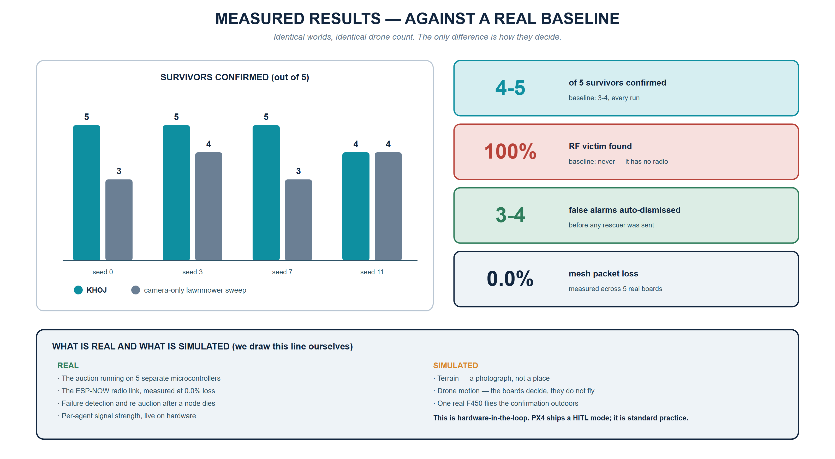
INNOHACK 2.0
DEMO · PROTOTYPE · RESULTS
Verified across four random worlds — plus the one victim a camera-only sweep can never find.
Notes:
Demo beats: self-organise, re-observation confirm, Hive-Mind dismissal, yank a drone's power, then the hidden phone. Never cut the power-yank.

Slide 12
INNOHACK 2.0
IMPACT & USE CASES
Who benefits
▪ Trapped survivors — specifically the ones every camera-based system is guaranteed to miss
▪ First responders — arrive with a ranked map of where people probably are, with false alarms already filtered
▪ Disaster authorities — a capability needing no network, no GPS base station, no central computer
Real-world scenarios
▪ Earthquake and building collapse — locates phones inside voids no camera can see
▪ Landslide and flood rescue — works with no cellular network at all
▪ Missing person in open terrain — climbs to an emitting device across featureless area
▪ Comms blackout — drones reposition as relays, becoming temporary disaster infrastructure (SDG 9)
$3 the decision-maker
A centralized equivalent needs a ground station computing O(N) trajectories. KHOJ is O(1) per drone, in parallel.
Zero infrastructure required
No RTK-GPS, no uplink, no internet. It runs in the conditions disasters actually create.
Graceful degradation, not failure
Any drone can die at any moment and the mission continues. Adding a drone means flashing one more board.
Notes:
The cost argument lands hard with judges: the intelligence is a $3 chip, not a datacentre.

Slide 13
INNOHACK 2.0
CHALLENGES FACED
1. The radio could not measure signal strength
The entire RF concept needs each drone reading a peer’s signal strength. The standard toolchain ships a core whose receive callback returns sender and payload — but no signal strength at all. A dedicated sniffer board could not fix it: the gradient needs each drone sampling at its own position.
Solved — migrated to a newer Arduino-ESP32 core, pinned it in the build, and made the firmware print rx_rssi=YES/NO at boot so it can never regress silently. Caught in hour 1, not hour 30.
2. Five boards, a working radio, and total silence
Every board transmitted and none received. Two compounding bugs: the WiFi driver returned an all-zero MAC when read too early, and our identity scheme derived board IDs from that MAC — so every board took the same ID and discarded the others’ packets as its own echo.
Solved — read the MAC from eFuse instead of the driver, and deleted the self-filter entirely, since a broadcast is never echoed to its sender.
3. Silent flashing failures
With five identical boards, flashing by hand meant believing all five were updated when only three were — discovered only through a confusing peer list.
Solved — an automated flash script that finds every connected board and prints a pass/fail table, so a missed board is impossible to overlook.
4. A result we chose not to hide
Our system finds more survivors than the baseline, but is not yet faster to the first one — the lawnmower sweep beelines while KHOJ self-organises. We could have quietly dropped the metric.
Instead we report it, and we know the fix: seeding the belief map with a prior. We would rather present a real limitation than a chart a judge can take apart.
Notes:
Challenge 1 is the strongest story: we found a silent architectural blocker in hour one because we verified instead of assuming.

Slide 14
INNOHACK 2.0
FUTURE SCOPE
Near-term
▪ Port the auction fully on-device so decisions never touch a laptop
▪ Belief-map priors — closes the time-to-first-survivor gap
▪ RELAY task type — drones bidding to become comms relays
▪ Rescue-route generation so responders can reach the survivor, not just locate them
Medium-term
▪ Full F450 fleet with onboard compute and real GPS
▪ Real phone detection via dedicated sniffers instead of a planted beacon
▪ Multi-hop routing to extend coverage beyond single-radio range
▪ Hash-chained evidence log — tamper-evident record of what was found, when, and by which drone (SDG 16)
LONG-TERM VISION
A disposable, infrastructure-free rescue layer.
A crate of low-cost drones that any municipal fire service can carry to a collapse site, throw into the air, and have self-organise into a search team within seconds — no operator assigning targets, no ground station, no network.
The intelligence lives in the fleet, not in a building that may itself have fallen down.
Notes:
Close the future slide on the vision line — it is the most quotable sentence in the deck.

Slide 15
INNOHACK 2.0
INNOHACK 2.0
CONCLUSION
What we built
▪ A five-board decentralized mesh with 0.0% measured packet loss and sub-2-second failure detection
▪ A unified auction where routine search, uncertain-sighting re-checks and invisible-victim localization are the same decision
▪ A complete simulation that beats a camera-only baseline on survivors found — and finds the RF-only victim every single run, which the baseline can never do
Why it matters
Every drone swarm you have seen is centrally controlled — a ground station computing every trajectory, needing GPS and a live uplink. That architecture is excellent for a light show and useless in a collapsed building.
KHOJ is built for the conditions disasters actually create: no network, no infrastructure, and no guarantee that every drone survives the hour.
THE NOVELTY
The swarm bids in information gain, not area.
Cooperative RF localization is the proof of it: several drones share what each one alone cannot interpret, and together point at a person nobody can see.
“Other swarms search together. KHOJ finds the invisible.”
Notes:
End on the tagline. Say it slowly and stop talking.

Slide 16
INNOHACK 2.0
ACKNOWLEDGEMENTS
Team [TEAM NAME]
▪ [MEMBER 1 — REG NO.] — Decentralized stack: ESP-NOW mesh, on-device auction, RF localization
▪ [MEMBER 2 — REG NO.] — [ROLE]
▪ [MEMBER 3 — REG NO.] — [ROLE]
▪ [MEMBER 4 — REG NO.] — [ROLE]
Mentors
▪ [MENTOR NAME(S) AND DEPARTMENT]
Tools
PlatformIO · Arduino-ESP32 · Python 3 · MAVSDK-Python · YOLO
References
▪ Gerkey, B. & Matarić, M. (2004). A Formal Analysis and Taxonomy of Task Allocation in Multi-Robot Systems. Int. Journal of Robotics Research.
▪ Lagoudakis, M. et al. (2005). Auction-Based Multi-Robot Routing. Robotics: Science and Systems.
▪ Espressif Systems. ESP-NOW Protocol Specification, ESP-IDF Programming Guide.
▪ Stone, L. D. Theory of Optimal Search — Bayesian search theory, as applied in the recovery of USS Scorpion and Air France 447.
▪ PX4 Autopilot. Hardware-in-the-Loop Simulation Documentation.
Notes:
Thank the mentors by name.

