Slide 1

ANALYSIS OF RAINFALL VARIABILITY
Rainfall Variability in Bangladesh
A 47-Year Historical Study of Rainfall Patterns Across Nine Weather Stations (1970–2016)
Arwa Alzakri
Data Science Immersive Program | General Assembly Bahrain

Slide 2




Agenda
Dataset Overview
Scope, structure, and completeness of the rainfall records
Problem Statement & Objectives
Why rainfall variability matters, and what we set out to answer
Analysis & Findings
Five data-driven objectives across stations, months, and decades
Summary & Recommendations
Key insights and practical next steps
Rainfall Variability in Bangladesh (1970–2016)
2

Slide 3

Dataset Overview
Daily rainfall records collected by the Bangladesh Meteorological Department
35
47
542,376
1970–2016
Weather Stations
Years of Records
Daily Observations
Study Period
Each record includes: Station Index, Station Name, Year, Month, Day, and Rainfall (mm)
Rainfall Variability in Bangladesh (1970–2016)
3

Slide 4
Data Completeness by Station
Only 9 of the 35 stations have a complete 47-year record (1970–2016)
The analysis focuses on these nine for consistency.
Rainfall Variability in Bangladesh (1970–2016)
4
Highlighted in orange: the nine stations with the full 47-year record used in this analysis

Slide 5
1. Tangail (1983)
2. Madaripur (1976)
3. Syedpur (1972)
4. Chuadanga (1974)
5. Mongla (1977)
6. Khepupara (1975)
7. Patuakhali (1975)
8. Teknaf (1977)
9. Feni (1973)
10. Kutubdia (1977)
11. Sitakunda (1977)
Why Some Stations Have Incomplete Records:
For most excluded ,the missing years align closely with their official establishment date meaning no data existed before the station was built.

Slide 6

Why Rainfall Variability Matters
Rainfall is crucial for Bangladesh's economy and agricultural sector. Data was collected from 1970 to 2016 across weather stations by the Bangladesh Meteorological Department and analyzed using Python.
PROBLEM STATEMENT
Rainfall variability across Bangladesh's weather stations does not follow one clear trend between 1970 and 2016. While some stations show increased variability, especially in recent years, others have become more stable. Creating an uneven pattern that complicates agricultural planning and flood risk management.
Rainfall Variability in Bangladesh (1970–2016)
5

Slide 7
Research Objectives
1
What are the top regions with the highest average rainfall (1970–2016)?
2
Which months offer the highest average rainfall with the lowest variability — best suited for planting?
3
How does rainfall variability (CV) change across decades, station by station?
4
Which season records the most months of extreme rainfall — indicating flood risk?
5
Is there a correlation between rainfall amount and rainfall variability?
Rainfall Variability in Bangladesh (1970–2016)
6

Slide 8
Objective 1
Average Rainfall by Station
HIGHEST RAINFALL
CoxsBazar, Rangamati,
and Bhola
LOWEST RAINFALL
Ishurdi, Satkhira,
and Bogra
Rainfall Variability in Bangladesh (1970–2016)
7

Slide 9
Objective 2
Best Months for Planting
Average rainfall and Coefficient of Variation, by month (1970–2016)
Average Rainfall (mm)
Coefficient of Variation (%)
Rainfall Variability in Bangladesh (1970–2016)
8

Slide 10
Objective 2 — Conclusion
July is the Most Reliable
Planting Month
523 mm
59%
Jun–Sep
Highest average
monthly rainfall
Relatively low
variability (CV)
The Monsoon window:
high & stable rainfall
July combines the highest average rainfall of any month with one of the lowest coefficients of variation making it the most dependable month for planting decisions.
Rainfall Variability in Bangladesh (1970–2016)
9

Slide 11
Objective 3
Rainfall Variability Across Decades
Coefficient of Variation (%) by station, 1970–2016
Rainfall Variability in Bangladesh (1970–2016)
10

Slide 12
Objective 4
Flood Risk by Season
Share of months exceeding the extreme-rainfall threshold (Mean + 2×SD), 1970–2016
93%
of all extreme-rainfall months (1970–2016) occurred during the Monsoon season (June–September).
Winter recorded zero extreme-rainfall events across the full 47-year record.
Rainfall Variability in Bangladesh (1970–2016)
11

Slide 13
Objective 5
Rainfall Amount vs. Variability
Average rainfall vs. Coefficient of Variation across the nine stations
CORRELATION
-0.13
Very weak relationship
Rainfall amount does not reliably predict rainfall stability each station should be assessed individually.
Rainfall Variability in Bangladesh (1970–2016)
12

Slide 14



Summary of Key Insights
CoxsBazar, Rangamati, and Bhola record the highest average rainfall; Ishurdi, Satkhira, and Bogra the lowest.
July offers the highest average rainfall (523mm) with relatively low variability (CV ≈ 59%) — the most reliable planting month.
Variability does not follow one trend nationally: some stations stabilized over time, while coastal stations grew more variable.
The Monsoon season (Jun–Sep) accounts for 93% of all extreme-rainfall months — by far the highest flood risk period.
Rainfall amount and variability are only weakly correlated (-0.13) — each station must be assessed on its own pattern.
Rainfall Variability in Bangladesh (1970–2016)
13

Slide 15
Recommendations
Prioritize Monsoon-season flood monitoring
Concentrate early-warning resources during June–September, especially at coastal stations.
Use June–September as the primary planting window
Farmers can rely on this period for consistently high, relatively stable rainfall.
Monitor coastal stations more closely
Stations like CoxsBazar show rising variability in recent decades and need adaptive planning.
Avoid generalizing by rainfall amount alone
Assess each station's variability individually rather than assuming similar stations behave alike.
Rainfall Variability in Bangladesh (1970–2016)
14

Slide 16
Thank You
Questions & Discussion

Slide 17
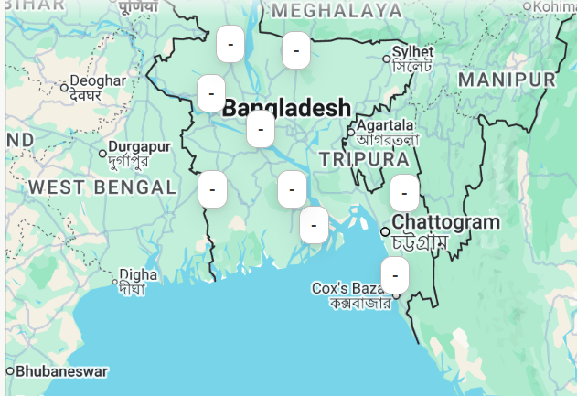
Locations
Coastal Stations
Barisal
Bhola
Cox's Bazar
Satkhira
Bogra → Inland (Northwestern Bangladesh)
Faridpur → Inland / Central floodplain
Ishurdi → Inland (Western Bangladesh)
Mymensingh → Inland (North-central Bangladesh)
Rangamati → Inland Hill Region (Chittagong Hill Tracts)

