Slide 1


Data Governance @ SneakerPark
Prepared by:
Submitted on:

Slide 2

How to use this Template
Theses slides are provided as a guide to ensure that you submit all the required components to successfully complete your project. For detailed instruction, please read the instruction in the classroom.
When presenting your project, please only think of this as a guide. We encouraged you to use creative freedom when making changes as long as the required information is present.
Remember to delete this and all of the other example slides before you submit your project.
Remember to add your name and the date to the cover slide
Remove this slide

Slide 3
What you are required to submit:
What we provide:
This Starter Slides Template
Sheets Template with 4 Tabs - Data Dictionary, Data Quality Issues, Standard Naming Convention, and Business Glossary
Workspace with an instance of Postgres and code that will create and populate the database you will be working with.
Grading rubric you can use to ensure you have submitted everything that is required.
Filled out Slides template.
Filled out Sheets template.
Remove this slide

Slide 4
Background
SneakerPark is an online shoe reseller that allows people to buy and sell used and new shoes. Buyers can bid for shoes or buy them outright, and sellers can set a price or sell to the highest bidder.
Each buyer and seller must have an active account in order to sell, bid, or purchase sneakers using SneakerPark’s website.
SneakerPark authenticates the shoes before shipping them to the buyer, so before listing an item, the seller must ship it to SneakerPark’s warehouse. Upon receipt, SneakerPark assigns an item number to each pair of sneakers and notifies the seller that they are now free to list their item. If the item is not listed within 45 days, SneakerPark returns it to the seller and sends an invoice to the seller for the shipping cost.
If the item is found to be inauthentic or in an unacceptable condition, it is also returned back to the seller in a similar fashion.
When the item sells, the buyer’s account is credited with the purchase price minus the SneakerPark service fee and shipping fees to deliver the item to the buyer.
Currently, SneakerPark only supports sales within the United States.

Slide 5
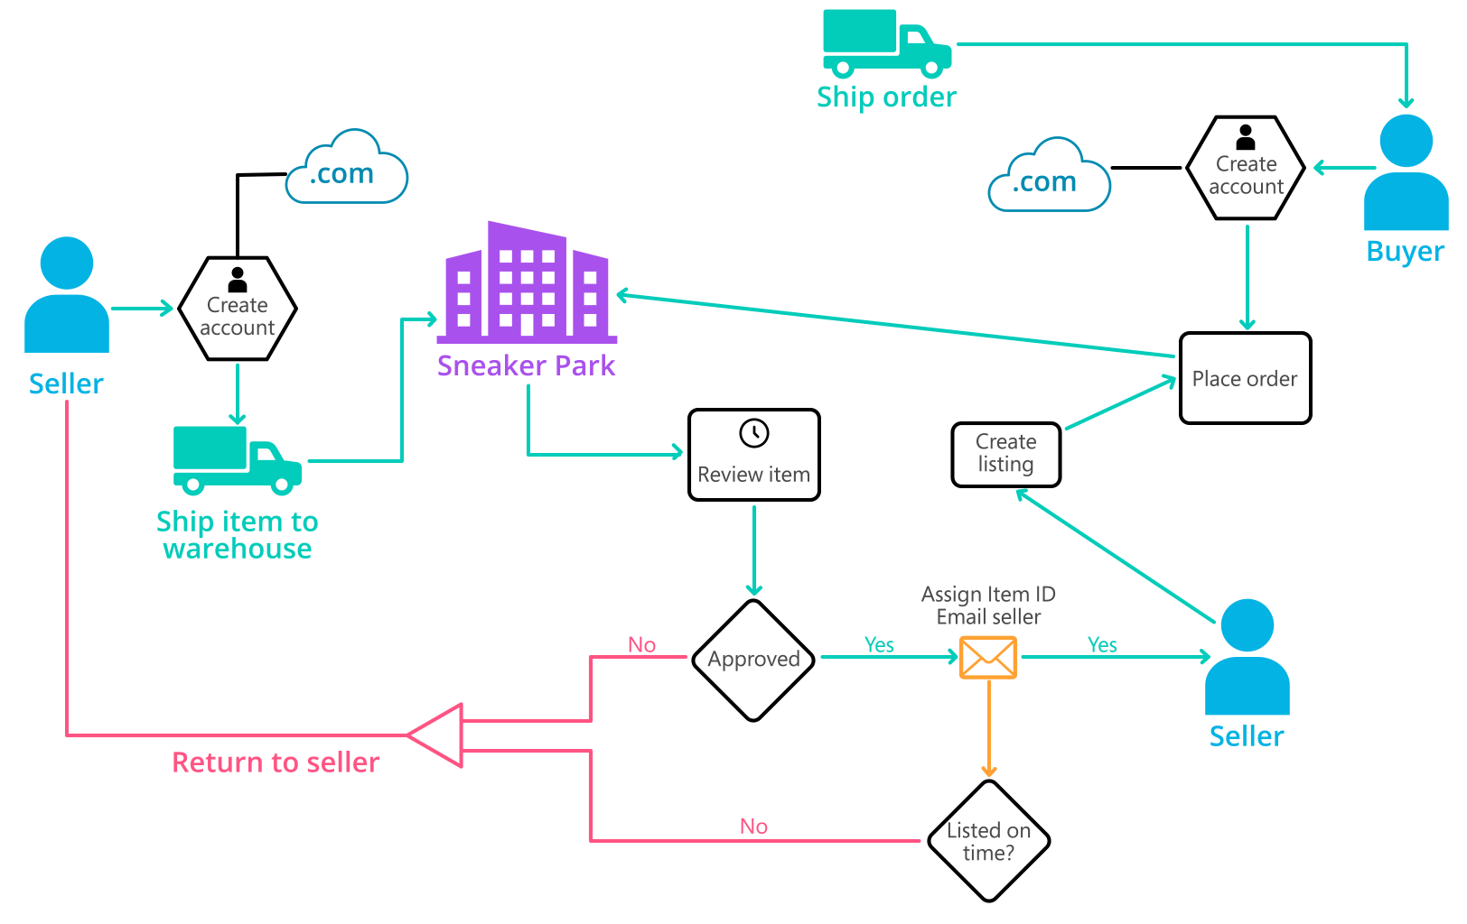
Background (cont’d)
Below you can see a diagram that will hopefully help you visualize some of SneakerPark's business processes. Keep in mind that it does not capture ALL processes and every nuance, but simply serves as another artifact to use in your project.

Slide 6
Step 1
Enterprise Data Catalog Part 1: Enterprise Data Model

Slide 7
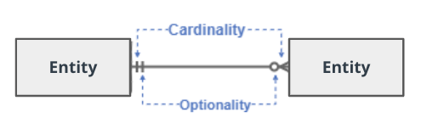
Create a conceptual data model that will provide SneakerPark with a holistic view of its data systems and help you grasp the organization's important entities and relationships, which will be instrumental as you move further in the project. You can use Lucidchart or any other diagramming tool of your choice, but please use the Crow’s Foot/IE Notation and please be sure to indicate both cardinality (the type of a relationship such as 1:N or N:N) and optionality (whether the relationship is optional or mandatory).

Slide 8
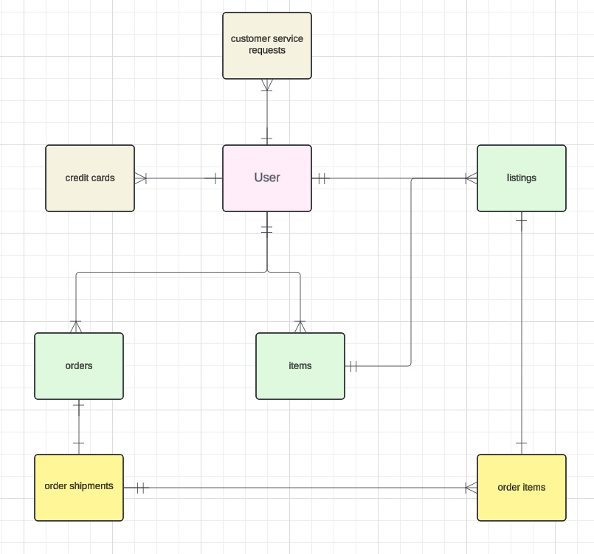
Replace the example below with your own solutions (obviously feel free to take more space):

Slide 9
Step 2
Enterprise Data Catalog Part 2: Metadata

Slide 10
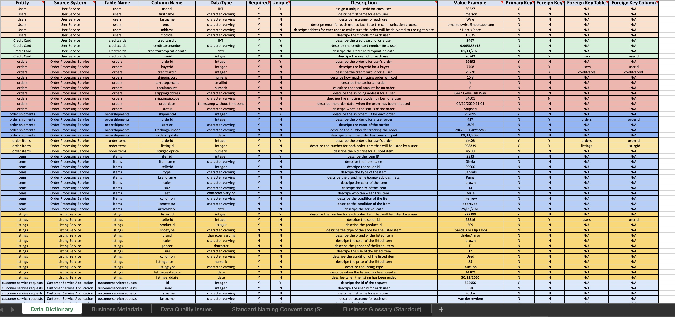
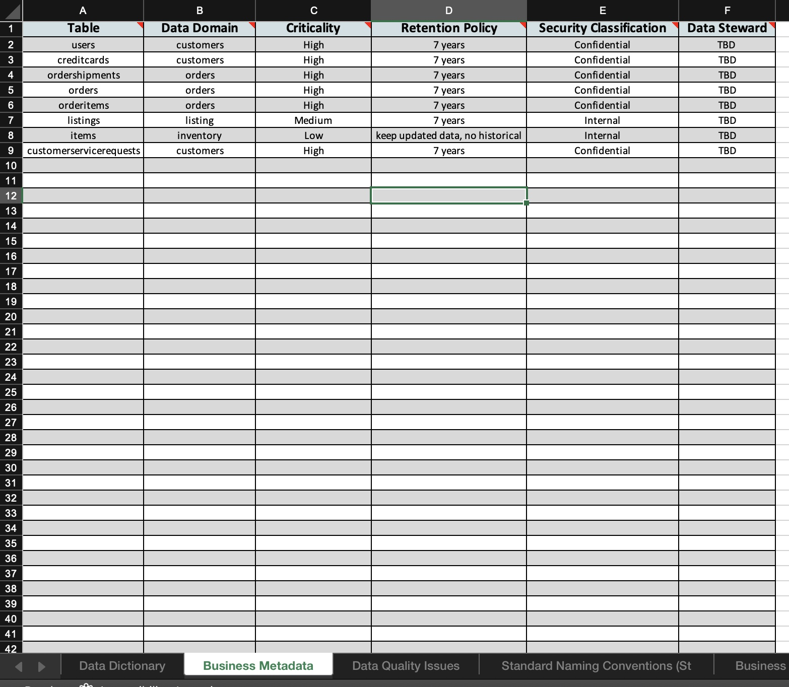
Create the first version of the Metadata Catalog by documenting the metadata from all systems in the "Data Dictionary" and the “Enterprise Data Catalog” tabs of the provided Sheets template. Please note that you are required to fill out all fields in both tabs.

Slide 11
Step 3
Data Quality
Part 1: Profiling and Cleansing

Slide 12
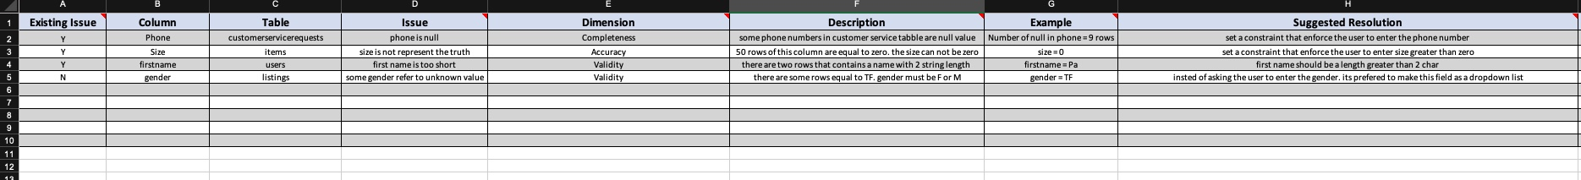
Profile the data to identify at least 3 data quality issues you see in the data. Also provide at least 1 data quality issue that you haven’t yet seen in the data, but can foresee occurring in the future. Based on the issues you’ve identified, come up with the data quality rule for each data quality issue, including for the one that you foresee.
Make sure you fill out all columns in the "Data Quality Issues" tab with your answers in the provided Sheets template.

Slide 13
Step 4
Data Quality
Part 2: Monitoring

Slide 14
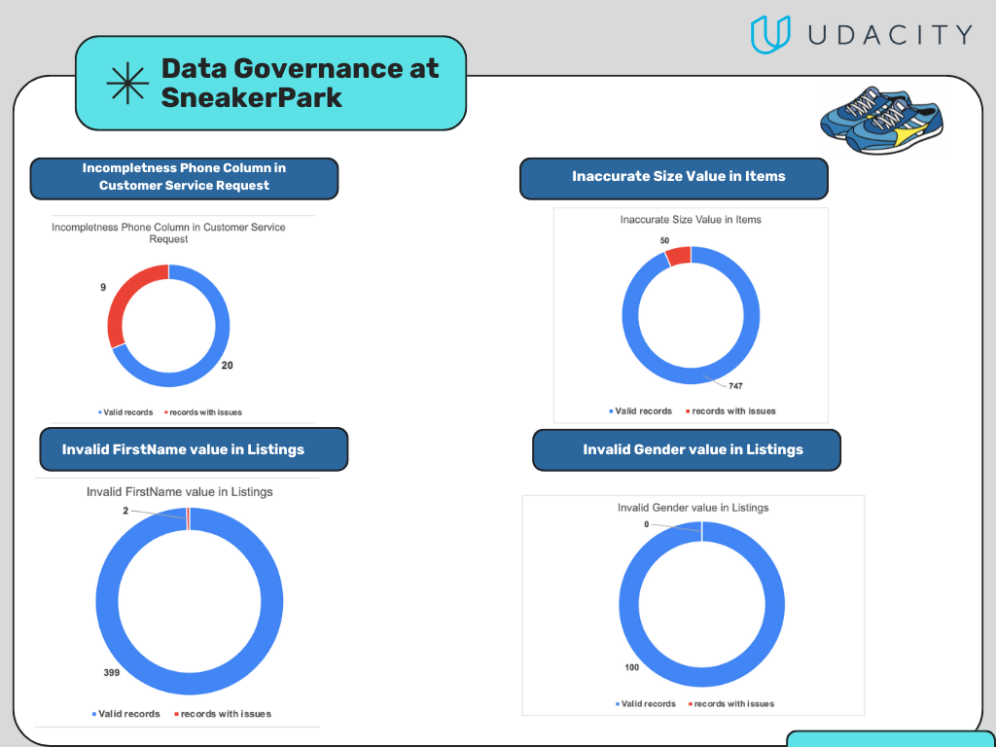
Using the metrics you've created in the last step, please create a mock-up of a data quality monitoring dashboard that will be used to monitor the data to ensure compliance with your data quality rules.
Please make sure to label your metrics clearly on your mock-up.
Replace the example dashboard below with your own. (obviously feel free to take more space).

Slide 16
Step 5
Master Data Management
Part 1: MDM Architecture

Slide 17
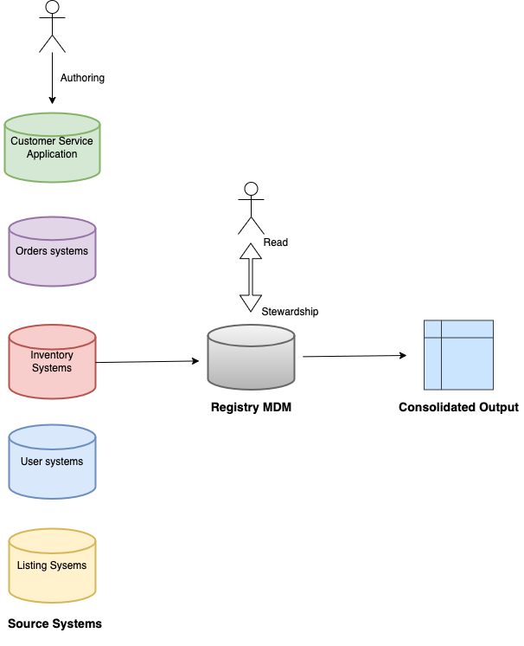
Based on what you’ve read about SneakerPark’s systems and business model, sketch out a proposed MDM implementation architecture, and write a detailed explanation of why you chose this specific approach.

Slide 18
Explanation:
As what I have learned and read about SneakerPark Company, the best architecture is Registry MDM. In my opinion, If the company decided to invest or want to implement a MDM solution. the First option is Registry then they can enhance the solution.
-BENEFITS:
Low cost and risk.
Scalability
-DRAWBACKS:
Limited control and governance

Slide 19
Step 6
Master Data Management
Part 2: Master Record

Slide 20
In this step, you will define a set of matching rules that will be used by the SneakerPark's MDM Hub to match item and customer entities between the company's different systems.
Please come up with 4 rules - 2 for Items and 2 for Customers and list them below.
Entitiy Name | Rule
Item: (BrandName, SellerID) | Match ItemID on the BrandName from Item entitiy and match SellerID from Listnigs.
Item: (ItemName, Color, size,Seller ID) | Match ItemID on the ItemName & Color & Size from Item entitiy and match SellerID from Listnigs.
Customer: (FirstName, LastName, CreditCardNumber) | Match FirstName, LastName on the UserID from Users and match CreditCardNumber on the CreditCardID from Users.
Customer: (FirstName, Email, ContactReason) | Match FirstName, Email on the UserID from Users and match ContactReason on the ID from Customer Service

Slide 21
Step 7
Data Governance:
Roles and Responsibilities

Slide 22
Write 1-2 paragraphs discussing what data governance roles and responsibilities will be necessary to oversee this new Data Management initiative. Please be sure to discuss the responsibilities in the context of at least 3 different aspects of Data Governance (such as Data Quality Management, Metadata Management, MDM, etc). Based on what you know, do SneakerPark's current employees have the necessary skills for these roles or should the company make new hires?
Aspect | DG Roles and responsibilities
Data Quality Management | Data Stewardship to take care of the overall managmant and quality of each data domains. perform data profiling and suggest data remeditions options for the DQ issues.
Metadata Management | Data Analyst / SME overseeing the creation, maintaince and governance of meta data across organization.
Master Data Management | Data Architecit to work with the busniess stakeholders to understand their requirments for managing master data effectively. in addition to design the data model for master data entities.
I think SneakerPark can depend on Jake and Jessica and provide them with the necessary courses and knowledge they need on the DQM and Meta data management. For the MDM , it can be handled and managed by me.

Slide 23
Standout Suggestions

Slide 24
Create a Business Glossary for SneakerPark and define common terms such as Item, Buyer, etc. Think and discuss how SneakerPark can improve on the consistency of the terms that its systems currently use. (You can use the “Business Glossary” tab of the same Sheets template you’ve been using for the other parts of this project to get you started.)
Document SneakerPark’s current naming conventions. Can you think of any improvements? (You can use the “Standard Naming Conventions” tab of the same Sheets template you’ve been using for the other parts of this project to get you started.) Some examples of Naming Conventions include;
Do not use spaces or special characters.
Use only LOWERCASE.
All identifier fields should end in “_id”.
Avoid acronyms and abbreviations.
Write SQL scripts for the matching rules that you’ve created in Step 6.

