Slide 1


Airline Passenger Satisfaction
Arwa alshankiti – Project 1-

Slide 2
Problem:
As we all know we love to travel, but more importantly, the airlines we chose! To be satisfied with them.
so, we want to see which are the most factors that effect that

Slide 3
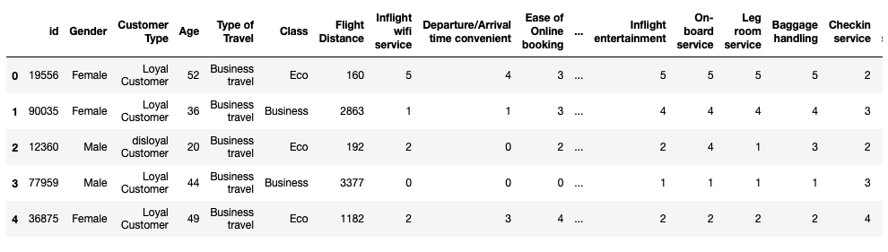
Data :
Data source from :
https://www.kaggle.com/johndddddd/customer-satisfaction?select=satisfaction.xlsx
The data contained 129,880 records with 24 features.

Slide 4
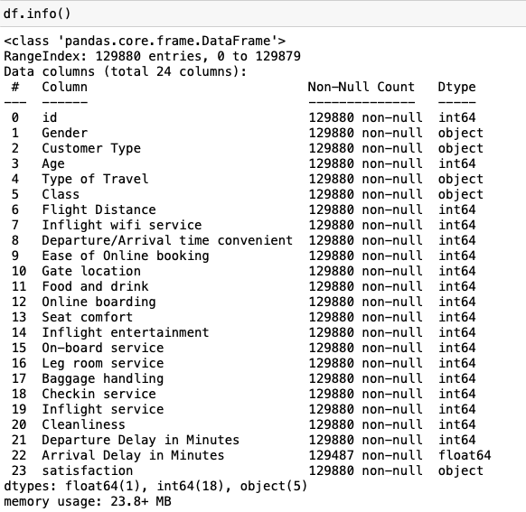
EDA :

Slide 5
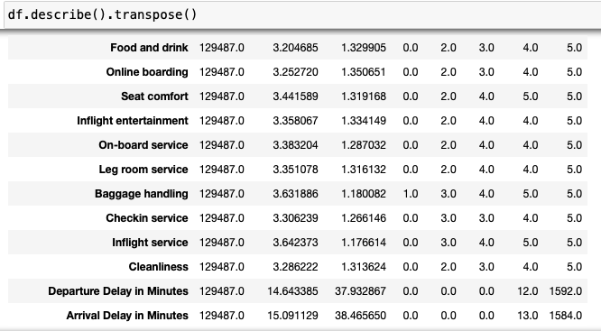
EDA :

Slide 6
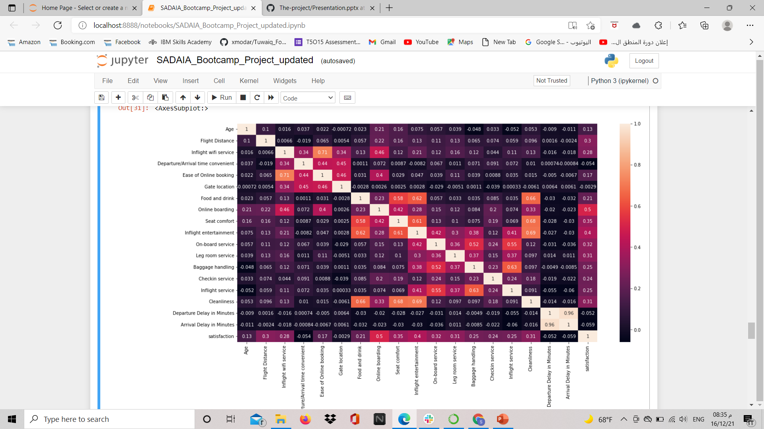
Correlation

Slide 7
ML Models
Train – test split
Models used :
KNN
Decision Tree
Random Forest
XGBoost

Slide 8
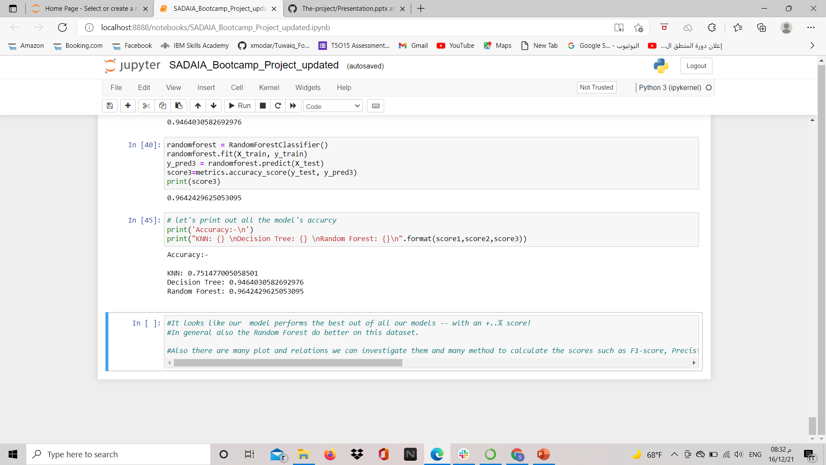
Result & conclusion

Slide 9





THANK YOU !

