Slide 1
Group H: BERT & GLUE
Nikhil (45551375), Arwa (45710333),
Jithendar (44521987), Harsha (45541116)
November 5, 2019
ITEC876 - Applications of Data Science

Slide 2
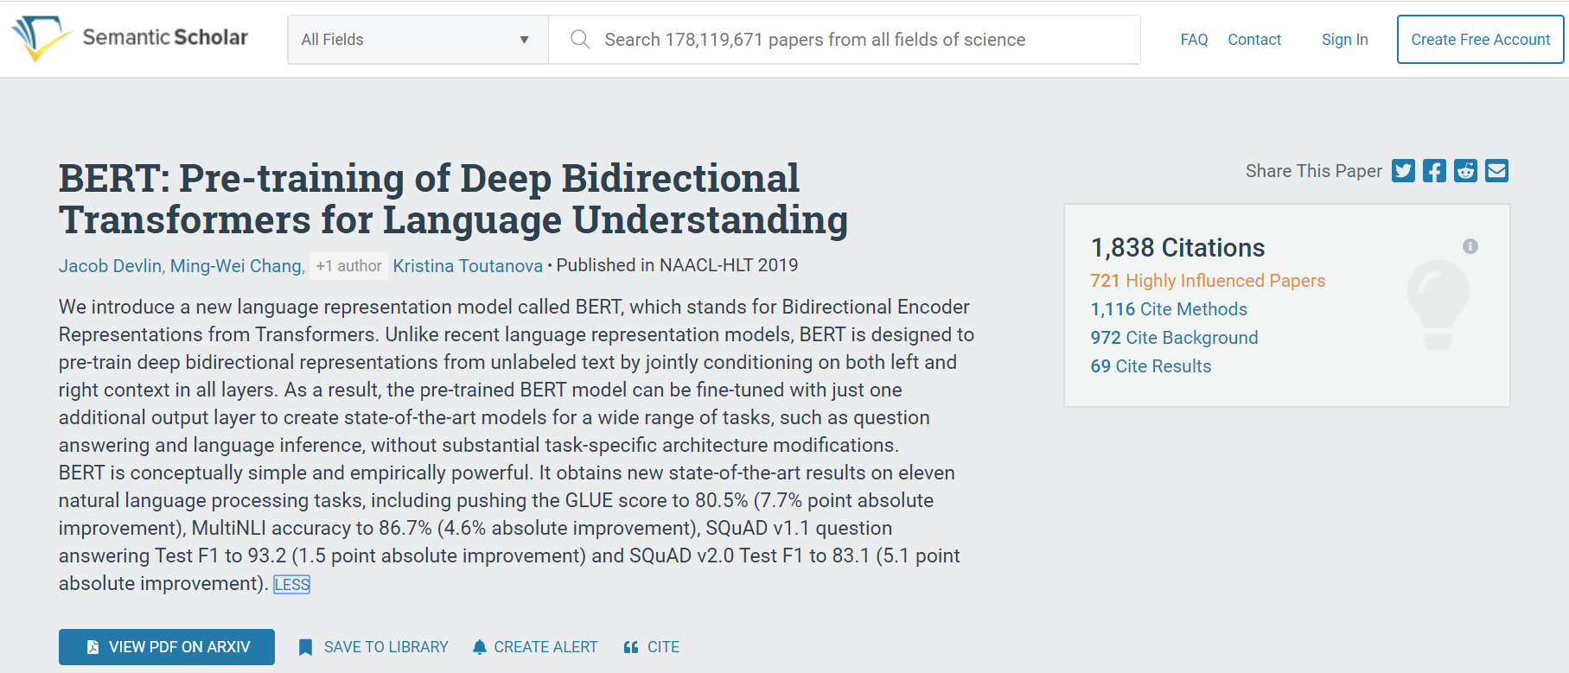
What is BERT?

Slide 3
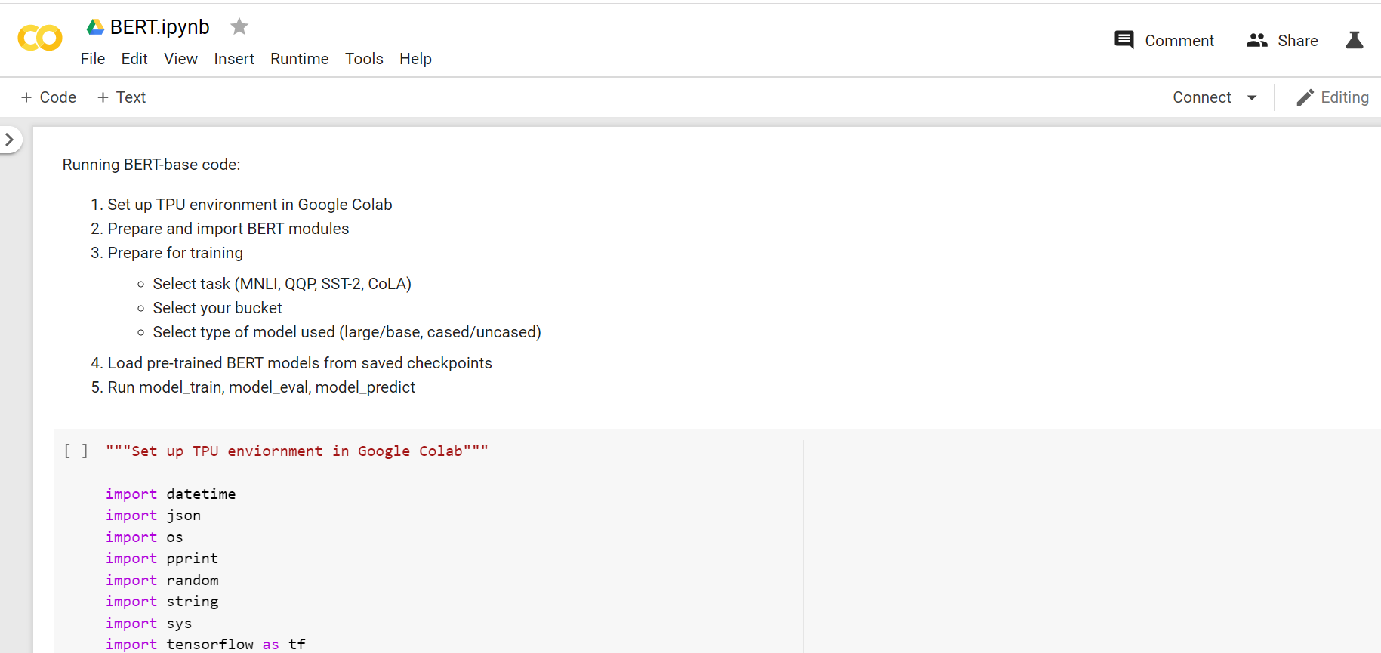
Using Google Colab (with TPU) to run BERT:

Slide 4
GLUE benchmark suite
MNLI by Arwa
Multi-Genre Natural Language Inference
Entailment classification task
QQP by Jithen
Quora Question Pairs
Binary classification task
SST-2 by Nikhil
The Stanford Sentiment Treebank
Binary single-sentence classification task
CoLA by Harsha
The Corpus of Linguistic Acceptability
Binary single-sentence classification task
Notes:
MNLI: Given a pair of sentences to predict whether the second sentence is an entailment, contradiction, or neutral with respect to the first one.
QQP: Where the goal is to determine if two questions asked on Quora are semantically equivalent.
SST-2: Consisting of sentences extracted from movie reviews with human annotations of their sentiment
CoLA: Where the goal is to predict whether an english sentence is linguistically “acceptable” or not

Slide 5
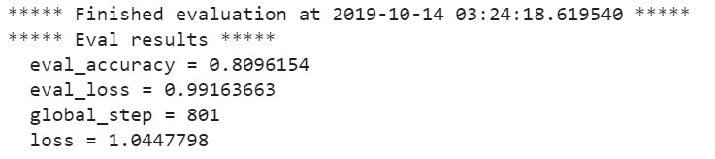
CoLA Dataset: Evaluation of Original data - by Harsha

Slide 6
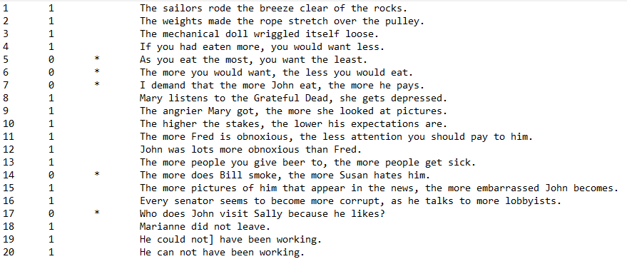
CoLA: New dataset

Slide 7
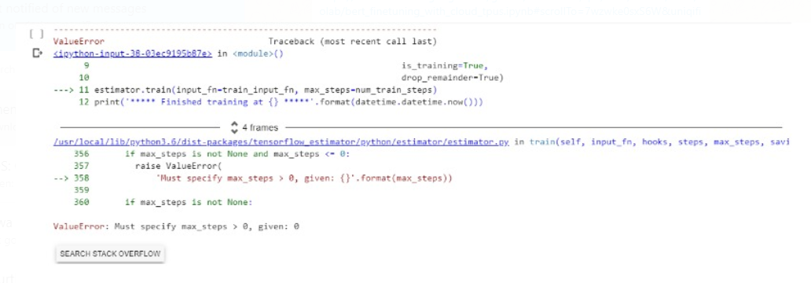
CoLA Dataset: Errors and Implementation Issues
Unable to extract data from Google Colab

Slide 8
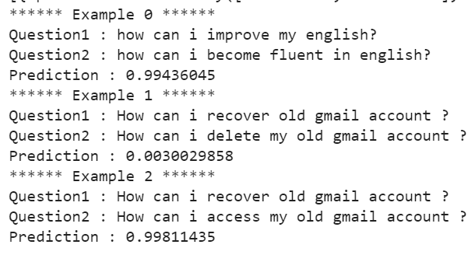
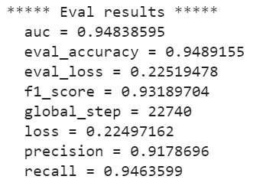
QQP Dataset: Evaluation of Original data - by Jithen

Slide 9
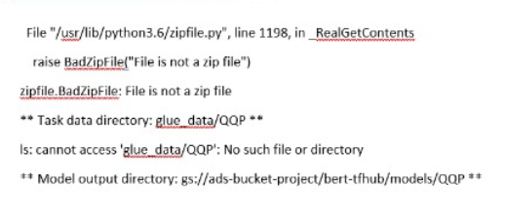
QQP Dataset: Errors and Implementation Issues
Extracting data from link:

Slide 10
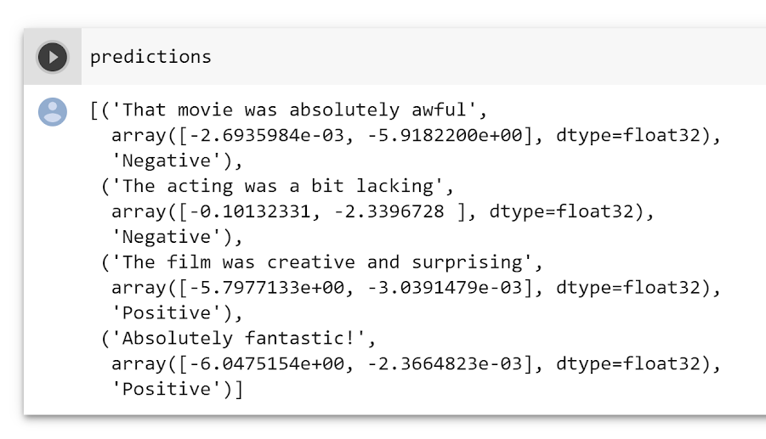
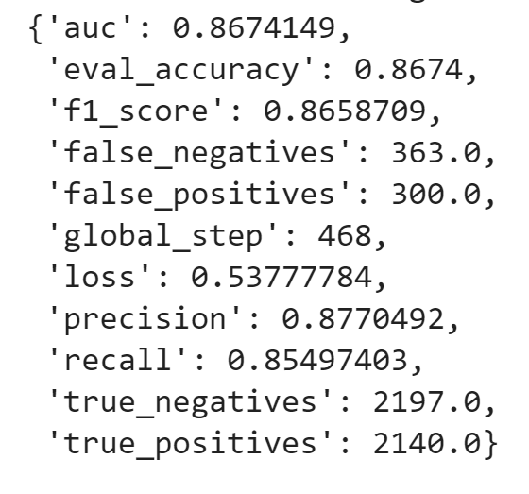
SST-2 Dataset: Evaluation of Original data - by Nikhil

Slide 11
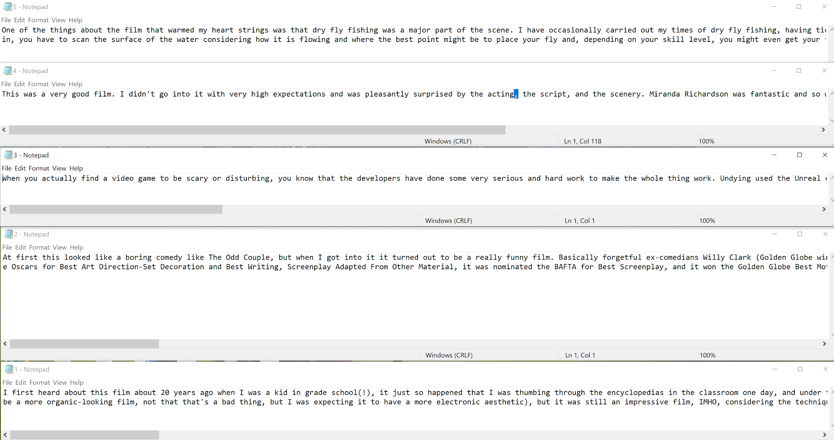
SST-2 Dataset: New Dataset - Manually created

Slide 12
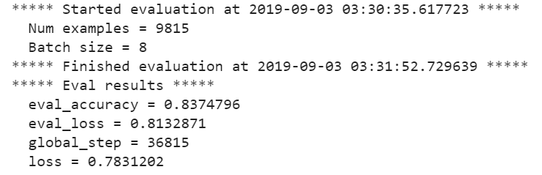
MNLI Dataset: Evaluation of Original data - by Arwa

Slide 13
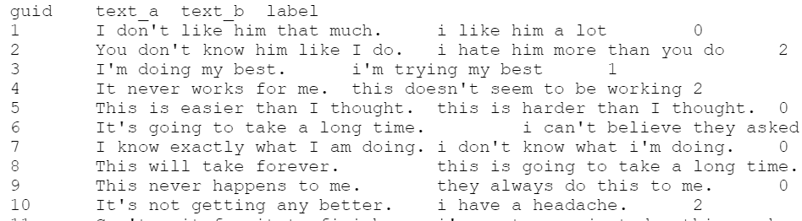
MNLI Dataset: Test dataset manually created
Made using Excel
‘ .TSV’ file = Tab Delimited file
Manually written sentences = 30 pairs
Label: 0 = ‘contradiction’, 1 = ’entailment’, 2 = ’neutral’

Slide 14
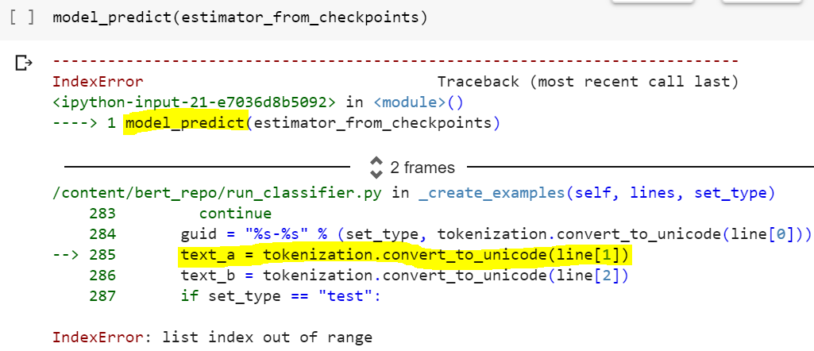
MNLI: Errors and Implementation issues
Original dataset runs perfectly on source code
Some edits were made to original source code to better run new dataset
But source code refuses to read new dataset - Don’t understand why!
New dataset matches original dataset’s format
New dataset is similar but smaller file size
Note: Same error arose for model_eval()

Slide 15

Conclusion
Original vs. Our Datasets
We expected to achieve similar results to the original BERT-base. This may no longer be possible.
Expected results:
MNLI: 83.4%
QQP: 71.2%
SST-2: 93.5%
CoLA: 52.1%

