Slide 1
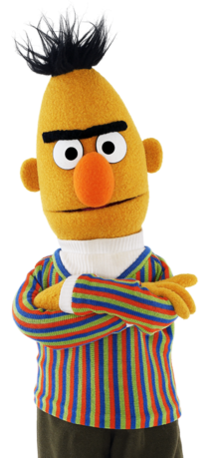
Group H: BERT & GLUE
September 3, 2019
ITEC876 - Applications of Data Science
Nikhil Yadav Moodamanchu Venkata - 45551375
Arwa Siddiqui - 45710333
Jithendar Nethiram - 44521987
Sri Harsha Vunnam - 45541116

Slide 2
What is BERT?
Arwa Siddiqui
BERT stands for Bidirectional Encoder Representations from Transformers.
Authors: Jacob Devlin, Ming-Wei Chang, Kenton Lee, Kristina Toutanova
BERT is designed to pretrain deep bidirectional representations from unlabeled text by jointly conditioning on both left and right context in all layers (Devlin, Chang, Lee, & Toutanova, 2018).
Developed by Google AI Language in 2018
Completely coded on Python and Jupyter Notebook, available on GitHub
Computing Research Repository (CoRR): Submitted on 11 Oct 2018, last revised 24 May 2019

Slide 3
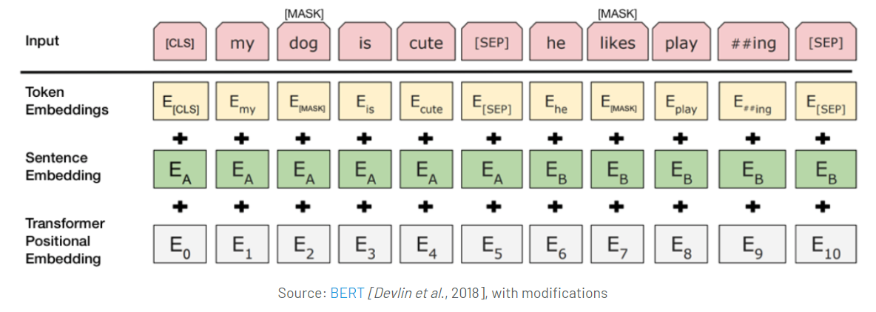
How BERT works:
Jithendar Nethiram

Slide 4
GLUE benchmark suite
MNLI by Arwa
Multi-Genre Natural Language Inference
Entailment classification task
QQP by Jithen
Quora Question Pairs
Binary classification task
SST-2 by Nikhil
The Stanford Sentiment Treebank
Binary single-sentence classification task
CoLA by Harsha
The Corpus of Linguistic Acceptability
Binary single-sentence classification task
Notes:
MNLI: Given a pair of sentences to predict whether the second sentence is an entailment, contradiction, or neutral with respect to the first one.
QQP: Where the goal is to determine if two questions asked on Quora are semantically equivalent.
SST-2: Consisting of sentences extracted from movie reviews with human annotations of their sentiment
CoLA: Where the goal is to predict whether an english sentence is linguistically “acceptable” or not

Slide 5
Conclusion
Sri Harsha Vunnam
Original Results
BERT obtains new results on eleven natural language processing tasks.
Original results:
GLUE score increased to 80.5% (7.7% improvement)
MultiNLI accuracy 86.7% (4.6% improvement)
And further tested tasks
Our Results
We expect to achieve similar results at the original experiment. We will be comparing the BERT-base experiment.
We will be using Google Colab and TPU.
Expected results:
MNLI: 84.6/83.4
QQP: 71.2
SST-2: 94.9
CoLA: 52.1

