Slide 1
Group H: BERT & GLUE
Nikhil (45551375), Arwa (45710333),
Jithendar (44521987), Harsha (45541116)
October 15, 2019
ITEC876 - Applications of Data Science

Slide 2
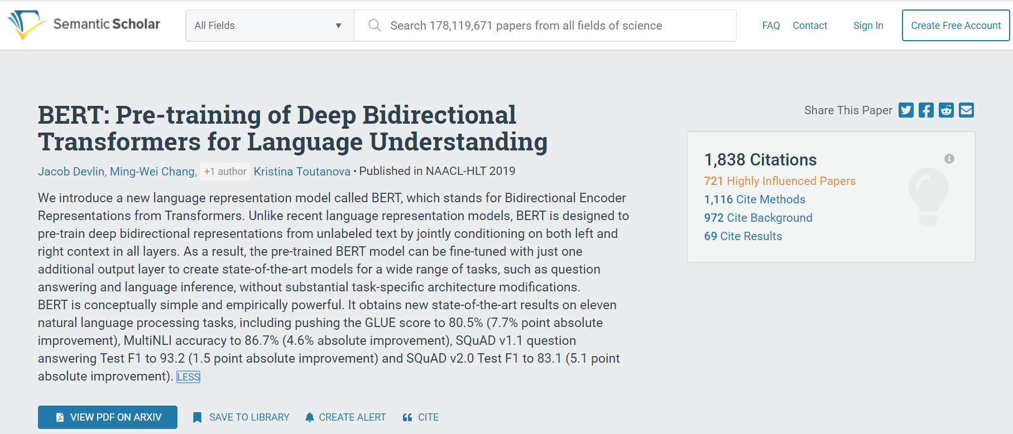
What is BERT?

Slide 3
Published in NAACL-HLT 2019
North American Chapter of the Association for Computational Linguistics: Human Language Technologies (NAACL-HLT 2019)
The 17th Annual Conference: held in Minneapolis on 2-7 June 2019
“Aims to bring together researchers interested in the design and study of natural language processing technology as well as its applications to new problem areas”
Invited submissions of long and short papers on “creative, substantial and unpublished research in all aspects of computational linguistics”
BERT was one of the accepted papers

Slide 4
GLUE benchmark suite
MNLI by Arwa
Multi-Genre Natural Language Inference
Entailment classification task
QQP by Jithen
Quora Question Pairs
Binary classification task
SST-2 by Nikhil
The Stanford Sentiment Treebank
Binary single-sentence classification task
CoLA by Harsha
The Corpus of Linguistic Acceptability
Binary single-sentence classification task
Notes:
MNLI: Given a pair of sentences to predict whether the second sentence is an entailment, contradiction, or neutral with respect to the first one.
QQP: Where the goal is to determine if two questions asked on Quora are semantically equivalent.
SST-2: Consisting of sentences extracted from movie reviews with human annotations of their sentiment
CoLA: Where the goal is to predict whether an english sentence is linguistically “acceptable” or not

Slide 5
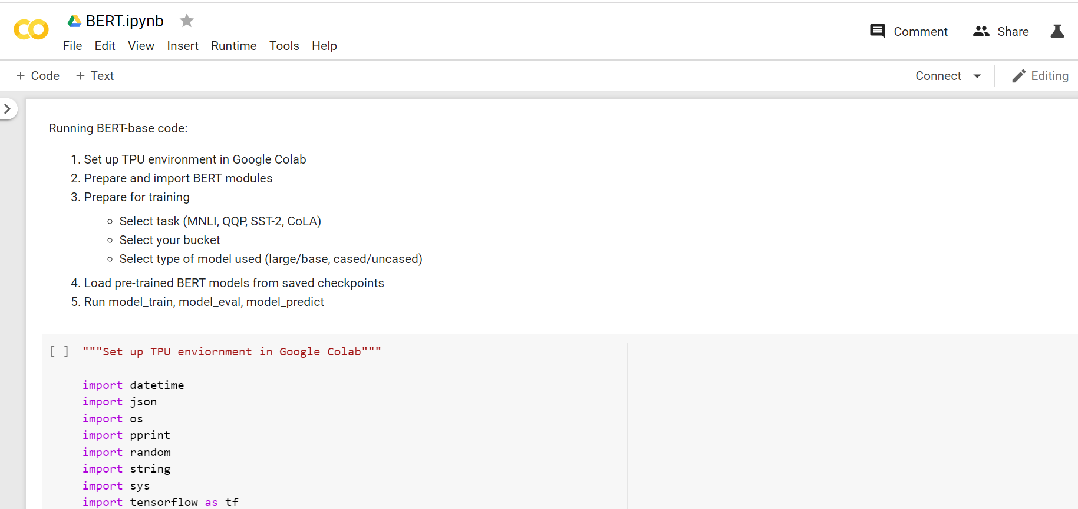
Using Google Colab to run BERT:

Slide 6
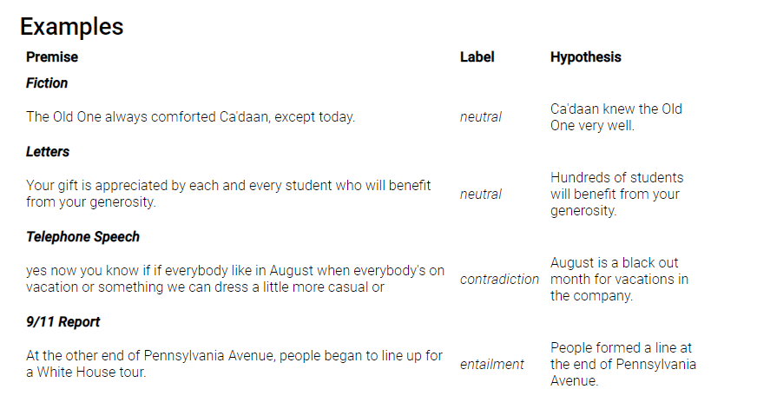
MNLI Dataset: Example - by Arwa

Slide 7
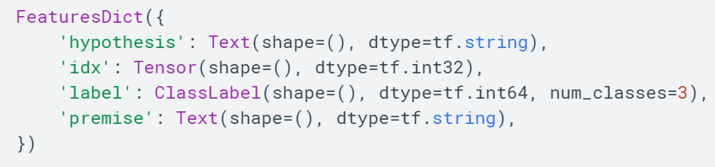
MNLI Dataset: Example code

Slide 8
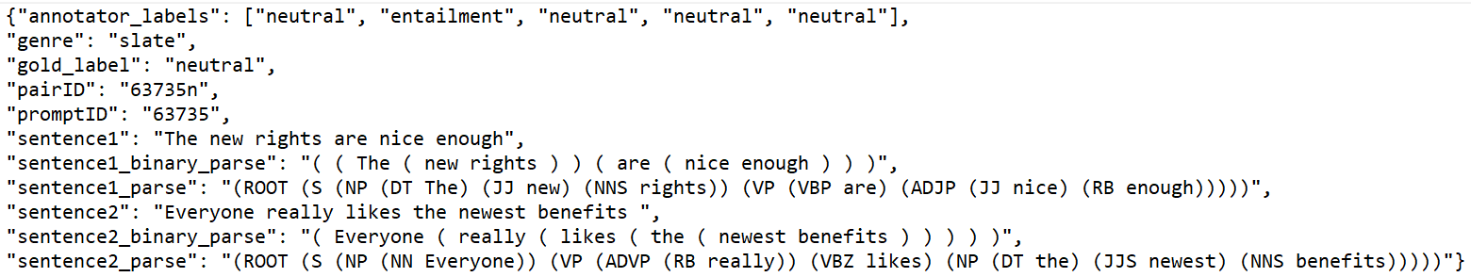
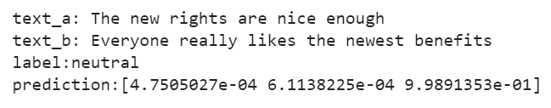
MNLI Dataset: Code
Input code:
Output code:

Slide 9
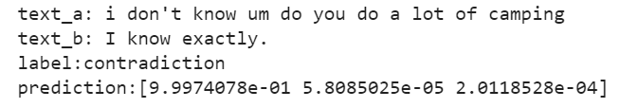
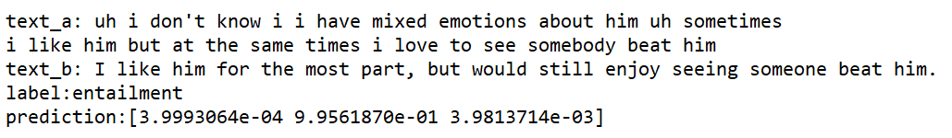
MNLI Dataset: Output examples

Slide 10
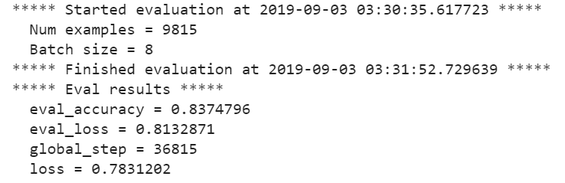
MNLI Dataset: Evaluation output based on Original data

Slide 11
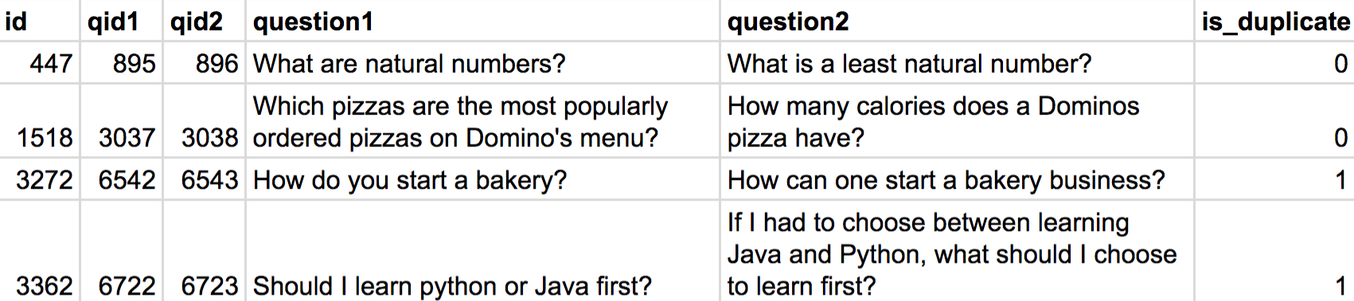
QQP Dataset: Example - by Jithen

Slide 12
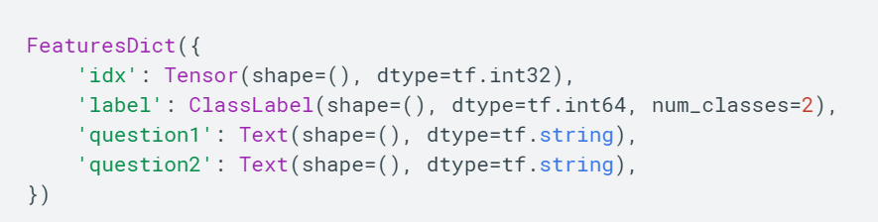
QQP Dataset: Code

Slide 13
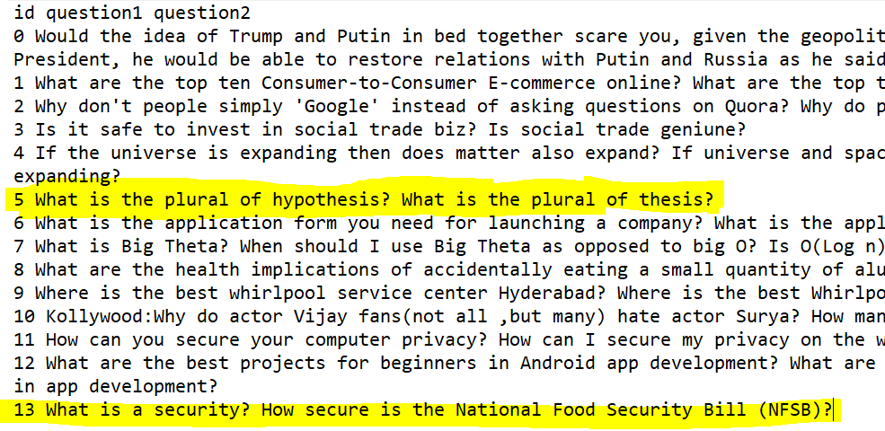
QQP Dataset: Input questions examples

Slide 14
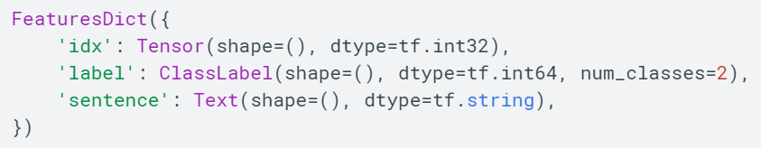
CoLA Dataset: Example code - By Harsha

Slide 15
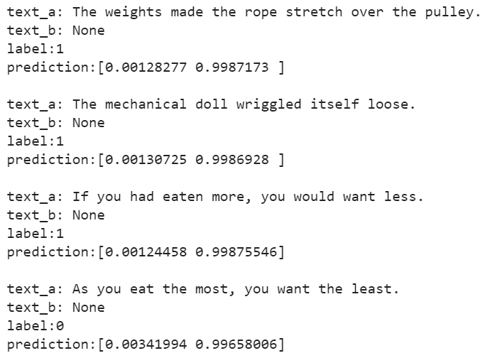
CoLA Dataset: Output example

Slide 16
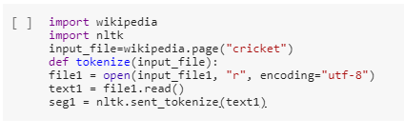
Code for creating Dataset:

Slide 17
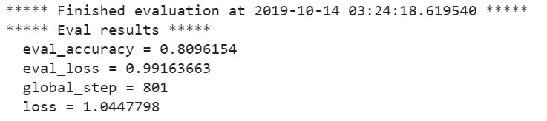
CoLA Dataset: Evaluation of Original data

Slide 18
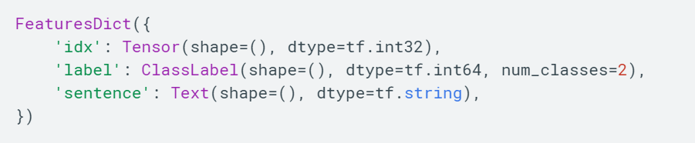
SST-2 Dataset: Example -Nikhil
Input sentences example:

Slide 19
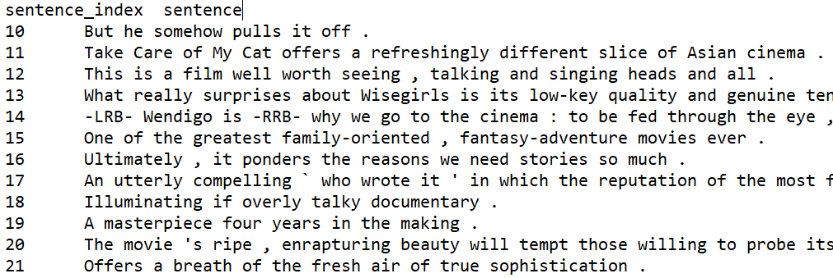
SST-2 Dataset: Sentences examples

Slide 20
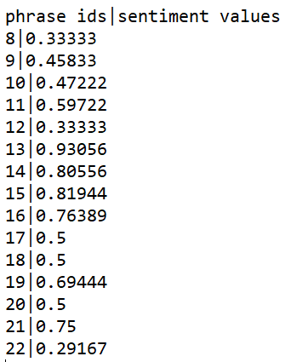
SST-2 Dataset: Sentiment Analysis example

Slide 21

Conclusion
Original vs. Our Datasets
We expect to achieve similar results to the original BERT-base.
We will be using Google Colab and Google Cloud Storage TPU (Bucket). .
Expected results:
MNLI: 83.4%
QQP: 71.2%
SST-2: 93.5%
CoLA: 52.1%

