Slide 1
AI- Based Presentation Skills Evaluation System
Supervisor: Dr. Fatma Helmy
Supervising Assistant: Eng.Saja Saadoun
Team Members: Ahmed Yehia, Arwaa Mamdoh, Mayar Adel, Mostafa Wael

Slide 2
Table of contents
01
02
03
04
05
06
07
08
09
INTRODUCTION
MOTIVATION
PROBLEM STATEMENT
SYSTEM OVERVIEW
SIMILAR SYSTEMS
DELIVERABLES
TIMELINE
SUPPORTIVE DOCUMENTS
DEMO

Slide 3
01
INTRODUCTION

Slide 4
INTRODUCTION
01
Presentation skills are essential for success in academic and professional settings
People often lack access to feedback on body language, voice tone, and clarity.
The AI-powered app analyzes presentation videos and provides personalized feedback on non-verbal cues, facial expressions, and speaking style
It helps users improve their confidence and communication skills.

Slide 5
02 MOTIVATION

Slide 6
02
MOTIVATION
ACADEMIC
The system helps students and academics enhance their communication skills.
It provides accurate and measurable insights into their presentation style.
These insights enable users to refine their ability to engage with audiences effectively.
It supports better idea sharing and fosters improved communication overall.
So enhancing presentation skills boosts users' confidence.

Slide 7
02
MOTIVATION
BUSINESS
Effective communication is essential for business success.
It plays a crucial role in sales meetings, client presentations, and leadership discussions.
Delivering a compelling message can significantly impact outcomes.
The system assists professionals in assessing and enhancing their communication skills.
It aims to improve users' confidence in professional interactions.

Slide 8
03
PROBLEM STATEMENT

Slide 9
03
PROBLEM STATEMENT
Speakers have difficulty recognizing and addressing areas of weakness, such as body language and speech clarity.
Many people cannot afford or obtain professional coaching.
Tracking progress over time can be difficult.
There is a need for personalized, accessible tools to address these gaps.
Evaluation of audience interaction and Q&A responses is absent from current solutions.

Slide 10
04
SYSTEM OVERVIEW

Slide 11
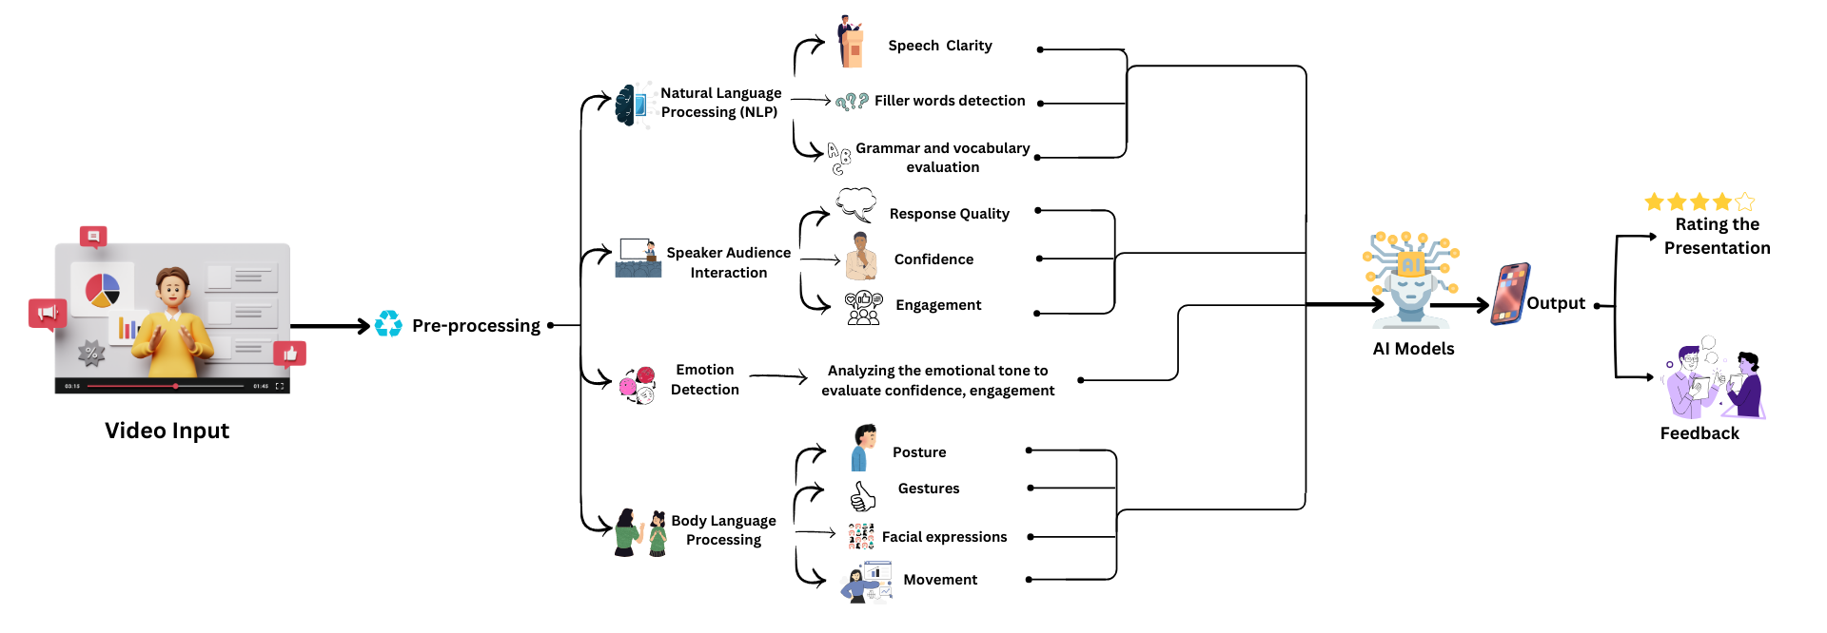
04
SYSTEM OVERVIEW

Slide 12
05
SIMILAR SYSTEMS

Slide 13
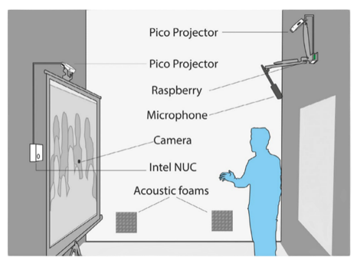
SIMILAR SYSTEMS
05
Academic
Controlled evaluation of a multimodal system to improve oral presentation skills in a real learning setting
RAP System Overview: Assesses oral presentation skills using multimodal learning analytics (MmLA).
Accuracy: 85% accuracy in performance evaluation.
Student Feedback Recall: Increased from 81% to 84% in follow-ups.
Self-assessment Decline: Dropped from 74% to 68% over time.
Algorithms: Employ SVM or RNN

Slide 14
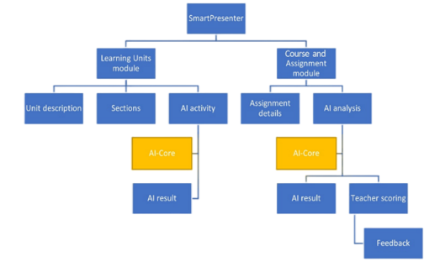
SIMILAR SYSTEMS
05
Academic
AI-Assisted Enhancement of Student Presentation Skills: Challenges and Opportunities
AI-Assisted Platform: Provides real-time feedback on presentation skills.
Speech Analysis: Assesses fluency, pronunciation, facial expressions, and vocal fillers.
Correlation Scores: Fluency (0.136), pronunciation (0.450).
Limitations: AI struggles with fluency and emotion recognition compared to human evaluations.
Algorithms: Uses speech-to-text, acoustic features, and facial recognition (CNN) for real-time feedback.

Slide 15
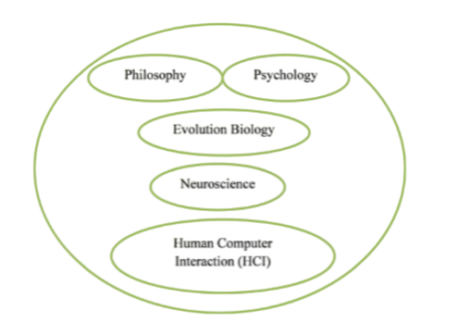
SIMILAR SYSTEMS
05
Academic
Machine learning for human emotion recognition: a comprehensive review
Naive Bayes (NB): Accuracy 74%.
SVM: Average accuracy 85.47%.
Random Forest (RF): Accuracy 95.6%.
CNN: Accuracy 80%
Decision Tree (DT): Accuracy 74%.
Bi-GRU: Accuracy 79.46%.
Ensemble Learning: Stacking achieved 98.2% accuracy.

Slide 16



SIMILAR SYSTEMS
05
Business Applications
Orai
Speeko
Virtual Speech
AI Speech Coach Assistant
Voice Recognition & Feedback
VR Speech Training Platform

Slide 17
06
DELIVERABLES

Slide 18
DELIVERABLES
06
Proposal document
Academic Papers
SRS Document
SDD
Document
Final Thesis Document
Mobile Application

Slide 19
07
TIME PLAN

Slide 20
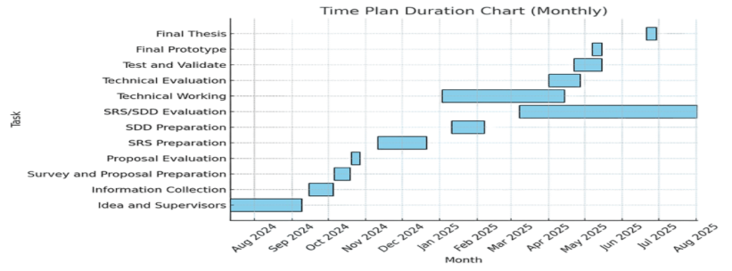
TIME PLAN
07

Slide 21
08
SUPPORTIVE DOCUMENTS

Slide 22
08
SUPPORTIVE DOCUMENTS
Audio Dataset
The dataset contains 5 folders, each representing different emotion:( Angry ,Fear,Happy,Sad,Neutral)
The dataset is balanced, each folder contains 1669 .wav audio files.
Audios length from 2 to 5 seconds, representing real-life emotional expressions.
Designed for speech emotion recognition
Includes labeled data for accurate emotion detection.

Slide 23
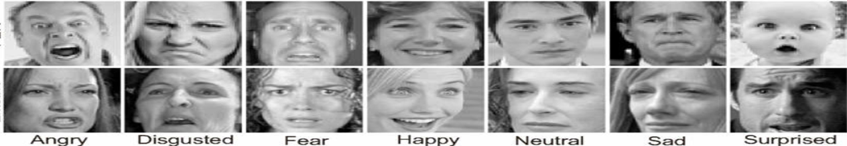
08
SUPPORTIVE DOCUMENTS
Facial Expressions Dataset
The dataset is large and well-organized, containing numerous facial screenshots from diverse individuals.
Images are 48x48 grayscale, with faces mostly centered.
It is divided into train and test folders, each containing 7 emotion-specific folders (Anger, Disgust, Fear, Happy, Sad, Surprise, Neutral).
The training set includes 28,709 examples, and the public test set has 3,589 examples.

Slide 24
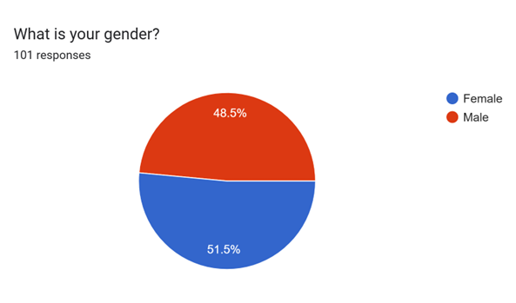
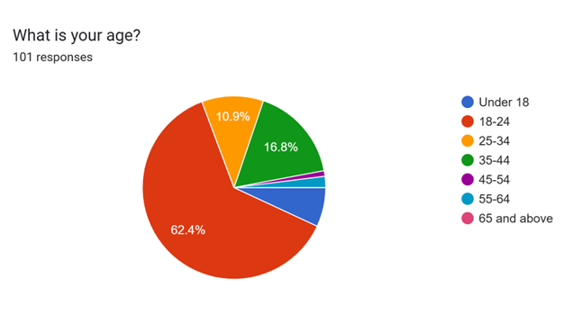
08
SUPPORTIVE DOCUMENTS
Survey

Slide 25
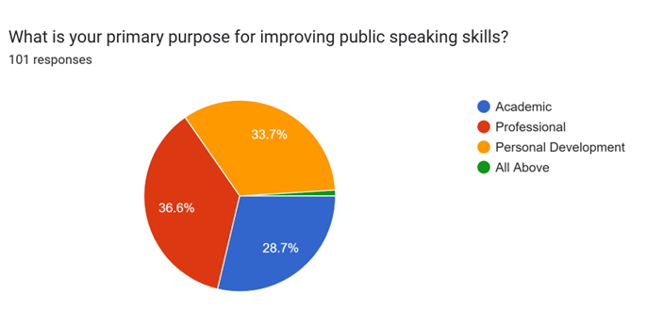
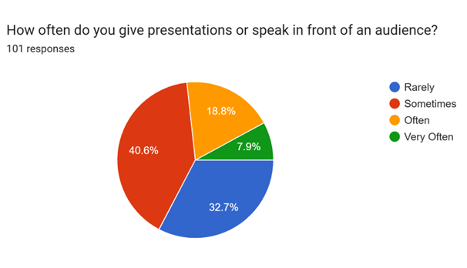
08
SUPPORTIVE DOCUMENTS
Survey

Slide 26
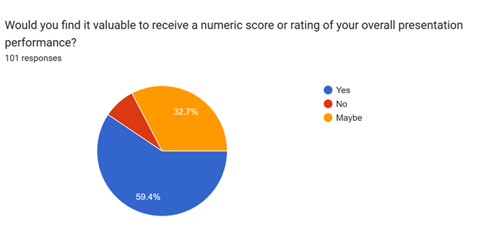
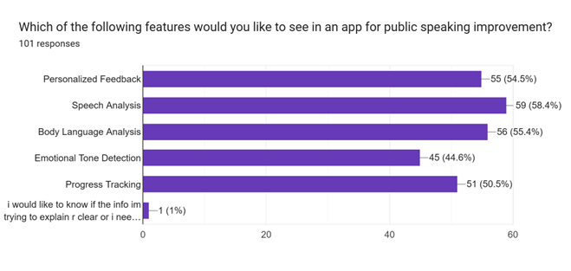
08
SUPPORTIVE DOCUMENTS
Survey

Slide 27
09
DEMO

Slide 28
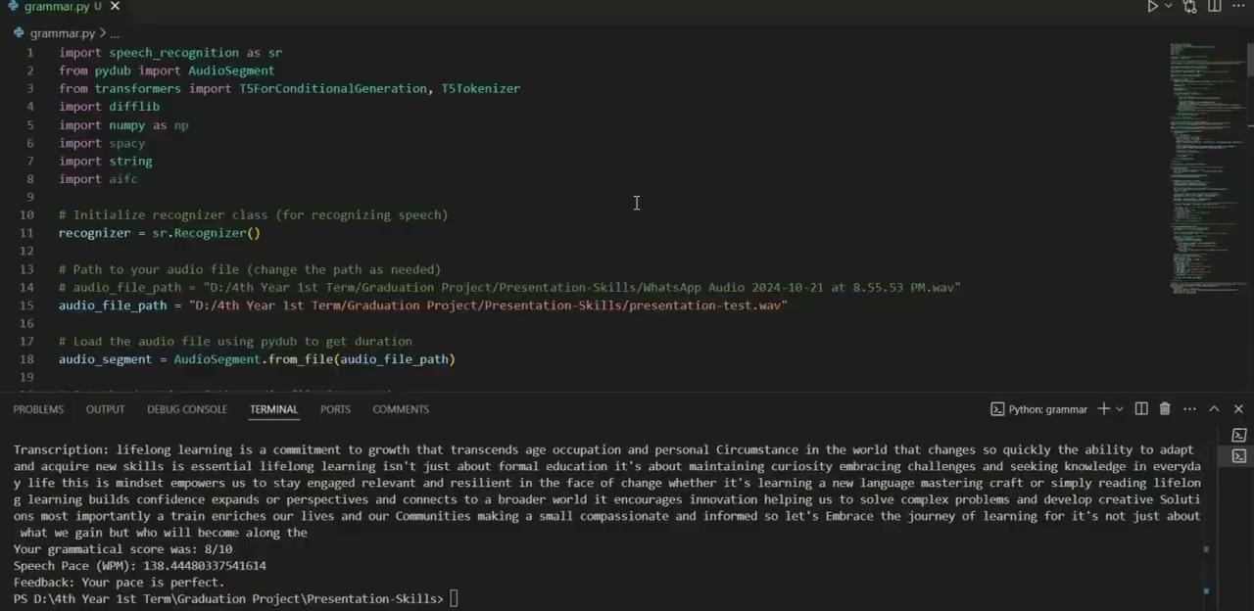

Slide 29
Thanks!
Do you have any questions?

