Slide 1
Learning management system (LMS)
Arwa Alharbi

Slide 2
WHAT IS A LEARNING MANAGEMENT SYSTEM (LMS)?
A learning management system is a software
application or web-based technology used to plan,
implement and assess a specific learning process.
It's used for e-learning practices.

Slide 3




Technologies Used

Slide 4




TOOLS Used
VS code
Github
Chrome
Render

Slide 5
PROJECT REQUIREMENT
Instructor Side
( register in the system, login, add a new course, delete courses, update coursess)
Student Side ( register/login in the system, register in any of the courses)

Slide 6
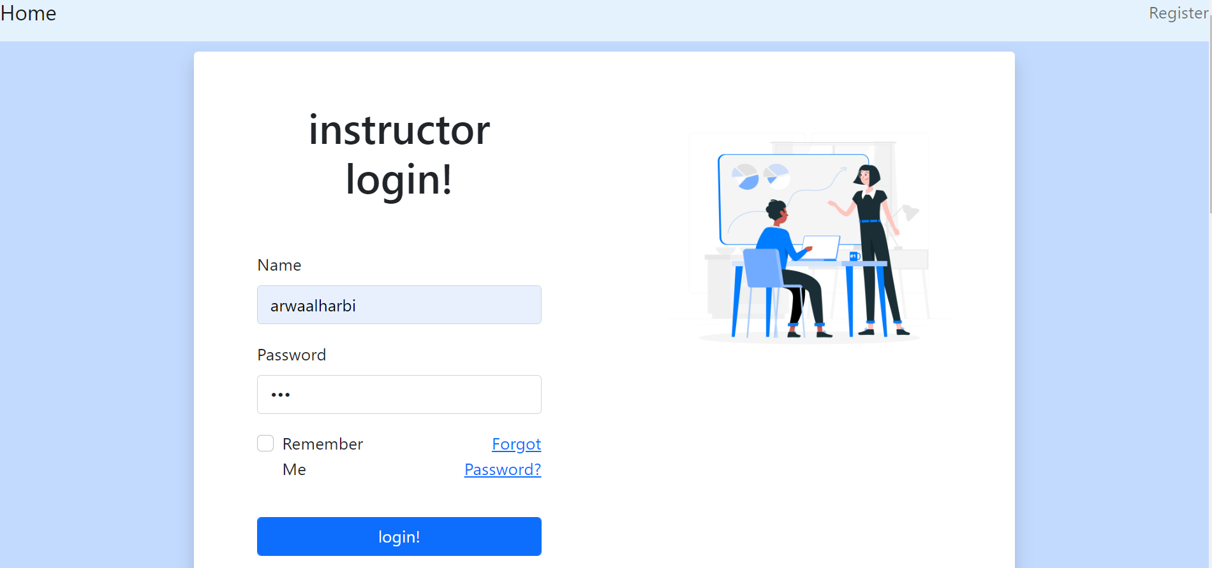
demo

Slide 7
thank you

