Slide 1
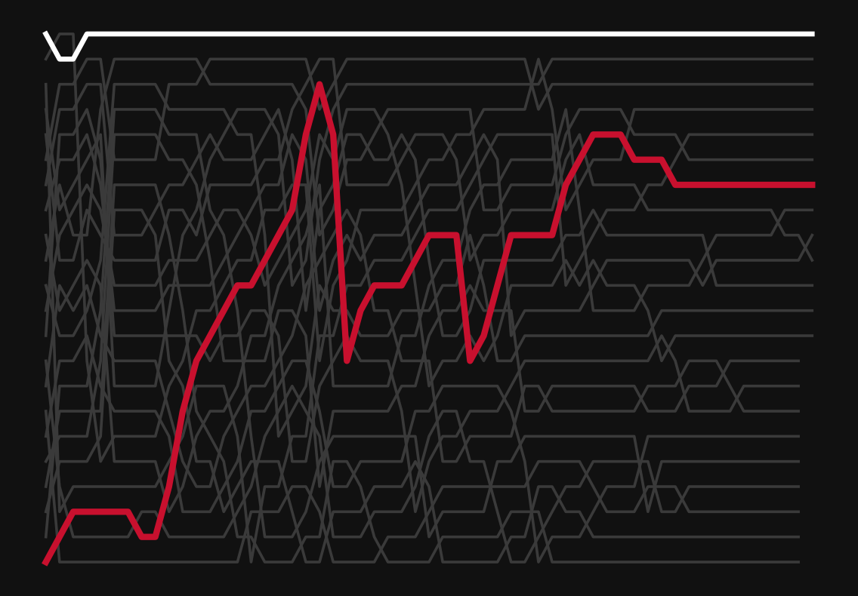
FINAL REVIEW · 23CSE353 DATA VISUALISATION
Formula 1, read as a chain of cause and effect
Drivers, constructors, race strategy and performance trends, 2015–2024
Arwindh C N
Roll No. CB.SC.U4CSE24207
Every line is one car in the 2016 Chinese GP. Red = Hamilton, white = Rosberg.
Notes:
Most people watch a Formula 1 race as a result: who won. Today I want to show you how a strategist on the pit wall reads a race: as a chain of cause and effect. I used ten seasons of data, 209 races from 2015 to 2024, and built one story in five acts. The picture behind the title is a real race, which we will open in a moment. Everything you see comes from one Jupyter notebook, and every number is produced by a code cell in it.

Slide 2
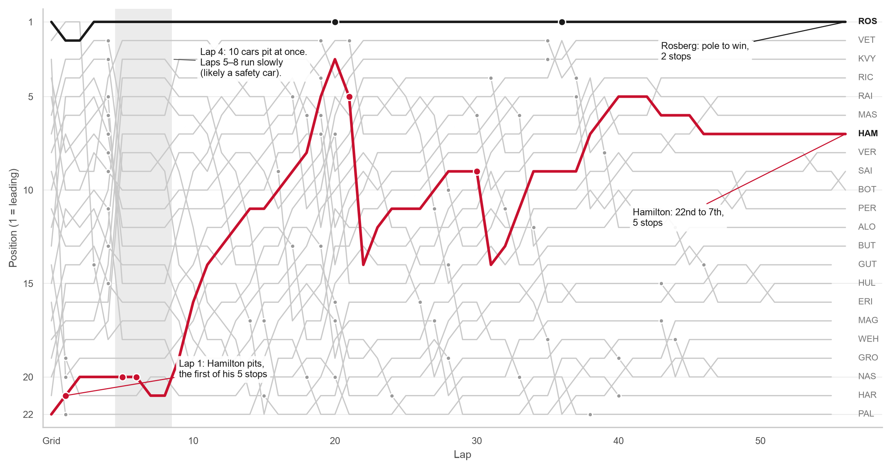
HOOK · ONE RACE, LAP BY LAP
844 position changes in one race, and the pole-sitter still won
844
position changes in the 2016 Chinese GP, the most of all 209 races
P22 → P7
Hamilton's climb, with 5 pit stops
The call you would make
Do not read a race from the result. Read it from the moves.
Arwindh C N · CB.SC.U4CSE24207 · 23CSE353 Data Visualisation
Notebook cell H.2 · 2 / 11
Notes:
This is the hook. Each line is one car, and the line shows where that car was at the end of every lap. The dots are pit stops. I chose this race by a rule, not by taste: I added up how many places every car gained or lost from lap to lap, and the 2016 Chinese GP scored highest of all 209 races, with 844. Look at the red line. Hamilton started 22nd, stopped on lap 1, made 5 stops and still climbed to 7th. On lap 4, 10 cars stopped together, just before the field slowed, probably for a safety car. Yet Rosberg, in black, started first and finished first. Keep this race in mind: by the end, every part of it will make sense.

Slide 3
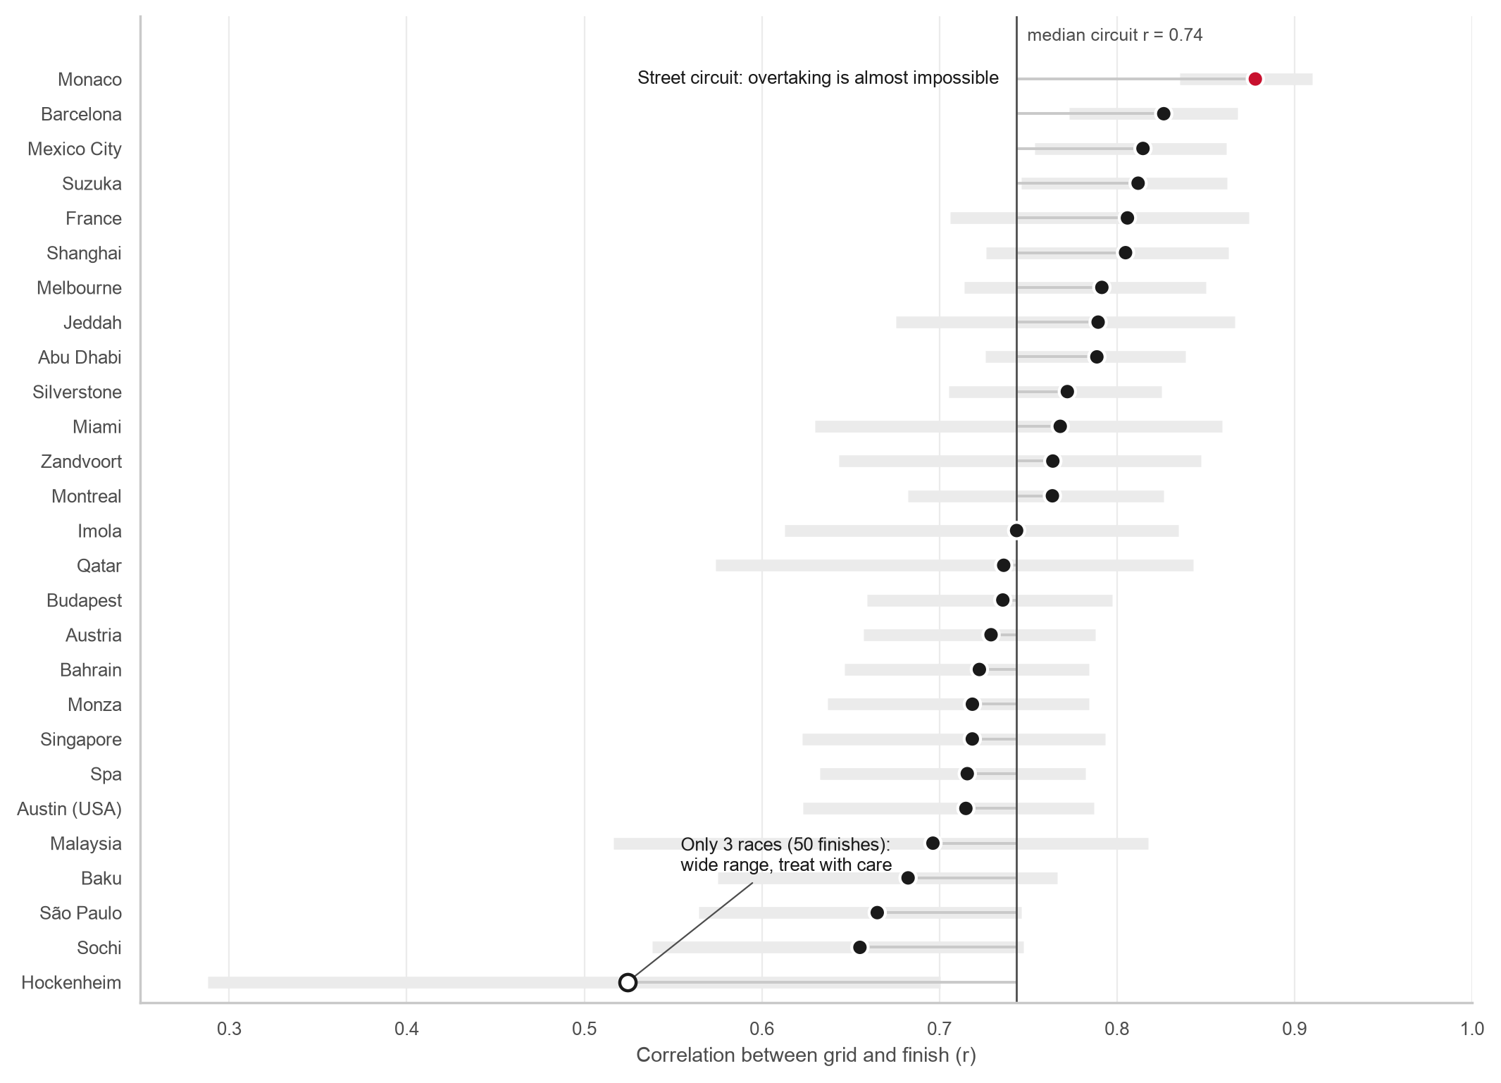
ACT 1 · SATURDAY DECIDES MORE THAN YOU THINK
Monaco locks the order in. Hockenheim lets it go.
0.75
link between grid and finish, all 3,518 finishes (1 = perfect)
0.88
at Monaco; Hockenheim only 0.52 (just 3 races)
The call you would make
At Monaco, treat qualifying as the race. At Sochi, Sunday can still fix a bad grid slot.
Arwindh C N · CB.SC.U4CSE24207 · 23CSE353 Data Visualisation
Notebook cell A1.2 · 3 / 11
Notes:
Act one asks: if I know where a driver starts, how well can I guess where they finish? Across all races the link is strong. The correlation is 0.75, where zero means no link and one means a perfect link, and pole position won 53% of all races. But it is not the same everywhere. Each dot here is one circuit. Monaco is at the top with 0.88: it is a narrow street circuit, so overtaking is almost impossible. Hockenheim is at the bottom with 0.52, but it only hosted 3 races, which is why its grey range is so wide, so I do not over-read its exact rank. The call: at high-r tracks, qualifying is the race.

Slide 4
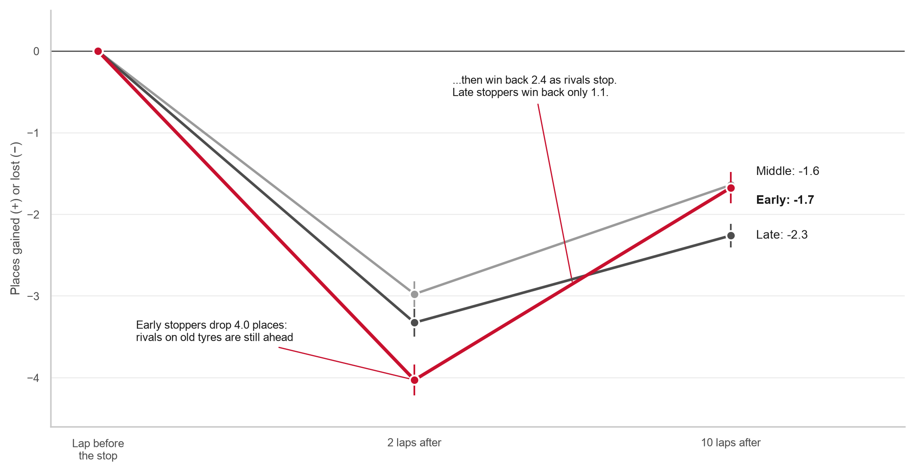
ACT 2 · THE UNDERCUT
Early stoppers lose 4 places, then win back 2.4 of them
-4.0 → -1.7
early stoppers: places after 2 laps, then after 10 laps
-3.3 → -2.3
late stoppers: they win back far less
The call you would make
If the car can survive two or three exposed laps, stop first.
Arwindh C N · CB.SC.U4CSE24207 · 23CSE353 Data Visualisation
Notebook cell A2.2 · 4 / 11
Notes:
Act two is about the pit stop. A stop costs about 23.7 seconds in the pit lane. I took every driver's first stop, 3,490 of them, and read their position the lap before, two laps after and ten laps after. Early stoppers, in red, drop 4.0 places at once, because rivals on old tyres are still ahead. But when those rivals make their own stops, early stoppers win back 2.4 places. Late stoppers win back only 1.1. This is the undercut: stopping first looks bad on TV for a few laps, and that is the strategy working. I also checked it without the stops in the first five laps, which are often damage, and the pattern stays the same.

Slide 5
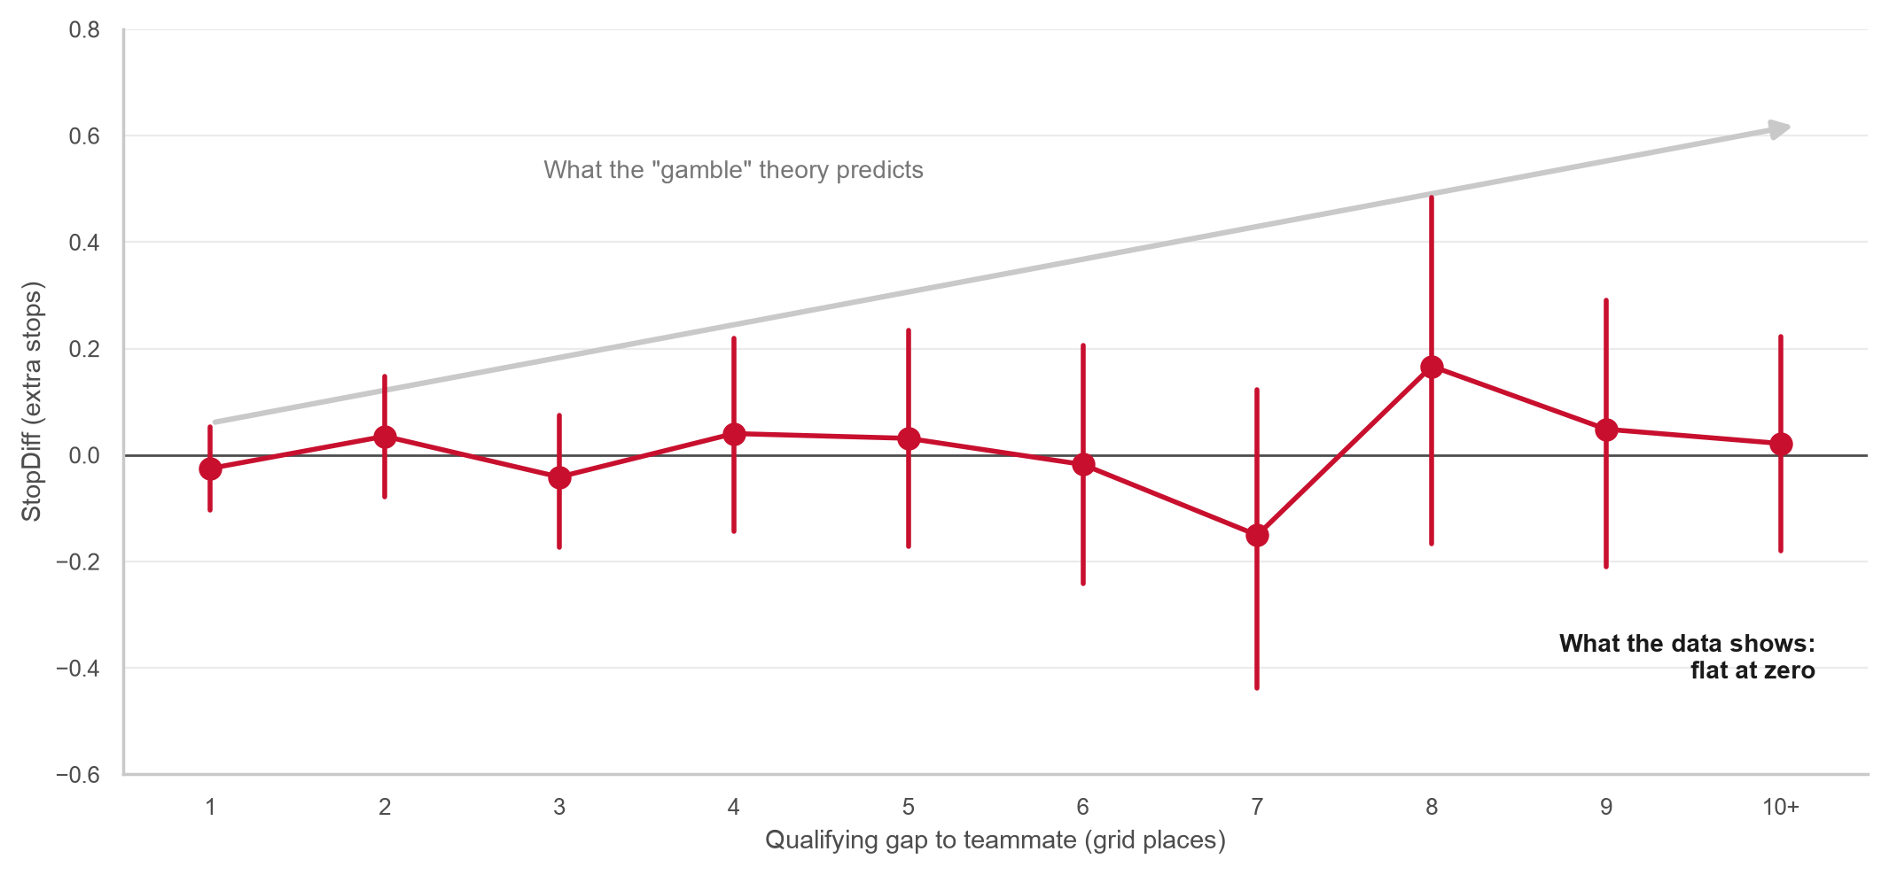
ACT 3 · THE ASSUMPTION
Myth: a driver far behind the teammate gambles on extra stops. The data says no (r = +0.02)
+0.02
link between qualifying gap and extra stops: none
2,085
teammate pairs: same team, same race, same car
The question
So if extra stops are not a planned gamble, what are they?
Arwindh C N · CB.SC.U4CSE24207 · 23CSE353 Data Visualisation
Notebook cell A3.3 · 5 / 11
Notes:
Act three is the twist. It joins three tables, qualifying, pit stops and results, through a link I had to build myself: who is my teammate. Teammates drive the same car, so comparing them takes the car out of the picture. Most fans would say: a driver who qualified far behind the teammate gambles on an extra pit stop. If that were true, the dots here would climb along the grey arrow. They do not. The correlation is +0.02, effectively zero, over 2,085 pairs. A driver ten places behind on Saturday is no more likely to make an extra stop than one who was a single place behind. So the assumption is dead. Then what is an extra stop?

Slide 6
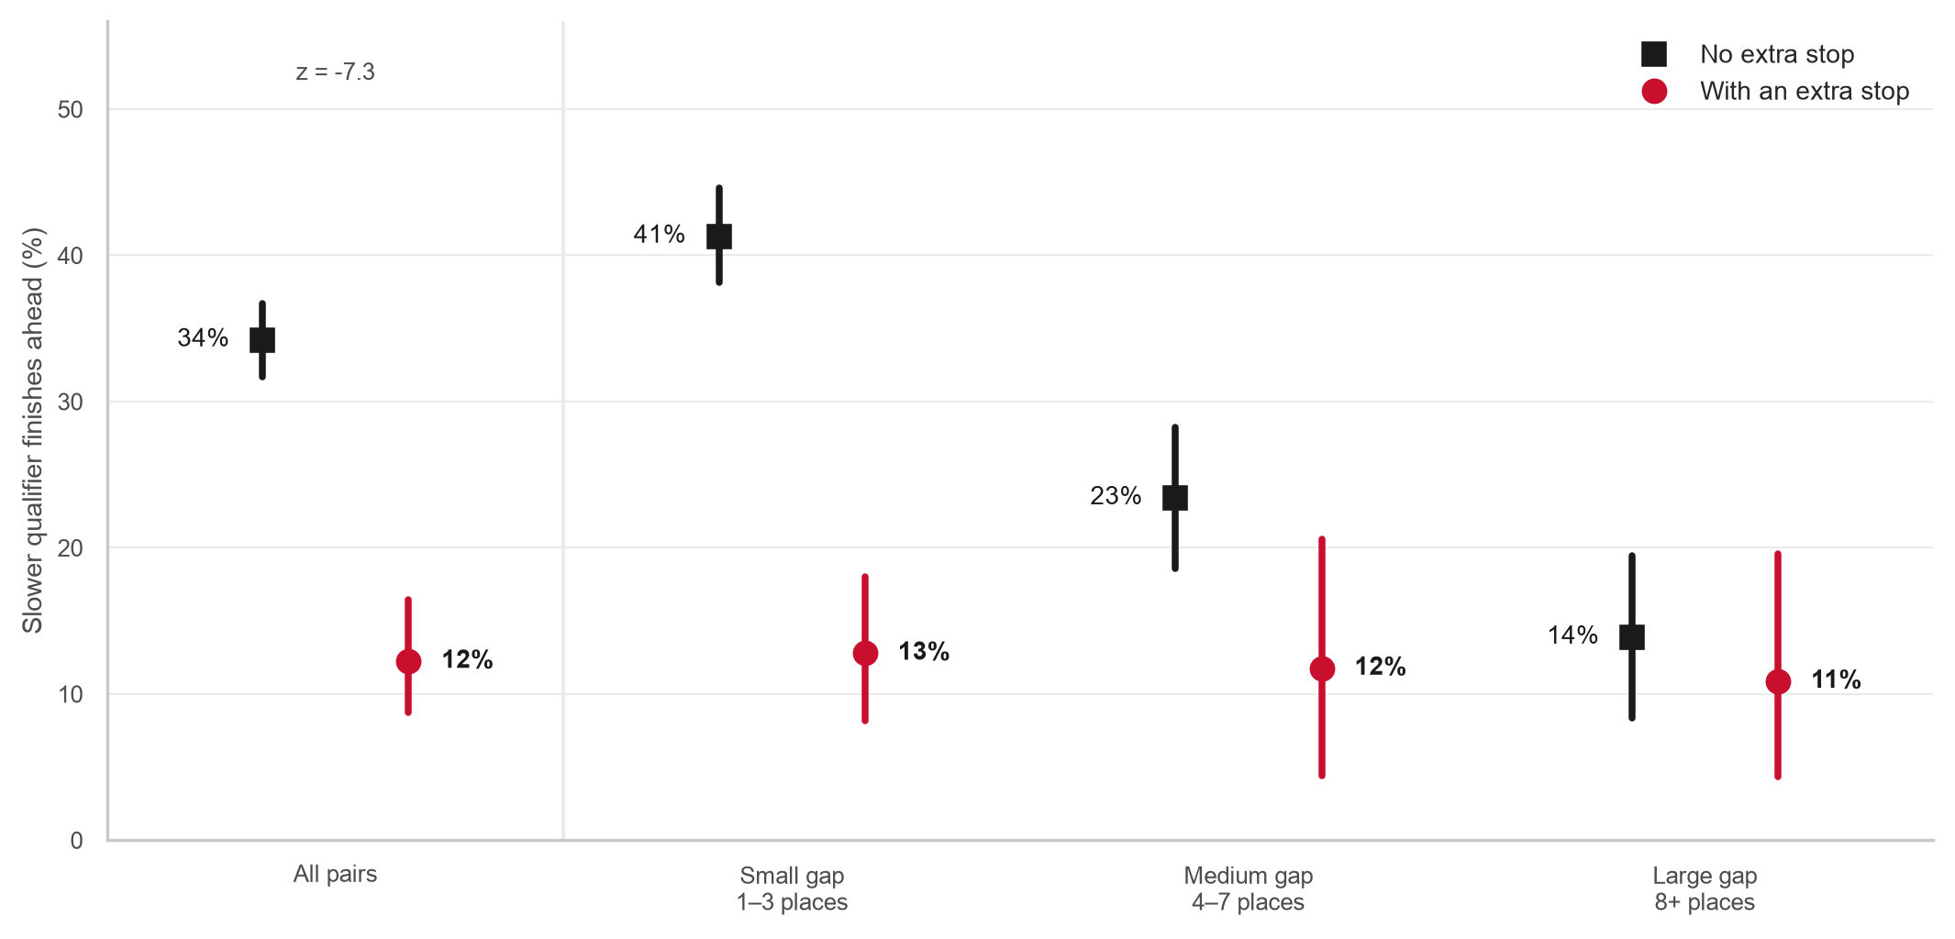
ACT 3 · THE REVEAL
The hidden alarm: with an extra stop, the slower teammate wins the duel 12% of the time, not 34%
z = -7.3
far beyond chance; holds at small, medium and large qualifying gaps
64%
when the teammate makes the extra stop, the slower qualifier usually wins
The call you would make
Treat an unplanned stop as an alarm, not a strategy. Protect the other car.
Arwindh C N · CB.SC.U4CSE24207 · 23CSE353 Data Visualisation
Notebook cell A3.4 · 6 / 11
Notes:
Here is the real finding. Among pairs where both cars were classified, the slower qualifier finished ahead of the teammate 34.2% of the time when there was no extra stop, but only 12.2% of the time with one. The test statistic is z = -7.3, which is far beyond chance, and it holds at every qualifying gap. It also works the other way: when the teammate made the extra stop, the slower qualifier won 64% of the time. And 27% of extra-stop drivers made their first stop in laps one to three, against 9% of the others. I want to be honest about what this means. The extra stop is a symptom of trouble, like damage or a puncture. It is not a weapon and it is not the cause. One caveat: in the large-gap bucket the sample is small and the difference is not significant.

Slide 7
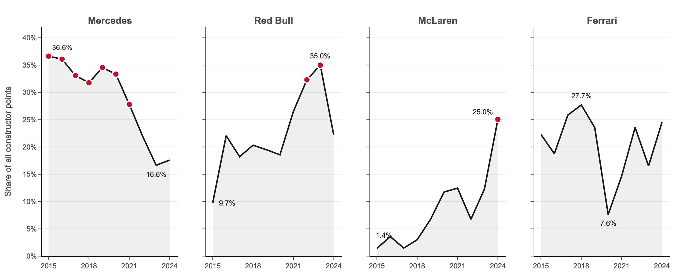
ACT 4 · THE CAR SETS THE CEILING
Three eras in ten seasons: Mercedes, then Red Bull, then McLaren
36.6% → 16.6%
9.7% → 35.0%
1.4% → 25.0%
Mercedes' share of all points, 2015 → 2023
Red Bull, 2015 → 2023
McLaren, 2015 → 2024: champion
Arwindh C N · CB.SC.U4CSE24207 · 23CSE353 Data Visualisation
Notebook cell A4.1 · 7 / 11
Notes:
Act four zooms out from one race to ten seasons. Each panel shows one team's share of all the constructor points in a season, and the red dots mark the champion. Mercedes took 36.6% of all points in 2015 and won 7 titles in a row, then fell to 16.6% in 2023. Red Bull rose from 9.7% to 35.0%. McLaren climbed from 1.4% to 25.0% and won in 2024. The biggest three-season swing in the data is Ferrari, whose share fell by 18 percentage points between 2017 and 2020. Changes like these are decided in the factory, not on the pit wall. I made this chart in Plotly, so in the notebook and the dashboard you can hover for the exact points.

Slide 8
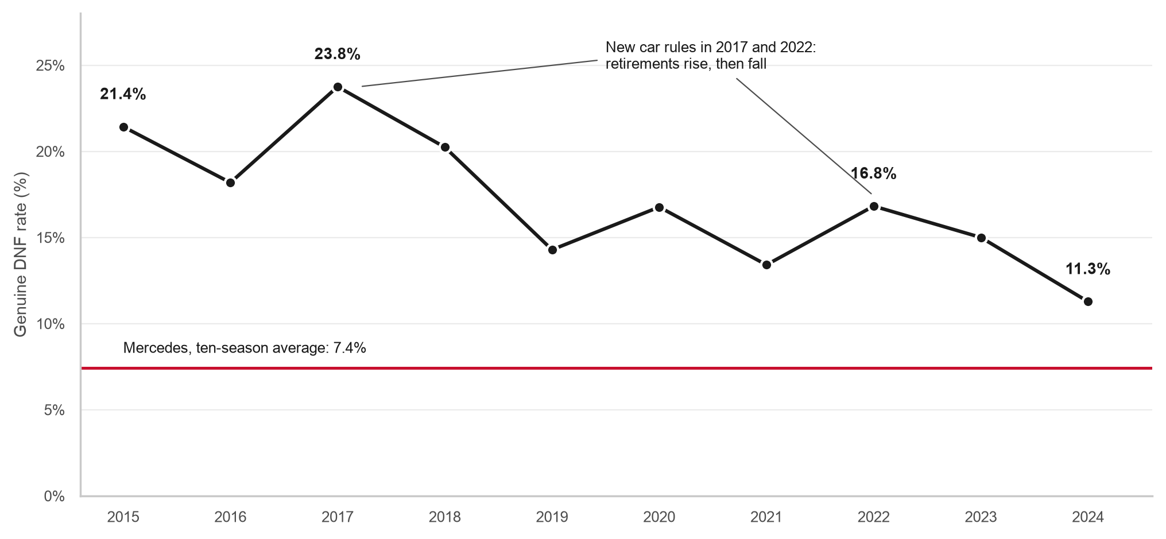
ACT 4 · THE CAR SETS THE CEILING
Cars now break down half as often (21% → 11%)
7.4%
Mercedes' DNF rate over ten seasons, the best of any team
67%
of all race wins went to that season's champion team
The call you would make
Plan the season around the car. Every edge from Acts 1–3 lives inside its ceiling.
Arwindh C N · CB.SC.U4CSE24207 · 23CSE353 Data Visualisation
Notebook cell A4.2 · 8 / 11
Notes:
Reliability is part of the ceiling too. A genuine DNF here means the car retired; a car that finished a lap down is not counted. In 2015, 21.4% of starts ended in a retirement; in 2024 only 11.3%. The fall is not smooth: 2017 and 2022 brought new technical rules, and retirements went up both times. Mercedes retired only 7.4% of the time. And 67% of all race wins went to the team that won the constructors' title that year. The notebook also has a driver-by-circuit heatmap: the driver rows differ by 4.6 places, the circuit columns by only 1.7. And an honest anti-climax: lap-time consistency is only weakly linked to points, r = -0.18, and that number moves a lot with the method. So the call for act four: every edge from acts one to three lives inside the ceiling the car sets.

Slide 9
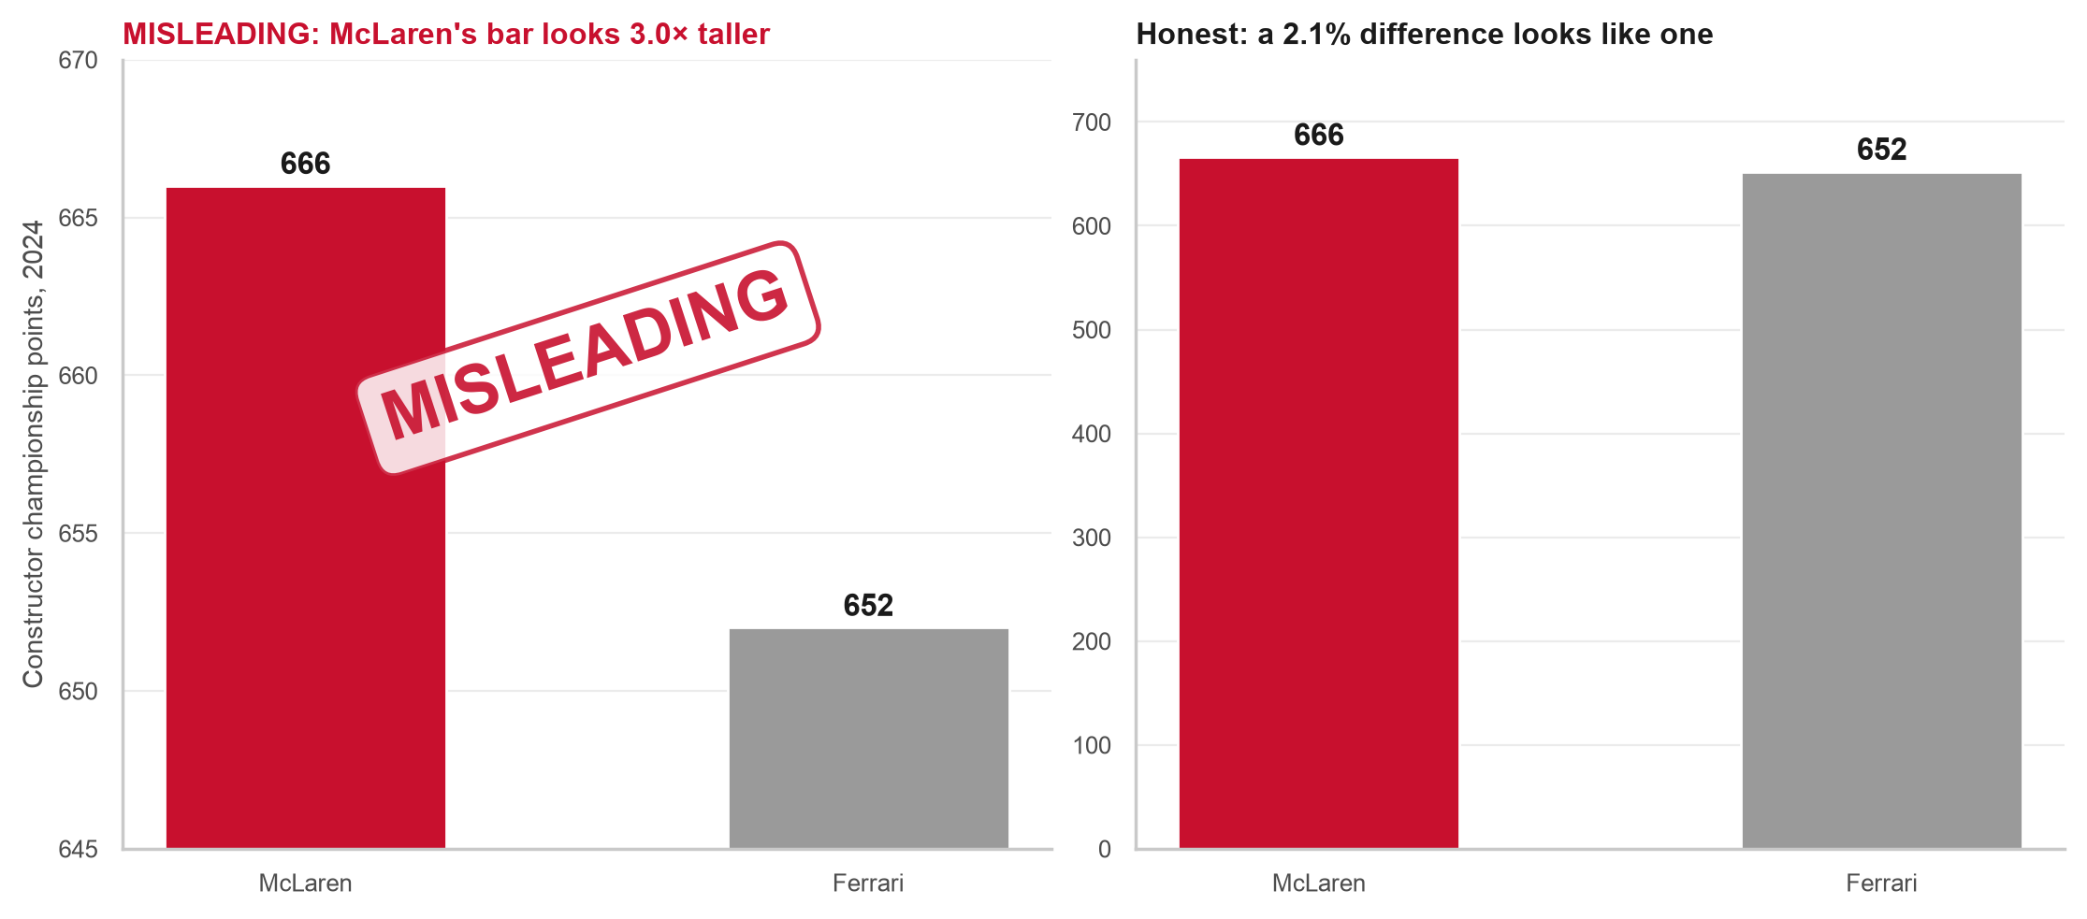
ACT 5 · WHAT THE DATA CANNOT TELL YOU
Same numbers, two stories: a cut axis turns a 2.1% gap into a bar 3.0× taller
What was manipulated
Only the y-axis: it starts at 645, not 0. Every number is real.
The false impression
"McLaren crushed Ferrari." In fact it was the closest constructors' title of the decade: 14 points.
The fix and the principle
Axis from zero, values on the bars. Truthful scaling and proportional ink: lie factor about 93 → 1.
Arwindh C N · CB.SC.U4CSE24207 · 23CSE353 Data Visualisation
Notebook cell A5.3 · 9 / 11
Notes:
Act five is about honesty. The chart on the left is deliberately misleading, and it is labelled that way. It shows the real 2024 constructor points: McLaren 666, Ferrari 652. The only change is the y-axis, which starts at 645 instead of zero. A bar shows value by its length, so cutting the axis makes McLaren's bar look 3.0 times taller, when the real gap is 2.1%. Tufte's lie factor compares the size of the effect in the picture with the size in the data; here it is about 93, where an honest chart is one. The honest version on the right starts at zero. What makes the misleading one dangerous is that no number on it is false. That is why every bar chart in my project starts at zero, and why I show confidence ranges and flag small samples.

Slide 10
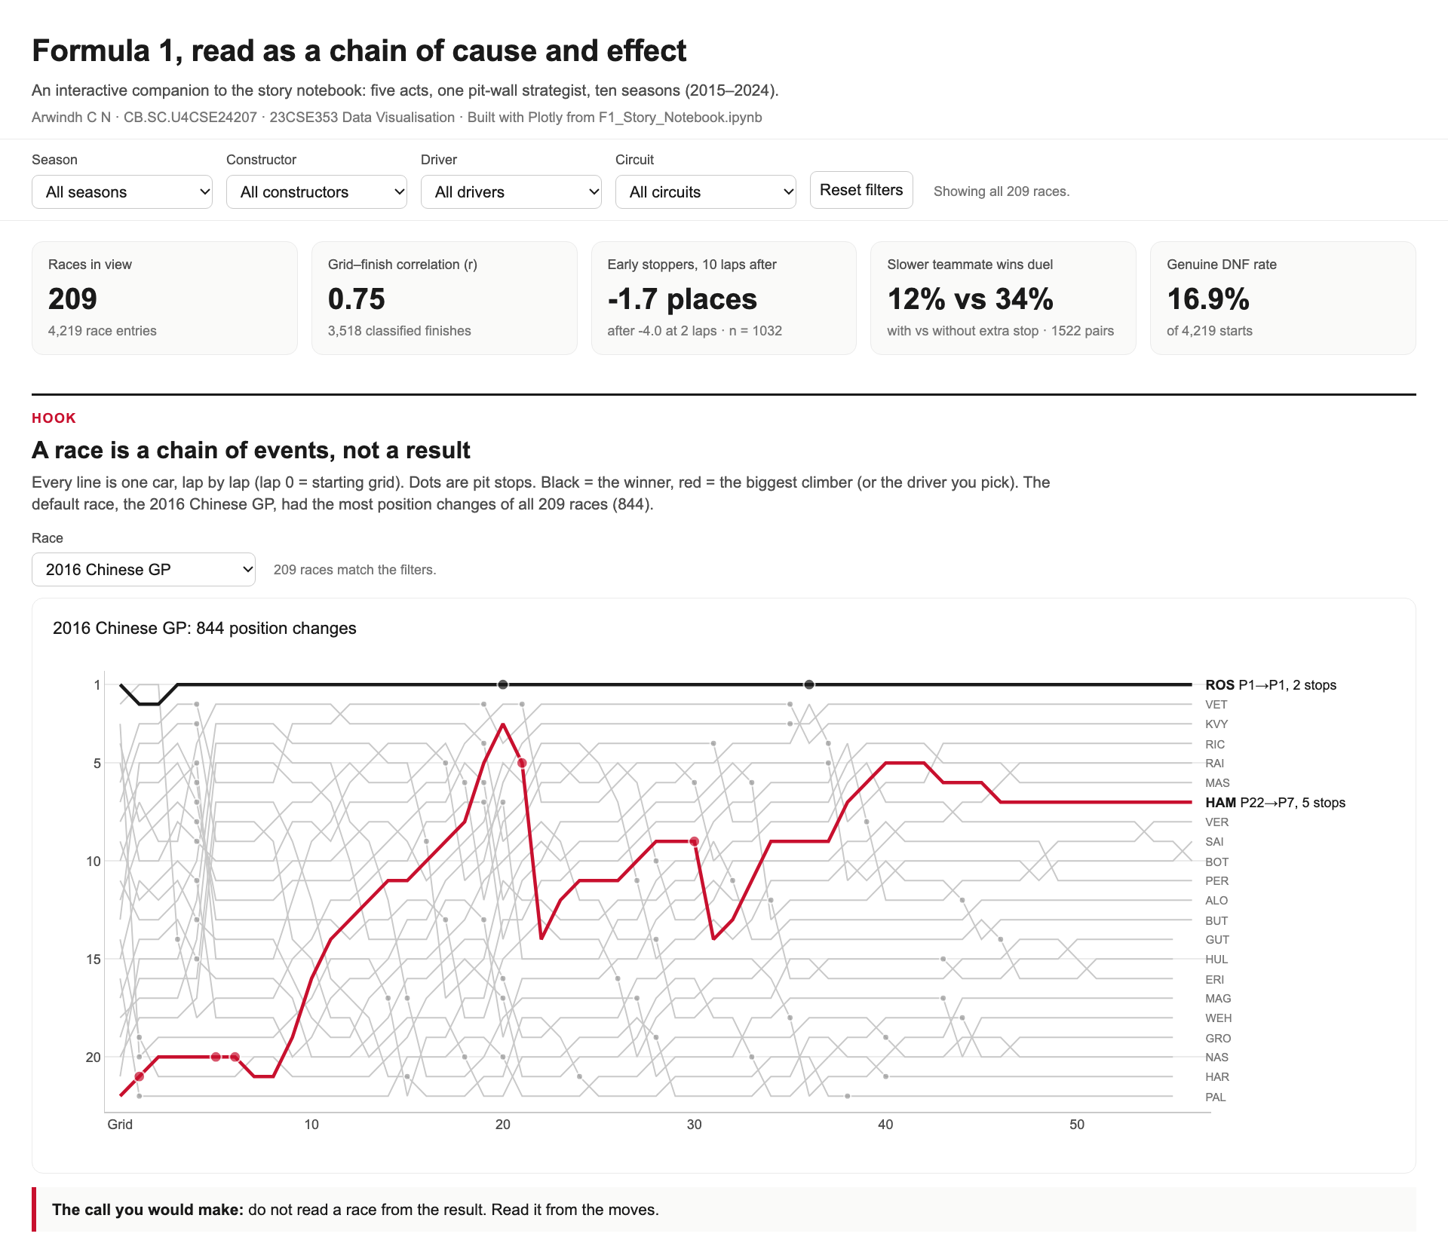
TOOLS AND DASHBOARD
Three tools, one notebook, one interactive dashboard
Matplotlib
Precise, hand-annotated story charts: the race trace, the undercut, the misleading pair.
Seaborn
Statistics with confidence ranges: correlations, teammate duel, heatmap, regression.
Plotly
Interactivity: hover, filters and the five-act dashboard in one HTML file.
Plotly replaced Power BI so the whole analysis stays reproducible in a single notebook.
Arwindh C N · CB.SC.U4CSE24207 · 23CSE353 Data Visualisation
Notebook cell D.1 · 10 / 11
Notes:
The course asks for three tools, and each one does a job the others cannot do as well. Matplotlib gives me pixel-level control, which I need for the race trace and for the misleading chart, where I control the axis exactly. Seaborn computes statistics for me, like the bootstrap confidence ranges in the teammate chart. Plotly gives interactivity. One change from my Primary Review: I planned Power BI, but Plotly replaced Power BI so the whole analysis stays reproducible in a single notebook. The dashboard, on the left, is one HTML file of about 5.9 megabytes. It has one filter row for season, constructor, driver and circuit, and every chart re-draws for the same selection. It follows the same five acts, and it warns you when a selection is too small to trust.

Slide 11
BACK TO THE HOOK
The 844 position changes were a chain of cause and effect
Act 1
Rosberg won from pole (Shanghai: r = 0.80).
Act 2
On lap 4, 10 cars pitted at once and the order reshuffled.
Act 3
Hamilton made 3 more stops than his teammate: the alarm, not the plan.
Act 4
Both drove the 2016 Mercedes, the car with 36.1% of all points.
What the data cannot tell you: every result is a correlation, not an experiment. There are no tyre, weather or safety-car fields, so the why behind an event is always outside the data.
Arwindh C N · CB.SC.U4CSE24207 · 23CSE353 Data Visualisation
11 / 11
Notes:
Let us go back to the race we started with and read it as a strategist. Act one: Rosberg started on pole and won, at a circuit where grid and finish are linked at 0.80. Act two: on lap 4, 10 cars pitted at once and the order reshuffled. Act three: Hamilton, the slower qualifier in the same car, made 3 more stops than his teammate, and his first stop came on lap 1: that was the alarm, not the plan. Act four: both drove the 2016 Mercedes, which took 36.1% of all points that season, which is how a car starting 22nd could still reach the points. And the limits: all of this is correlation, not causation, and the data has no tyre, weather or safety-car fields. The 844 position changes were never random. They were a chain of cause and effect. Thank you.

