Slide 1
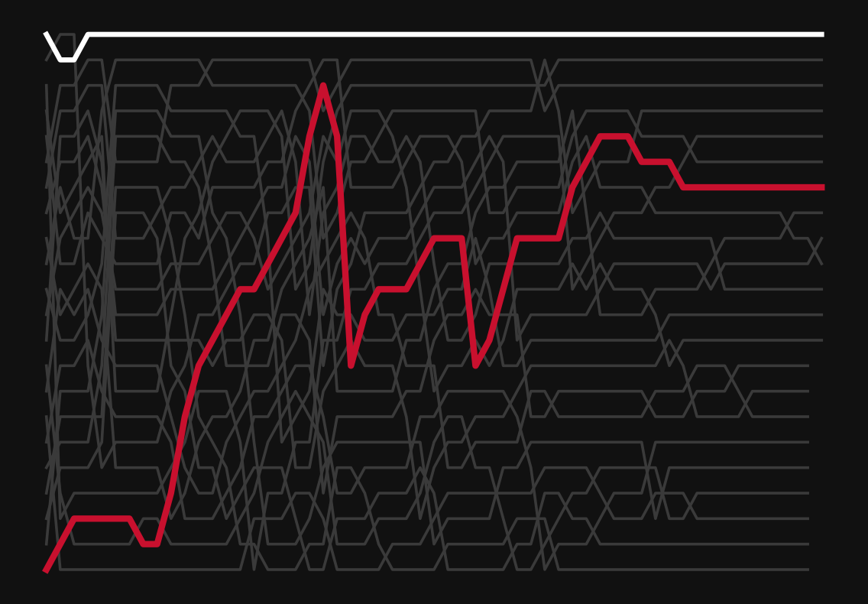
FINAL REVIEW · DATA VISUALISATION CASE STUDY
Formula 1, read as a chain of cause and effect
Drivers, constructors, race strategy and performance trends, 2015–2024
Arwindh C N
CB.SC.U4CSE24207 · 23CSE353 Data Visualisation
209
10
227,123
15 + 1
races analysed
seasons, 2015–2024
lap-by-lap records
visualizations + dashboard
Notes:
F1 BASICS: Formula 1, or F1, is the top level of car racing. About twenty cars race around a track for many laps, and the first car to cross the finish line wins.
WHAT: My project looks at 10 years of Formula 1 races: 209 races from 2015 to 2024.
WHY: Most people only see who won. I want to show why they won. A race is a chain of cause and effect.

Slide 2
SECTION 1 · PROBLEM STATEMENT AND OBJECTIVES
Why do races end the way they do? Six questions, one story
Problem background
A Formula 1 result depends on many linked factors: the car, the driver, qualifying, pit stops, the track and reliability. A results table shows who won, not why.
Problem statement
Which factors really shape a race result, by how much, and which only appear to?
Why it matters
A strategist has seconds to decide. Knowing which levers are real, and which are myths, changes the call.
Approach
One story in five acts, told to one reader: the strategist on the pit wall.
Analytical objectives (from the Primary Review)
O1
Driver performance across seasons
Act 4
O2
Constructor performance across seasons
Act 4
O3
Qualifying position vs final position
Act 1
O4
Pit-stop strategy vs race outcome
Acts 2–3
O5
Driver performance across circuits
Act 4
O6
DNF and retirement patterns over time
Act 4
Arwindh C N · CB.SC.U4CSE24207 · 23CSE353 Data Visualisation
2 / 16
Notes:
F1 BASICS: A season has around twenty races in different countries. Each race is called a Grand Prix. Drivers and teams collect points in every race to win the championship.
WHAT: A race result depends on many things: the car, the driver, the starting position, pit stops and the track.
WHY: A results table only shows who won, not why. So in my Primary Review I set six questions, O1 to O6. Each part of my story answers one of them.

Slide 3
SECTION 1 · DATASET DESCRIPTION
Ten seasons, 209 races, every car on every lap
Source
Ergast-lineage Formula 1 dataset (the data behind the Jolpica F1 API): 14 linked CSV tables, 1950–2024.
Coverage
2015–2024: 209 races, 53 drivers, 18 constructors, 32 circuits.
Data quality concerns
641 drivers have no finishing position; "+1 Lap" looks like a retirement but is not; 79 pit-lane starts are coded as grid 0; missing values are written as \N.
Table | Rows | One row is
results | 4,219 | one driver in one race
qualifying | 4,205 | one driver's qualifying session
pit_stops | 7,544 | one pit stop (lap, pit-lane time)
lap_times | 227,123 | one car on one lap (position, time)
standings (final) | 223 / 101 | a driver's / team's final season table
races, circuits | 209 / 32 | calendar and track details
All tables link through ID numbers (raceId, driverId, constructorId), so the joins are exact even when a team changes its name.
Arwindh C N · CB.SC.U4CSE24207 · 23CSE353 Data Visualisation
Notebook cell P.12 · 3 / 16
Notes:
F1 BASICS: In F1, a team is called a constructor. Each team builds its own car and runs two cars. The two drivers in the same team are called teammates, and they drive the same car.
WHAT: I used the Ergast F1 dataset: 14 linked tables. I kept 2015 to 2024: 209 races, 53 drivers and 18 teams.
WHY: The lap table is the most important one. It shows where every car was on every lap, so I can follow a race move by move.

Slide 4
SECTION 1 · DATA CLEANING AND PREPROCESSING
Fourteen raw tables cleaned into one driver-race dataset
1. 14 raw CSVs
2. Keep 2015–2024
3. Join on IDs
4. Fix and flag
5. Merge and check
1950–2024; missing values written as \N
209 of 1,125 races
never on names: teams rename (Toro Rosso → RB)
grid 0 → missing; lapped car ≠ DNF
one driver-race table; every count = workbook
Before → after | Raw | Clean
Race-result rows | 26,759 | 4,219
Races | 1,125 | 209
Lap records | 589,081 | 227,123
Columns (results → merged) | 18 | 35
Pit-stop time | text (m:ss) | seconds
Key decisions
Two flags, not one: 641 unclassified vs 715 genuine DNFs. 74 cars retired late but still got a position.
Pit time from milliseconds: 484 stops of 60 s or more (red flags, repairs); normal median 23.7 s.
Verified: every row count matches the Primary Review workbook.
Arwindh C N · CB.SC.U4CSE24207 · 23CSE353 Data Visualisation
Notebook cell P.1–P.12 · 4 / 16
Notes:
F1 BASICS: The grid is the starting order of the race. DNF means 'did not finish': the car crashed or broke down. A car that finishes one lap behind the leader still finished, so it is not a DNF.
WHAT: I cleaned the data in 5 steps: read the files, kept 2015 to 2024, joined the tables using ID numbers, fixed wrong codes, and merged everything into one table.
WHY: Without cleaning, the numbers would be wrong. For example, a car that finished one lap behind is not a retirement. My row counts match my Primary Review workbook.

Slide 5
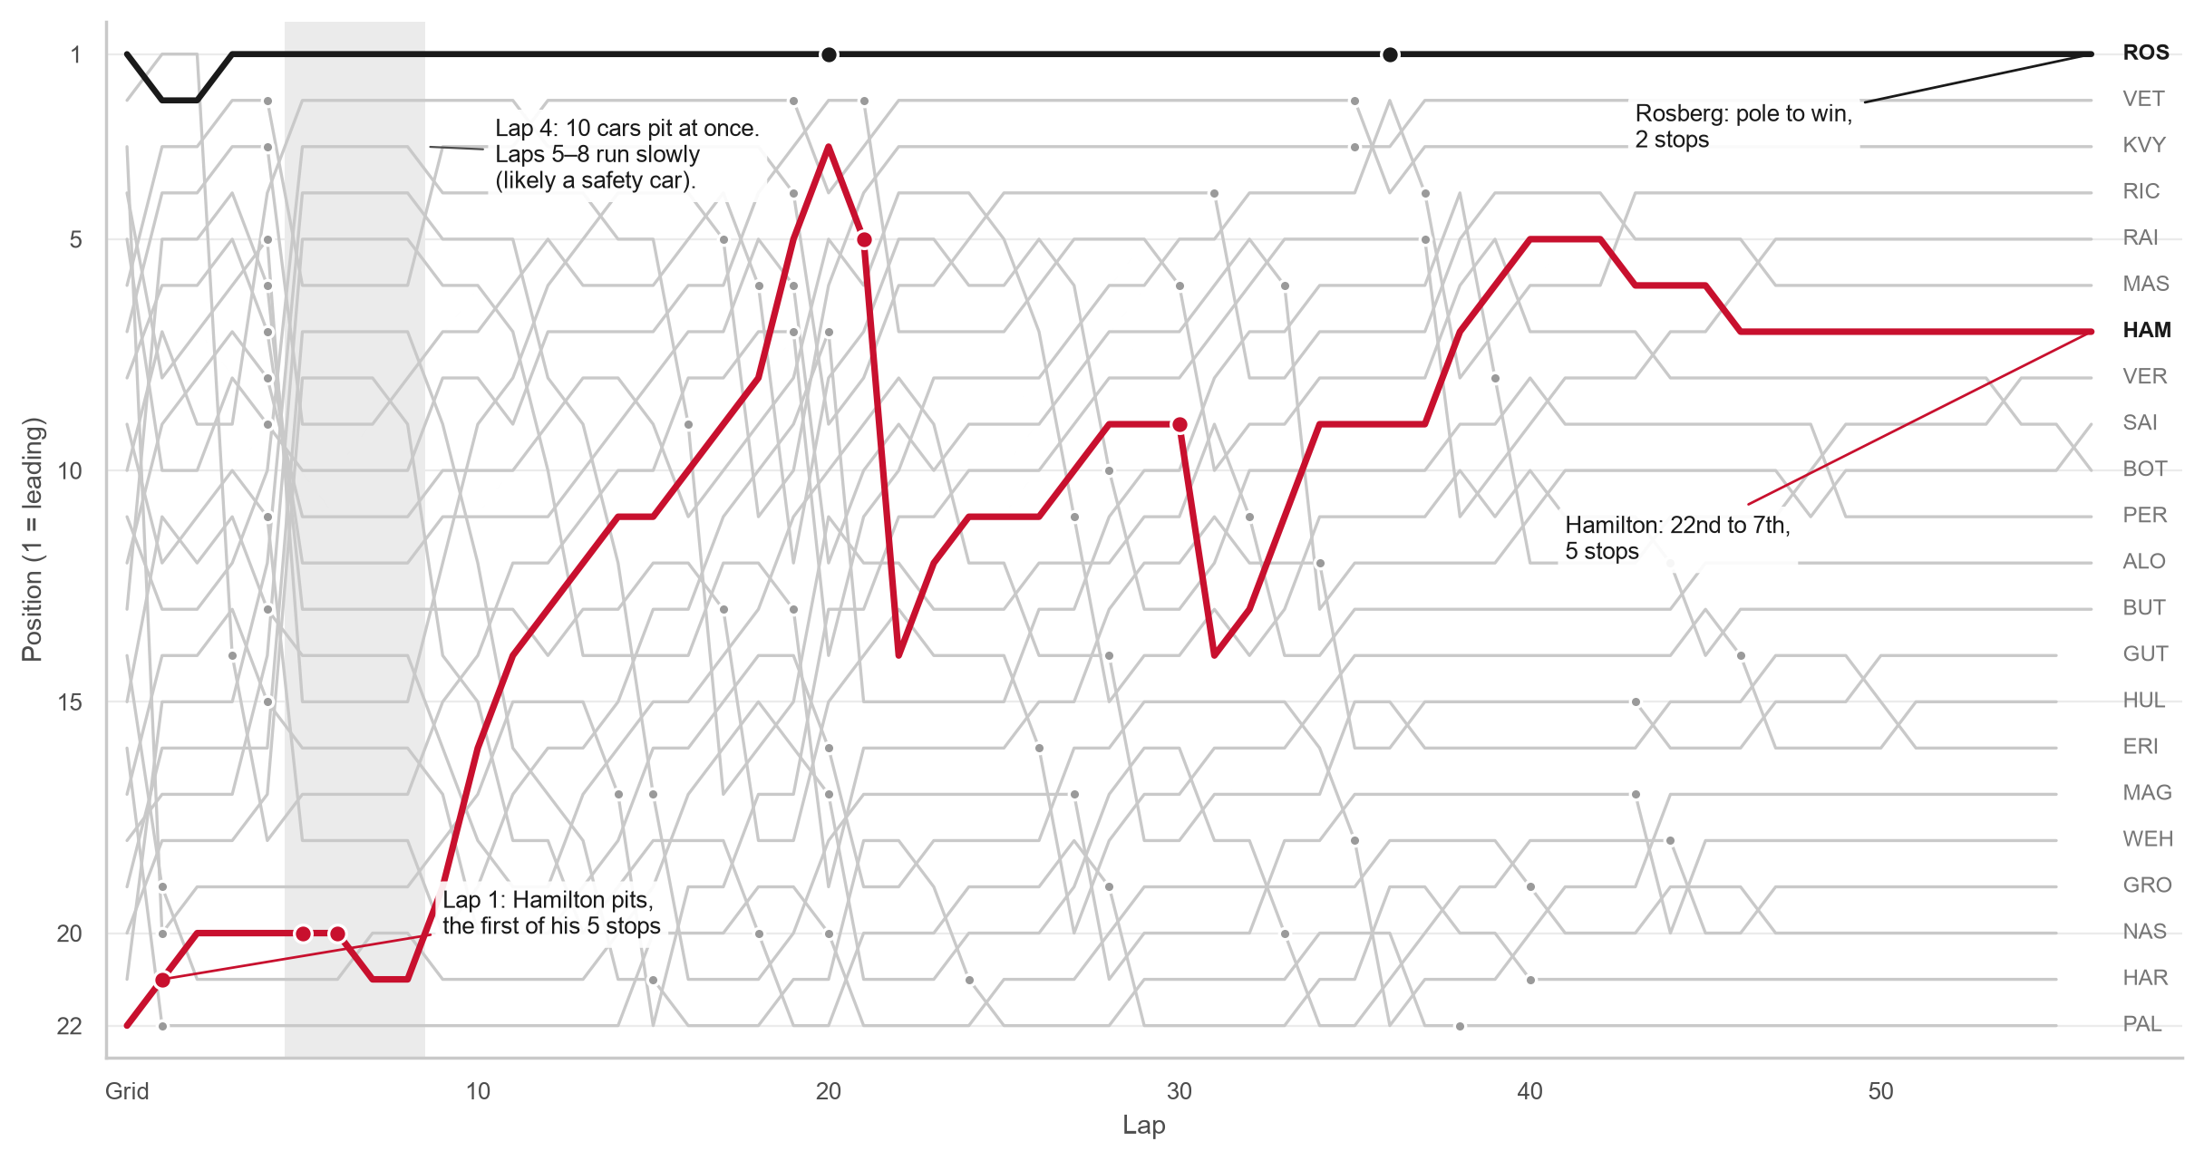
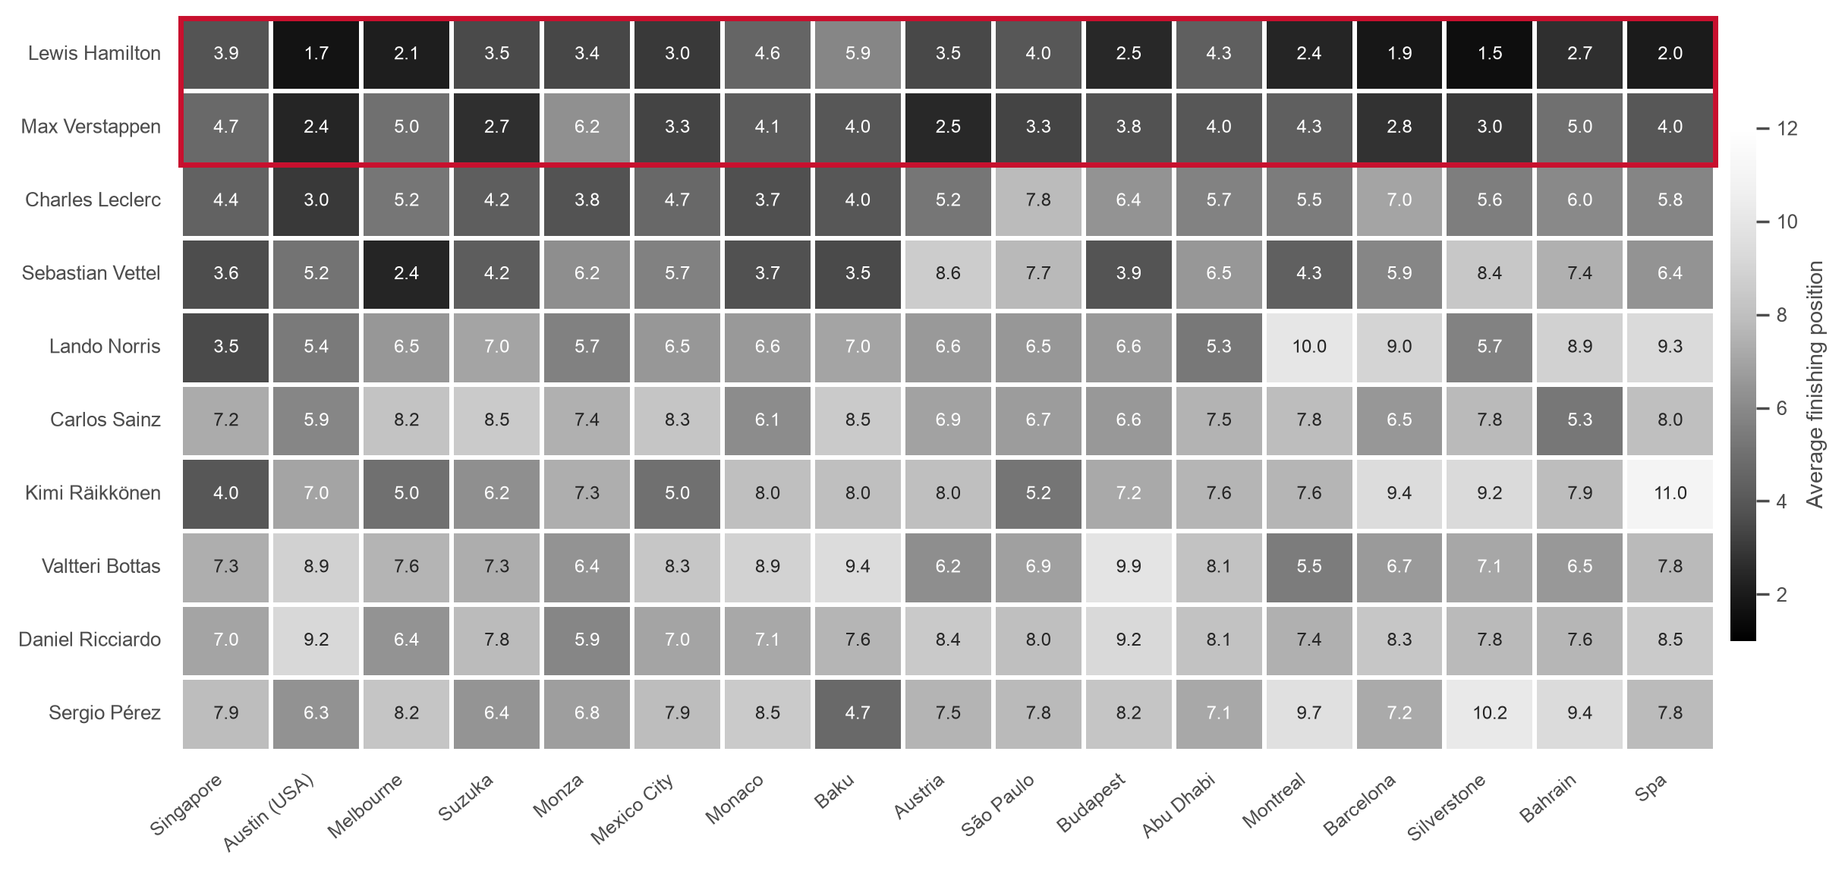
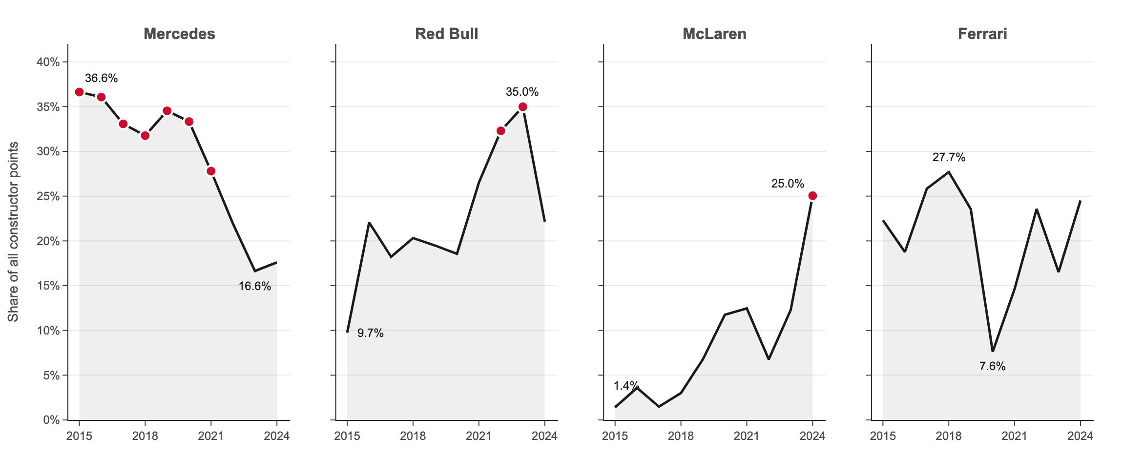
SECTION 2 · TOOLS AND VISUALIZATION APPROACH
Three tools, each doing the job it does best
Matplotlib
Precise, hand-annotated story charts
V1 bump chart · V4 slope chart · V10 DNF trend · V11 wins bars · V15 misleading pair
Exact control of every mark, label and axis, which the ethics demo needs.
Seaborn
Statistics with confidence ranges
V2 density · V3 lollipop · V5 strip plot · V6–V8 point plots · V13 heatmap · V14 regression
Bootstrap confidence intervals and grouping in one call.
Plotly
Interaction
V9 points-share eras · V12 season points · the five-act dashboard
Hover, filters and one offline HTML file anyone can explore.
Beyond basic charts: bump chart, lollipop with 95% ranges, slope chart, dodged point plots, small multiples, annotated heatmap, misleading-vs-honest pair and a linked dashboard. One colour rule throughout: greys for context, red for the thing to look at.
Plotly replaced Power BI so the whole analysis stays reproducible in a single notebook.
Arwindh C N · CB.SC.U4CSE24207 · 23CSE353 Data Visualisation
5 / 16
Notes:
F1 BASICS: A lap is one full trip around the track. A car's position is its place in the race order: first, second, third and so on. My charts follow these positions lap by lap.
WHAT: I used three tools. Matplotlib for detailed story charts. Seaborn for statistics. Plotly for interactive charts and the dashboard.
WHY: Each tool does one job best. I also avoided basic bar and pie charts. Plotly replaced Power BI so the whole analysis stays reproducible in a single notebook.

Slide 6
SECTION 2 · VISUALIZATIONS · HOOK
844 position changes in one race, and the pole-sitter still won
Observation
The 2016 Chinese GP had the most position changes of all 209 races. Hamilton (red) started 22nd, made 5 stops and finished 7th. Rosberg (black), same car, won from pole.
The call you would make
Do not read a race from the result. Read it from the moves.
Visualization 1 · Bump chart with pit-stop markers · Matplotlib
Arwindh C N · CB.SC.U4CSE24207 · 23CSE353 Data Visualisation
Notebook cell H.2 · 6 / 16
Notes:
F1 BASICS: Pole position means starting first. A pit stop is when a car drives into a side lane, called the pit lane, to change its tyres. It costs time, so the car usually loses a few places.
WHAT: Each line is one car, showing its position on every lap. Dots are pit stops. This race had 844 position changes, the most of all 209 races.
WHY: Hamilton, in red, started 22nd, made 5 stops and finished 7th. Rosberg, in black, started first and won. A race is a story of moves, not just a result.

Slide 7
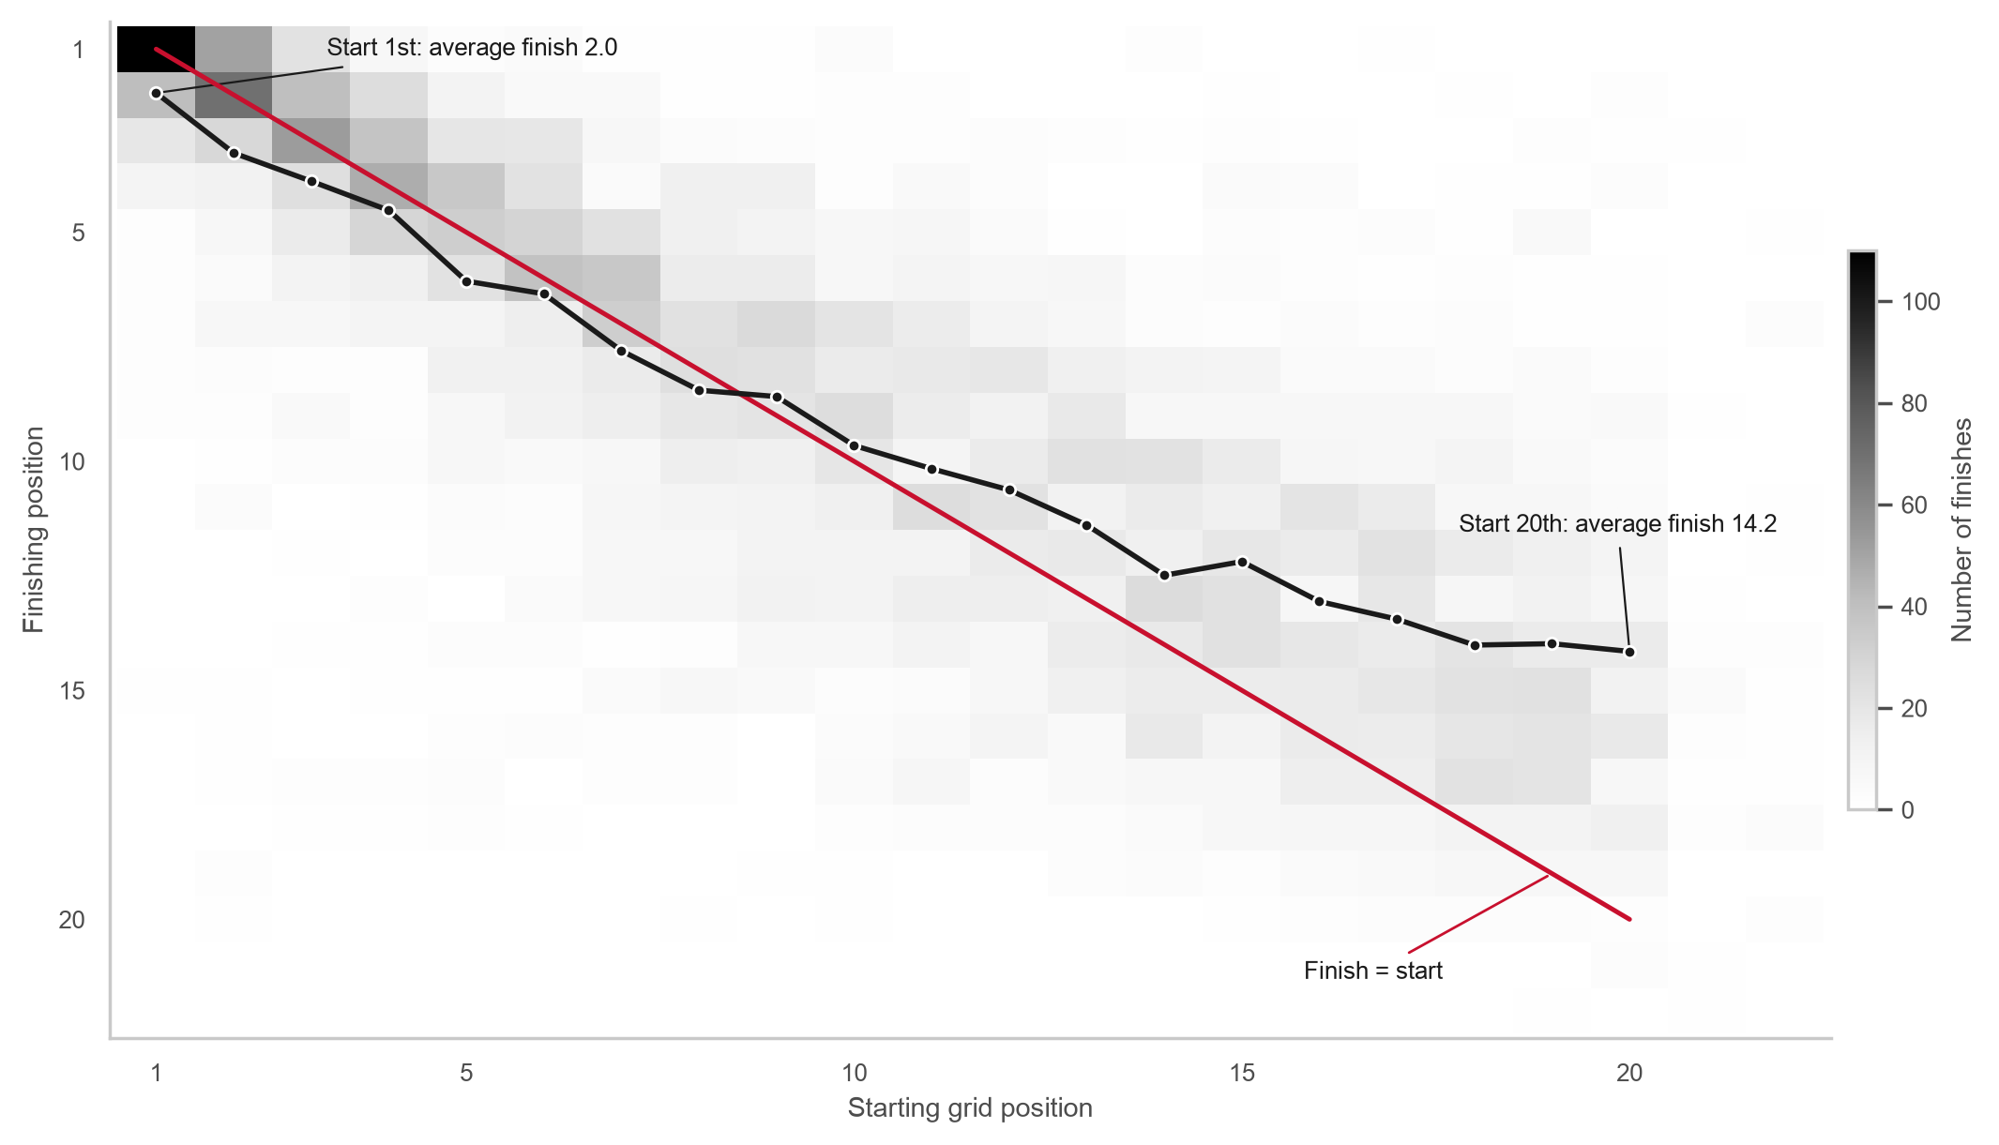
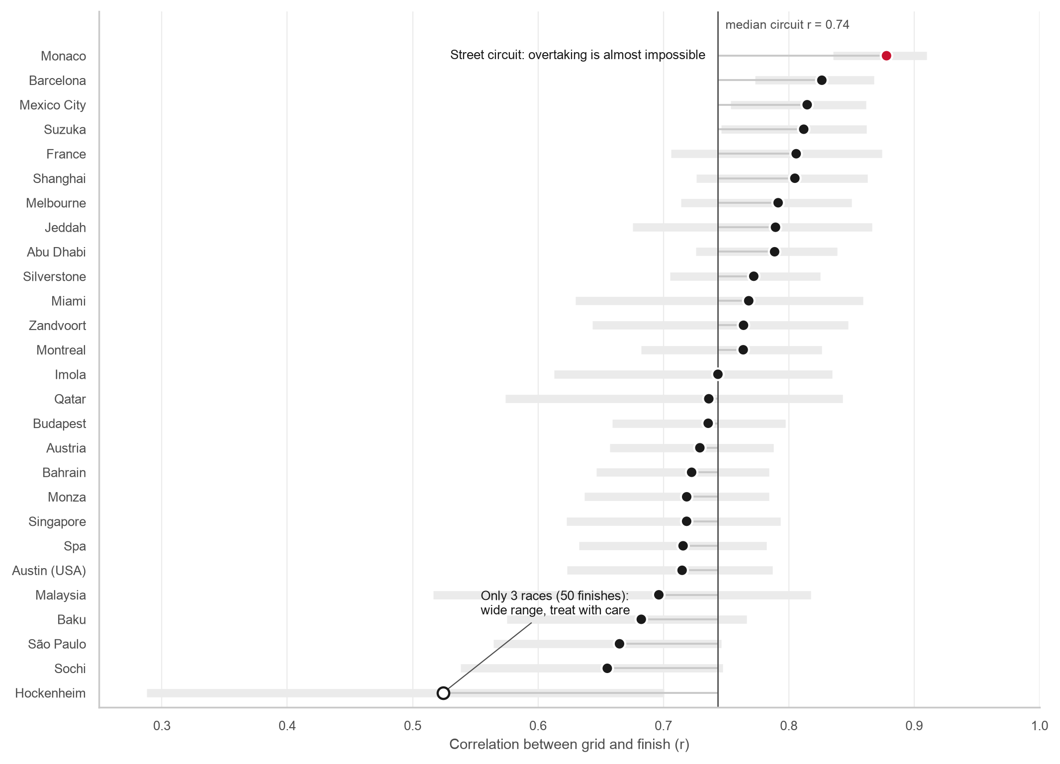
SECTION 2 · VISUALIZATIONS · ACT 1
Saturday decides more than you think: Monaco locks the order in
Visualization 2 · 2D histogram with mean line · Seaborn
Visualization 3 · Lollipop with 95% ranges · Seaborn
Observation: strong link between grid and finish (r = 0.75); pole won 53% of races.
Observation: Monaco 0.88; Hockenheim 0.52, but only 3 races, so its range is wide.
Arwindh C N · CB.SC.U4CSE24207 · 23CSE353 Data Visualisation
Notebook cell A1.1–A1.2 · 7 / 16
Notes:
F1 BASICS: Qualifying happens on Saturday. Each driver tries one very fast lap, and the fastest driver starts at the front on Sunday. Overtaking means passing another car on the track.
WHAT: These charts compare where drivers start and where they finish. The link score is 0.75 out of 1, which is strong. Pole position won 53% of all races.
WHY: The link changes by track. Monaco is 0.88 because its streets are too narrow to overtake. So at Monaco, Saturday's qualifying decides the race.

Slide 8
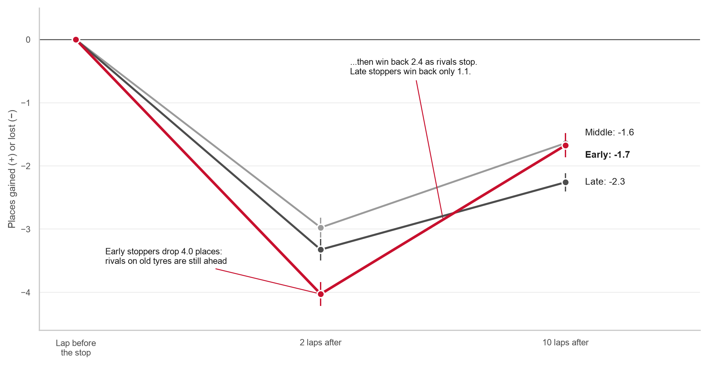
SECTION 2 · VISUALIZATIONS · ACT 2
Early stoppers lose 4 places, then win back 2.4 of them
Observation
Across 3,490 first pit stops, early stoppers go -4.0 then -1.7; late stoppers -3.3 then -2.3. Same pattern without the stops in laps 1–5.
The call you would make
If the car can survive two or three exposed laps, stop first.
Visualization 4 · Slope chart with error bars · Matplotlib
Arwindh C N · CB.SC.U4CSE24207 · 23CSE353 Data Visualisation
Notebook cell A2.1–A2.3 · 8 / 16
Notes:
F1 BASICS: Tyres wear out during a race, so every car must stop at least once to change them. A stop costs around 23.7 seconds. The undercut means stopping before your rival, so your new tyres make you faster while the rival is still on old tyres.
WHAT: This chart shows a driver's position before and after the first pit stop. Early stoppers drop about 4.0 places, then win back 2.4.
WHY: Late stoppers win back only 1.1. So stopping first pays off: that is the undercut working.

Slide 9
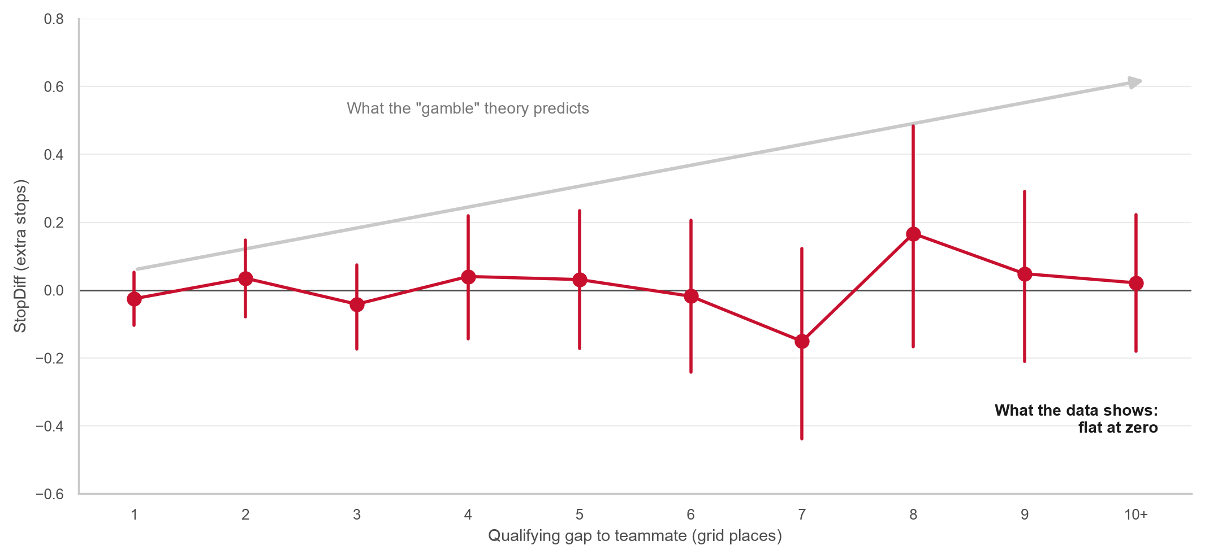
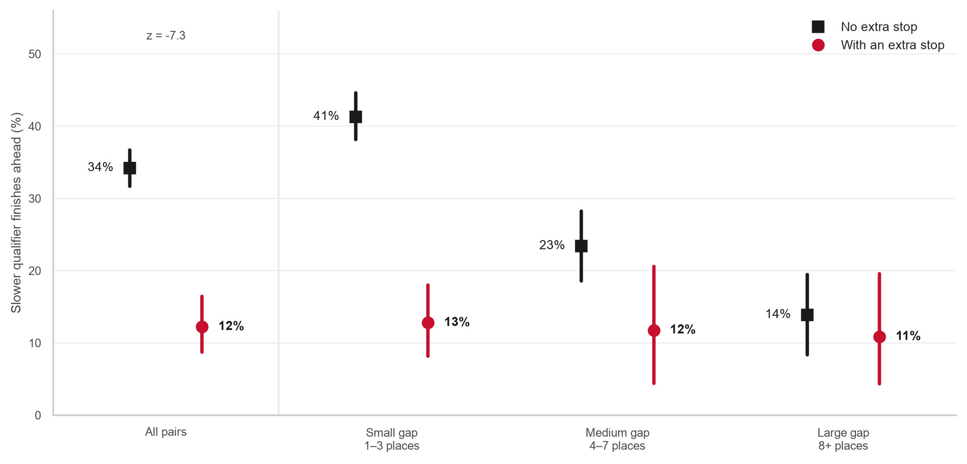
SECTION 2 · VISUALIZATIONS · ACT 3
The myth is dead, the alarm is real: an extra stop means trouble
Visualization 6 · Point plot vs expected trend · Seaborn
Visualization 7 · Dodged point plot with CIs · Seaborn
Observation: the myth says drivers far behind their teammate gamble on extra stops. No link: r = +0.02.
Observation: with an extra stop the slower teammate wins 12% of duels, not 34% (z = -7.3).
The call you would make: treat an unplanned stop as an alarm, not a strategy, and protect the other car's result.
Arwindh C N · CB.SC.U4CSE24207 · 23CSE353 Data Visualisation
Notebook cell A3.3–A3.5 · 9 / 16
Notes:
F1 BASICS: Teammates drive the same car, so comparing them is fair. An extra pit stop means stopping one more time than the teammate, often because of damage, a flat tyre or a crash.
WHAT: I compared teammates, because they drive the same car. People think a driver who is far behind gambles on extra pit stops. The left chart shows no link at all.
WHY: The right chart shows the truth. With an extra stop, a driver beats the teammate only 12% of the time, not 34%. An extra stop is a warning sign that something went wrong, not a plan.

Slide 10
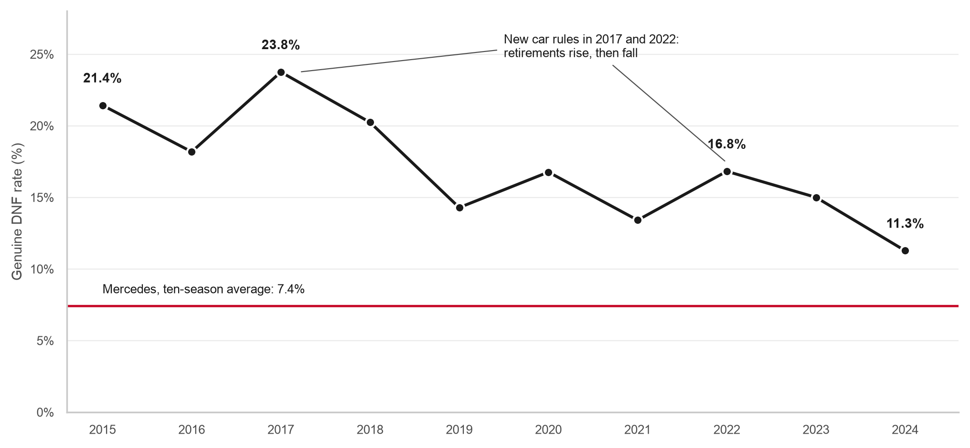
SECTION 2 · VISUALIZATIONS · ACT 4
The car sets the ceiling: three eras in ten seasons
Visualization 9 · Small-multiple area charts · Plotly
Visualization 10 · Trend line with reference line · Matplotlib
Observation: Mercedes 36.6% of points (2015) → 16.6% (2023); Red Bull up to 35.0%; McLaren 1.4% → 25.0%.
Observation: genuine DNFs 21.4% → 11.3%; Mercedes 7.4%.
The call you would make: plan the season around the car: every edge from Acts 1–3 lives inside its ceiling.
Arwindh C N · CB.SC.U4CSE24207 · 23CSE353 Data Visualisation
Notebook cell A4.1–A4.2 · 10 / 16
Notes:
F1 BASICS: Each team builds its own car, so some cars are simply faster. The top ten cars in each race get points. The team with the most points in a year wins the constructors' championship.
WHAT: These charts show each team's share of all points, and how often cars broke down. Mercedes led first, then Red Bull, then McLaren. Breakdowns fell from 21.4% to 11.3%.
WHY: The car matters most. Good strategy can only help within the limit the car sets.

Slide 11
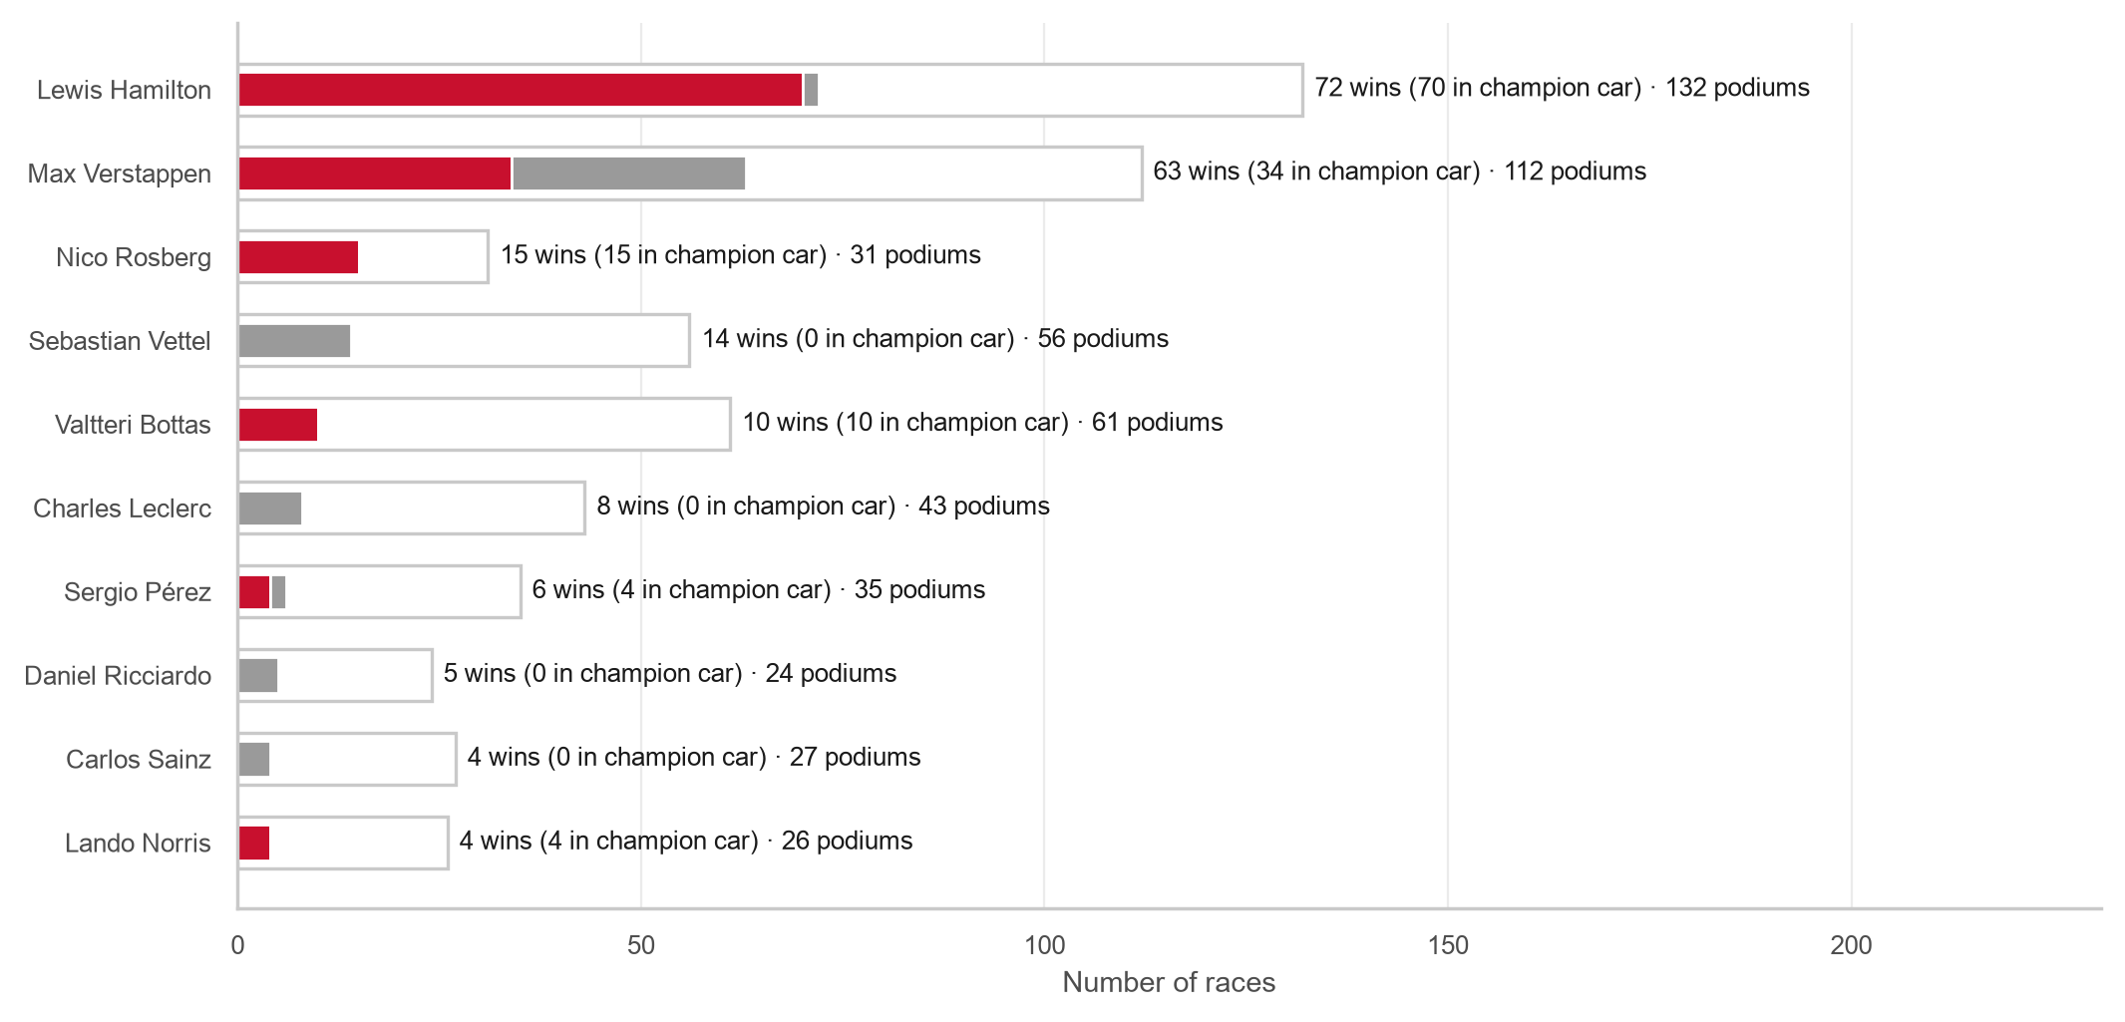
SECTION 2 · VISUALIZATIONS · ACT 4
Wins follow the car, and the driver matters more than the track
Visualization 11 · Stacked bars with podium outline · Matplotlib
Visualization 13 · Annotated heatmap · Seaborn
Observation: 67% of all wins went to that season's champion team; Hamilton 70 of 72 in the champion car.
Observation: driver rows differ by 4.6 places, circuit columns by only 1.7.
Honest anti-climax: lap-time consistency barely predicts points (r = -0.18, Visualization 14), and other methods give +0.03 to -0.40.
Arwindh C N · CB.SC.U4CSE24207 · 23CSE353 Data Visualisation
Notebook cell A4.3–A4.6 · 11 / 16
Notes:
F1 BASICS: Every year there are two championships: one for drivers and one for teams. A driver in the fastest car usually wins the most races.
WHAT: Left: 67% of all race wins went to the best team of that season. Right: drivers stay at the same level at almost every track.
WHY: The car and the driver matter more than the track. Steady lap times barely help, and I show that honestly.

Slide 12
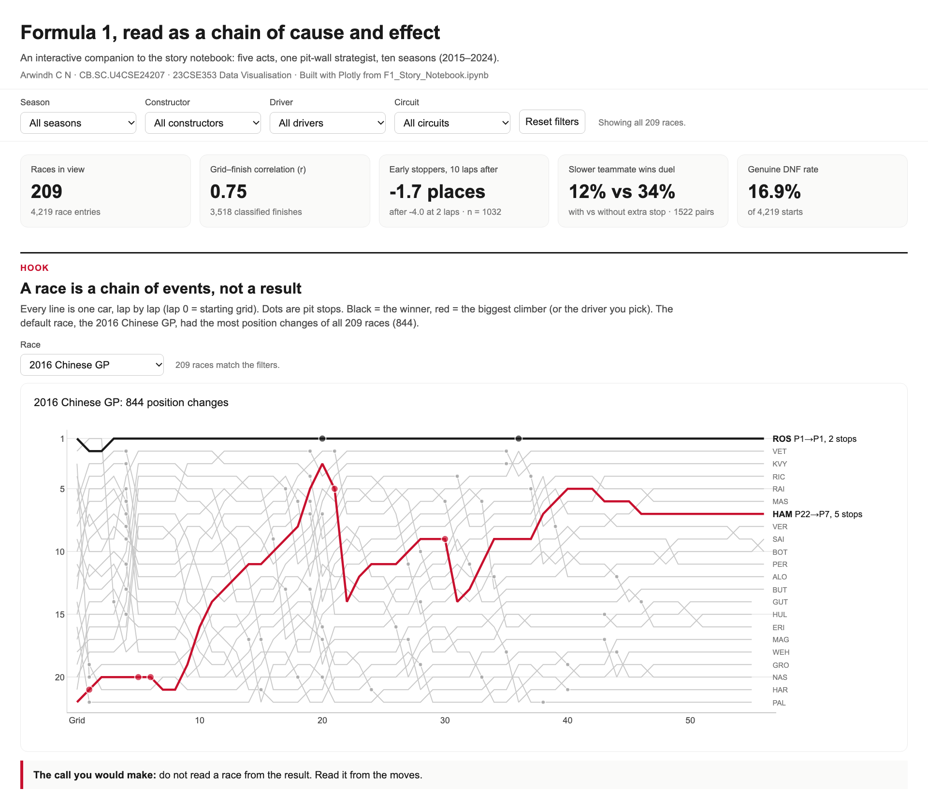
SECTION 2 · INTERACTIVE DASHBOARD (PLOTLY)
One interactive page: four filters, five acts, every chart linked
Components: 5 headline tiles (races, grid–finish r, early-stopper change, teammate duel, DNF rate), a race selector with the lap-by-lap chart, and 8 linked charts arranged as the five acts.
Filters: season, constructor, driver and circuit in one row; every chart re-draws for the same selection.
Interactions: hover for exact values; the chosen team or driver turns red; a toggle switches the Act 5 chart between misleading and honest; the view is saved in the link.
Honesty built in: small selections are labelled "small sample"; grey lines show the all-data result behind a filtered one.
Delivery: one HTML file (5.9 MB) that works offline, generated by the notebook.
Arwindh C N · CB.SC.U4CSE24207 · 23CSE353 Data Visualisation
Notebook cell D.1 · 12 / 16
Notes:
F1 BASICS: A season is one year of races. A circuit is the track where a race happens, and every circuit is different: some are fast and wide, some are slow and narrow.
WHAT: This is my interactive dashboard, made with Plotly. You can filter by season, team, driver and track, and every chart updates.
WHY: Anyone can explore the data and ask their own questions without writing code. It is one file and works offline.

Slide 13
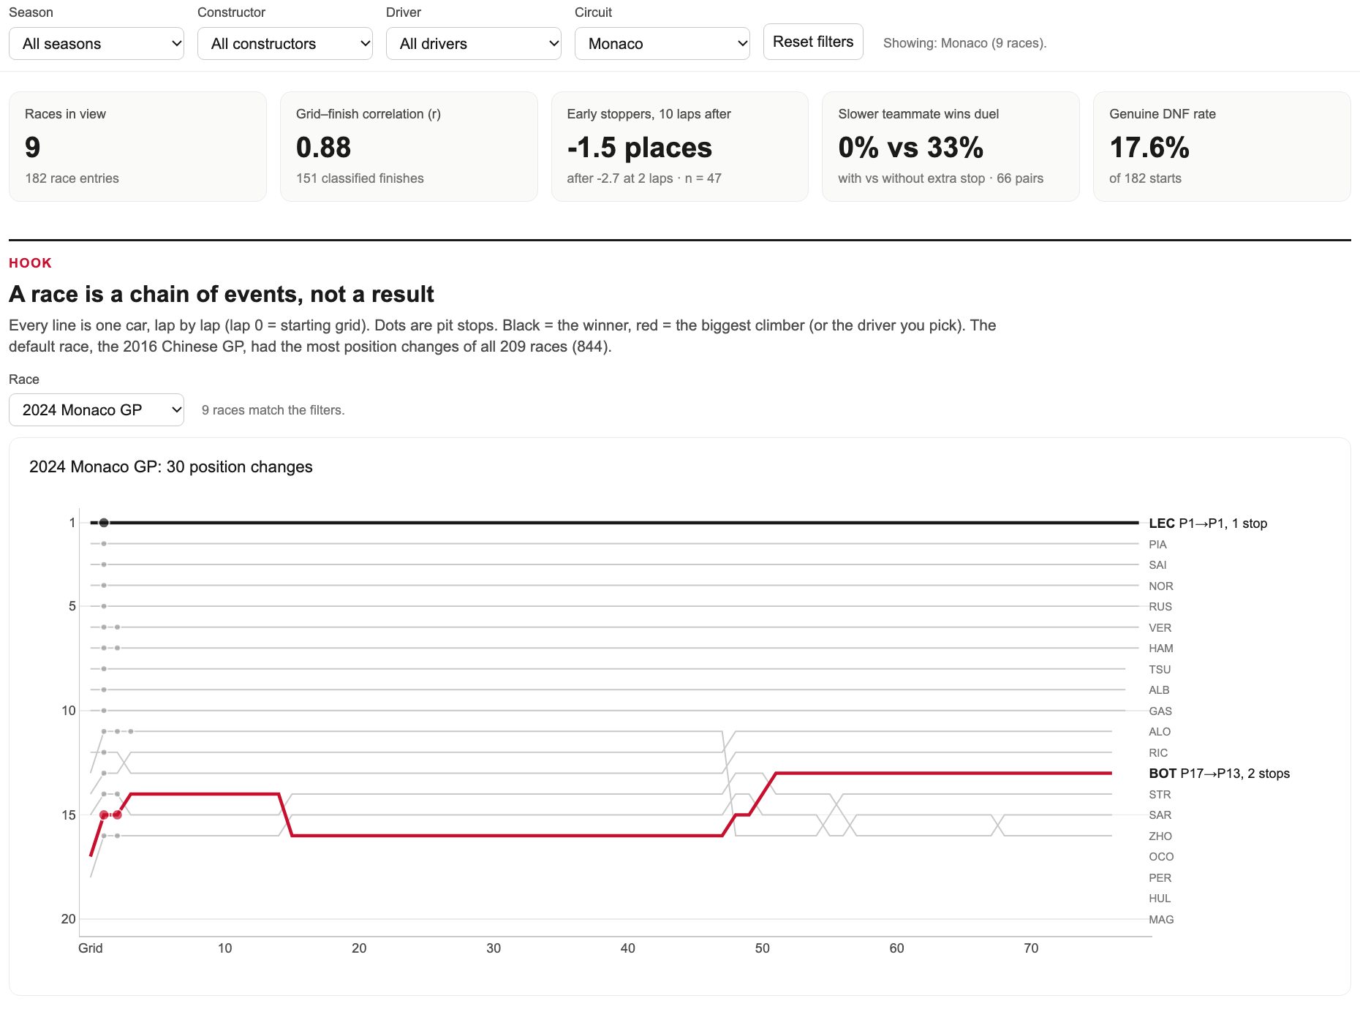
SECTION 2 · DASHBOARD INSIGHTS AND DATA STORYTELLING
Filter to Monaco and the story sharpens: r rises from 0.75 to 0.88
KPI | All races | Circuit = Monaco
Races | 209 | 9
Grid–finish correlation r | 0.75 | 0.88
Early stoppers after 10 laps | -1.7 | -1.5 (n = 47)
Slower teammate wins (extra vs none) | 12% vs 34% | 0% vs 33% (only 11 extra)
Genuine DNF rate | 16.9% | 17.6%
What? At Monaco the start order mostly holds; the 2024 Monaco GP had 30 position changes against 844 in the hook race.
So what? At street circuits the race is largely decided on Saturday.
Now what? All-in on qualifying at Monaco; keep risk for overtaking tracks.
Arwindh C N · CB.SC.U4CSE24207 · 23CSE353 Data Visualisation
Notebook cell D.2 · 13 / 16
Notes:
F1 BASICS: Monaco is a tiny country in the south of France. Its race runs through narrow city streets with walls on both sides, so overtaking is almost impossible.
WHAT: Here I set the filter to Monaco. The start-to-finish link rises from 0.75 to 0.88. The 2024 Monaco race had only 30 position changes.
WHY: At street tracks the race is mostly decided on Saturday. So a team should focus on qualifying there.

Slide 14
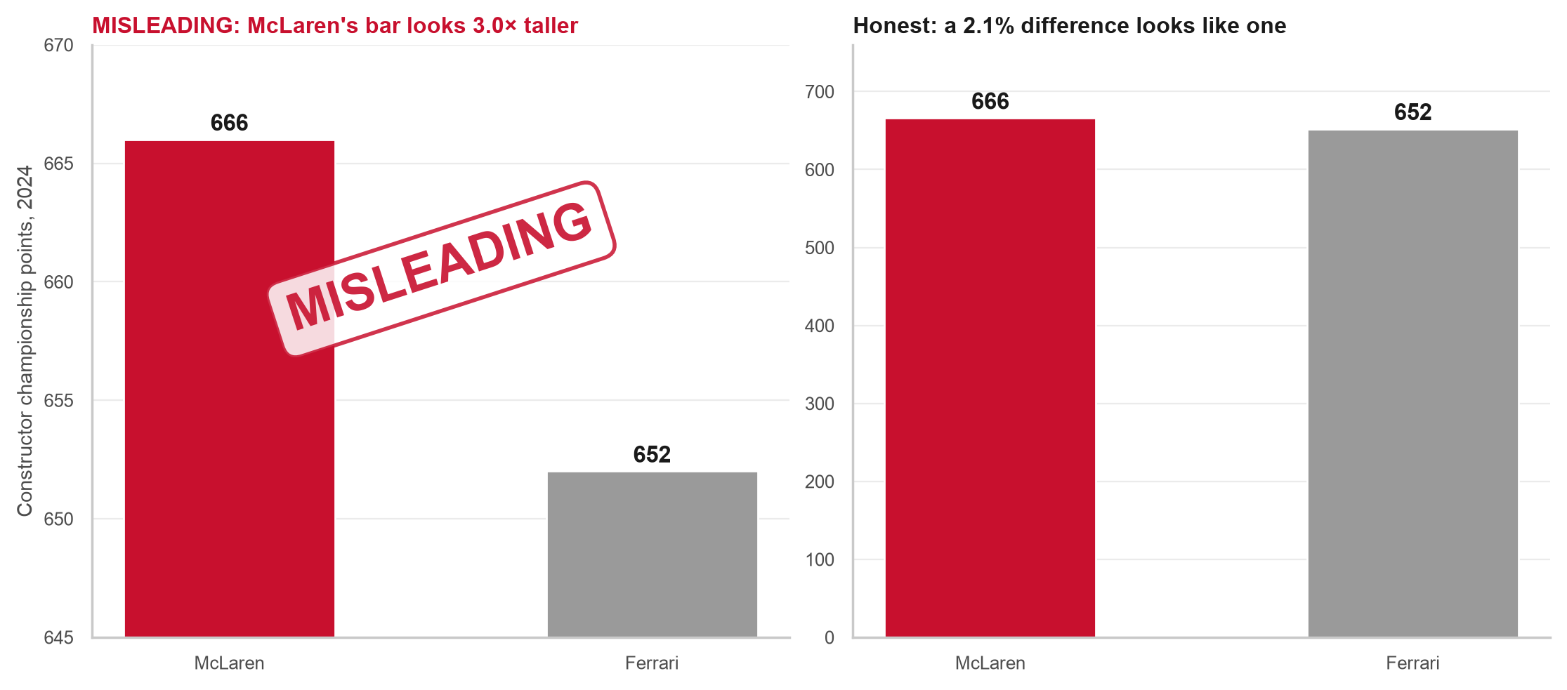
SECTION 2 · MISLEADING VISUALIZATION AND ETHICAL REDESIGN
Same numbers, two stories: a cut axis turns a 2.1% gap into a bar 3.0× taller
Visualization 15 · Misleading vs corrected bar pair · Matplotlib
Misleading chart
Y-axis starts at 645, not 0. The real numbers (McLaren 666, Ferrari 652) look like a rout.
False impression
"McLaren crushed Ferrari." In fact it was the closest constructors' title of the decade: 14 points.
Corrected chart and principle
Zero baseline and values on the bars. Truthful scaling and proportional ink: lie factor about 93 → 1.
Arwindh C N · CB.SC.U4CSE24207 · 23CSE353 Data Visualisation
Notebook cell A5.1–A5.3 · 14 / 16
Notes:
F1 BASICS: The constructors' championship adds up all the points a team scores in a year. In 2024, McLaren and Ferrari finished very close to each other.
WHAT: Both charts use the same real numbers: McLaren 666, Ferrari 652. The left chart starts its axis at 645, so McLaren's bar looks 3.0 times taller.
WHY: The real gap is only 2.1%. Cutting the axis tricks the eye. The honest chart starts at zero, and so do all my bar charts.

Slide 15
SECTION 2 · KEY FINDINGS AND INSIGHTS
Two expectations were overturned: extra stops and circuit specialists
Objective | What the data shows | As expected? | Visual
O1 Drivers across seasons | Hamilton 72 wins, Verstappen 63; titles follow the car eras | Partly | V11, V12
O2 Constructors across seasons | Three eras: Mercedes 36.6% (2015) → Red Bull 35.0% (2023) → McLaren champion 2024 | Yes | V9
O3 Qualifying vs finish | Strong link, r = 0.75; Monaco 0.88, Hockenheim 0.52 | Yes, varies by track | V2, V3
O4 Pit strategy vs outcome | Early stops win back 2.4 places vs 1.1; extra stop: 12% vs 34% | No: a symptom, not a gamble | V4, V6, V7
O5 Drivers across circuits | Driver rows differ by 4.6 places, circuits by 1.7 | No: specialists are rare | V13
O6 DNFs over time | Genuine DNFs fell from 21.4% to 11.3% | Yes | V10
Every result is a correlation in historical records, not an experiment.
Arwindh C N · CB.SC.U4CSE24207 · 23CSE353 Data Visualisation
15 / 16
Notes:
F1 BASICS: Strategy is the team's plan during the race, mainly when to make pit stops. Reliability means how often a car finishes without breaking down.
WHAT: This table answers my six questions from the Primary Review.
WHY: Most results matched what I expected. Two did not: an extra pit stop is a warning sign, not a gamble, and the driver matters more than the track.

Slide 16
SECTION 3 · RECOMMENDATIONS AND CONCLUSION
The 844 position changes were a chain of cause and effect
Recommendations for the pit wall
1. Weight qualifying effort by circuit: all-in at Monaco, Barcelona and Mexico City.
2. If the car can survive a few exposed laps, stop first: early stoppers win back 2.4 places, late ones 1.1.
3. Treat an unplanned extra stop as an alarm and protect the other car's result.
4. Plan the season around the car: 67% of wins went to the champion team.
Main conclusion
Saturday sets the order, pit timing trades places, an extra stop signals trouble, and the car sets the ceiling.
Limitations
Correlation, not causation. No tyre, weather or safety-car data. Small samples are flagged (Hockenheim: 3 races).
Back to the hook: Rosberg won from pole, 10 cars pitted on lap 4, Hamilton's 3 extra stops were the alarm, and the 2016 Mercedes took 36.1% of all points.
Arwindh C N · CB.SC.U4CSE24207 · 23CSE353 Data Visualisation
16 / 16
Notes:
F1 BASICS: The strategist sits on the pit wall, the team's control desk next to the track. This person decides when each car stops and how to react during the race.
WHAT: My four tips for a team: focus on qualifying at tracks like Monaco, stop early when you can, treat an extra stop as a warning, and plan around the car.
WHY: The 844 position changes in my first race were not random. They were cause and effect. One limit: my data shows links, not proof. Thank you.

