Slide 1
GOMOKU ALGORITHM STUDY MIN-MAX AND MONTE CARLO APPROACHING
Xie Guochen, Ge weixun, Jingtong Liu, Sun Wei

Slide 2
GOMOKU ALGORITHM STUDY
Introduction
Approaching
MiniMax
Monte
Tests
Conclusion

Slide 3
GOMOKU ALGORITHM STUDY
Introduction
Approaching
MiniMax
Monte
Tests
Conclusion

Slide 4
Introduction
Gomoku is an abstract strategy board game, also called Gobang or Five in a Row, played on a board of 15X15 intersections.
Complicated, not very complicated
Algorithm
Minimax
Monte Carlo

Slide 5
Why Monte? (Motivation)
For some games, Minimax works really well. But for some other games, the search tree could be very large.
It motivates us to implement an alternative algorithm called MonteCarlo Tree Search.
For some games, We believe, if we use simulate annealing with applying local Minimax search, the agent will get better than simply adopted Minimax search.

Slide 6
Assumptions(Modification later)
(1) Moves are performed randomly with the probabilities assigned by the method of simulated annealing,
(2) The value of a position is defined by the win rate of the given position
(3)To find the best move in a given position, play the game to the very end as suggested by (1) and then evaluate as in (2); play thousands of such random games, and the best move will be the one doing the best.
Unique game, so modifications later

Slide 7
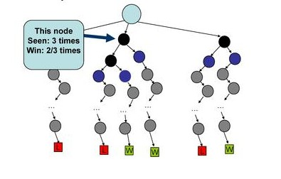
Win Time (Evaluation Function)

Slide 8
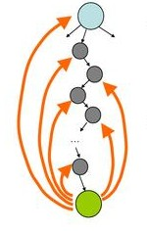
Updating the win time
Update the Win Time by each roll out.
The best move should always be played.

Slide 9
Issues we need to solve or improve
How to choose the roots to build the search tree
Two idiots play or something else?
Uniqueness of the game: Order of the moves is important

Slide 10
GOMOKU ALGORITHM STUDY
Introduction
Approaching
MiniMax
Monte
Tests
Conclusion

Slide 11
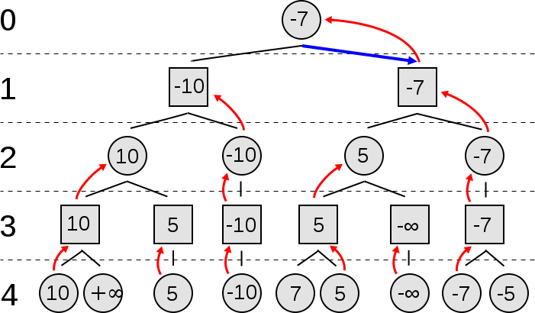
Minimax

Slide 12
Minimax
Evaluation Function:

Slide 13
GOMOKU ALGORITHM STUDY
Introduction
Approaching
MiniMax
Monte
Tests
Conclusion

Slide 14
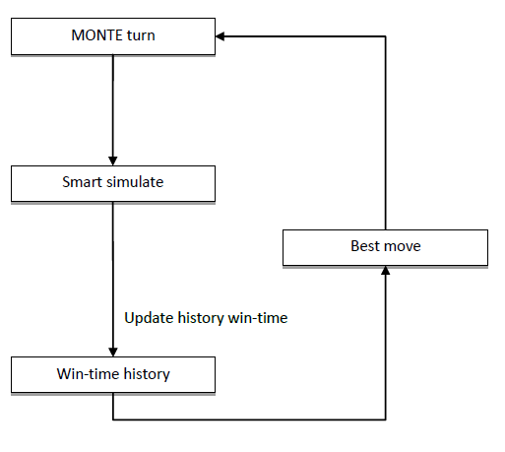
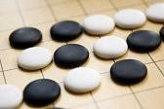
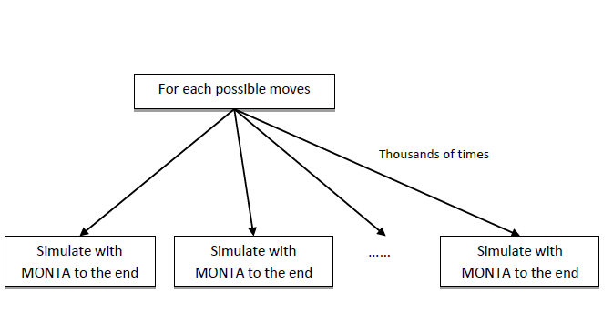
Monte Carlo Gomoku
simulate

Slide 15
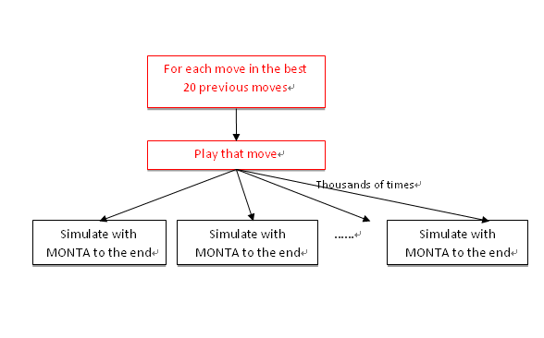
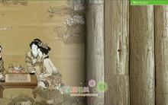
How to build the roots(Genetic Algorithm)
Instead of sing root or 5 roots, we enlarge it to 20.

Slide 16
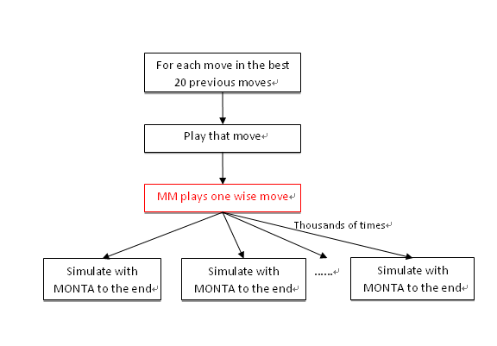
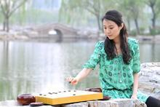
Monte Carlo Gomoku
Smart Simulate (trained by minimax as opponent)

Slide 17
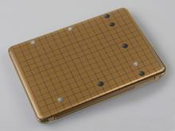
Monte Carlo Gomoku
When minimax trained twice, perform worse

Slide 18
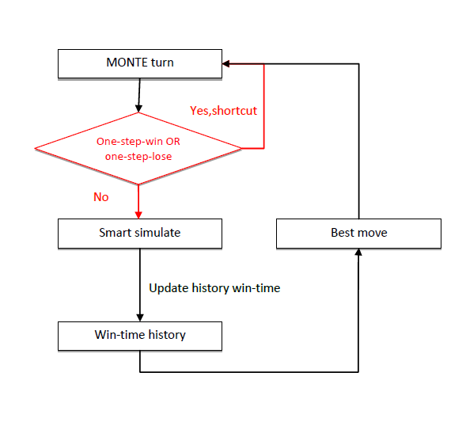
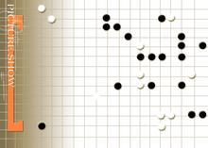
Order importance (short-cut)
Best moves should be played immediately.
Urgent moves are important than big moves.

Slide 19
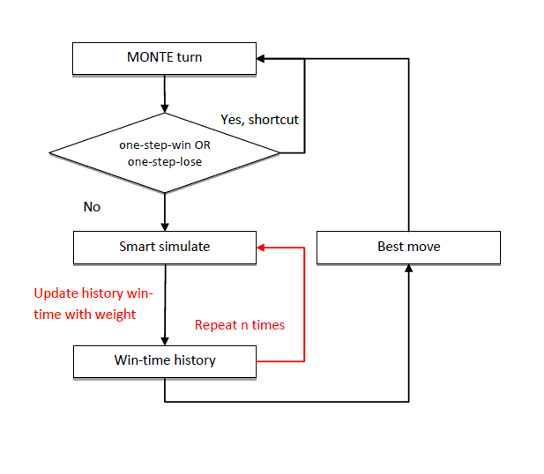
Win Time History(improvement)
Update the win time history with weight

Slide 20
GOMOKU ALGORITHM STUDY
Introduction
Approaching
MiniMax
Monte
Tests
Conclusion

Slide 21
GOMOKU ALGORITHM STUDY
Introduction
Approaching
MiniMax
Monte
Tests
Conclusion

