Slide 1

Bangalore Institute of Technology
Department of Artificial Intelligence & Machine Learning
K.R. Road, V.V.Pura, Bengaluru-560 004
Advanced Machine Learning(18AI72)
Mini Project on
“Spotify Music Recommendation Using Machine Learning”
Presented by
Batch No - 9
Aryan Khera 1BI20AI005
Harsh Singh 1BI20AI014
VII Semester

Slide 2
Contents
INTRODUCTION
PROBLEM STATEMENT
PROPOSED METHODOLOGY
SYSTEM REQUIREMENTS
ARCHITECTURE
MODULE DESCRIPTION

Slide 3
Introduction
In this project, we dive into the world of recommendation systems using Scikit-Learn to create a Top 10 Music Recommendation System.
We explore collaborative and content-based filtering, focusing on a content-based approach. Leveraging CountVectorizer, we convert song data into a matrix of word counts to analyze and recommend similar songs.
Our Python code uses pandas for data manipulation and Scikit-Learn for the recommendation model. The interactive system prompts users to input a song, generating a dynamic Top 10 list based on similarities..

Slide 4
Literature Survey
Si. No. | Paper title, Name of Journal , Year of Publication, Authors | Proposed Idea | Gap in literature
1 2 | Unbiased Identification of Broadly Appealing Content Using a Pure Exploration Infinitely-Armed Bandit Strategy MARYAM AZIZ, Spotify, USA JESSE ANDERTON, Spotify, USA KEVIN JAMIESON, University of Washington, USA ALICE WANG, Spotify, USA HUGUES BOUCHARD, Spotify, Spain JAVED ASLAM, Northeastern University, USA A survey on multi-objective recommender systems Dietmar Jannach1* and Himan Abdollahpouri2 2023 | The paper explores a recommendation system with modules for song similarity ranking and user interaction. It conducts experiments to study the impact of popularity bias on user behavior. The paper reviews and discusses the landscape of multi-objective recommender systems, categorizing objectives into quality, multistakeholder, time horizon, user experience, and engineering dimensions. It provides a taxonomy of different types of multi-objective recommendation settings and discusses various approaches used in the literature. | Simplified Popularity Model: May not fully capture real-world complexity. Dataset Dependency: Effectiveness relies on dataset characteristics. Incomplete Real-World Simulation: Bandit experiment may not fully replicate real-world dynamics. Algorithmic Dependency: Applicability may vary with different datasets. The limitation lies in the lack of concrete examples or case studies demonstrating the application of the proposed multi-objective framework in real-world scenarios. Additionally, it highlights a gap in the existing research practices, where a significant focus remains on accuracy, hindering the development of more comprehensive and valuable recommender systems.

Slide 5
Si. No. | Paper title, Name of Journal , Year of Publication, Authors | Proposed Idea | Gap in literature
3 4 | Analysis of The Trend of Spotify Jingting Li1, 2022 Spotify: You have a Hit! Spotify: You have a Hit! Christopher E. Dawson Jr. , Steve Mann, Edward Roske , Gauthier Vasseur 2021 | The paper employs a combination of qualitative and quantitative research methods. Qualitative research is likely used to understand user preferences, market trends, and Spotify's current challenges, while quantitative research involves the analysis of financial data and statistical trends The paper explores the application of data science and machine learning techniques to predict the commercial success of songs on Spotify. The primary goal is to help Spotify identify hit songs and artists before major record labels, potentially reducing licensing costs and increasing the platform's profitability. | The paper acknowledges a lack of broader data, primarily focusing on the financial situation of the last year. This limitation suggests that the analysis might not capture a more extended historical context or recent developments. The analysis focuses on Spotify data from the past three years, potentially limiting the capture of long-term trends or changes in user preferences.

Slide 6
Problem Statement
Develop an interactive Music Recommendation System utilizing content-based filtering to suggest personalized song recommendations based on user input, enhancing the music discovery experience.

Slide 7
Proposed Methodology
The proposed methodology involves implementing a content-based filtering approach using Scikit-Learn in Python. It utilizes the CountVectorizer to analyze song data, create a similarity matrix, and generate personalized song recommendations based on user input, enhancing the user's music exploration..

Slide 8
System requirements
Hardware Requirements:
-CPU : Processor i5 or more
-RAM : 8GB
-Operating System
Software Requirements:
-Jupyter Notebook
-Anaconda Navig
-Python 3.8

Slide 9
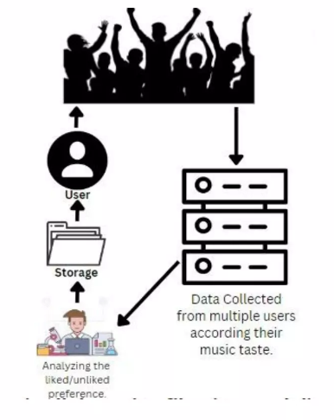
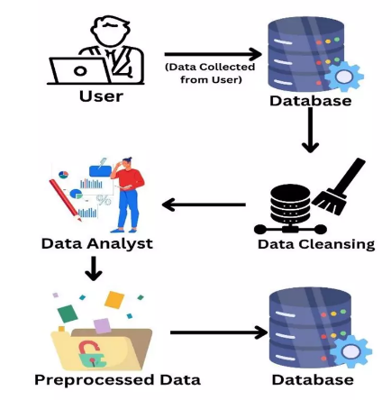
Architecture

Slide 10
Data Collection:
Acquire a dataset with comprehensive information about songs, including features such as artist name, song name, chart performance metrics (days, top 10 occurrences), and streaming statistics.
Data Cleaning and Preprocessing:
Remove duplicate entries to maintain data integrity and avoid biases in recommendations.
Handle missing values through techniques like imputation or elimination, ensuring a clean dataset.
Eliminate irrelevant columns, keeping only the essential features required for recommendation.
Feature Engineering:
Combine artist name and song name into a new feature, creating a unique identifier for each song.
This combined feature serves as the basis for content-based recommendations.
Text Vectorization:
Utilize the CountVectorizer from the Scikit-Learn library to transform textual data (artist names, song names) into a matrix of word counts.
The matrix captures the frequency of each artist and song across the entire dataset.

Slide 11
Module Description
Data Collection Module:
This module focuses on obtaining a comprehensive dataset containing information about various songs, including artist names, song names, chart performance metrics, and streaming statistics.
Data Cleaning and Preprocessing Module:
Responsible for cleaning the acquired dataset by removing duplicate entries to maintain data integrity.
Handles missing values through techniques such as imputation or elimination.
Eliminates irrelevant columns, ensuring that only essential features are retained for further analysis.
Feature Engineering Module:
Combines artist names and song names into a new feature, creating a unique identifier for each song.
Generates a combined feature that serves as the foundation for content-based recommendations.
Text Vectorization Module:
Utilizes the CountVectorizer from the Scikit-Learn library to convert textual data (artist names, song names) into a matrix of word counts.
Creates a matrix capturing the frequency of each artist and song across the entire dataset.

Slide 12
Cosine Similarity Calculation Module:
Calculates the cosine similarity between songs based on the vectorized features.
Uses the cosine similarity matrix to measure relationships between all pairs of songs in the dataset.
Recommendation System Model Module:
Builds a recommendation model incorporating the cosine similarity matrix.
Defines how recommendations are generated based on calculated similarities.
Implements algorithms to select songs with the highest similarity scores for recommendations.
User Input Handling Module:
Implements a user interface or input mechanism to accept a user's chosen song.
Validates user input to ensure it corresponds to a song present in the dataset, preventing errors in the recommendation process.
.

Slide 13
Recommendation Generation Module:
Retrieves cosine similarities of the input song with all other songs in the dataset.
Ranks songs based on their similarity scores in descending order.
Excludes the input song from the list to provide diverse and relevant recommendations.
User Interaction Loop Module:
Facilitates the presentation of recommended songs to the user along with relevant details.
Allows users to explore recommended songs and potentially choose another song for additional recommendations.
Provides options for users to exit the system or continue exploring recommendations.

Slide 14
Thank You

