Slide 1
Distracted Driver Detection
Classifying driver activity from dashboard images: classical ML vs a small neural network
UE24CS352A | Machine Learning | Mini-Project | Problem #24
Arya Devang (PES1UG24AM054) | Ananthakrishna (PES1UG24AM036)
https://github.com/Arya-677/ML_miniProject_sem5

Slide 2
The problem
▸ Task: given ONE in-cabin image, predict the driver's activity (10 classes).
▸ Why it matters: distracted driving contributes to severe crashes, and different activities carry different risk.
▸ Our question: how well do simple models on raw pixels work, and does the accuracy hold for drivers the model has never seen?
▸ Basis: re-implementation and extension of the CS229 report by Feng & Yue (2019).
The 10 classes
c0 Safe driving
c1 Texting - right
c2 Talking on phone - right
c3 Texting - left
c4 Talking on phone - left
c5 Operating the radio
c6 Drinking
c7 Reaching behind
c8 Hair and makeup
c9 Talking to passenger
UE24CS352A | ML Mini-Project #24 | Arya Devang (PES1UG24AM054) | Ananthakrishna (PES1UG24AM036)

Slide 3
Dataset: State Farm Distracted Driver Detection (Kaggle)
22,424
10
26
640x480
labelled images
classes (1 safe + 9 distractions)
different drivers
RGB in-cabin camera
▸ Only the training folder is labelled (the official test images are not), so we hold out 20% of it for validation.
▸ driver_imgs_list.csv gives the driver ID of every image.
▸ The catch: images are frames from short videos, so frames of one driver look almost identical. A random split can put the same driver in train AND validation, which may inflate accuracy.
▸ This run: 17,747 training and 4,677 validation images.
UE24CS352A | ML Mini-Project #24 | Arya Devang (PES1UG24AM054) | Ananthakrishna (PES1UG24AM036)

Slide 4
Pre-processing pipeline
Image
Resize
Flatten
Normalise
Classifier
➜
➜
➜
➜
640x480x3
64x64x3
(OpenCV, area)
12,288-vector
divide by 255,
minus train mean image
5 models
▸ Why 64x64: 640x480x3 is about 921k values per image, too large for from-scratch NumPy models; 12,288 is manageable.
▸ The mean image comes from the TRAIN set only, so validation data never influences preprocessing.
▸ Preprocessed images are cached once as .npz so repeated runs are fast.
UE24CS352A | ML Mini-Project #24 | Arya Devang (PES1UG24AM054) | Ananthakrishna (PES1UG24AM036)

Slide 5
Five models
Linear SVM
Softmax
Two-layer NN
Naive Bayes
Decision Tree
Multi-class hinge loss + L2.
Scores = W x + b,
mini-batch SGD.
Cross-entropy + L2.
Same linear scores,
probabilistic output.
12,288 -> 100 ReLU -> 10
softmax. He init,
LR decay each epoch.
Gaussian per pixel,
assumes pixels are
independent.
Axis-aligned splits on
pixel values.
Default settings.
FROM SCRATCH (NumPy)
FROM SCRATCH (NumPy)
FROM SCRATCH (NumPy)
scikit-learn
scikit-learn
▸ All analytic gradients are checked against numerical gradients (see notebook, section 4).
▸ SVM, softmax and the network tune learning rate and regularisation by grid search.
UE24CS352A | ML Mini-Project #24 | Arya Devang (PES1UG24AM054) | Ananthakrishna (PES1UG24AM036)

Slide 6
Evaluation protocol
1 Random 80/20 split
2 Driver-wise 80/20 split
Comparable to the reference report.
Frames of the same driver can be on both sides.
Whole drivers are held out for validation.
Tests generalisation to people never seen in training.
MAY BE OPTIMISTIC
STRICTER TEST
▸ Hyper-parameters: grid search over learning rate x regularisation for SVM, softmax and the network.
▸ No peeking: tuning is scored on an inner split of the TRAIN set; validation is used once for the final number.
▸ Metrics: train/validation accuracy, per-class accuracy, confusion matrix of the best model.
▸ Reproducible: fixed random seed (these models are sensitive to weight initialisation).
UE24CS352A | ML Mini-Project #24 | Arya Devang (PES1UG24AM054) | Ananthakrishna (PES1UG24AM036)

Slide 7
Results: validation accuracy
Model | Random: train | Random: val | Driver-wise: train | Driver-wise: val
Naive Bayes | 55.47 | 55.22 | 61.12 | 32.61
Decision Tree | 100.00 | 89.12 | 100.00 | 29.66
Linear SVM | 96.16 | 95.34 | 93.63 | 45.39
Softmax | 71.69 | 71.39 | 75.97 | 41.93
Two-layer NN | 98.57 | 98.02 | 99.10 | 51.55
Accuracy in %. Reference report (random split): NN 92.24, softmax 82.31, SVM 71.39, tree 84.73, Naive Bayes 54.99.
Best model: Two-layer NN.
UE24CS352A | ML Mini-Project #24 | Arya Devang (PES1UG24AM054) | Ananthakrishna (PES1UG24AM036)

Slide 8
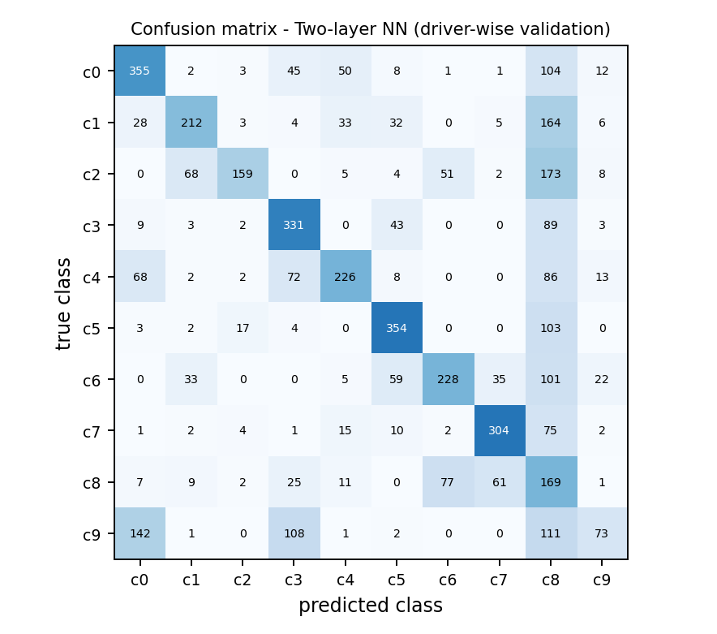
Best model in detail: Two-layer NN
▸ Per-class validation accuracy, hardest first:
▸ Talking to passenger: 16.7%
▸ Talking on phone - right: 33.8%
▸ Texting - right: 43.5%
▸ Hair and makeup: 46.7%
▸ ...and easiest:
▸ Reaching behind: 73.1%
▸ Operating the radio: 73.3%
UE24CS352A | ML Mini-Project #24 | Arya Devang (PES1UG24AM054) | Ananthakrishna (PES1UG24AM036)

Slide 9
What the results tell us
▸ On the random split, validation accuracy ranks: Two-layer NN 98.0%, Linear SVM 95.3%, Decision Tree 89.1%, Softmax 71.4%, Naive Bayes 55.2%.
▸ On the driver-wise split, validation accuracy ranks: Two-layer NN 51.6%, Linear SVM 45.4%, Softmax 41.9%, Naive Bayes 32.6%, Decision Tree 29.7%.
▸ Holding out whole drivers changes the best model (Two-layer NN) from 98.0% to 51.6%; averaged over all models, validation accuracy falls by 41.6 points.
▸ A large drop is what we would expect if the random split is optimistic: frames of the same driver are near-duplicates, so a model can partly memorise people instead of learning the activity.
▸ The best model (Two-layer NN) fits the training set at 99.1% against 51.6% on validation, a gap of 47.6 points - clear overfitting, so stronger regularisation, augmentation or a CNN would help.
▸ Hardest classes for Two-layer NN: Talking to passenger (16.7%) and Talking on phone - right (33.8%); easiest: Operating the radio (73.3%).
▸ Most frequent confusion: 'Talking on phone - right' predicted as 'Hair and makeup' (173 validation images).
▸ Our random-split numbers can be compared with the reference report (two-layer net 92.2%, softmax 82.3%, SVM 71.4%, decision tree 84.7%, Naive Bayes 55.0%): ours are 98.0%, 71.4%, 95.3%, 89.1% and 55.2%.
UE24CS352A | ML Mini-Project #24 | Arya Devang (PES1UG24AM054) | Ananthakrishna (PES1UG24AM036)

Slide 10
Implementation
repo/
distracted_driver_detection.ipynb
README.md
requirements.txt
writeup.pdf
slides.pptx
results_random/
results_driver/
▸ From scratch: vectorised losses and back-propagation in NumPy.
▸ Verified: numerical gradient check, error below 1e-6.
▸ Leak-free: driver-wise split, train-only mean image, tuning on an inner split.
▸ Reproducible: fixed seed; everything runs top to bottom in one notebook.
▸ Cached: preprocessed images stored once as .npz.
▸ Saved models are reused by the live-demo cell.
UE24CS352A | ML Mini-Project #24 | Arya Devang (PES1UG24AM054) | Ananthakrishna (PES1UG24AM036)

Slide 11
Live demonstration
1 Open the notebook
2 Pick an image
Final section loads the saved two-layer net and the mean image.
Set IMAGE_PATH to any driver photo, e.g. one from data/state-farm/train/.
3 Run the cell
4 Show the outputs
Shows the image, the predicted activity and top-3 probabilities.
results_driver/results.json, confusion_matrix.png, loss_curves.png.
UE24CS352A | ML Mini-Project #24 | Arya Devang (PES1UG24AM054) | Ananthakrishna (PES1UG24AM036)

Slide 12
Conclusions and future work
Conclusions
Limitations and next steps
Re-implemented SVM, softmax and a two-layer net from scratch; gradients verified numerically.
Compared them with Naive Bayes and a decision tree under two evaluation protocols.
Driver-wise best: Two-layer NN at 51.6% validation accuracy.
Random-split best: Two-layer NN at 98.0%.
64x64 raw pixels lose detail (phone vs hand); fully-connected models ignore spatial structure.
Single seed and single split.
Next: CNN or transfer learning, data augmentation, driver-grouped k-fold CV, semi-supervised use of the unlabelled test images.
UE24CS352A | ML Mini-Project #24 | Arya Devang (PES1UG24AM054) | Ananthakrishna (PES1UG24AM036)

