Slide 1





APPLICATION OF EIGENVALUES AND EIGENVECTORS IN OIL EXTRACTION
K. J. SOMAIYA COLLEGE OF ENGINEERING, MUMBAI – 400 077
(A CONSTITUENT COLLEGE OF SOMAIYA VIDYAVIHAR UNIVERSITY) DEPT. OF SCIENCE AND HUMANITIES
F.Y. B. TECH. SEMESTER –I (2020-21)
APPLIED MATHEMATICS-I
IA-I
NAME : Arya Nair
ROLL NO. : 16010421063
DIV:IT G BATCH: G3
Oil companies frequently use Eigenvalue and Eigenvectors to help search for probable reserves of Oil.
They rely on the fact that the waves change when they pass through different materials in the ground

Slide 2

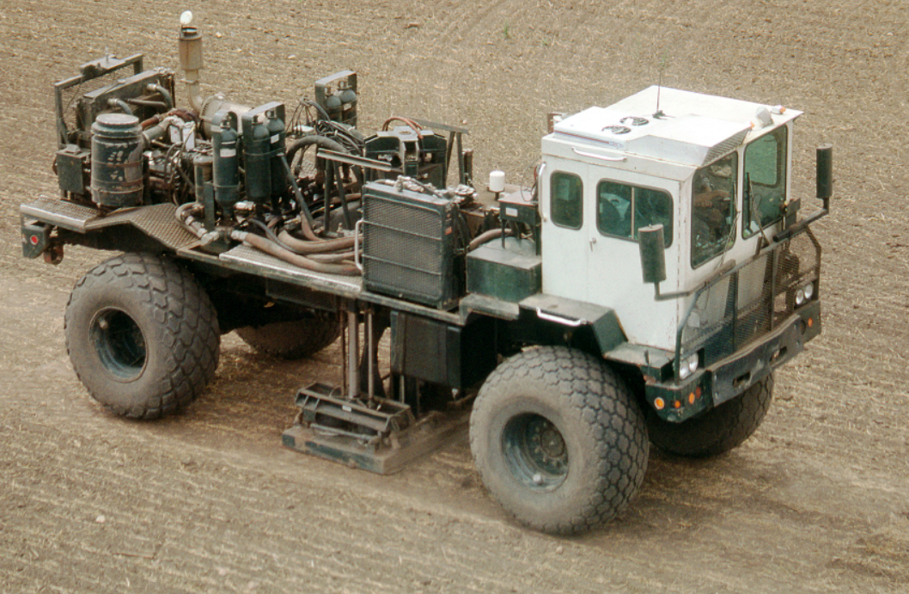
APPLICATION OF EIGENVALUES AND EIGENVECTORS IN OIL EXTRACTION
K. J. SOMAIYA COLLEGE OF ENGINEERING, MUMBAI – 400 077
(A CONSTITUENT COLLEGE OF SOMAIYA VIDYAVIHAR UNIVERSITY) DEPT. OF SCIENCE AND HUMANITIES
F.Y. B. TECH. SEMESTER –I (2020-21)
APPLIED MATHEMATICS-I
IA-I
Companies deploy trucks cause vibration, then pick up the wave reflection data with the use of probes.
The data gathered from these help in finalising the site of reserves.
References-
iadc-dredgeing
Medium
Caly Poly Pomona

