Slide 1
UNIT III
Introduction to Data Warehousing and multi-dimensional Modeling

Slide 2
3.1 Operational Vs Decisional Support System ,The Need for Data
Warehousing
3.2 Data Warehouse Definition, Features , The Information Flow
Mechanism, Architecture , Role of Metadata, Classification of
Metadata
3.3 Data Warehouse Vs Data Marts, Data Warehousing Design Strategies,
Data Warehouse Modeling Vs O perational Database Modeling

Slide 3
3.5 Updates To Dimension Tables - Slowly Changing Dimensions,
Type 1, Type 2 and Type 3 Changes, Large Dimensions , Rapidly
Changing Dimensions, Junk Dimensions, Aggregate Fact Tables
3.6 Data lake, Architecture of Data lake, Data Warehouse Vs Data lake

Slide 4
Operational Vs Decisional Support System
Operational Support systems | Decisional Support Systems
Data represented by operational support systems are transactions that happen in real time. | Decisional support systems use the operational data at a particular point in time.
Operational data is regarded as update transactions. | Decisional support data is regarded as query transaction. Which is read-only.
The concurrent transaction volume in operational data is very high. | The concurrent transaction volume is found at low or medium levels.
Operational data usually consists of information about transactions and is stored in numerous tables. | Decision support data is usually stored in less number of tables that store data derived from the operational data.

Slide 5
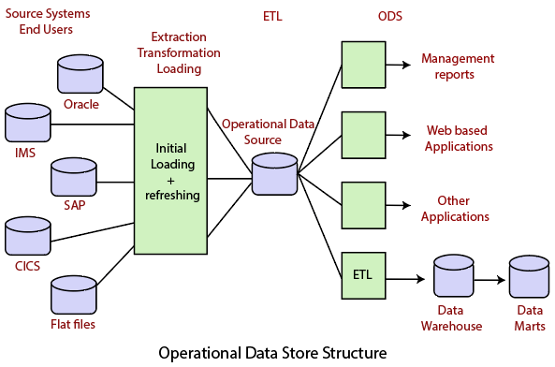

Slide 6
What is a Data Warehouse?
Defined in many different ways, but not rigorously.
A decision support database that is maintained separately from the organization’s operational database
Support information processing by providing a solid platform of consolidated, historical data for analysis.
“A data warehouse is a subject-oriented, integrated, time-variant, and nonvolatile collection of data in support of management’s decision-making process.”—W. H. Inmon
Data warehousing:
The process of constructing and using data warehouses
6
Notes:
6

Slide 7
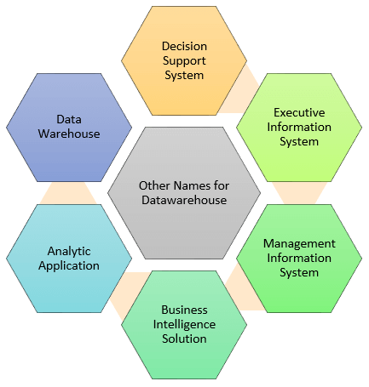
Data Warehouse Definition
A Data Warehousing (DW) is process for collecting and managing data from varied sources to provide meaningful business insights.
A Data warehouse is typically used to connect and analyze business data from heterogeneous sources. The data warehouse is the core of the BI system which is built for data analysis and reporting.

Slide 8
The Need for Data Warehousing
It is difficult to retrieve data from tables for analytical purposes.
Data warehousing is the best way to integrate valuable data from different sources into the database of a particular application.
Data warehouses make it easy to develop and store metadata
Business experts or users become habitual to see many customized data on display screens fields such as rolled-up general ledger balances. These fields do not exist in the database.
When we perform reporting and analysis functions on the hardware that handles transactions, the performance is often poor. Therefore, data warehouse should be used for reporting and analysis.

Slide 9
Features of Data Warehouse
A data warehouse is a combination of data from enterprise-wide sources. A data warehouse consists of four main features. These features are:
Subject Oriented
Integrated
Non-volatile
Time variant

Slide 10
Data Warehouse—Subject-Oriented
Organized around major subjects, such as customer, product, sales
Focusing on the modeling and analysis of data for decision makers, not on daily operations or transaction processing
Provide a simple and concise view around particular subject issues by excluding data that are not useful in the decision support process
10
Notes:
10

Slide 11
Data Warehouse—Integrated
Constructed by integrating multiple, heterogeneous data sources
relational databases, flat files, on-line transaction records
Data cleaning and data integration techniques are applied.
Ensure consistency in naming conventions, encoding structures, attribute measures, etc. among different data sources
E.g., Hotel price: currency, tax, breakfast covered, etc.
When data is moved to the warehouse, it is converted.
11
Notes:
11

Slide 12
Data Warehouse—Time Variant
The time horizon for the data warehouse is significantly longer than that of operational systems
Operational database: current value data
Data warehouse data: provide information from a historical perspective (e.g., past 5-10 years)
Every key structure in the data warehouse
Contains an element of time, explicitly or implicitly
But the key of operational data may or may not contain “time element”
12
Notes:
12

Slide 13
Data Warehouse—Nonvolatile
A physically separate store of data transformed from the operational environment
Operational update of data does not occur in the data warehouse environment
Does not require transaction processing, recovery, and concurrency control mechanisms
Requires only two operations in data accessing:
initial loading of data and access of data
13
Notes:
13

Slide 14
Information Flow Mechanism
Lineage tracing and drill-back
General direction of the flow of data
JMI – Enabled Metadata Service
ETL
Operational Data Store
Analysis Store (star schema)
OLAP
Visualization
Fig. Data Warehouse Information Flow

Slide 15
Information supply chain is fully-integrated
Integration via centralized shared metadata and metadata – driven tools
Metadata communication via JMI programmatic API and bulk interchange (XML)
MOF/JMI reflection used to reconcile metadata integration between tools based on dissimilar metamodels.

Slide 16
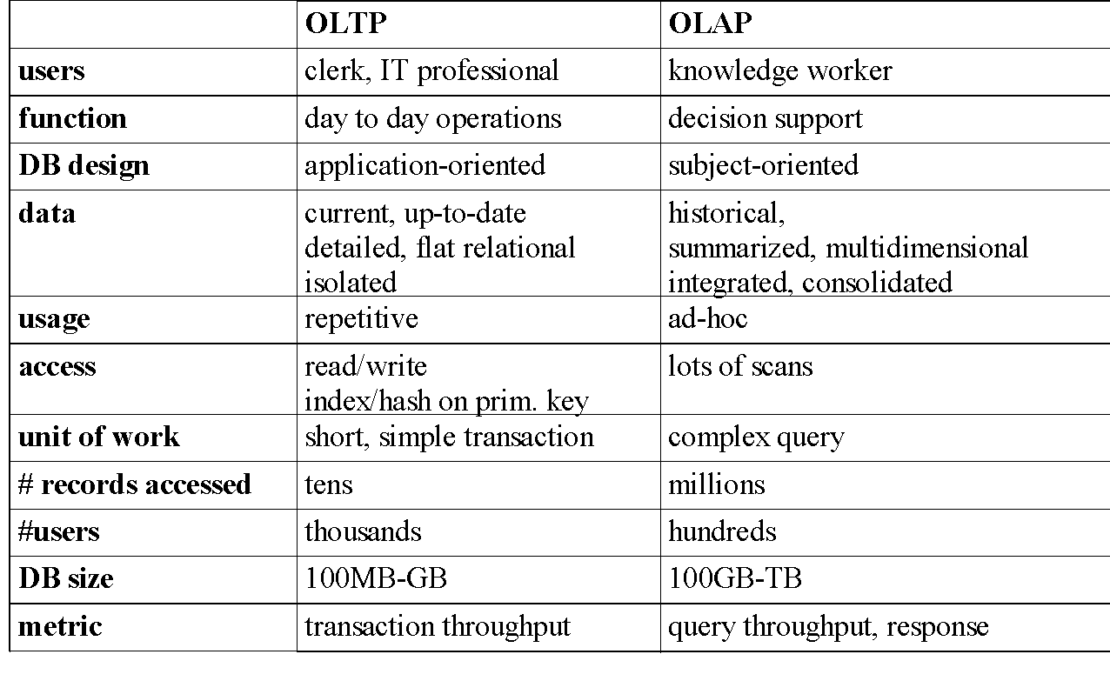
OLTP vs. OLAP
16
Notes:
16

Slide 17
Data warehouses and their architectures very depending upon the elements of an organization's situation.
Three common architectures are:
Data Warehouse Architecture: Basic
Data Warehouse Architecture: With Staging Area
Data Warehouse Architecture: With Staging Area and Data Marts

Slide 18
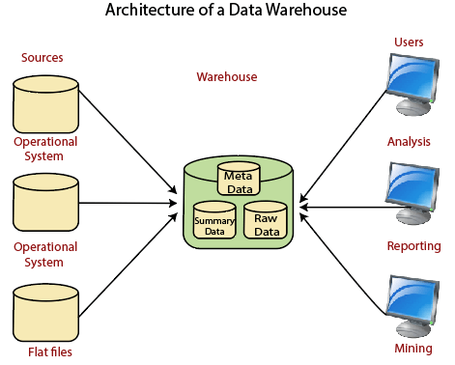

Slide 19
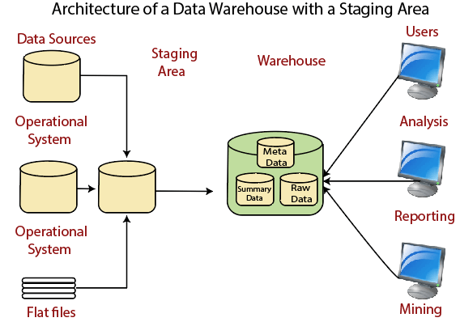
Data Warehouse Architecture: With Staging Area

Slide 20
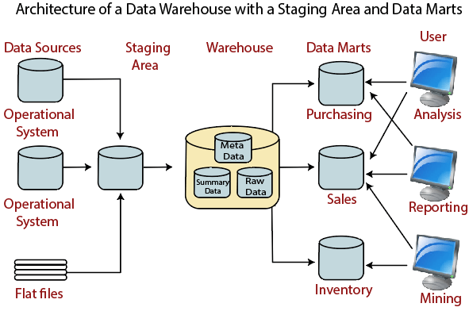
Data Warehouse Architecture: With Staging Area and Data Marts

Slide 21
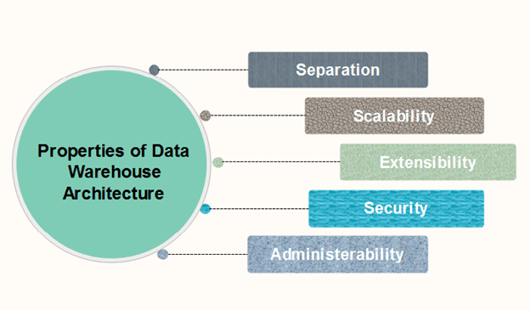
Properties of Data Warehouse Architectures

Slide 22
1. Separation: Analytical and transactional processing should be keep apart as much as possible.
2. Scalability: Hardware and software architectures should be simple to upgrade the data volume, which has to be managed and processed, and the number of user's requirements, which have to be met, progressively increase.
3. Extensibility: The architecture should be able to perform new operations and technologies without redesigning the whole system.
4. Security: Monitoring accesses are necessary because of the strategic data stored in the data warehouses.
5. Administer ability: Data Warehouse management should not be complicated.

Slide 23
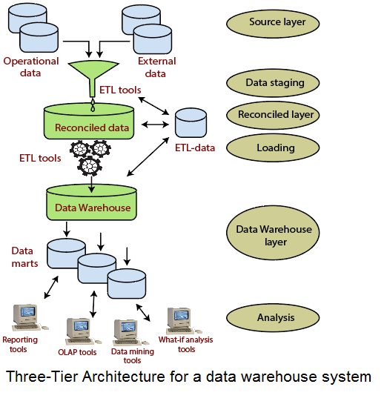

Slide 24
Data extraction commonly happens in one of the three following ways.
Update notification
In update notification, the source system notifies you when a data record changes. You can then run the extraction process for that change. Most databases and web applications provide update mechanisms to support this data integration method.
Incremental extraction
Some data sources can't provide update notifications but can identify and extract data that has been modified over a given time period. In this case, the system checks for changes at periodic intervals, such as once a week, once a month, or at the end of a campaign. You only need to extract data that has changed.
Full extraction
Some systems can't identify data changes or give notifications, so reloading all data is the only option. This extraction method requires you to keep a copy of the last extract to check which records are new. Because this approach involves high data transfer volumes, we recommend you use it only for small tables.

Slide 25
Basic data transformation
Basic transformations improve data quality by removing errors, emptying data fields, or simplifying data.
Examples of these transformations follow.
Data cleansing
Data deduplication
Data format revision
Advanced data transformation
Derivation
Joining
Splitting
Summarization
Encryption

Slide 26
Full load
In full load, the entire data from the source is transformed and moved to the data warehouse. The full load usually takes place the first time you load data from a source system into the data warehouse.
Incremental load
In incremental load, the ETL tool loads the delta (or difference) between target and source systems at regular intervals. It stores the last extract date so that only records added after this date are loaded. There are two ways to implement incremental load.
Streaming incremental load
If you have small data volumes, you can stream continual changes over data pipelines to the target data warehouse. When the speed of data increases to millions of events per second, you can use event stream processing to monitor and process the data streams to make more-timely decisions.
Batch incremental load
If you have large data volumes, you can collect load data changes into batches periodically. During this set period of time, no actions can happen to either the source or target system as data is synchronized.

Slide 27
Why a Separate Data Warehouse?
High performance for both systems
DBMS— tuned for OLTP: access methods, indexing, concurrency control, recovery
Warehouse—tuned for OLAP: complex OLAP queries, multidimensional view, consolidation
Different functions and different data:
missing data: Decision support requires historical data which operational DBs do not typically maintain
data consolidation: DS requires consolidation (aggregation, summarization) of data from heterogeneous sources
data quality: different sources typically use inconsistent data representations, codes and formats which have to be reconciled
Note: There are more and more systems which perform OLAP analysis directly on relational databases
27
Notes:
27

Slide 28
Data Warehouse: A Multi-Tiered Architecture
Monitor
&
Integrator
OLAP Server
Other
sources
Metadata
Analysis
Query
Reports
Data mining
Operational
DBs
Extract
Transform
Load
Refresh
Data
Warehouse
Serve
Data Marts
Data Sources
Data Storage
OLAP Engine
Front-End Tools
28
Notes:
28

Slide 29
Three Data Warehouse Models
Enterprise warehouse
collects all of the information about subjects spanning the entire organization
Data Mart
a subset of corporate-wide data that is of value to a specific groups of users. Its scope is confined to specific, selected groups, such as marketing data mart
Independent vs. dependent (directly from warehouse) data mart
Virtual warehouse
A set of views over operational databases
Only some of the possible summary views may be materialized
29
Notes:
29

Slide 30
Extraction, Transformation, and Loading (ETL)
Data extraction
get data from multiple, heterogeneous, and external sources
Data cleaning
detect errors in the data and rectify them when possible
Data transformation
convert data from legacy or host format to warehouse format
Load
sort, summarize, consolidate, compute views, check integrity, and build indicies and partitions
Refresh
propagate the updates from the data sources to the warehouse
30
Notes:
30

Slide 31
Metadata Repository
Meta data is the data defining warehouse objects. It stores:
Description of the structure of the data warehouse
schema, view, dimensions, hierarchies, derived data defn, data mart locations and contents
Operational meta-data
data lineage (history of migrated data and transformation path), currency of data (active, archived, or purged), monitoring information (warehouse usage statistics, error reports, audit trails)
The algorithms used for summarization
The mapping from operational environment to the data warehouse
Data related to system performance
warehouse schema, view and derived data definitions
Business data
business terms and definitions, ownership of data, charging policies
31
Notes:
31

Slide 32
Classification of Metadata
Determine if dissimilar kinds are grouped together. While grouping, subject or subgroup does not inherit all the features of the superset. Which signifies that the knowledge and requirements about the superset are not relevant for the members of the subset.
Determine whether the classes have overlaps.
Whether subordinates (may) have several superordinate's or not. Multiple supertypes for one subtype signify that the subordinate contains the features of all its superordinate's.
Evaluate whether the standards for belonging to a class or group are well defined.
Whether or not the types of relations between the concepts are made clear and well defined.
Whether or not the subtype-supertype relations are differentiated from composition relations and from object-role relations.

Slide 33
Data warehouse and Data Marts
Data warehouse | Data Marts
It has a corporate/ enterprise-wide scope. | Its scope is departmental that is specific to one department.
It is a union of all data marts | It is a single business process.
Data is received from the staging area. | Data is received from star-join (facts and dimensions).
It queries on the presentation resources. | It is technology optimal for data access and analysis.
It has structure for corporate view of data. | It has structure to suit the departmental view of data.

Slide 34
Chapter 4: Data Warehousing and On-line Analytical Processing
Data Warehouse: Basic Concepts
Data Warehouse Modeling: Data Cube and OLAP
Data Warehouse Design and Usage
Data Warehouse Implementation
Data Generalization by Attribute-Oriented Induction
Summary
34
Notes:
34

Slide 35
3.4 The Star Schema - Fact Tables and Dimension Tables, The Factless Fact Table, Keys in the Data Warehouse Schema- Primary Keys, Surrogate Keys & Foreign Keys, The Snowflake Schema,
Fact Constellation Schema(Family of Stars)

Slide 36
From Tables and Spreadsheets to Data Cubes
A data warehouse is based on a multidimensional data model which views data in the form of a data cube
A data cube, such as sales, allows data to be modeled and viewed in multiple dimensions
Dimension tables, such as item (item_name, brand, type), or time(day, week, month, quarter, year)
Fact table contains measures (such as dollars_sold) and keys to each of the related dimension tables
In data warehousing literature, an n-D base cube is called a base cuboid. The top most 0-D cuboid, which holds the highest-level of summarization, is called the apex cuboid. The lattice of cuboids forms a data cube.
36
Notes:
36

Slide 37
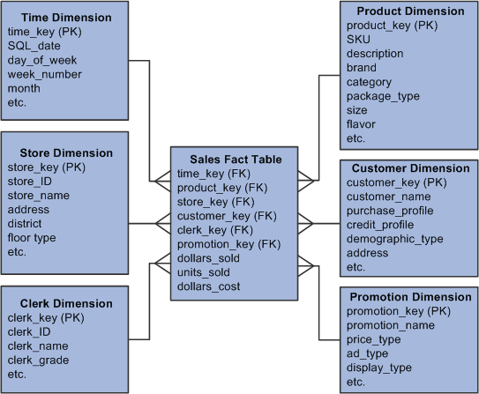

Slide 38
Cube: A Lattice of Cuboids
all
0-D (apex) cuboid
time
item
location
supplier
1-D cuboids
time,location
item,location
location,supplier
time,item
2-D cuboids
time,supplier
item,supplier
time,location,supplier
3-D cuboids
time,item,location
time,item,supplier
item,location,supplier
4-D (base) cuboid
time, item, location, supplier
38
Notes:
38

Slide 39
Conceptual Modeling of Data Warehouses
Modeling data warehouses: dimensions & measures
Star schema: A fact table in the middle connected to a set of dimension tables
Snowflake schema: A refinement of star schema where some dimensional hierarchy is normalized into a set of smaller dimension tables, forming a shape similar to snowflake
Fact constellations: Multiple fact tables share dimension tables, viewed as a collection of stars, therefore called galaxy schema or fact constellation
39
Notes:
39

Slide 40
Example of Star Schema
time
time_key
day
day_of_the_week
month
quarter
year
item
item_key
item_name
brand
type
supplier_type
Sales Fact Table
time_key
item_key
branch_key
branch
location
location_key
branch_key
branch_name
branch_type
location_key
street
city
state_or_province
country
units_sold
dollars_sold
avg_sales
Measures
40
Notes:
40

Slide 41
Example of Snowflake Schema
time
item
time_key
day
day_of_the_week
month
quarter
year
item_key
item_name
brand
type
supplier_key
supplier
Sales Fact Table
supplier_key
supplier_type
time_key
item_key
branch_key
branch
location
location_key
location_key
street
city_key
branch_key
branch_name
branch_type
units_sold
dollars_sold
city
city_key
city
state_or_province
country
avg_sales
Measures
41
Notes:
41

Slide 42
Example of Fact Constellation
time
time_key
day
day_of_the_week
month
quarter
year
item
Shipping Fact Table
item_key
item_name
brand
type
supplier_type
Sales Fact Table
time_key
time_key
item_key
shipper_key
item_key
branch_key
from_location
branch
location_key
location
to_location
branch_key
branch_name
branch_type
units_sold
location_key
street
city
province_or_state
country
dollars_cost
dollars_sold
units_shipped
avg_sales
shipper
Measures
shipper_key
shipper_name
location_key
shipper_type
42
Notes:
42

Slide 43
Slowly Changing Dimensions
What is a Slowly Changing Dimension?
A Slowly Changing Dimension (SCD) is a dimension that stores and manages both current and historical data over time in a data warehouse. It is considered and implemented as one of the most critical ETL tasks in tracking the history of dimension records.
There are three types of SCDs and you can use Warehouse Builder to define, deploy, and load all three types of SCDs.
What are the three types of SCDs?
The three types of SCDs are:
Type 1 SCDs - Overwriting
In a Type 1 SCD the new data overwrites the existing data. Thus the existing data is lost as it is not stored anywhere else. This is the default type of dimension you create. You do not need to specify any additional information to create a Type 1 SCD.
Type 2 SCDs - Creating another dimension record
A Type 2 SCD retains the full history of values. When the value of a chosen attribute changes, the current record is closed. A new record is created with the changed data values and this new record becomes the current record. Each record contains the effective time and expiration time to identify the time period between which the record was active.
Type 3 SCDs - Creating a current value field
A Type 3 SCD stores two versions of values for certain selected level attributes. Each record stores the previous value and the current value of the selected attribute. When the value of any of the selected attributes changes, the current value is stored as the old value and the new value becomes the current value.
Note: SCD Type 2 and 3 are available with the Enterprise ETL option of OWB 10gR2. With Core ETL features, SCD Type 1, that is, Do not keep history option, is only available.

Slide 44
Type 1 : Overwrite the dimension records
Type 2 : Add a new dimension records
Type 3 : Create new fields in the dimension record

Slide 45
Type 1 changes: Correction of Errors
These changes relate to correction of errors in source systems.
These changes do not have any significance in the source systems.
The old value needs to be discarded.
New value overwrites the old value in the source system.
Such changes in the source system need not be preserved in the data warehouse.
Type 1 changes are applied to the data stored in the data warehouse.
Overwrite the value of the attribute with the new value in the dimension table now.
The old value of the attribute is discarded , that is, not persevered.
No other changes are made in the dimension table row.
The key of this dimension table row is not affected.

Slide 46
Customer key | Customer ID | Customer Name | Marital status | Address
- | - | - | - | -
22522134 | C12345 | July Michael | Single | AAAAAAA
Customer key | Customer ID | Customer Name | Marital status | Address
- | - | - | - | -
22522134 | C12345 | July Michel | Single | AAAAAAA
Method for applying Type 1 change

Slide 47
Type 2 Changes: Preservation of History
These changes relate to true changes in source system.
The history must be preserved in the data warehouse.
These changes cause the history to be partitioned in the data warehouse.
Every change that occurs in the attribute value must be preserved.
How Type 2 changes applied to the data store in datawarehouse
A new dimension table row with the new value of the changed attribute is added.
A new column called the effective date is added in the dimension table.
The original row in the dimension table is not changed.
The key of the original row remains the same.
The new row is inserted with anew surrogate key in the dimension table.

Slide 48
Customer key | Customer ID | Customer Name | Marital status | Address
- | - | - | - | -
22522134 | C12345 | Jenny david | Single | AAAAAAA
- | - | - | - | -
Customer key | Customer ID | Customer Name | Marital status | Address | Effective Date
- | - | - | - | - | -
22522134 | C12345 | Jenny david | Single | AAAAAAA | 1/Mar/03
- | - | - | - | - | -
22522134 | C12345 | Jenny david | Married | AAAAAAA | 16/Jan/06
Method for applying Type 2 change

Slide 49
Type 3 changes: Tentative Soft Revisions
How Type 3 changes applied to the data stored in the datawarehouse
There is a need to track history with both old and new value of the same attribute.
Type 3 changes are used to compare performance across the transition.
They enable the users to track data in both forward and backward directions.
An “old” field is added in the dimension table for the affected attribute.
The existing value of the attribute is pushed down from the “current” field to the “old” field.
The new value of the attribute is kept in the “current” field.

Slide 50
A “current” effective data field is also added for the changed attribute.
The key of the row is not affected.
No new dimension row is added in the dimension table.
The existing queries will automatically switch to the “current” value.
Revision must be done to queries that need to use the “old” value.
This technique works well with one soft change at a time and if there are a succession of changes, more sophisticated techniques must be devised.

Slide 51
Salesperson key | Salesperson ID | Salesperson Name | Old Location | Current Location | Effective date
- | - | - | - | -
22522134 | C12345 | Jenny david |  | Delhi | 1/Mar/03
- | - | - | - | -
Salesperson key | Salesperson ID | Salesperson Name | Old Location | Current Location | Effective date
- | - | - | - | -
22522134 | C12345 | Jenny david | Delhi | Mumbai | 1/Mar/03
- | - | - | - | -
Method for applying type 3 changes

Slide 52
A Product dimension table contains four attributes namely, Product ID which is the Primary key, launch year in which the product was brought into the market, name which specifies the name of the product and finally product price which tells the price of the product. In the year 2005 , the price of Product 1 was Rs. 350 which later on changed to Rs. 450. With this dimension construct slowly changing Dimensions.

Slide 53
Types of Dimensions
Dimension: A dimension table has two types of columns, primary keys and descriptive data. For example, Time and Customer.
Types of Dimensions
Slowly Changing Dimensions
Rapidly Changing Dimensions
Junk Dimensions

Slide 54
Slowly Changing Dimensions
It depends on the business requirement, where any particular feature history of changes in the data warehouse is preserved. It is called a slowly changing feature, and a quality dimension is called a slowly changing dimension.

Slide 55
Rapidly Changing Dimensions
A dimension attribute change is a rapidly changing feature. If we do not need to track changes, rapid quality is not a problem. If you need to follow the changes, then using the standard slowly changing amplitude technique can cause massive amplitude size inflation. The solution moves the attribute to its dimension, with a different foreign key. The new dimension is called a rapidly changing size.

Slide 56
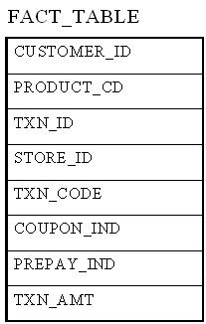
:
Junk Dimensions
A junk dimension fact table is a single table with the combination of attributes to avoid multiple foreign keys. Junk dimensions are created to manage foreign dimensions, that are created by rapidly changing dimensions.
Assuming that we have the following fact table

Slide 57
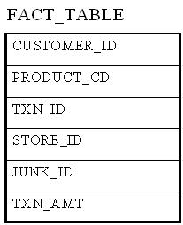
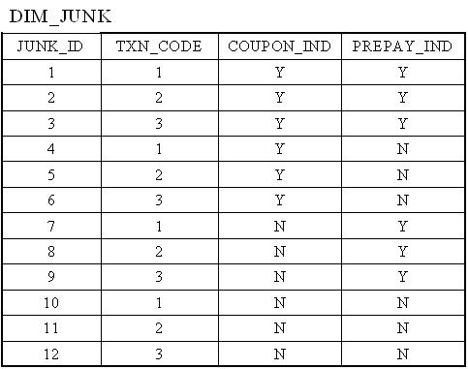
we have 3 possible values for the TXN_CODE field, 2 possible values for the COUPON_IND field, and 2 possible values for the PREPAY_IND field. This results in a total of 3 x 2 x 2 = 12 rows for the junk dimension table.
By using a junk dimension to replace the 3 indicator fields, we have decreased the number of dimensions by 2 and also decreased the number of fields in the fact table by 2. This will result in a data warehousing environment that offer better performance as well as being easier to manage.

Slide 58
Data lake, Architecture of Data lake, Data Warehouse vs Data lake

Slide 59
Data lake data often comes from disparate sources and can include a mix of structured, semi-structured , and unstructured data formats. Data is stored with a flat architecture and can be queried as needed. For companies that need to collect and store a lot of data but do not necessarily need to process and analyze all of it right away, a data lake offers an effective solution that can load and store large amounts of data very rapidly without transformation.

Slide 60
Why do you need a data lake?
Organizations that successfully generate business value from their data, will outperform their peers. An Aberdeen survey saw organizations who implemented a Data Lake outperforming similar companies by 9% in organic revenue growth. These leaders were able to do new types of analytics like machine learning over new sources like log files, data from click-streams, social media, and internet connected devices stored in the data lake. This helped them to identify, and act upon opportunities for business growth faster by attracting and retaining customers, boosting productivity, proactively maintaining devices, and making informed decisions.

Slide 62
A Concept Hierarchy: Dimension (location)
all
all
region
Europe
...
North_America
country
Germany
...
Spain
Canada
...
Mexico
city
Frankfurt
...
Vancouver
...
Toronto
office
L. Chan
...
M. Wind
62
Notes:
62

Slide 63
Data Cube Measures: Three Categories
Distributive: if the result derived by applying the function to n aggregate values is the same as that derived by applying the function on all the data without partitioning
E.g., count(), sum(), min(), max()
Algebraic: if it can be computed by an algebraic function with M arguments (where M is a bounded integer), each of which is obtained by applying a distributive aggregate function
E.g., avg(), min_N(), standard_deviation()
Holistic: if there is no constant bound on the storage size needed to describe a subaggregate.
E.g., median(), mode(), rank()
63
Notes:
63

Slide 64
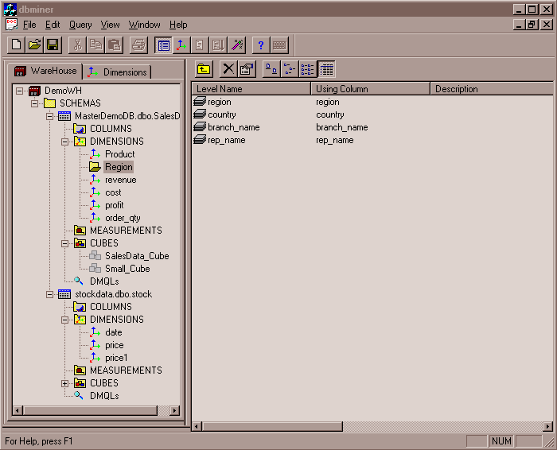
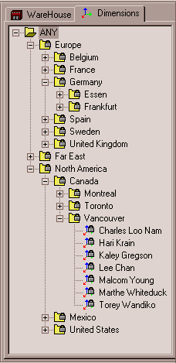
View of Warehouses and Hierarchies
Specification of hierarchies
Schema hierarchy
day < {month < quarter; week} < year
Set_grouping hierarchy
{1..10} < inexpensive
64
Notes:
64

Slide 65
Multidimensional Data
Sales volume as a function of product, quarter, and country
Dimensions: Product, Location, Time
Hierarchical summarization paths
country
Industry Region Year
Category Country Quarter
Product City Month Week
Office Day
Product
Quarter
65
Notes:
65

Slide 66
A Sample Data Cube
Quarter
Total annual sales
of TVs in U.S.A.
1Qtr
2Qtr
3Qtr
4Qtr
sum
Product
TV
PC
U.S.A
VCR
sum
Canada
Country
Mexico
sum
All, All, All
66
Notes:
66

Slide 67
Cuboids Corresponding to the Cube
all
0-D (apex) cuboid
product
date
country
1-D cuboids
product,date
product,country
date, country
2-D cuboids
3-D (base) cuboid
product, date, country
67
Notes:
67

Slide 68
Typical OLAP Operations
Roll up (drill-up): summarize data
by climbing up hierarchy or by dimension reduction
Drill down (roll down): reverse of roll-up
from higher level summary to lower level summary or detailed data, or introducing new dimensions
Slice and dice: project and select
Pivot (rotate):
reorient the cube, visualization, 3D to series of 2D planes
Other operations
drill across: involving (across) more than one fact table
drill through: through the bottom level of the cube to its back-end relational tables (using SQL)
68
Notes:
68

Slide 69
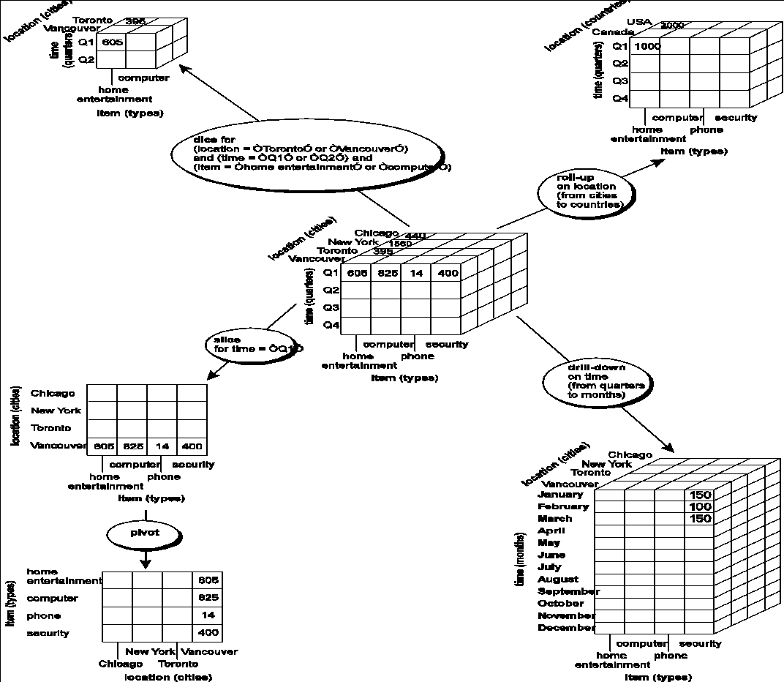
Fig. 3.10 Typical OLAP Operations
69
Notes:
69

Slide 70
A Star-Net Query Model
Customer Orders
Shipping Method
Customer
CONTRACTS
AIR-EXPRESS
ORDER
TRUCK
PRODUCT LINE
Time
Product
ANNUALY
QTRLY
DAILY
PRODUCT ITEM
PRODUCT GROUP
CITY
SALES PERSON
COUNTRY
DISTRICT
REGION
DIVISION
Location
Each circle is called a footprint
Promotion
Organization
70
Notes:
70

Slide 71
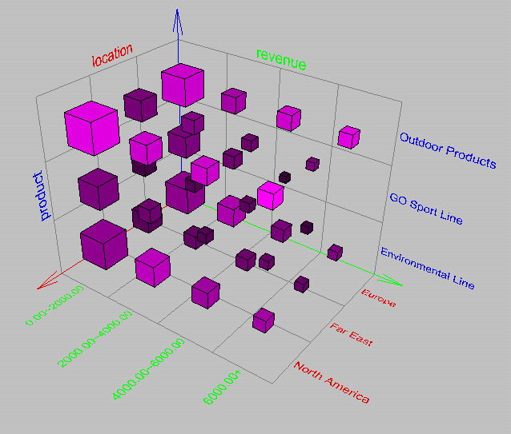
Browsing a Data Cube
Visualization
OLAP capabilities
Interactive manipulation
71
Notes:
71

Slide 72
Chapter 4: Data Warehousing and On-line Analytical Processing
Data Warehouse: Basic Concepts
Data Warehouse Modeling: Data Cube and OLAP
Data Warehouse Design and Usage
Data Warehouse Implementation
Data Generalization by Attribute-Oriented Induction
Summary
72
Notes:
72

Slide 73
Design of Data Warehouse: A Business Analysis Framework
Four views regarding the design of a data warehouse
Top-down view
allows selection of the relevant information necessary for the data warehouse
Data source view
exposes the information being captured, stored, and managed by operational systems
Data warehouse view
consists of fact tables and dimension tables
Business query view
sees the perspectives of data in the warehouse from the view of end-user
73
Notes:
73

Slide 74
Data Warehouse Design Process
Top-down, bottom-up approaches or a combination of both
Top-down: Starts with overall design and planning (mature)
Bottom-up: Starts with experiments and prototypes (rapid)
From software engineering point of view
Waterfall: structured and systematic analysis at each step before proceeding to the next
Spiral: rapid generation of increasingly functional systems, short turn around time, quick turn around
Typical data warehouse design process
Choose a business process to model, e.g., orders, invoices, etc.
Choose the grain (atomic level of data) of the business process
Choose the dimensions that will apply to each fact table record
Choose the measure that will populate each fact table record
74
Notes:
74

Slide 75
Data Warehouse Development: A Recommended Approach
Multi-Tier Data Warehouse
Distributed Data Marts
Enterprise Data Warehouse
Data Mart
Data Mart
Model refinement
Model refinement
Define a high-level corporate data model
75
Notes:
75

Slide 76
Data Warehouse Usage
Three kinds of data warehouse applications
Information processing
supports querying, basic statistical analysis, and reporting using crosstabs, tables, charts and graphs
Analytical processing
multidimensional analysis of data warehouse data
supports basic OLAP operations, slice-dice, drilling, pivoting
Data mining
knowledge discovery from hidden patterns
supports associations, constructing analytical models, performing classification and prediction, and presenting the mining results using visualization tools
76
Notes:
76

Slide 77
From On-Line Analytical Processing (OLAP) to On Line Analytical Mining (OLAM)
Why online analytical mining?
High quality of data in data warehouses
DW contains integrated, consistent, cleaned data
Available information processing structure surrounding data warehouses
ODBC, OLEDB, Web accessing, service facilities, reporting and OLAP tools
OLAP-based exploratory data analysis
Mining with drilling, dicing, pivoting, etc.
On-line selection of data mining functions
Integration and swapping of multiple mining functions, algorithms, and tasks
77
Notes:
77

Slide 78
Chapter 4: Data Warehousing and On-line Analytical Processing
Data Warehouse: Basic Concepts
Data Warehouse Modeling: Data Cube and OLAP
Data Warehouse Design and Usage
Data Warehouse Implementation
Data Generalization by Attribute-Oriented Induction
Summary
78
Notes:
78

Slide 79
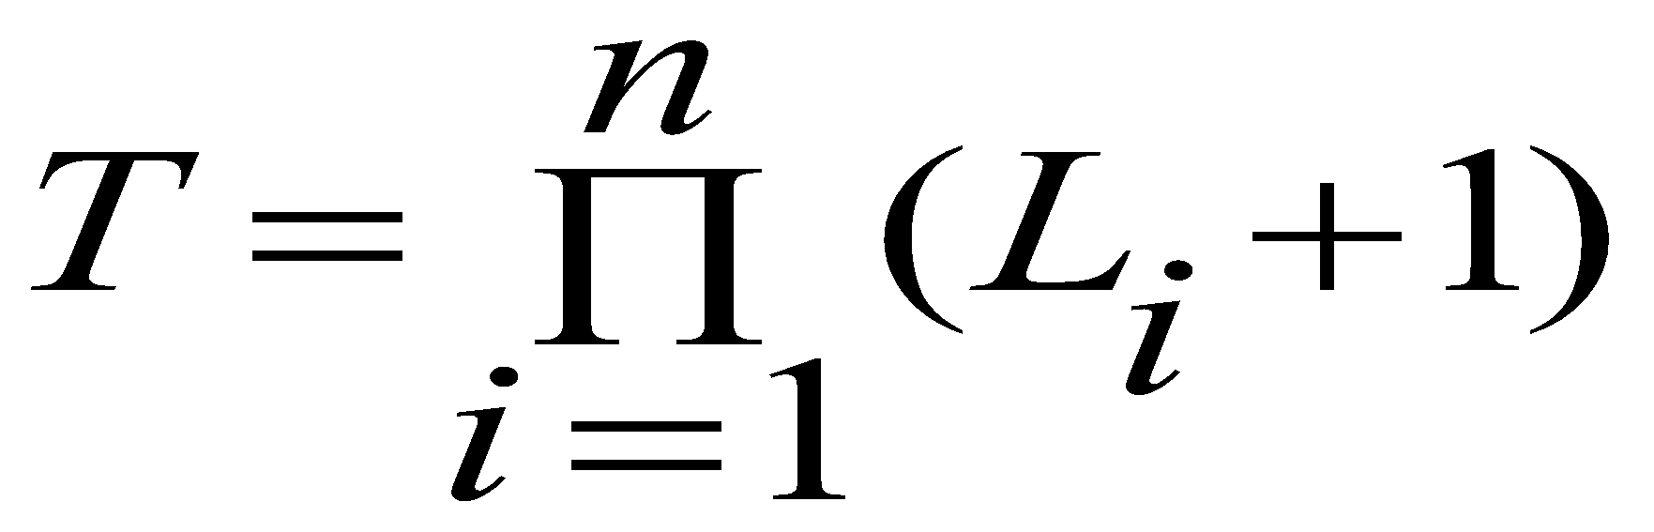
Efficient Data Cube Computation
Data cube can be viewed as a lattice of cuboids
The bottom-most cuboid is the base cuboid
The top-most cuboid (apex) contains only one cell
How many cuboids in an n-dimensional cube with L levels?
Materialization of data cube
Materialize every (cuboid) (full materialization), none (no materialization), or some (partial materialization)
Selection of which cuboids to materialize
Based on size, sharing, access frequency, etc.
79
Notes:
79

Slide 80
The “Compute Cube” Operator
Cube definition and computation in DMQL
define cube sales [item, city, year]: sum (sales_in_dollars)
compute cube sales
Transform it into a SQL-like language (with a new operator cube by, introduced by Gray et al.’96)
SELECT item, city, year, SUM (amount)
FROM SALES
CUBE BY item, city, year
Need compute the following Group-Bys
(date, product, customer),
(date,product),(date, customer), (product, customer),
(date), (product), (customer)
()
()
(city)
(item)
(year)
(city, item)
(city, year)
(item, year)
(city, item, year)
80
Notes:
80

Slide 81
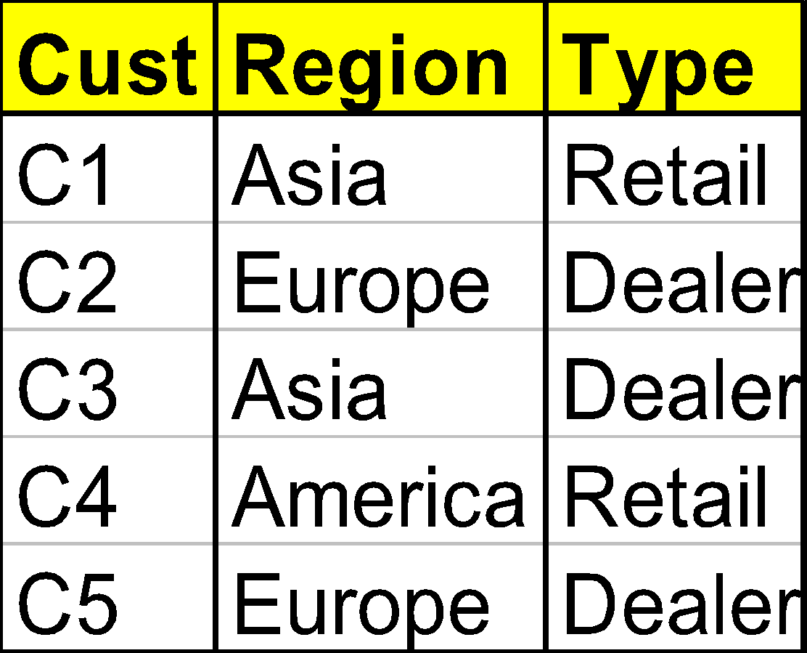
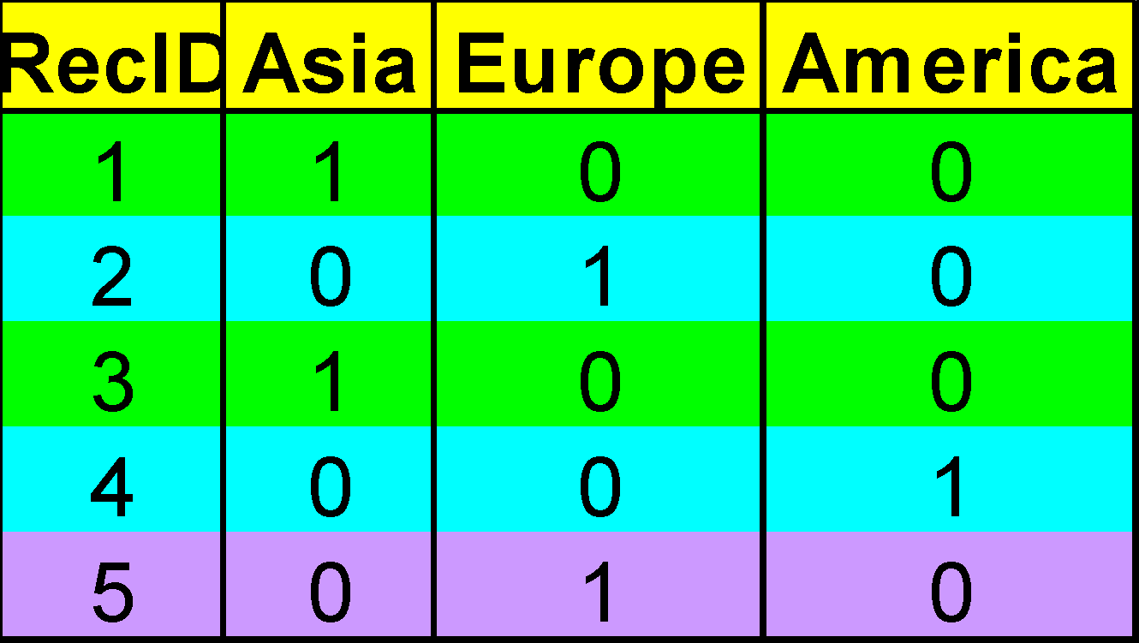
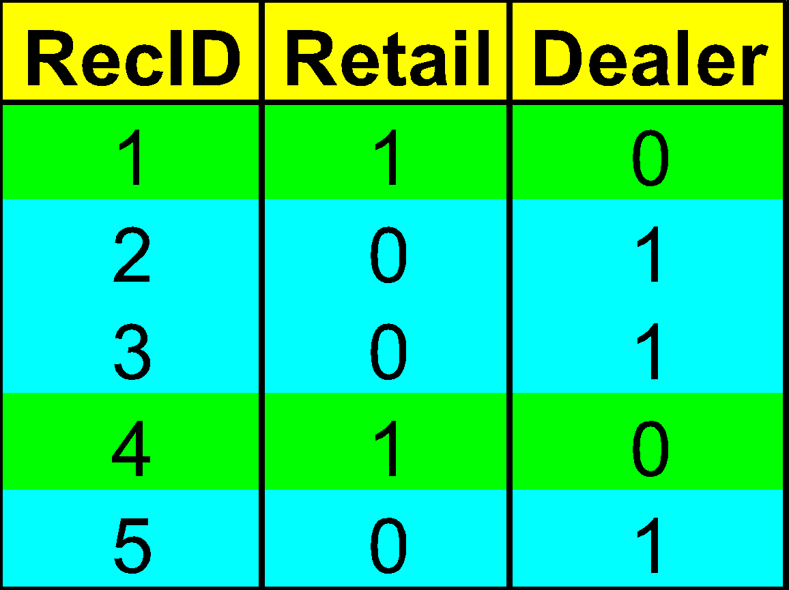
Indexing OLAP Data: Bitmap Index
Index on a particular column
Each value in the column has a bit vector: bit-op is fast
The length of the bit vector: # of records in the base table
The i-th bit is set if the i-th row of the base table has the value for the indexed column
not suitable for high cardinality domains
A recent bit compression technique, Word-Aligned Hybrid (WAH), makes it work for high cardinality domain as well [Wu, et al. TODS’06]
Base table
Index on Region
Index on Type
81
Notes:
81

Slide 82
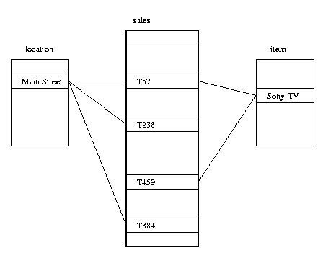
Indexing OLAP Data: Join Indices
Join index: JI(R-id, S-id) where R (R-id, …)  S (S-id, …)
Traditional indices map the values to a list of record ids
It materializes relational join in JI file and speeds up relational join
In data warehouses, join index relates the values of the dimensions of a start schema to rows in the fact table.
E.g. fact table: Sales and two dimensions city and product
A join index on city maintains for each distinct city a list of R-IDs of the tuples recording the Sales in the city
Join indices can span multiple dimensions
82
Notes:
82

Slide 83
Efficient Processing OLAP Queries
Determine which operations should be performed on the available cuboids
Transform drill, roll, etc. into corresponding SQL and/or OLAP operations, e.g., dice = selection + projection
Determine which materialized cuboid(s) should be selected for OLAP op.
Let the query to be processed be on {brand, province_or_state} with the condition “year = 2004”, and there are 4 materialized cuboids available:
1) {year, item_name, city}
2) {year, brand, country}
3) {year, brand, province_or_state}
4) {item_name, province_or_state} where year = 2004
Which should be selected to process the query?
Explore indexing structures and compressed vs. dense array structs in MOLAP
83
Notes:
83

Slide 84
OLAP Server Architectures
Relational OLAP (ROLAP)
Use relational or extended-relational DBMS to store and manage warehouse data and OLAP middle ware
Include optimization of DBMS backend, implementation of aggregation navigation logic, and additional tools and services
Greater scalability
Multidimensional OLAP (MOLAP)
Sparse array-based multidimensional storage engine
Fast indexing to pre-computed summarized data
Hybrid OLAP (HOLAP) (e.g., Microsoft SQLServer)
Flexibility, e.g., low level: relational, high-level: array
Specialized SQL servers (e.g., Redbricks)
Specialized support for SQL queries over star/snowflake schemas
84
Notes:
84

Slide 85
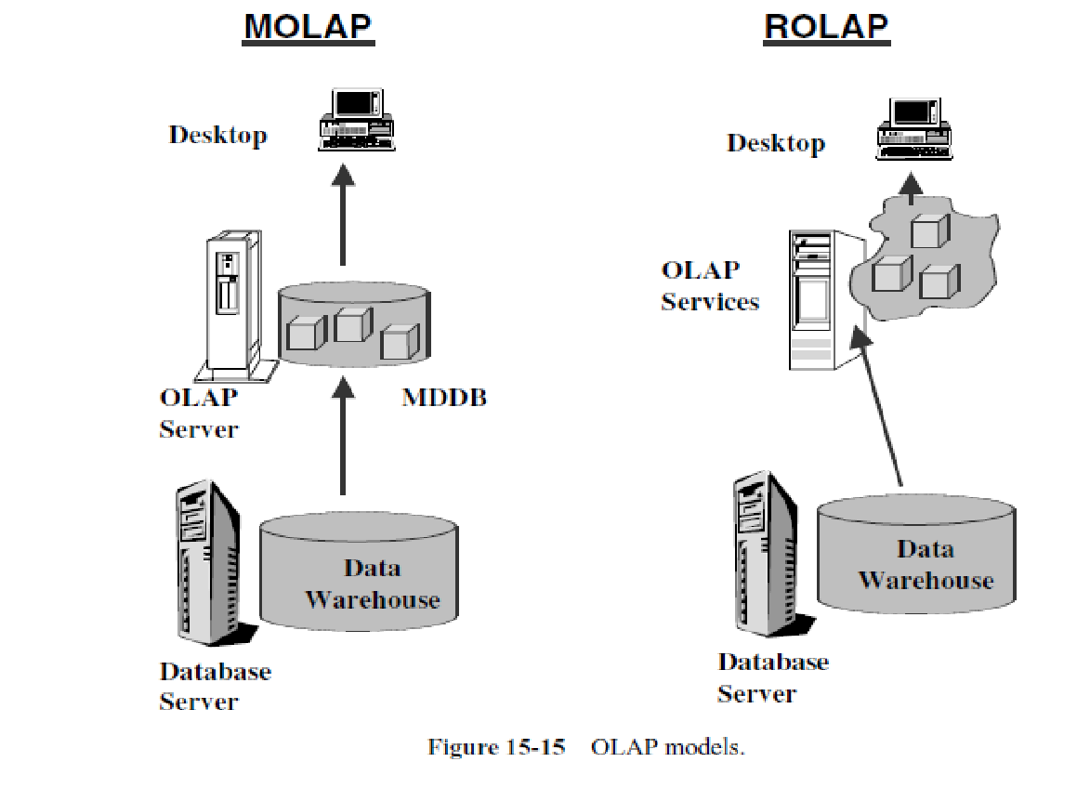
*
Data Mining: Concepts and Techniques
85

Slide 86
References (II)
Jiawei Han, Micheline Kamber, and Jian Pei
University of Illinois at Urbana-Champaign &
Simon Fraser University
©2011 Han, Kamber & Pei. All rights reserved.
C. Imhoff, N. Galemmo, and J. G. Geiger. Mastering Data Warehouse Design: Relational and Dimensional Techniques. John Wiley, 2003
W. H. Inmon. Building the Data Warehouse. John Wiley, 1996
R. Kimball and M. Ross. The Data Warehouse Toolkit: The Complete Guide to Dimensional Modeling. 2ed. John Wiley, 2002
P. O’Neil and G. Graefe. Multi-table joins through bitmapped join indices. SIGMOD Record, 24:8–11, Sept. 1995.
P. O'Neil and D. Quass. Improved query performance with variant indexes. SIGMOD'97
Microsoft. OLEDB for OLAP programmer's reference version 1.0. In http://www.microsoft.com/data/oledb/olap, 1998
S. Sarawagi and M. Stonebraker. Efficient organization of large multidimensional arrays. ICDE'94
A. Shoshani. OLAP and statistical databases: Similarities and differences. PODS’00.
D. Srivastava, S. Dar, H. V. Jagadish, and A. V. Levy. Answering queries with aggregation using views. VLDB'96
P. Valduriez. Join indices. ACM Trans. Database Systems, 12:218-246, 1987.
J. Widom. Research problems in data warehousing. CIKM’95
K. Wu, E. Otoo, and A. Shoshani, Optimal Bitmap Indices with Efficient Compression, ACM Trans. on Database Systems (TODS), 31(1): 1-38, 2006
86
Notes:
86

