Slide 1
NoSQL

Slide 2
Contents
What is NoSQL , why NoSQL
Understand NoSQL business Drivers
Desirable features of NoSQL
Need for NoSQL through case studies
NoSQL data Architectural Pattern
variations of NoSQL Architectural Pattern
How NoSQL is used to manage big data
How NoSQL system handles big data problems

Slide 3
NoSQL Database is a non-relational Data Management System, that does not require a fixed schema. It avoids joins, and is easy to scale.
NoSQL is used for Big data and real-time web apps.
For example, companies like Twitter, Facebook and Google collect terabytes of user data every single day.

Slide 4
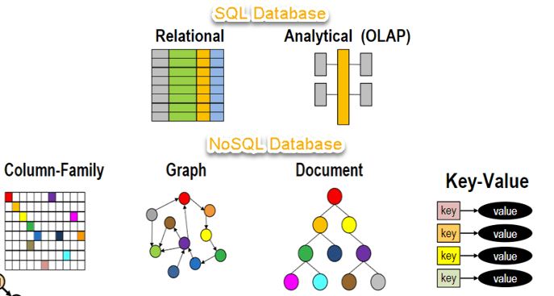
NoSQL database system encompasses a wide range of database technologies that can store structured, semi-structured, unstructured and polymorphic data.

Slide 5
Brief History of NoSQL Databases
1998- Carlo Strozzi use the term NoSQL for his lightweight, open-source relational
database
2000- Graph database Neo4j is launched
2004- Google BigTable is launched
2005- CouchDB is launched
2007- The research paper on Amazon Dynamo is released
2008- Facebooks open sources the Cassandra project
2009- The term NoSQL was reintroduced

Slide 6
Features of NoSQL
Non-relational
NoSQL databases never follow the relational model
Never provide tables with flat fixed-column records
Work with self-contained aggregates or BLOBs
Doesn’t require object-relational mapping and data normalization
No complex features like query languages, query planners , referential integrity joins, ACID
Schema-free
NoSQL databases are either schema-free or have relaxed schemas
Do not require any sort of definition of the schema of the data
Offers heterogeneous structures of data in the same domain

Slide 7
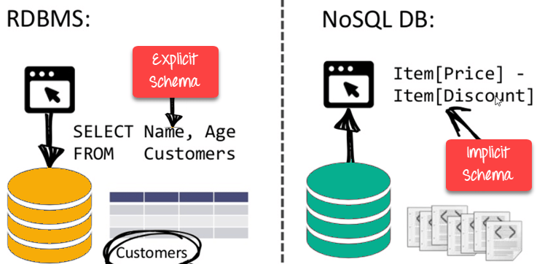
NoSQL is Schema-Free

Slide 8
Simple API
Offers easy to use interfaces for storage and querying data provided
APIs allow low-level data manipulation & selection methods
Text-based protocols mostly used with HTTP REST with JSON
Mostly used no standard based NoSQL query language
Web-enabled databases running as internet-facing services
Distributed
Multiple NoSQL databases can be executed in a distributed fashion
Offers auto-scaling and fail-over capabilities
Often ACID concept can be sacrificed for scalability and throughput
Mostly no synchronous replication between distributed nodes Asynchronous Multi-Master Replication, peer-to-peer, HDFS Replication
Only providing eventual consistency
Shared Nothing Architecture. This enables less coordination and higher distribution.

Slide 9
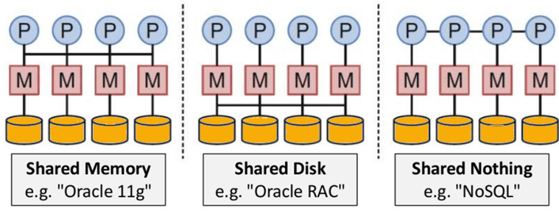
NoSQL is Shared Nothing.

Slide 10
Types of NoSQL Databases
NoSQL Databases are mainly categorized into four types: Key-value pair, Column-oriented, Graph-based and Document-oriented. Every category has its unique attributes and limitations. None of the above-specified database is better to solve all the problems. Users should select the database based on their product needs.
Types of NoSQL Databases:
Key-value Pair Based
Column-oriented Graph
Graphs based
Document-oriented

Slide 11
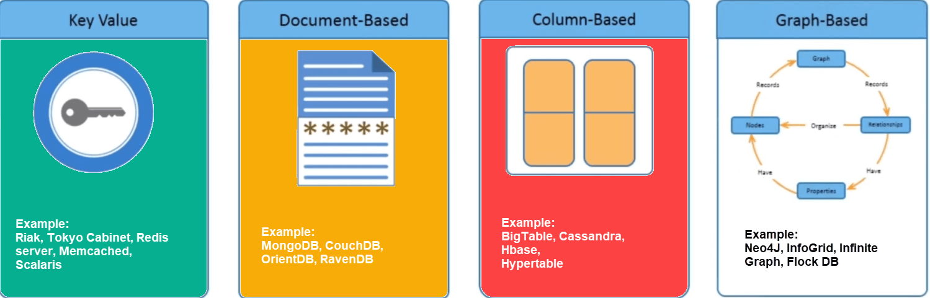

Slide 12
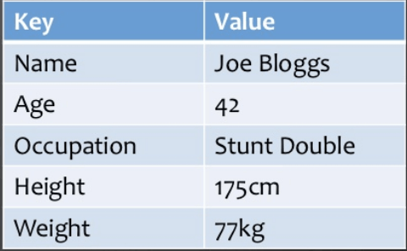
Key Value Pair Based
Data is stored in key/value pairs. It is designed in such a way to handle lots of data and heavy load.
Key-value pair storage databases store data as a hash table where each key is unique, and the value can be a JSON, BLOB(Binary Large Objects), string, etc.
For example, a key-value pair may contain a key like “Website” associated with a value like “google”.
It is one of the most basic NoSQL database example. This kind of NoSQL database is used as a collection, dictionaries, associative arrays, etc. Key value stores help the developer to store schema-less data. They work best for shopping cart contents.
Redis, Dynamo, Riak are some NoSQL examples of key-value store DataBases. They are all based on Amazon’s Dynamo paper.

Slide 13
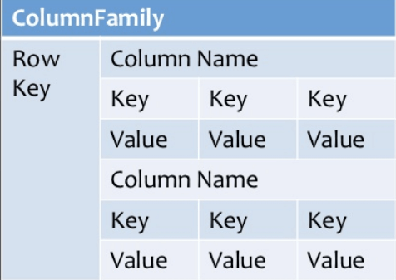
Column-based
Column-oriented databases work on columns and are based on BigTable paper by Google. Every column is treated separately. Values of single column databases are stored contiguously.
Column based NoSQL database
They deliver high performance on aggregation queries like SUM, COUNT, AVG, MIN etc. as the data is readily available in a column.
Column-based NoSQL databases are widely used to manage data warehouses, business intelligence, CRM, Library card catalogs , HBase, Cassandra, HBase, Hypertable are NoSQL query examples of column based database

Slide 14
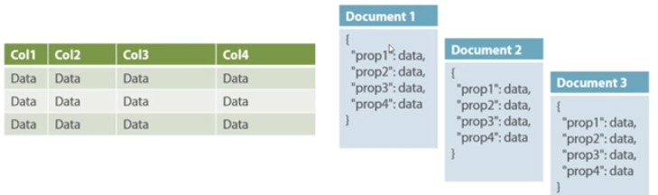
Document-Oriented:
Document-Oriented NoSQL DB stores and retrieves data as a key value pair but the value part is stored as a document. The document is stored in JSON or XML formats. The value is understood by the DB and can be queried.
Relational Vs. Document

Slide 15
In this diagram on your left you can see we have rows and columns, and in the right, we have a document database which has a similar structure to JSON. Now for the relational database, you have to know what columns you have and so on. However, for a document database, you have data store like JSON object. You do not require to define which make it flexible.
The document type is mostly used for CMS systems, blogging platforms, real-time analytics & e-commerce applications. It should not use for complex transactions which require multiple operations or queries against varying aggregate structures.
Amazon SimpleDB, CouchDB, MongoDB, Riak, Lotus Notes, MongoDB, are popular Document originated DBMS systems.

Slide 16
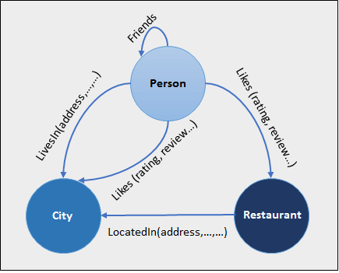
Graph-Based
A graph type database stores entities as well the relations amongst those entities. The entity is stored as a node with the relationship as edges. An edge gives a relationship between nodes. Every node and edge has a unique identifier.
Compared to a relational database where tables are loosely connected, a Graph database is a multi-relational in nature. Traversing relationship is fast as they are already captured into the DB, and there is no need to calculate them.
Graph base database mostly used for social networks, logistics, spatial data.
Neo4J, Infinite Graph, OrientDB, FlockDB are some popular graph-based databases.

Slide 17
Query Mechanism tools for NoSQL
The most common data retrieval mechanism is the REST-based retrieval of a value based on its key/ID with GET resource
Document store Database offers more difficult queries as they understand the value in a key-value pair. For example, CouchDB allows defining views with MapReduce

Slide 18
What is the CAP Theorem?
CAP theorem is also called brewer’s theorem. It states that is impossible for a distributed data store to offer more than two out of three guarantees
Consistency
Availability
Partition Tolerance
Consistency:
The data should remain consistent even after the execution of an operation. This means once data is written, any future read request should contain that data. For example, after updating the order status, all the clients should be able to see the same data.

Slide 19
Availability:
The database should always be available and responsive. It should not have any downtime.
Partition Tolerance:
Partition Tolerance means that the system should continue to function even if the communication among the servers is not stable. For example, the servers can be partitioned into multiple groups which may not communicate with each other. Here, if part of the database is unavailable, other parts are always unaffected.

Slide 20
Eventual Consistency
The term “eventual consistency” means to have copies of data on multiple machines to get high availability and scalability. Thus, changes made to any data item on one machine has to be propagated to other replicas.
Data replication may not be instantaneous as some copies will be updated immediately while others in due course of time. These copies may be mutually, but in due course of time, they become consistent. Hence, the name eventual consistency.
BASE: Basically Available, Soft state, Eventual consistency
Basically, available means DB is available all the time as per CAP theorem
Soft state means even without an input; the system state may change
Eventual consistency means that the system will become consistent over time

Slide 21
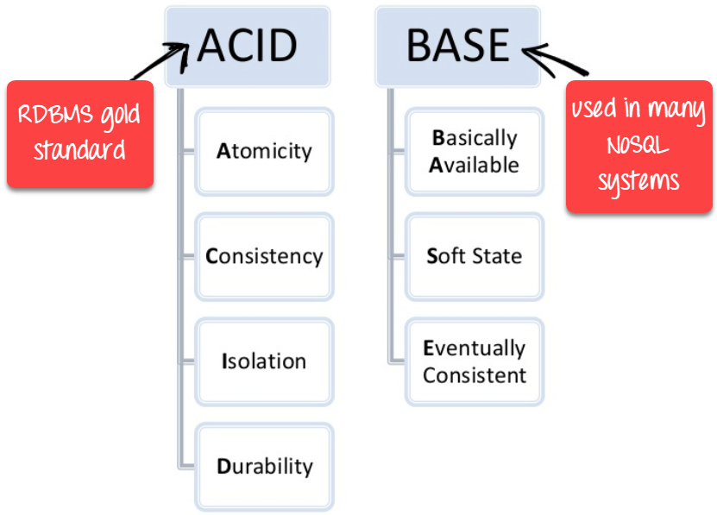

Slide 22
Advantages of NoSQL
Can be used as Primary or Analytic Data Source
Big Data Capability
No Single Point of Failure
Easy Replication
No Need for Separate Caching Layer
It provides fast performance and horizontal scalability.
Can handle structured, semi-structured, and unstructured data with equal effect
Object-oriented programming which is easy to use and flexible
NoSQL databases don’t need a dedicated high-performance server
Support Key Developer Languages and Platforms
Simple to implement than using RDBMS
It can serve as the primary data source for online applications.
Handles big data which manages data velocity, variety, volume, and complexity
Excels at distributed database and multi-data center operations
Eliminates the need for a specific caching layer to store data
Offers a flexible schema design which can easily be altered without downtime or service disruption

Slide 23
Disadvantages of NoSQL
No standardization rules
Limited query capabilities
RDBMS databases and tools are comparatively mature
It does not offer any traditional database capabilities, like consistency when multiple transactions are performed simultaneously.
When the volume of data increases it is difficult to maintain unique values as keys become difficult
Doesn’t work as well with relational data
The learning curve is stiff for new developers
Open source options so not so popular for enterprises.

Slide 24

CAP Theorem
Conjectured by Prof. Eric Brewer at PODC (Principle of Distributed Computing) 2000 keynote talk
Described the trade-offs involved in distributed system
It is impossible for a web service to provide following three guarantees at the same time:
Consistency
Availability
Partition-tolerance

Slide 25
CAP Theorem
Consistency:
All nodes should see the same data at the same time
Availability:
Node failures do not prevent survivors from continuing to operate
Partition-tolerance:
The system continues to operate despite network partitions
A distributed system can satisfy any two of these guarantees at the same time but not all three

Slide 26
CAP Theorem
C
A
P

Slide 27

CAP Theorem
A simple example:
Hotel Booking: are we double-booking the same room?
Bob
Dong

Slide 28
CAP Theorem
A simple example:
Hotel Booking: are we double-booking the same room?
Bob
Dong

Slide 29

CAP Theorem
A simple example:
Hotel Booking: are we double-booking the same room?
Bob
Dong

Slide 30
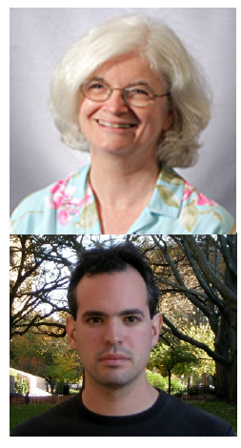
CAP Theorem: Proof
2002: Proven by research conducted by Nancy Lynch and Seth Gilbert at MIT
Gilbert, Seth, and Nancy Lynch. "Brewer's conjecture and the feasibility of consistent, available, partition-tolerant web services." ACM SIGACT News 33.2 (2002): 51-59.

Slide 31
CAP Theorem: Proof
A simple proof using two nodes:
A
B

Slide 32
CAP Theorem: Proof
A simple proof using two nodes:
Not Consistent!
A
B
Respond to client

Slide 33

CAP Theorem: Proof
A simple proof using two nodes:
Not Available!
A
B
Wait to be updated

Slide 34
CAP Theorem: Proof
A simple proof using two nodes:
Not Partition Tolerant!
A
B
A gets updated from B

Slide 35
Why this is important?
The future of databases is distributed (Big Data Trend, etc.)
CAP theorem describes the trade-offs involved in distributed systems
A proper understanding of CAP theorem is essential to making decisions about the future of distributed database design
Misunderstanding can lead to erroneous or inappropriate design choices

Slide 36
Problem for Relational Database to Scale
The Relational Database is built on the principle of ACID (Atomicity, Consistency, Isolation, Durability)
It implies that a truly distributed relational database should have availability, consistency and partition tolerance.
Which unfortunately is impossible …

Slide 37
Revisit CAP Theorem
Of the following three guarantees potentially offered a by distributed systems:
Consistency
Availability
Partition tolerance
Pick two
This suggests there are three kinds of distributed systems:
CP
AP
CA
C
A
P
Any problems?

Slide 38
A popular misconception: 2 out 3
How about CA?
Can a distributed system (with unreliable network) really be not tolerant of partitions?
C
A

Slide 39

A few witnesses
Coda Hale, Yammer software engineer:
“Of the CAP theorem’s Consistency, Availability, and Partition Tolerance, Partition Tolerance is mandatory in distributed systems. You cannot not choose it.”
http://codahale.com/you-cant-sacrifice-partition-tolerance/

Slide 40

A few witnesses
Werner Vogels, Amazon CTO
“An important observation is that in larger distributed-scale systems, network partitions are a given; therefore, consistency and availability cannot be achieved at the same time.”
http://www.allthingsdistributed.com/2008/12/eventually_consistent.html

Slide 41

A few witnesses
Daneil Abadi, Co-founder of Hadapt
So in reality, there are only two types of systems ... I.e., if there is a partition, does the system give up availability or consistency?
http://dbmsmusings.blogspot.com/2010/04/problems-with-cap-and-yahoos-little.html

Slide 42
CAP Theorem 12 year later
Prof. Eric Brewer: father of CAP theorem
“The “2 of 3” formulation was always misleading because it tended to oversimplify the tensions among properties. ...
CAP prohibits only a tiny part of the design space: perfect availability and consistency in the presence of partitions, which are rare.”
http://www.infoq.com/articles/cap-twelve-years-later-how-the-rules-have-changed

Slide 43
Consistency or Availability
Consistency and Availability is not “binary” decision
AP systems relax consistency in favor of availability – but are not inconsistent
CP systems sacrifice availability for consistency- but are not unavailable
This suggests both AP and CP systems can offer a degree of consistency, and availability, as well as partition tolerance
C
A
P

Slide 44
AP: Best Effort Consistency
Example:
Web Caching
DNS
Trait:
Optimistic
Expiration/Time-to-live
Conflict resolution

Slide 45
CP: Best Effort Availability
Example:
Majority protocols
Distributed Locking (Google Chubby Lock service)
Trait:
Pessimistic locking
Make minority partition unavailable

Slide 46
Types of Consistency
Strong Consistency
After the update completes, any subsequent access will return the same updated value.
Weak Consistency
It is not guaranteed that subsequent accesses will return the updated value.
Eventual Consistency
Specific form of weak consistency
It is guaranteed that if no new updates are made to object, eventually all accesses will return the last updated value (e.g., propagate updates to replicas in a lazy fashion)

Slide 47
Eventual Consistency Variations
Causal consistency
Processes that have causal relationship will see consistent data
Read-your-write consistency
A process always accesses the data item after it’s update operation and never sees an older value
Session consistency
As long as session exists, system guarantees read-your-write consistency
Guarantees do not overlap sessions

Slide 48
Eventual Consistency Variations
Monotonic read consistency
If a process has seen a particular value of data item, any subsequent processes will never return any previous values
Monotonic write consistency
The system guarantees to serialize the writes by the same process
In practice
A number of these properties can be combined
Monotonic reads and read-your-writes are most desirable

Slide 49



Eventual Consistency - A Facebook Example
Bob finds an interesting story and shares with Alice by posting on her Facebook wall
Bob asks Alice to check it out
Alice logs in her account, checks her Facebook wall but finds:
- Nothing is there!
?

Slide 50

Eventual Consistency - A Facebook Example
Bob tells Alice to wait a bit and check out later
Alice waits for a minute or so and checks back:
- She finds the story Bob shared with her!

Slide 51
Eventual Consistency - A Facebook Example
Reason: it is possible because Facebook uses an eventual consistent model
Why Facebook chooses eventual consistent model over the strong consistent one?
Facebook has more than 1 billion active users
It is non-trivial to efficiently and reliably store the huge amount of data generated at any given time
Eventual consistent model offers the option to reduce the load and improve availability

Slide 52



Eventual Consistency - A Dropbox Example
Dropbox enabled immediate consistency via synchronization in many cases.
However, what happens in case of a network partition?

Slide 53
Eventual Consistency - A Dropbox Example
Let’s do a simple experiment here:
Open a file in your drop box
Disable your network connection (e.g., WiFi, 4G)
Try to edit the file in the drop box: can you do that?
Re-enable your network connection: what happens to your dropbox folder?

Slide 54
Eventual Consistency - A Dropbox Example
Dropbox embraces eventual consistency:
Immediate consistency is impossible in case of a network partition
Users will feel bad if their word documents freeze each time they hit Ctrl+S , simply due to the large latency to update all devices across WAN
Dropbox is oriented to personal syncing, not on collaboration, so it is not a real limitation.

Slide 55
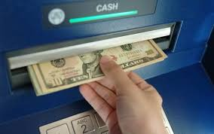
Eventual Consistency - An ATM Example
In design of automated teller machine (ATM):
Strong consistency appear to be a nature choice
However, in practice, A beats C
Higher availability means higher revenue
ATM will allow you to withdraw money even if the machine is partitioned from the network
However, it puts a limit on the amount of withdraw (e.g., $200)
The bank might also charge you a fee when a overdraft happens

Slide 56
Dynamic Tradeoff between C and A
An airline reservation system:
When most of seats are available: it is ok to rely on somewhat out-of-date data, availability is more critical
When the plane is close to be filled: it needs more accurate data to ensure the plane is not overbooked, consistency is more critical
Neither strong consistency nor guaranteed availability, but it may significantly increase the tolerance of network disruption

Slide 57
Heterogeneity: Segmenting C and A
No single uniform requirement
Some aspects require strong consistency
Others require high availability
Segment the system into different components
Each provides different types of guarantees
Overall guarantees neither consistency nor availability
Each part of the service gets exactly what it needs
Can be partitioned along different dimensions

Slide 58
Discussion
In an e-commercial system (e.g., Amazon, e-Bay, etc), what are the trade-offs between consistency and availability you can think of? What is your strategy?
Hint -> Things you might want to consider:
Different types of data (e.g., shopping cart, billing, product, etc.)
Different types of operations (e.g., query, purchase, etc.)
Different types of services (e.g., distributed lock, DNS, etc.)
Different groups of users (e.g., users in different geographic areas, etc.)

Slide 59
Partitioning Examples
Data Partitioning
Operational Partitioning
Functional Partitioning
User Partitioning
Hierarchical Partitioning

Slide 60
Partitioning Examples
Data Partitioning
Different data may require different consistency and availability
Example:
Shopping cart: high availability, responsive, can sometimes suffer anomalies
Product information need to be available, slight variation in inventory is sufferable
Checkout, billing, shipping records must be consistent

Slide 61
Partitioning Examples
Operational Partitioning
Each operation may require different balance between consistency and availability
Example:
Reads: high availability; e.g.., “query”
Writes: high consistency, lock when writing; e.g., “purchase”

Slide 62
Partitioning Examples
Functional Partitioning
System consists of sub-services
Different sub-services provide different balances
Example: A comprehensive distributed system
Distributed lock service (e.g., Chubby) :
Strong consistency
DNS service:
High availability

Slide 63
Partitioning Examples
User Partitioning
Try to keep related data close together to assure better performance
Example: Craglist
Might want to divide its service into several data centers, e.g., east coast and west coast
Users get high performance (e.g., high availability and good consistency) if they query servers closet to them
Poorer performance if a New York user query Craglist in San Francisco

Slide 64
Partitioning Examples
Hierarchical Partitioning
Large global service with local “extensions”
Different location in hierarchy may use different consistency
Example:
Local servers (better connected) guarantee more consistency and availability
Global servers has more partition and relax one of the requirement

Slide 65
What if there are no partitions?
Tradeoff between Consistency and Latency:
Caused by the possibility of failure in distributed systems
High availability -> replicate data -> consistency problem
Basic idea:
Availability and latency are arguably the same thing: unavailable -> extreme high latency
Achieving different levels of consistency/availability takes different amount of time

Slide 66
CAP -> PACELC
A more complete description of the space of potential tradeoffs for distributed system:
If there is a partition (P), how does the system trade off availability and consistency (A and C); else (E), when the system is running normally in the absence of partitions, how does the system trade off latency (L) and consistency (C)?
Abadi, Daniel J. "Consistency tradeoffs in modern distributed database system design." Computer-IEEE Computer Magazine 45.2 (2012): 37.

Slide 67
PACELC
C
A
C
L
Normal
Partitioned

Slide 68
Examples
PA/EL Systems: Give up both Cs for availability and lower latency
Dynamo, Cassandra, Riak
PC/EC Systems: Refuse to give up consistency and pay the cost of availability and latency
BigTable, Hbase, VoltDB/H-Store
PA/EC Systems: Give up consistency when a partition happens and keep consistency in normal operations
MongoDB
PC/EL System: Keep consistency if a partition occurs but gives up consistency for latency in normal operations
Yahoo! PNUTS

Slide 69
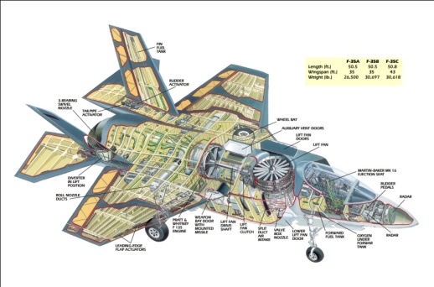


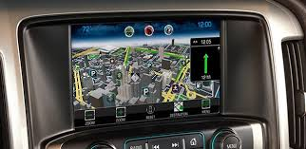


CSE 40437/60437, Spring 2015:
Social Sensing & Cyber-Physical Systems
Zero-Energy Buildings
Embedded Computing Systems
Cyber
Physical
Systems
Social Sensing
Green Navigation Systems
Body Area Networks
Smart Grids
Contact: Prof. Dong Wang: dwang5@nd.edu
http://www3.nd.edu/~dwang5/teach/spring15/spring15_wang_flyer.pdf

Slide 70
CSE 40437/60437, Spring 2015:
Social Sensing & Cyber-Physical Systems
Zero-Energy Buildings
Energy
Time
Embedded Computing Systems
Cyber
Physical
Systems
Social Sensing
Data
Social
Green Navigation Systems
Body Area Networks
Smart Grids
Contact: Prof. Dong Wang: dwang5@nd.edu
http://www3.nd.edu/~dwang5/teach/spring15/spring15_wang_flyer.pdf

Slide 71
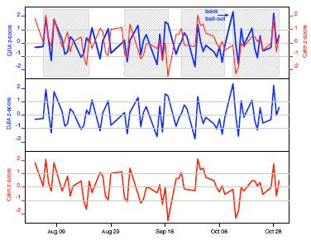

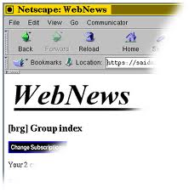
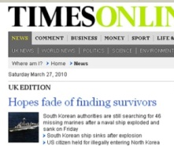
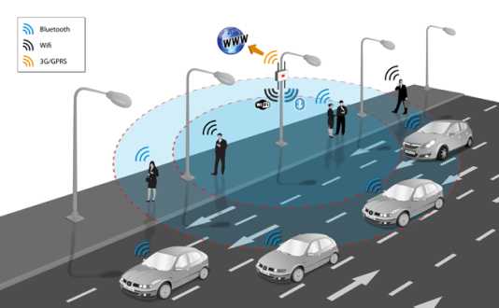

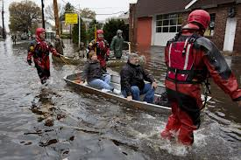






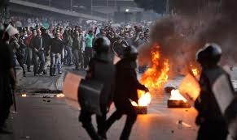



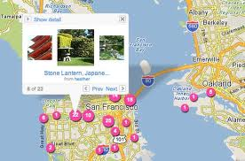
CSE 40437/60437, Spring 2015:
Social Sensing & Cyber-Physical Systems
Events
Stock Prediction (Money)
Applications
Analytics
News and Public Sources
Boston Bombing
Decision
Support
Traffic Monitoring (Time)
Hurricane Sandy
People
Disaster Response (Lives)
Data
Egypt unrest
Sensors
Contact: Prof. Dong Wang: dwang5@nd.edu
http://www3.nd.edu/~dwang5/teach/spring15/spring15_wang_flyer.pdf
Geo Tagging (Smart City)

Slide 72
Consistency
Availability
Partition Tolerance
Blogs website
Multiplayer online games
Stock trading platforms
Video streaming sites
Ticket booking system
Video chat application
Bank

Slide 73
Thank you!

