Slide 1
901320 Computer Architecture
Chapter 1 Objectives
Know the difference between computer organization and computer architecture.
Understand units of measure common to computer systems
Appreciate the evolution of computers.
Understand the computer as a layered system.
Be able to explain the von Neumann architecture and the function of basic computer components.

Slide 2
Overview
A modern computer is an electronic, digital, general purpose computing machine that automatically follows a step-by-step list of instructions to solve a problem. This step-by step list of instructions that a computer follows is also called an algorithm or a computer program.
Why study computer organization and architecture?
  Design better programs, including system software such as compilers, operating systems, and device drivers.
  Optimize program behavior.
  Evaluate (benchmark) computer system performance.
  Understand time, space, and price tradeoffs.
Computer organization
  Encompasses all physical aspects of computer systems.
  E.g., circuit design, control signals, memory types.
  How does a computer work?

Slide 3
Computer architecture
Focuses on the structure(the way in which the components are interrelated) and behavior of the computer system and refers to the logical aspects of system implementation as seen by the programmer
Computer architecture includes many elements such as
  instruction sets and formats, operation codes, data types, the number and types of registers, addressing modes, main memory access methods, and various I/O mechanisms.
The architecture of a system directly affects the logical execution of programs.
The computer architecture for a given machine is the combination of its hardware components plus its instruction set architecture (ISA).
The ISA is the interface between all the software that runs on the machine and the hard
Studying computer architecture helps us to answer the question: How do I design a computer?

Slide 4
Overview
In the case of the IBM, SUN and Intel ISAs, it is possible to purchase processors which execute the same instructions from more than one manufacturer
All these processors may have quite different internal organizations but they all appear identical to a programmer, because their instruction sets are the same
Organization & Architecture enables a family of computer models
  Same Architecture, but with differences in Organization
  Different price and performance characteristics
When technology changes, only organization changes
  This gives code compatibility (backwards)

Slide 5
Principle of Equivalence
No clear distinction between matters related to computer organization and matters relevant to computer architecture.
Principle of Equivalence of Hardware and Software
  Anything that can be done with software can also be done with hardware, and anything that can be done with hardware can also be done with software.

Slide 6
Principle of Equivalence
Since hardware and software are equivalent, what is the advantage of building digital circuits to perform specific operations where the circuits, once created, are frozen?
(Speed)
While computers are extremely fast, every instruction must be fetched, decoded, and executed. If a program is constructed out of circuits, then the speed of execution is equal to the speed that the current flows across the circuits.

Slide 7
Principle of Equivalence
Since hardware is so fast, why do we spend so much time in our society with computers and software engineering?
Flexibility
Specialized circuits, but once constructed, the programs are frozen in place.
We have too many general-purpose needs and our most of the programs that we use tend to evolve over time requiring replacements.
Replacing software is far cheaper and easier than having to manufacture and install new chips

Slide 8
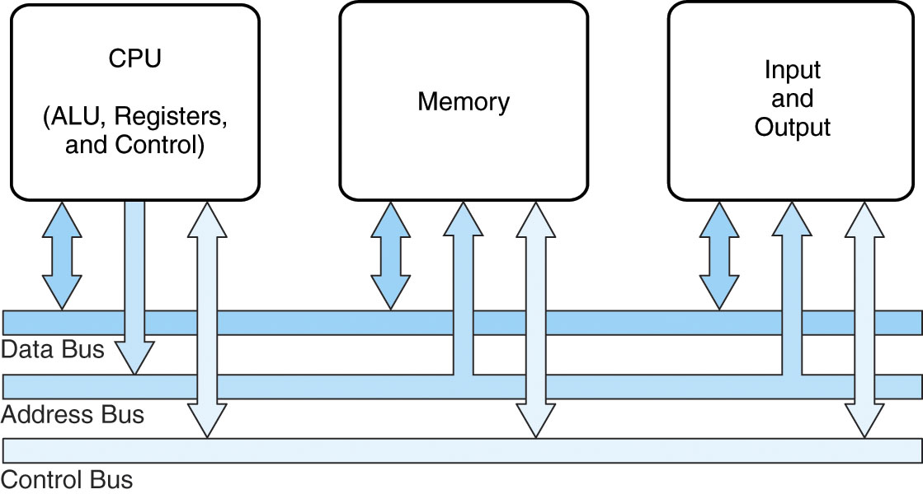
1.2 Computer Components
At the most basic level, a computer is a device consisting of 3 pieces
  A processor to interpret and execute programs
  A memory ( Includes Cache, RAM, ROM)
    to store both data and program instructions
  A mechanism for transferring data to and from the outside world.
    I/O to communicate between computer and the world
    Bus to move info from one computer component to another

Slide 9
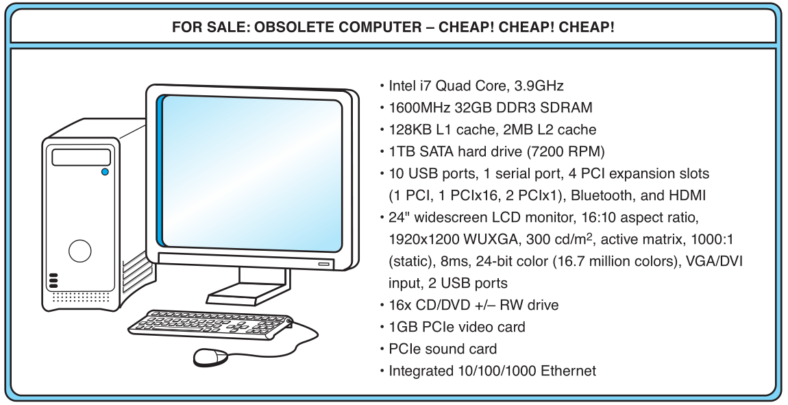
1.3 An Example System
What does it all mean??

Slide 10
Measures of capacity and speed
Kilo- (K) = 1 thousand = 10³ and 2¹⁰
Mega- (M) = 1 million = 10⁶ and 2²⁰
Giga- (G) = 1 billion = 10⁹ and 2³⁰
Tera- (T) = 1 trillion = 10¹² and 2⁴⁰
Peta- (P) = 1 quadrillion = 10¹⁵ and 2⁵⁰
Exa- (E) = 1 quintillion = 10¹⁸ and 2⁶⁰
Zetta-(Z) = 1 sextillion = 10²¹ and 2⁷⁰
Yotta-(Y) = 1 septillion = 10²⁴ and 2⁸⁰
Whether a metric refers to a power of 10 or a power of 2 typically depends upon what is being measured.
Hertz = clock cycles per second (frequency)
  1MHz = 1,000,000Hz
  Processor speeds are measured in MHz or GHz.
Byte = a unit of storage
  1KB = 2¹⁰ = 1024 Bytes
  1MB = 2²⁰ = 1,048,576 Bytes
  Main memory (RAM) is measured in MB
  Disk storage is measured in GB for small systems, TB for large systems.

Slide 11
1.3 An Example System
Measures of time and space:
  Milli- (m) = 1 thousandth = 10 ⁻³
  Micro- (μ) = 1 millionth = 10 ⁻⁶
  Nano- (n) = 1 billionth = 10 ⁻⁹
  Pico- (p) = 1 trillionth = 10 ⁻¹²
  Femto- (f) = 1 quadrillionth = 10 ⁻¹⁵
  Atto- (a) = 1 quintillionth = 10 ⁻¹⁸
  Zepto- (z) = 1 sextillionth = 10 ⁻²¹
  Yocto- (y) = 1 septillionth = 10 ⁻²⁴
We note that cycle time is the reciprocal of clock frequency.
A bus operating at 133MHz has a cycle time of 7.52 nanoseconds
Millisecond = 1 thousandth of a second
  Hard disk drive access times are often 10 to 20 milliseconds.
Nanosecond = 1 billionth of a second
  Main memory access times are often 50 to 70 nanoseconds.
Micron (micrometer) = 1 millionth of a meter
  Circuits on computer chips are measured in microns.

Slide 12
The microprocessor is the “brain” of the system. It executes program instructions. This one is an Intel i7 running at 3.9GHz.

Slide 13
1.3 An Example System
Computers with large main memory capacity can run larger programs with greater speed than computers having small memories.
RAM is an acronym for random access memory. Random access means that memory contents can be accessed directly if you know its location.
Cache is a type of temporary memory that can be accessed faster than RAM.

Slide 14
1.3 An Example System
This system has 32GB of (fast) synchronous dynamic RAM (SDRAM)
2 levels of cache memory
the level 1 (L1) cache is smaller and faster than the L2 cache. Note that these cache sizes are measured in KB and MB.

Slide 15
1.3 An Example System
Hard disk capacity determines the amount of data and size of programs you can store.
This one can store 1TB. 7200 RPM is the rotational speed of the disk. Generally, the faster a disk rotates, the faster it can deliver data to RAM. (There are many other factors involved.)

Slide 16
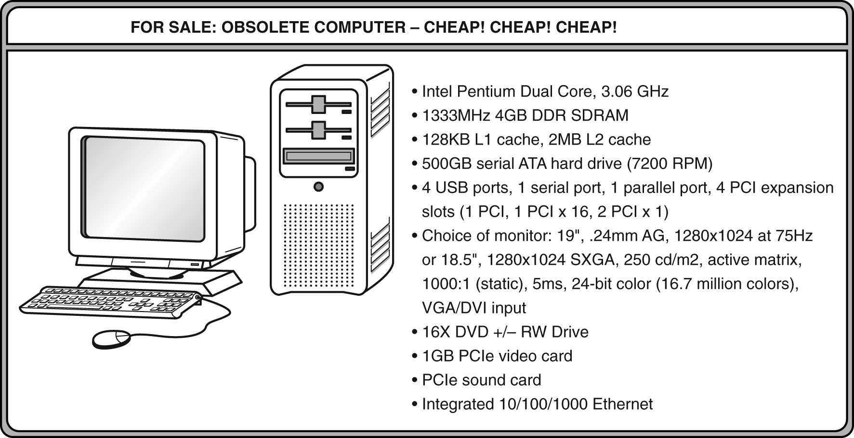
1.3 An Example System
ATA advanced technology attachment, which describes how the hard disk interfaces with (or connects to) other system components
DVD can store about 4.7GB of data. This drive supports rewritable DVDs, +/-RW, that can be written to many times.. 16x describes its speed.

Slide 17
1.3 An Example System
Ports allow movement of data between a system and its external devices.
This system has ten ports.

Slide 18
1.3 An Example System
Serial ports send data as a series of pulses along one or two data lines.
Parallel ports send data as a single pulse along at least eight data lines.
USB, Universal Serial Bus, is an intelligent serial interface that is self-configuring. (It supports “plug and play.”)

Slide 19
1.3 An Example System
System buses can be augmented by dedicated I/O buses. PCI, peripheral component interface, is one such bus.
This system has two PCIe (PCI express) devices: a video card and a sound card.

Slide 20
1.3 An Example System
Active matrix technology uses one transistor per picture element (pixel). The resolution of a monitor determines the amount of text and graphics that the monitor can display.
Super VGA (SVGA) tells us this monitor has a resolution of 1280 × 1024 pixels.
The video card contains memory and programs that support the monitor.

Slide 21
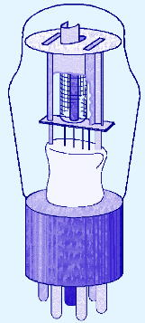
1st Generation Computers
  Used vacuum tubes for logic and storage (very little storage available)
  A vacuum-tube circuit storing 1 byte
  Programmed in machine language
  Often programmed by physical connection (hardwiring)
  Slow, unreliable, expensive
  The ENIAC – often thought of as the first programmable electronic computer – 1946
  17468 vacuum tubes, 1800 square feet, 30 tons

Slide 22
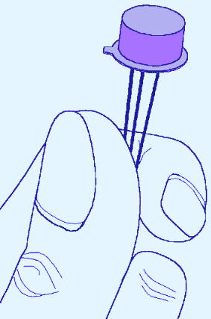
2nd Generation Computers
Transistors replaced vacuum tubes
Magnetic core memory introduced
  Changes in technology brought about cheaper and more reliable computers (vacuum tubes were very unreliable)
  Because these units were smaller, they were closer together providing a speedup over vacuum tubes
  Various programming languages introduced (assembly, high-level)
  Rudimentary OS developed
    The first supercomputer was introduced, CDC 6600 ($10 million)

Slide 23
3rd Generation Computers
Integrated circuit (IC)
The ability to place circuits onto silicon chips
  Replaced both transistors and magnetic core memory
  Result was easily mass-produced components reducing the cost of computer manufacturing significantly
  Also increased speed and memory capacity
  Computer families introduced
  Minicomputers introduced
  More sophisticated programming languages and OS developed
    Popular computers included PDP-8, PDP-11, IBM 360 and Cray produced their first supercomputer, Cray-1
  Silicon chips now contained both logic (CPU) and memory
  Large-scale computer usage led to time-sharing OS

Slide 24
4th Generation Computers
1971-Present: Microprocessors
Miniaturization took over
  From SSI (10-100 components per chip) to
  MSI (100-1000), LSI (1,000-10,000), VLSI (10,000+)
Thousands of ICs were built onto a single silicon chip(VLSI), which allowed Intel, in 1971, to
  create the world’s first microprocessor, the 4004, which was a fully functional, 4-bit system that ran at 108KHz.
  Intel also introduced the RAM chip, accommodating 4Kb of memory on a single chip. This allowed computers of the 4th generation to become smaller and faster than their solid-state predecessors
  Computers also saw the development of GUIs, the mouse and handheld devices

Slide 25
Moore’s Law
How small can we make transistors?
How densely can we pack chips?
No one can say for sure
In 1965, Intel founder Gordon Moore stated,
“The density of transistors in an integrated circuit will
double every year.”
The current version of this prediction is usually conveyed as “the density of silicon chips doubles every 18 months”
Using current technology, Moore’s Law cannot hold forever
There are physical and financial limitations
At the current rate of miniaturization, it would take about 500 years to put the entire solar system on a chip
Cost may be the ultimate constraint

Slide 26
Rock’s Law
Arthur Rock, is a corollary to Moore’s law: “The cost of capital equipment to build semiconductor will double every four years”
Rock’s Law arises from the observations of a financier who has seen the price tag of new chip facilities escalate from about $12,000 in 1968 to $12 million in the late 1990s.
At this rate, by the year 2035, not only will the size of a memory element be smaller than an atom, but it would also require the entire wealth of the world to build a single chip!
So even if we continue to make chips smaller and faster, the ultimate question may be whether we can afford to build them

Slide 27
The Computer Level Hierarchy
Through the principle of abstraction, we can imagine the machine to be built from a hierarchy of levels, in which each level has a specific function and exists as a distinct hypothetical Machine
Abstraction is the ability to focus on important aspects of a situation at a higher level while ignoring the underlying complex details
We call the hypothetical computer at each level a virtual machine.
Each level’s virtual machine executes its own particular set of instructions, calling upon machines at lower levels to carry out the tasks when necessary

Slide 28
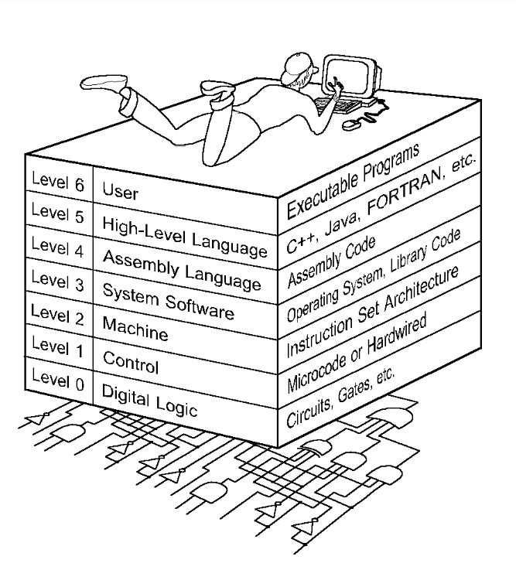
1.6 The Computer Level Hierarchy
Level 6: The User Level
Composed of applications and is the level with which everyone is most familiar.
At this level, we run programs such as word processors, graphics packages, or games. The lower levels are nearly invisible from the User Level.

Slide 29
Level 5: High-Level Language Level
  The level with which we interact when we write programs in languages such as C, Pascal, Lisp, and Java
  These languages must be translated to a language the machine can understand. (using compiler / interpreter)
  Compiled languages are translated into assembly language and then assembled into machine code. (They are translated to the next lower level.)
  The user at this level sees very little of the lower levels

Slide 30
Level 4: Assembly Language Level
  Acts upon assembly language produced from Level 5, as well as instructions programmed directly at this level
  As previously mentioned, compiled higher-level languages are first translated to assembly, which is then directly translated to machine language. This is a one-to-one translation, meaning that one assembly language instruction is translated to exactly one machine language instruction.
  By having separate levels, we reduce the semantic gap between a high-level language and the actual machine language

Slide 31
Level 3: System Software Level
  deals with operating system instructions.
  This level is responsible for multiprogramming, protecting memory, synchronizing processes, and various other important functions.
  Often, instructions translated from assembly language to machine language are passed through this level unmodified

Slide 32
Level 2: Machine Level
  Consists of instructions (ISA)that are particular to the architecture of the machine
  Programs written in machine language need no compilers, interpreters, or assemblers
Level 1: Control Level
  A control unit decodes and executes instructions and moves data through the system.
  Control units can be microprogrammed or hardwired
  A microprogram is a program written in a low-level language that is implemented by the hardware.
  Hardwired control units consist of hardware that directly executes machine instruction

Slide 33

Level 0: Digital Logic Level
  This level is where we find digital circuits (the chips)
  Digital circuits consist of gates and wires.
  These components implement the mathematical logic of all other levels

Slide 34
The Von Neumann Architecture
Named after John von Neumann, Princeton, he designed a computer architecture whereby data and instructions would be retrieved from memory, operated on by an ALU, and moved back to memory (or I/O)
This architecture is the basis for most modern computers (only parallel processors and a few other unique architectures use a different model)

Slide 35
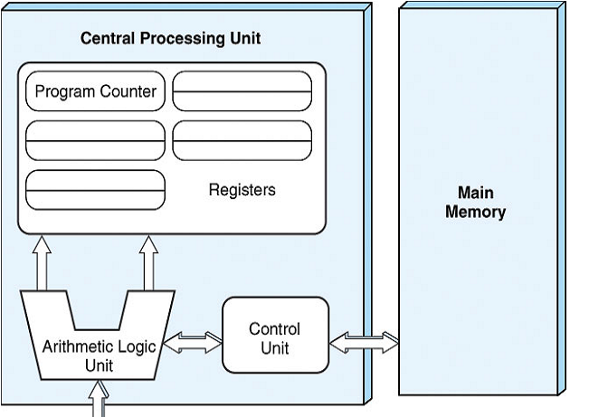
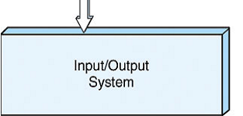
Hardware consists of 3 units
  CPU (control unit, ALU, registers)
  Memory (stores programs and data)
  I/O System (including secondary storage)
Instructions in memory are executed sequentially unless a program instruction explicitly changes the order

Slide 36
Von Neumann Architectures
There is a single pathway used to move both data and instructions between memory, I/O and CPU
  the pathway is implemented as a bus
  the single pathway creates a bottleneck
    known as the von Neumann bottleneck
  A variation of this architecture is the Harvard architecture which separates data and instructions into two pathways
  Another variation, used in most computers, is the system bus version in which there are different buses between CPU and memory and memory and I/O

Slide 37
Fetch-execute cycle
The von Neumann architecture operates on the fetch-execute cycle
  Fetch an instruction from memory as indicated by the Program Counter register
  Decode the instruction in the control unit
  Data operands needed for the instruction are fetched from memory
  Execute the instruction in the ALU storing the result in a register
  Move the result back to memory if needed

Slide 38
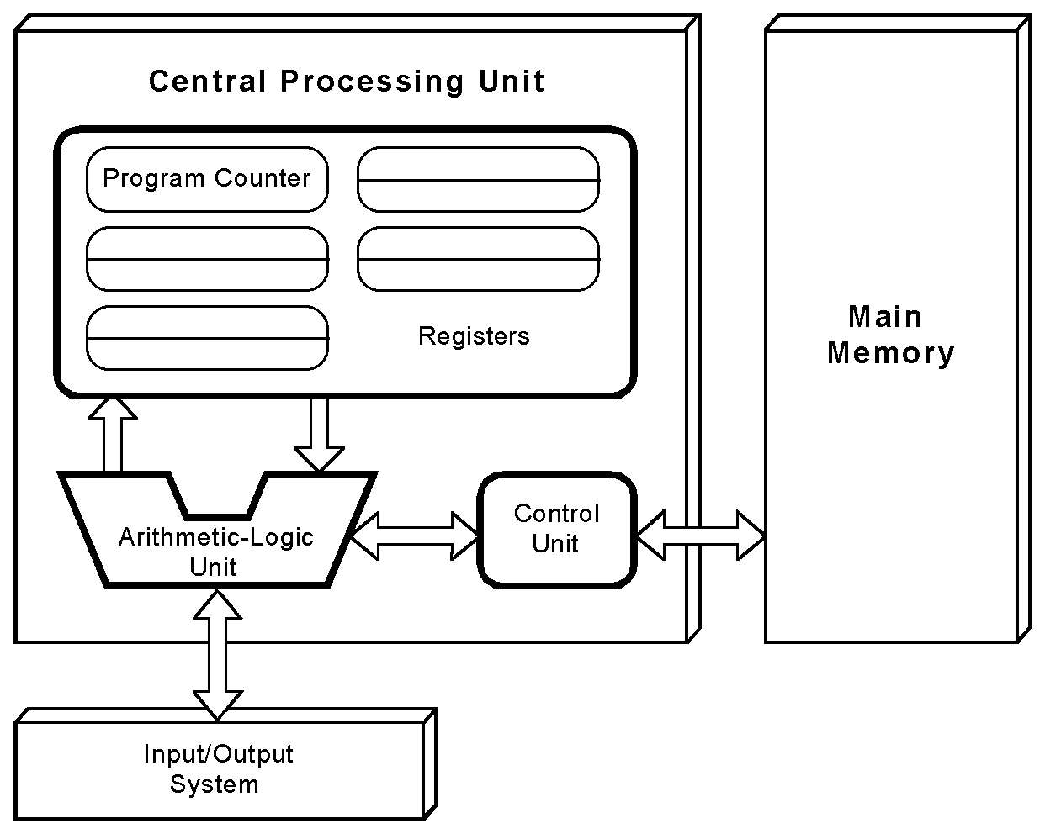
1.7 The von Neumann Model
This is a general depiction of a von Neumann system:
These computers employ a fetch-decode-execute cycle to run programs as follows . . .

Slide 39
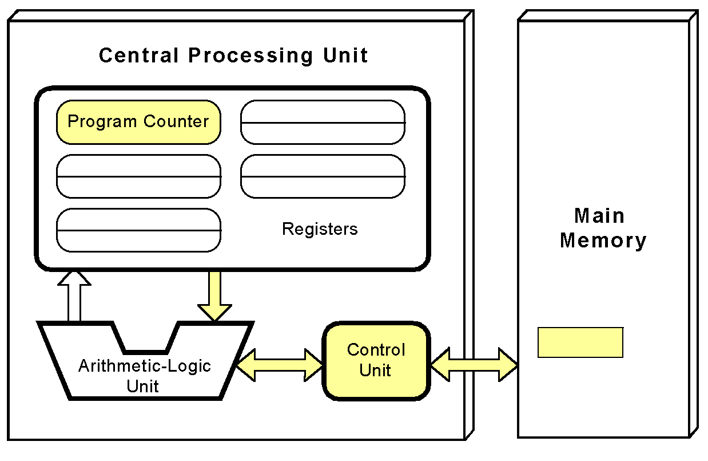
The von Neumann Model
The control unit fetches the next instruction from memory using the program counter to determine where the instruction is located

Slide 40
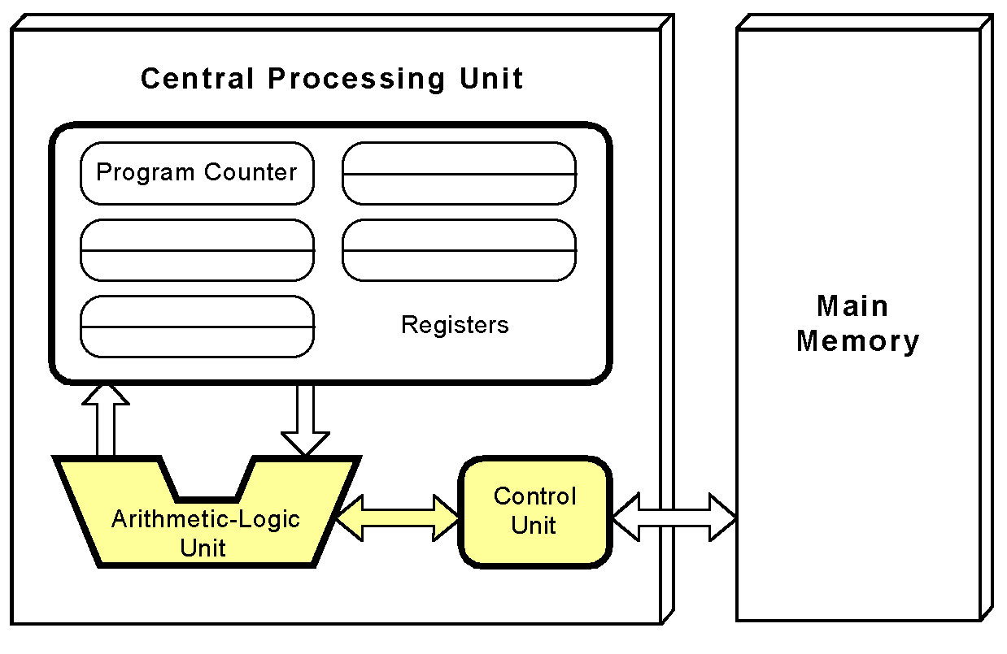
The von Neumann Model
The instruction is decoded into a language that the ALU can understand.

Slide 41
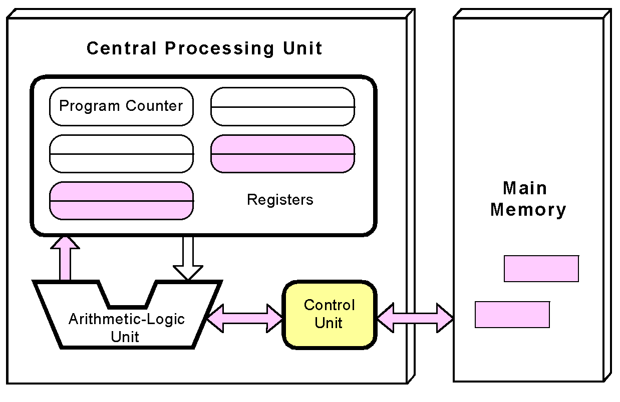
The von Neumann Model
Any data operands required to execute the instruction are fetched from memory and placed into registers within the CPU.

Slide 42
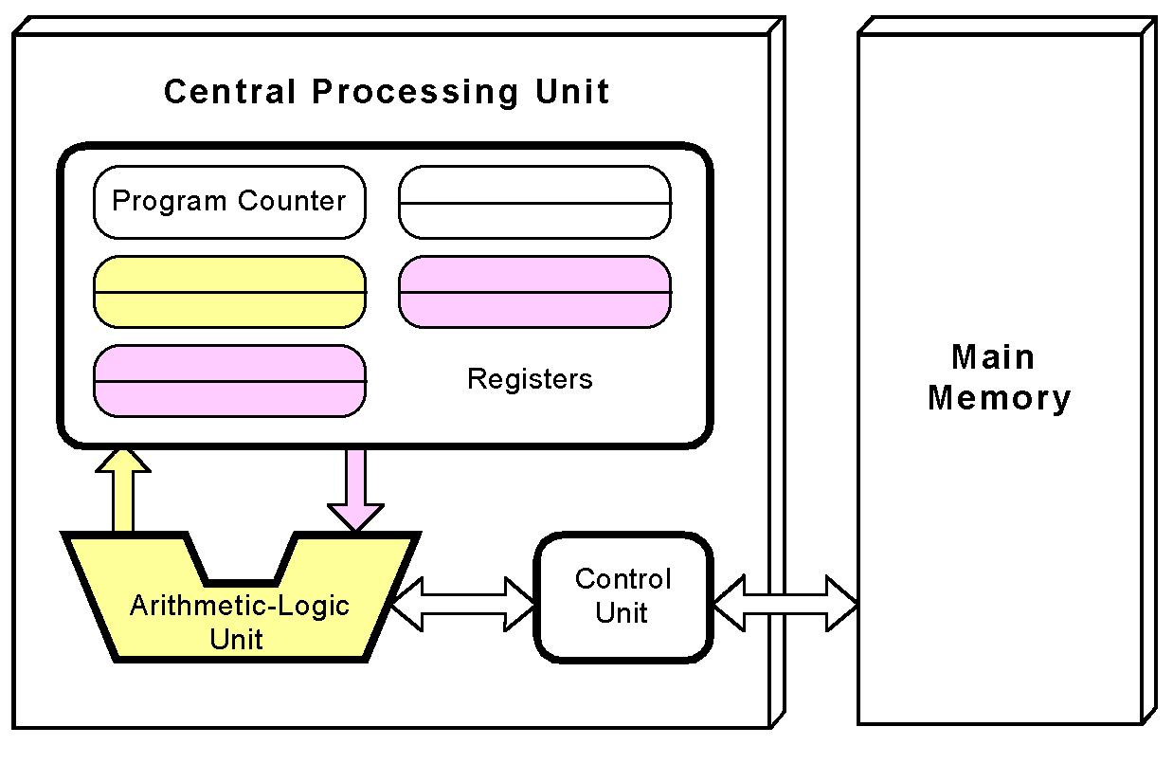
The von Neumann Model
The ALU executes the instruction and places results in registers or memory.

Slide 43
Non-von Neumann Models
Conventional stored-program computers have undergone many incremental improvements over the years
  specialized buses
  floating-point units
  cache memories
But enormous improvements in computational power require departure from the classic von Neumann architecture
  Adding processors is one approach

Slide 44
Non-von Neumann Models
In the late 1960s, high-performance computer systems were equipped with dual processors to increase computational throughput.
In the 1970s supercomputer systems were introduced with 32 processors.
Supercomputers with 1,000 processors were built in the 1980s.
In 1999, IBM announced its Blue Gene system containing over 1 million processors.

Slide 45
Parallel Computing
Parallel processing allows a computer to simultaneously work on subparts of a problem.
Multicore processors have 2 or more processor cores sharing a single die.
Each core has its own ALU and set of registers, but all processors share memory and other resources.
“Dual core” differs from “dual processor.”
  Dual-processor machines, have two processors, but each processor plugs into the motherboard separately.
Multi-core systems provide the ability to multitask
  E.g., browse the Web while burning a CD
Multithreaded applications spread mini-processes, threads, across one or more processors for increased throughput.

Slide 46
Computing as a Service
Cloud Computing
The ultimate aim of every computer system is to deliver functionality to its users.
Computer users typically do not care about terabytes of storage and gigahertz of processor speed.
Many companies outsource their data centers to 3rd-party specialists, who agree to provide computing services for a fee.
These arrangements are managed through service-level agreements (SLAs).
Rather than pay a third party to run a company-owned data center, another approach is to buy computing services from someone else’s data center and connect to it via the Internet.
This is the idea behind a collection of service models known as Cloud computing.

Slide 47
Cloud Computing
Enabling on-demand network access to a shared pool of configurable computing resources (e.g., networks, servers, applications, and services) that can be rapidly provisioned and released with minimal management effort or service provider interaction

Slide 48
Cloud Computing
Cloud computing models:
  Software as a Service,
    The consumer of this service buy application services
  Platform as a Service,
    Provides server hardware, operating systems, database services, security components, and backup and recovery services
  Infrastructure as a Service
    provides only server hardware, secure network access to the servers, and backup and recovery services. The customer is responsible for all system software including the operating system and databases

Slide 49
Grid computing
Combination of computer resources from multiple administrative domains to reach a common goal.
What distinguishes grid computing from conventional high performance computing systems s.a cluster computing is that grids tend to be more loosely coupled, heterogeneous, and geographically dispersed.
Although a grid can be dedicated to a specialized application, it is more common that a single grid will be used for a variety of different purposes

Slide 50
Cluster computing
A group of linked computers, working together closely thus in many respects forming a single computer. The components of a cluster are commonly, but not always, connected to each other through fast LANs
Clusters are usually deployed to improve performance and availability over that of a single computer, while typically being much more cost-effective than single computers of comparable speed or availability

Slide 51
Throughout the remainder of this book you will see how these components work and how they interact with software to make complete computer systems.
This statement raises two important questions
What assurance do we have that computer components will operate as we expect?
What assurance do we have that computer components will operate together?

Slide 52
Standards Organizations
There are many organizations that set computer hardware standards to include the interoperability of computer components
Institute of Electrical and Electronic Engineers (IEEE)
  Establishes standards for computer components, data representation, among many other things
The International Telecommunications Union (ITU)
  Concerns itself with the interoperability of telecommunications systems, including data communications and telephony
The American National Standards Institute (ANSI)
The British Standards Institution (BSI)
  National groups establish standards within their respective countries
The International Organization for Standardization
  Establishes worldwide standards for everything from screw threads to photographic film

Slide 53
Computer Performance Measures
Program Execution Time
For a specific program compiled to run on a specific machine “A”, the following parameters are provided:
  The total instruction count of the program.
  The average number of cycles per instruction (average CPI).
  Clock cycle of machine “A”
How can one measure the performance of this machine running this program?
  The machine is said to be faster or has better performance running this program if the total execution time is shorter.
  Thus the inverse of the total measured program execution time is a possible performance measure or metric:
  Performance_{A} = 1 / Execution Time_{A}
  How to compare performance of different machines?
  What factors affect performance? How to improve performance?

Slide 54
Comparing Computer Performance Using Execution Time
To compare the performance of two machines “A”, “B” running a given specific program
Performance_{A} = 1 / Execution Time_{A}
Performance_{B} = 1 / Execution Time_{B}
Machine A is n times faster than machine B means:
Example:
For a given program:
  Execution time on machine A: Execution_{A} = 1 second
  Execution time on machine B: Execution_{B} = 10 seconds
  Performance_{A} / Performance_{B} = Execution Time_{B} / Execution Time_{A}
  = 10 / 1 = 10
  The performance of machine A is 10 times the performance of machine B when
  running this program, or: Machine A is said to be 10 times faster than machine B
  when running this program.
Performance_{A}
Execution Time_{B}
Speedup = n = =
Performance_{B}
Execution Time_{A}

Slide 55
CPU Execution Time
The CPU Equation
A program is comprised of a number of instructions executed , I
  Measured in: instructions/program
The average instruction takes a number of cycles per instruction (CPI) to be completed.
  Measured in: cycles/instruction, CPI
CPU has a fixed clock cycle time C = 1/clock rate
  Measured in: seconds/cycle
CPU execution time is the product of the above three parameters as follows:
CPU time = Seconds = Instructions x Cycles x Seconds
Program Program Instruction Cycle
T = I x CPI x C

Slide 56
Example
A Program is running on a specific machine with the following parameters:
  Total executed instruction count: 10,000,000 instructions
  Average CPI for the program: 2.5 cycles/instruction.
  CPU clock rate: 200 MHz.
What is the execution time for this program?
CPU time = Instruction count x CPI x Clock cycle
= 10,000,000 x 2.5 x 1 / clock rate
= 10,000,000 x 2.5 x 5x10⁻⁹
= .125 seconds

Slide 57
Example
From the previous example: A Program is running on a specific machine with the following parameters:
  Total executed instruction count, I: 10,000,000 instructions
  Average CPI for the program: 2.5 cycles/instruction.
  CPU clock rate: 200 MHz.
Using the same program with these changes:
  A new compiler used: New instruction count 9,500,000
  New CPI: 3.0
  Faster CPU implementation: New clock rate = 300 MHZ
What is the speedup with the changes?
Speedup = (10,000,000 x 2.5 x 5x10⁻⁹) / (9,500,000 x 3 x 3.33x10⁻⁹ )
= .125 / .095 = 1.32
or 32 % faster after changes.
Speedup = Old Execution Time = I_{old} x CPI_{old} x Clock cycle_{old}
New Execution Time I_{new} x CPI_{new} x Clock Cycle_{new}

Slide 58
