Slide 1







K. J. Somaiya College of Engineering, Mumbai – 400 077
(A Constituent College of Somaiya Vidyavihar University)
Created By-
Arya Nair 16010421063
Karan Patel 16010421072

Slide 2


K. J. Somaiya College of Engineering, Mumbai – 400 077
(A Constituent College of Somaiya Vidyavihar University)
CONTENTS
Introduction
ER/EER Diagram
Relational Model
Flow Diagram
References

Slide 3
K. J. Somaiya College of Engineering, Mumbai – 400 077
(A Constituent College of Somaiya Vidyavihar University)
THE COMPANY AT A GLANCE
Zomato is an Indian multinational restaurant aggregator and food delivery company . It allows user to get their food delivered from their favorite restraunts by using the app. It acts as a middleman which connects the user to their favorite restraunts through a common interface while also helping restaurant by providing delivery service of their goods

Slide 4
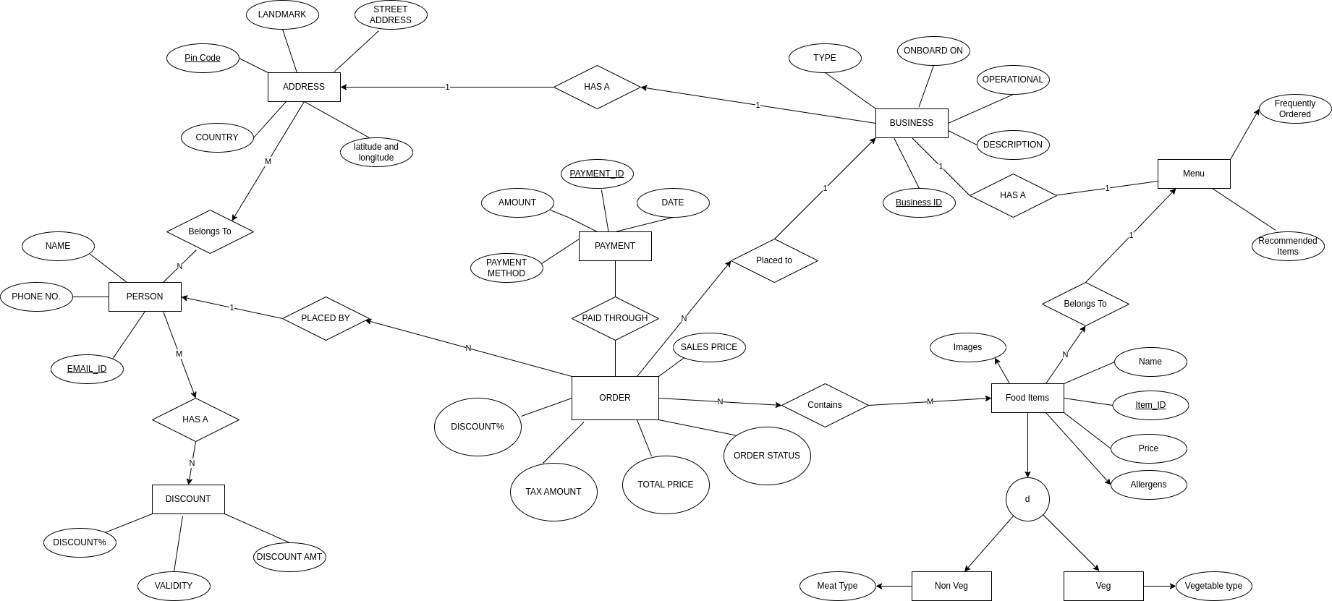
K. J. Somaiya College of Engineering, Mumbai – 400 077
(A Constituent College of Somaiya Vidyavihar University)
ER/EER MODEL

Slide 5
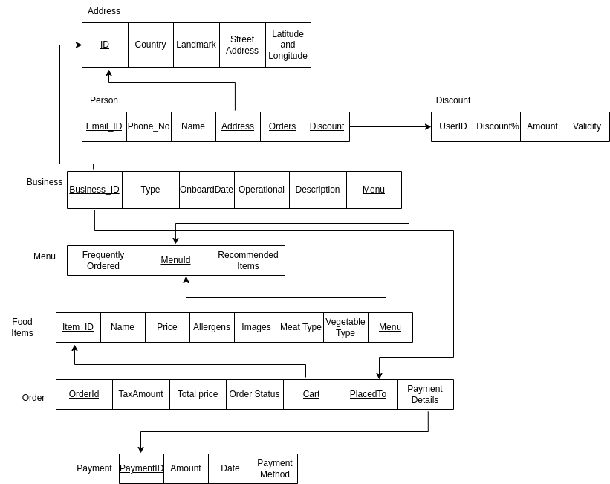
K. J. Somaiya College of Engineering, Mumbai – 400 077
(A Constituent College of Somaiya Vidyavihar University)
RELATIONAL MODEL

Slide 6


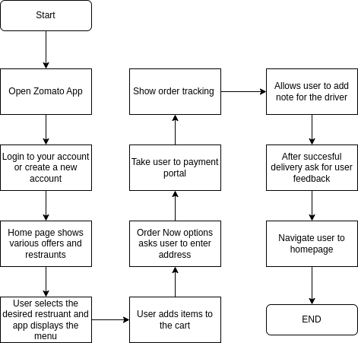
K. J. Somaiya College of Engineering, Mumbai – 400 077
(A Constituent College of Somaiya Vidyavihar University)
FLOW DIAGRAM

Slide 7
K. J. Somaiya College of Engineering, Mumbai – 400 077
(A Constituent College of Somaiya Vidyavihar University)
REFERENCES
Software Ideas.net
Concept Draw
inettutor

Slide 8


K. J. Somaiya College of Engineering, Mumbai – 400 077
(A Constituent College of Somaiya Vidyavihar University)
THANK YOU

