Slide 1
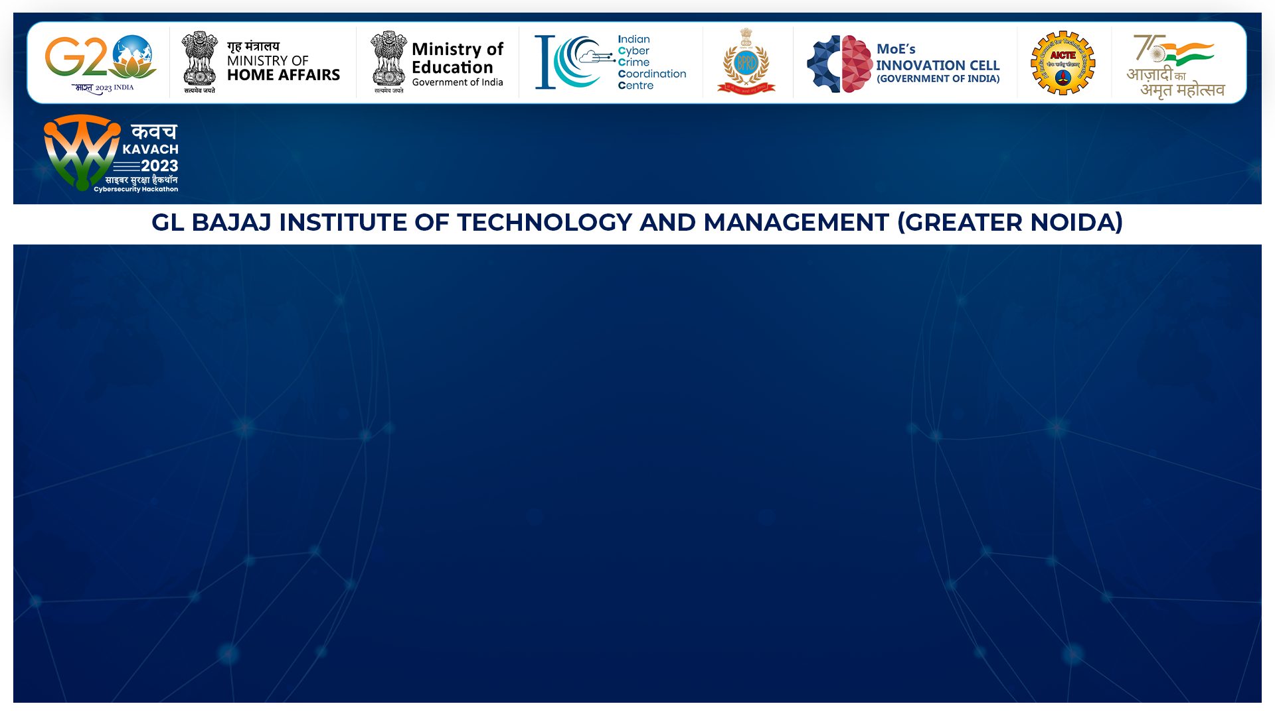

MEET THE TEAM
Team Obviously
KVH-012
Details of Team
IDEA SUMMARY
The system leverages OCR to standardize transaction data, applying advanced algorithms for insights like abnormal pattern recognition and risk assessment. Its primary objective is to combat illicit money transactions, safeguard financial systems, and promote transparency.
Fund Trail Analysis Tool
KJSCE

