Slide 1
Experiential Learning Phase - I :
Operating Systems
CS235AI
Distributed Shared Memory
ARYA HARIHARAN (1RV22CS029)
PROFESSOR – Dr. PAVITHRA H

Slide 2
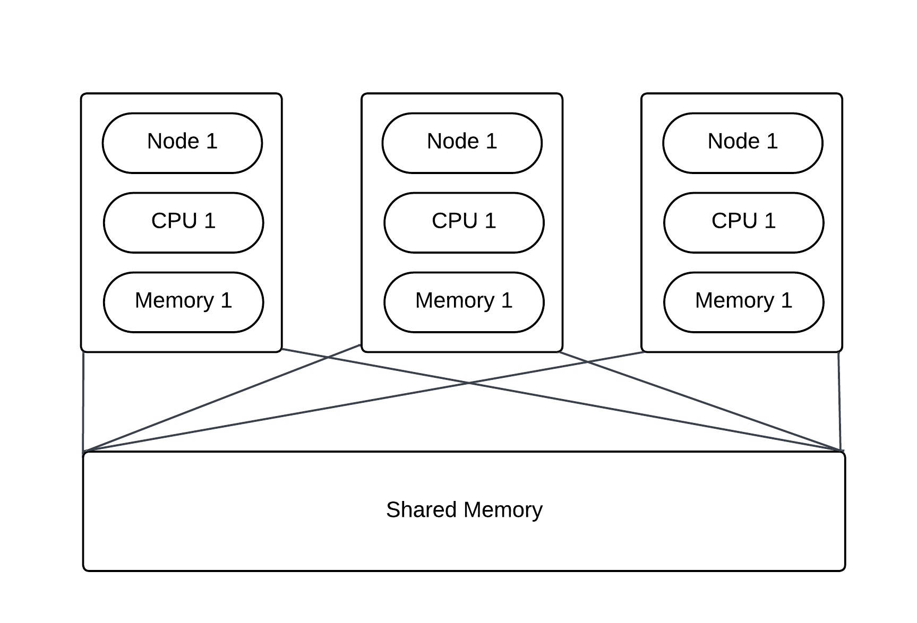
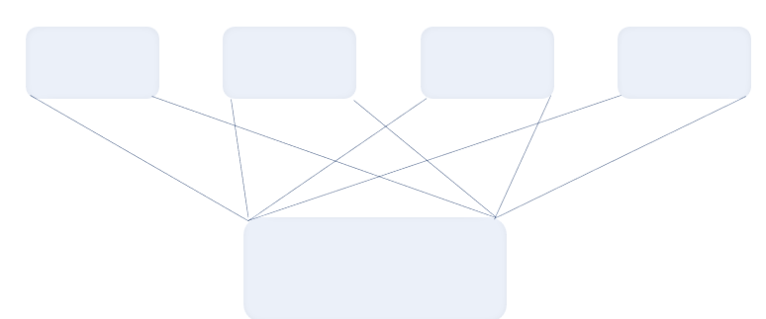
INTRODUCTION

Slide 3
A cluster of computers are present, each with its own physical memory.
Through DSM, each computer/node can also access a shared memory space.
It creates the illusion of a single, coherent memory space across the network, allowing access to shared data as if it were local.
Distributed shared memory is a service that manages memory across multiple nodes so that applications will have the illusion that they are running on a single shared-memory machine.

Slide 4
PROBLEM STATEMENT
To simulate Distributed Shared Memory (DSM) architecture by implementing the central server algorithm using sockets in Python

Slide 5
OBJECTIVES
Simulate the working of a distributed shared memory system using socket programming in Python.
Implement the central server DSM algorithm.
Clearly define read and write accesses for different clients.

Slide 6
RELEVANCE TO COURSE
This project involves several concepts that are core OS concepts or are deeply interconnected to the OS course –
It simulates a memory management technique, generally applied among various nodes accessing the same data.
It employs sockets to simulate the client and server processes.
It uses threads to process the requests of each client.
It uses mutex locks to control writing to resources.

Slide 7
METHODOLOGY
1
2
Create Sockets
Create two different .py files, one for defining server behaviour and the other, for client behaviour. Create a server socket and client socket in the programs respectively using the socket library. Perform the necessary connection and binding.
Set Up the Communication channel
Using the in-built functions in Python, set up communication between the client sockets and server sockets. Define exit conditions and entry channels.
3
4
Define Different Accesses
Clearly define the different accesses and allowances for different modes such as read and write. Create threads for each client to process the requests
Initialize Page Table and Mutex Locks for Each File for Writing
Maintain a page table using a two dimensional list to maintain a list of clients, files it has access to and what operation it can perform. Mutex locks have to be implemented to ensure only one client can write at a time.

Slide 8
METHODOLOGY
5
Create the Files for Sharing
Implement a number of files present in the shared memory space. These files can be written by only one client at a time, but can be read by multiple clients at a time.
6
Run the Simulation
Run the simulation. Ensure edge case conflicts are rectified to ensure the integrity of data, such as multiple write, read-write at the same time, etc.

Slide 9
TOOLS/API
Some of the tools and APIs that will be used in this project are -
Python
socket API in Python
thread API in Python

Slide 10
WHY DSM?
1
2
Simplified Parallel Programming
Utilization of Cluster Resources
A DSM system allows extending these familiar models (like pthreads and OpenMP) to a distributed environment, simplifying the transition to distributed computing.
Clusters of machines offer a cost-effective way to increase computing power and resources.
3
4
Resource Efficiency
Load Balancing and Scalability
DSM systems can help in efficient resource utilization.
A DSM system can intelligently distribute memory pages across machines, achieving load balancing and improving scalability.

Slide 11
APPLICATIONS
Computationally Intensive Tasks
A scientific research project requires running computationally intensive simulations or numerical computations.
These simulations often involve complex mathematical models and require significant computational resources to execute.
Computational workload can be distributed across multiple nodes or clusters.
To coordinate data access and sharing of intermediate results between distributed nodes, DSM can be employed.

Slide 12
APPLICATIONS
Computationally Intensive Tasks
Lighting and illumination effects in virtual environments
Simulating the propagation of light rays through a scene, accounting for factors such as reflection, refraction, and scattering
Typically involves ray tracing or radiosity methods
DSM can aid in distributing the computational workload across multiple nodes
Distribution and sharing of scene data using DSM

Slide 13
REFERENCES
Nelson J, Holt B, Myers B, Briggs P, Ceze L, Kahan S, Oskin M. {Latency-Tolerant} software distributed shared memory. In2015 USENIX Annual Technical Conference (USENIX ATC 15) 2015 (pp. 291-305).
El-Ghazawi, Tarek, William Carlson, Thomas Sterling, and Katherine Yelick. UPC: distributed shared memory programming. John Wiley & Sons, 2005.
Wu J. Distributed system design. CRC press; 2017 Dec 14.
B. Nitzberg and V. Lo, "Distributed shared memory: a survey of issues and algorithms," in Computer, vol. 24, no. 8, pp. 52-60, Aug. 1991, doi: 10.1109/2.84877.
M. Stumm and S. Zhou, "Algorithms Implementing Distributed Shared Memory", Computer, vol. 23, no. 5, pp. 54-64, May 1990.

