Slide 1
Experiential Learning Phase -I :
Advanced Algorithms (CS355TBB)
Neurosymbolic AI in Healthcare for Low Grade Glioma Segmentation and Analysis
Aditya Verma
1RV22CS011
Akshatha A
1RV22CS017
Arya Hariharan
1RV22CS029
Gagana M V
1RV22CS054

Slide 2
PRESENTATION CONTENTS
Introduction
Literature Review
Problem Statement
Motivation and Objectives
Proposed Approach
Dataset and Tools
Expected Outcomes

Slide 3
Introduction
Low-Grade Glioma (LGG)
Low-Grade Gliomas are slow-growing brain tumors, primarily affecting young adults, with significant implications for quality of life and survival.
Key Challenges
Hard to distinguish tumor regions in MRI.
Variability in clinical outcomes.
What is Neurosymbolic AI?
A hybrid AI approach that merges deep learning with symbolic reasoning to create interpretable and efficient models.
Current glioma segmentation models often lack transparency, struggle with limited data, and fail to incorporate expert medical knowledge effectively.
Notes:
arya

Slide 4
Literature Review
Title: Opportunities and challenges of artificial intelligence in the medical field: current application, emerging problems, and problem-solving strategies
Citation: Jiang L, Wu Z, Xu X, Zhan Y, Jin X, Wang L, Qiu Y. Opportunities and challenges of artificial intelligence in the medical field: current application, emerging problems, and problem-solving strategies. J Int Med Res. 2021 Mar;49(3):3000605211000157. doi: 10.1177/03000605211000157. PMID: 33771068; PMCID: PMC8165857.
Key Findings AI in COVID-19 - AI aided in rapid COVID-19 diagnosis, drug discovery, virus prediction, and resource management​. Ethical Issues - Challenges include data privacy, ownership, bias, and fairness in underserved communities​. Legal Gaps - Lack of global laws creates ambiguity in AI accountability and liability in healthcare​. Security Concerns - Risks include hardware flaws, algorithm vulnerabilities, genetic data misuse, and human errors​. Acceptance Issues - Patients trust doctors over AI; medical workers worry about job replacement. More AI education is needed​. Ethics Focus - Independent committees should ensure fairness, transparency, and inclusion for marginalized populations​. Improving Feasibility - AI must be reliable, user-friendly, and refined through real-world feedback to gain public trust​.

Slide 5
Literature Review
Title: Explainable Diagnosis Prediction through Neuro-Symbolic Integration
Citation: Q. Lu, R. Li, E. Sagheb, A. Wen, J. Wang, L. Wang, J. W. Fan, and H. Liu, "Explainable Diagnosis Prediction through Neuro-Symbolic Integration," arXiv, 2025. https://arxiv.org/abs/2410.01855
Objectives Develop explainable AI models for healthcare diagnosis prediction using neuro-symbolic methods. Address the "black-box" nature of traditional machine learning and deep learning models by integrating domain-specific logical rules with neural networks. Demonstrate the use of Logical Neural Networks (LNNs) to balance accuracy and interpretability in diagnosis tasks. Highlight the potential of neuro-symbolic approaches in precision medicine and equitable healthcare solutions. | Methodology Neuro-Symbolic Framework LNNs combine logical reasoning with learnable parameters for flexibility and explainability. Differentiable logic operators (e.g., conjunction, disjunction) enable gradient-based optimization. 2. Model Development: Logical rules derived from domain knowledge were encoded into LNNs. Models included feature thresholds and logical combinations for diagnosis prediction. Example models: Mglucose-bmi, Mfamily-insulin, Mmulti-pathway, and Mcomprehensive. 3. Model Evaluation: Models were evaluated using accuracy, precision, recall, F1-score, and area under the ROC curve (AUC). | Limitations Some LNN rules, such as those relying on strict conjunctions, resulted in low sensitivity (e.g., the Mfamily-insulin model). Heavily reliant on expert-defined rules, which may introduce biases and reduce scalability to other medical conditions with less-established knowledge. Results Mmulti-pathway achieved the highest F1-score (0.6875) and AUC (0.8457), effectively balancing sensitivity and specificity. Mcomprehensive achieved the highest precision (0.8788) and shared the highest accuracy (80.52%) LNN models outperformed traditional machine learning models (e.g., Random Forest, SVM) in both accuracy and interpretability. The models offered direct insights into feature contributions, enhancing trust and transparency.

Slide 6
Literature Review
Title: NEURO-SYMBOLIC AI: REVOLUTIONIZING ADVANCED REASONING IN AI ASSISTANTS
Citation: Raj Agrawal, Nakul Pandey, ”Neuro-symbolic AI: revolutionizing advanced reasoning in AI assistants”, International Journal of Research In Computer Applications and Information Technology (IJRCAIT) Volume 7, Issue 1, January-June 2024, pp. 30-40, Article ID: IJRCAIT_07_01_004
Objectives Explore the integration of deep learning and symbolic reasoning in neuro-symbolic AI. Investigate how neuro-symbolic AI enhances decision-making, reasoning, and interpretability in AI assistants. Highlight applications in critical domains such as healthcare, explainability and logical reasoning are essential. Discuss the potential for neuro-symbolic AI to foster human-like understanding and collaborative problem-solving between humans and AI. | Methodology Deep Learning: Neural networks extract patterns and insights from large-scale data, excelling in tasks like image and sequence analysis. Symbolic Reasoning: Knowledge representations (e.g., first-order logic and knowledge graphs) enable logical reasoning and explicit rule encoding. Integration: The hybrid neuro-symbolic framework combines neural network learning with structured symbolic rules for advanced reasoning and explainability. Complex knowledge structures are represented by embedding symbolic knowledge into neural frameworks. | Limitations Current neuro-symbolic AI systems face challenges in handling large, complex datasets efficiently. Symbolic reasoning heavily relies on accurate domain-specific rules, which may introduce biases or require extensive manual effort. While neuro-symbolic systems aim for human-like reasoning, achieving seamless natural language interaction and context understanding remains a challenge. Results By combining pattern recognition with logical reasoning, neuro-symbolic AI enables context-aware, accurate, and interpretable decisions. Symbolic reasoning provides explainable frameworks, helping AI assistants justify decisions in human-understandable terms. Demonstrated success in domains requiring transparency and logical rigor, such as healthcare diagnostics.

Slide 7
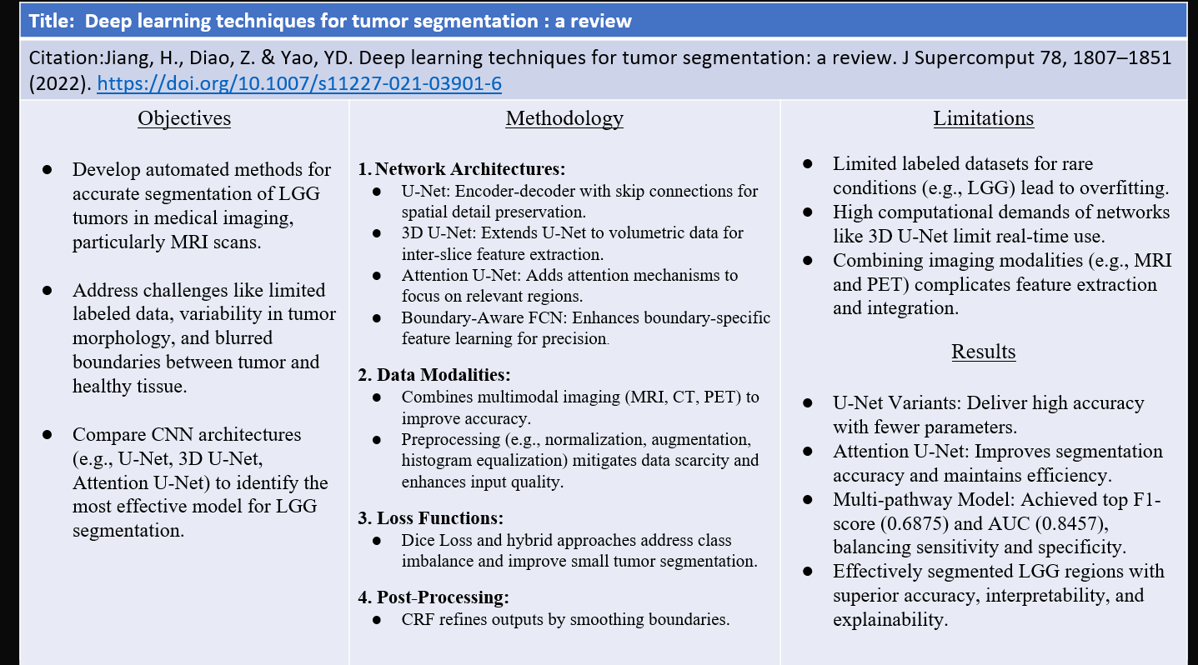
Literature Review

Slide 8
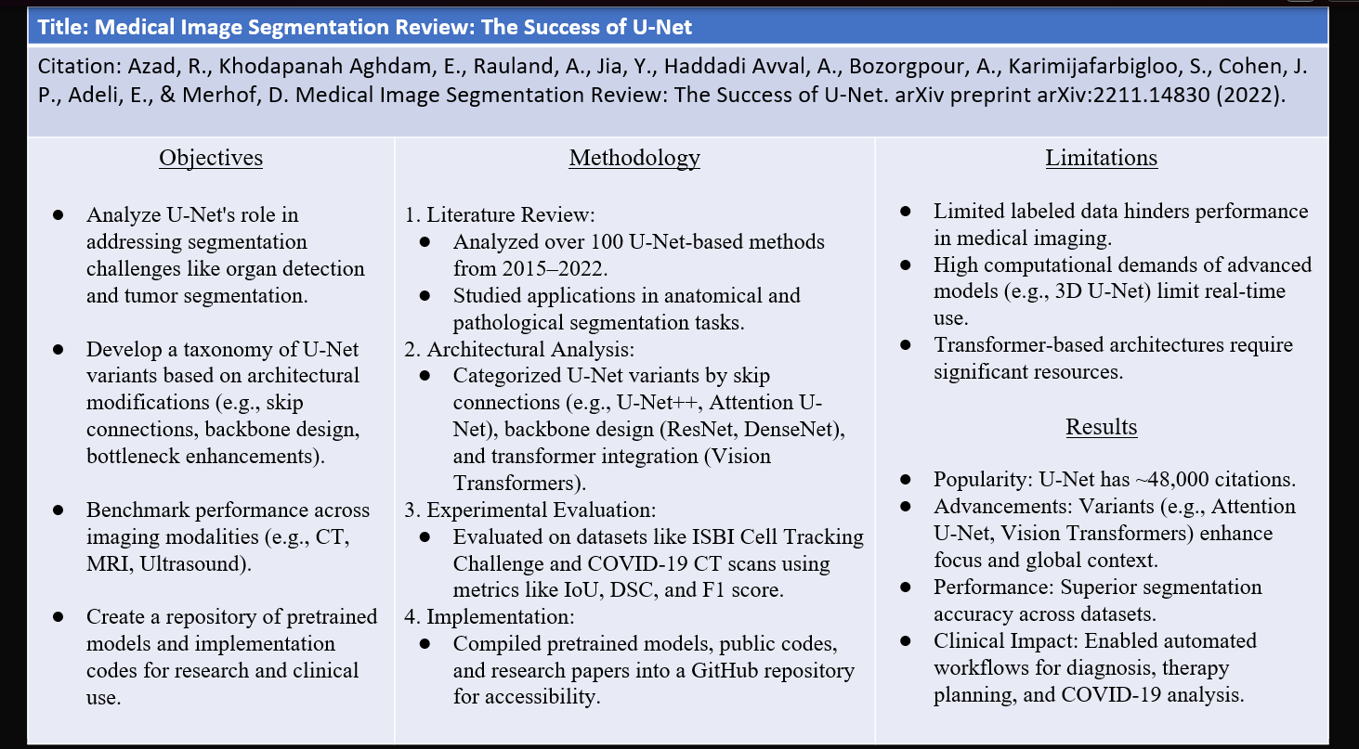
Literature Review

Slide 9
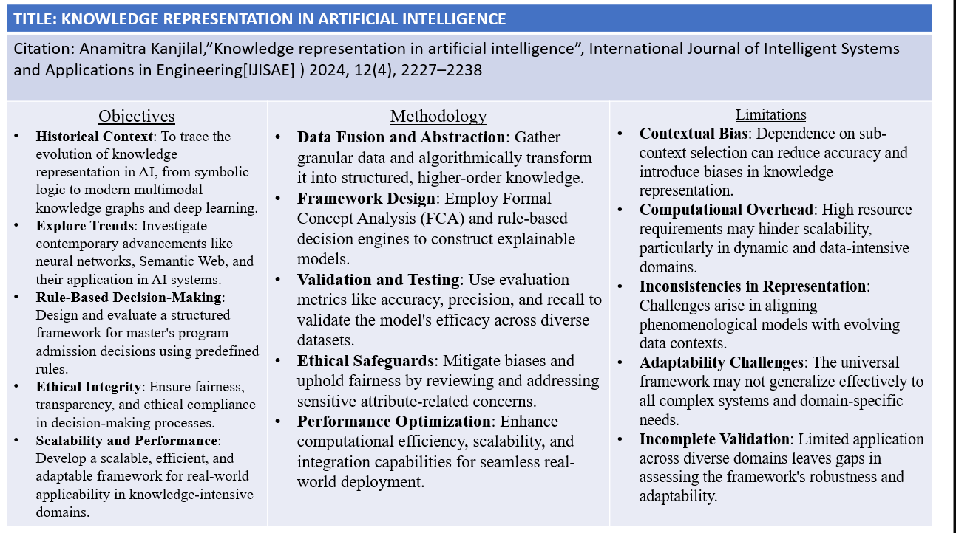
Literature Review

Slide 10
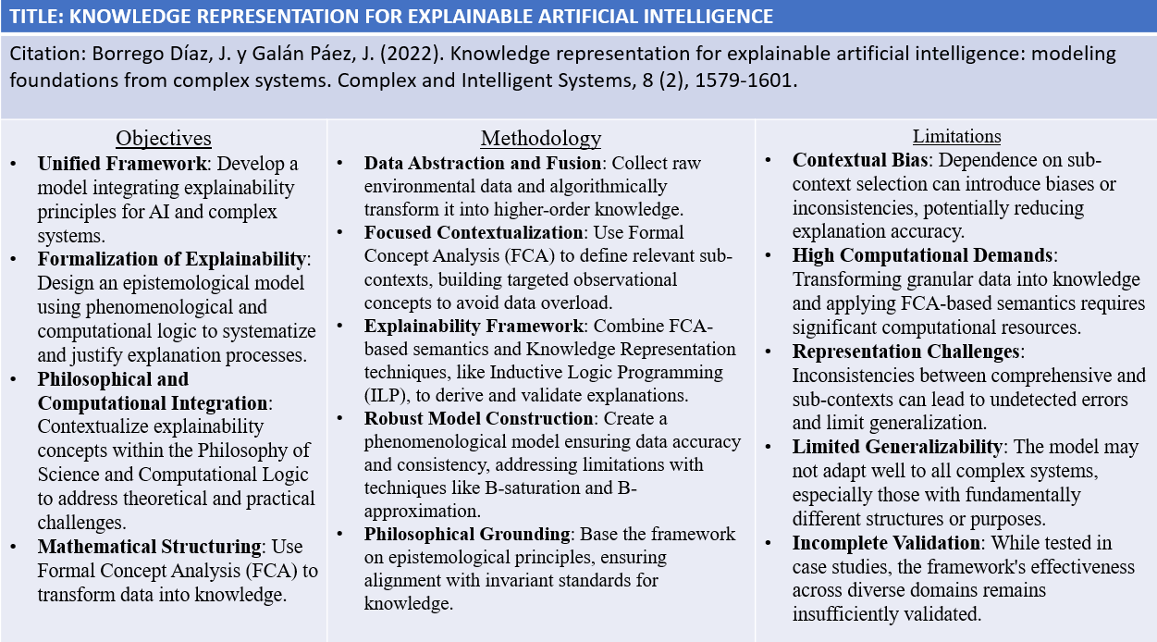
Literature Review

Slide 11
Problem Statement
"Develop an interpretable and efficient Neurosymbolic AI framework for accurate segmentation and analysis of low-grade gliomas in MRI images by integrating deep learning with domain knowledge."
Notes:
Gagana and aditya

Slide 12
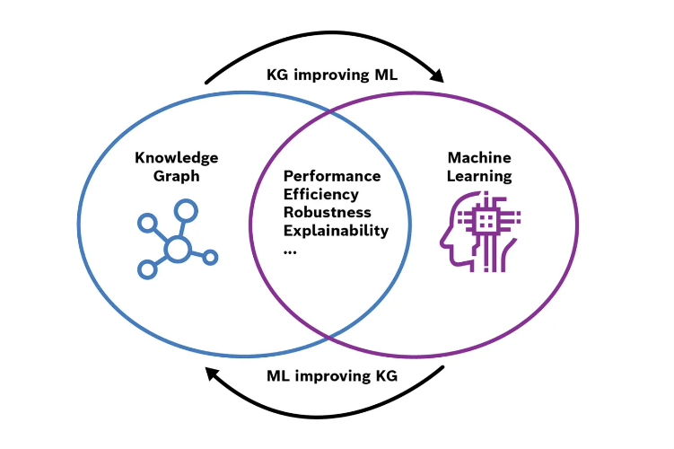
Motivation and Objectives
Why Neurosymbolic AI?
Deep learning excels in pattern recognition but lacks interpretability. Neurosymbolic AI bridges this gap by –
Encoding clinical rules and medical guidelines as a knowledge graph.
Allowing for decision-making that mimics human reasoning.
Notes:
akshatha

Slide 13
Motivation and Objectives
Develop a prototype for –
Segmentation of LGG in MRI images using neural networks.
Integration of clinical knowledge for enhanced interpretability using knowledge graphs.
Testing the feasibility of the approach on a small dataset and verifying the results against clinical results.
Notes:
akshatha

Slide 14
Proposed Approach
Neural network (e.g., U-Net) for MRI segmentation to identify tumor regions
Clean and preprocess the dataset from the Cancer Imaging Archive.
Understand the spread of data, the type of characteristics it covers and remove any redundancies.
Train a U-Net model for image segmentation, the goal being to get the segmentation masks of the tumor
Knowledge graph with symbolic rules (e.g., tumor growth patterns, clinical guidelines) to validate and interpret the segmentation
Scrap data from public repositories and represent as a knowledge graph.
Implement graph algorithms to traverse and extract data efficiently based on context.
Symbolic Rules Example: "If segmentation shows a tumor region overlapping critical brain areas, apply additional verification steps from the knowledge graph. Provide information on further tests required, giving guidance on steps to be taken."
Notes:
Gagana and aditya

Slide 15
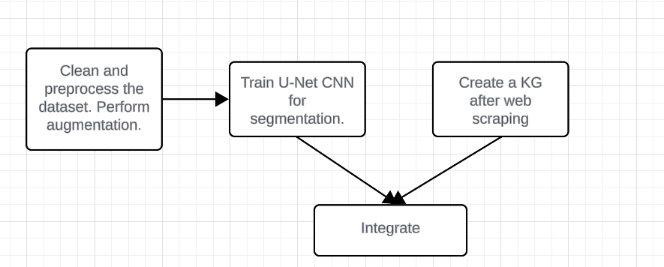
Proposed Approach
Notes:
Gagana and aditya

Slide 16
Dataset and Tools
Dataset
The Cancer Imaging Archive LGG Dataset with 110 patient entries, complete with patient details and MRI scans and masks.
Preprocessing
Normalization and augmentation (rotation, flipping).
Tools
Neural Network Framework – PyTorch
Knowledge Representation - Neo4j for knowledge graph creation.
Notes:
Gagana and aditya

Slide 17
Expected Outcomes
Neural Component
Accurate segmentation masks for LGG regions from MRI images.
Symbolic Component
Interpretability in segmentation results using encoded clinical rules.
Integrated Outcome - Outputs like
"Tumour detected in left frontal lobe with low likelihood of progression."
"Segmentation validated with clinical knowledge, suggesting further biopsy."
Notes:
arya

Slide 18
Thank You
Notes:
arya

