Slide 1

SMART INDIA HACKATHON 2026
TITLE PAGE
• Problem Statement ID – 26166
• Problem Statement Title – Multi-modal, Sun angle and scale invariant image correspondence using Chandrayaan-2 optical images (OHRC, TMC and IIRS)
• Theme – Space Technology
• PS Category – Software
• Team ID – 800C4B
• Team Name – Bugs Janta Party
SETU
Geometry for scale and viewpoint. Physics for the Sun. Learning only for what is left.
Live demo https://arya-patil686.github.io/setu-sih2026/ Code https://github.com/Arya-Patil686/setu-sih2026

Slide 2
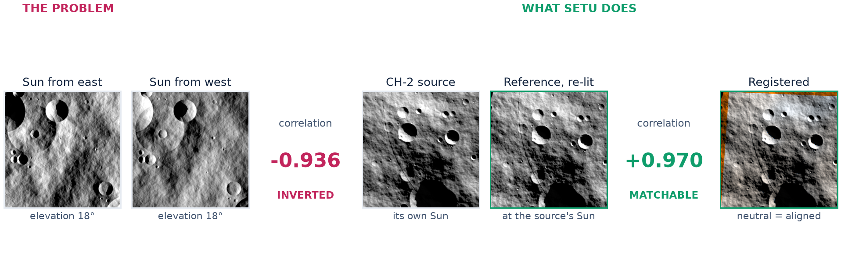
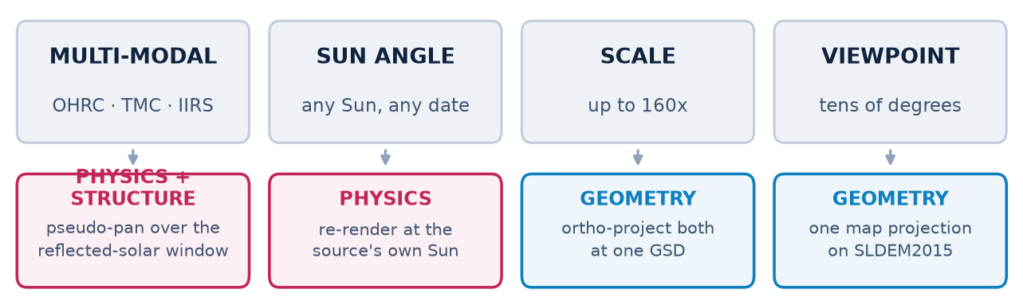
SETU: spend the geometry, remove the Sun
Bugs Janta Party
MEASURED ON 31 PAIRS WITH EXACT GROUND TRUTH
0.361 px
tie-point RMSE vs truth
100%
matches within 3 px
416×
better than SIFT
Multi-modal, the hardest of the three. On an IIRS-class sensor gap at a 4× scale ratio SETU reaches 0.70 px in the source frame (14 m on the ground). It is the only method that registers these pairs at all: the best baseline is 311 px.
Every match carries a 2×2 covariance, which weights the fit and ships in the tie-point file.

Slide 3
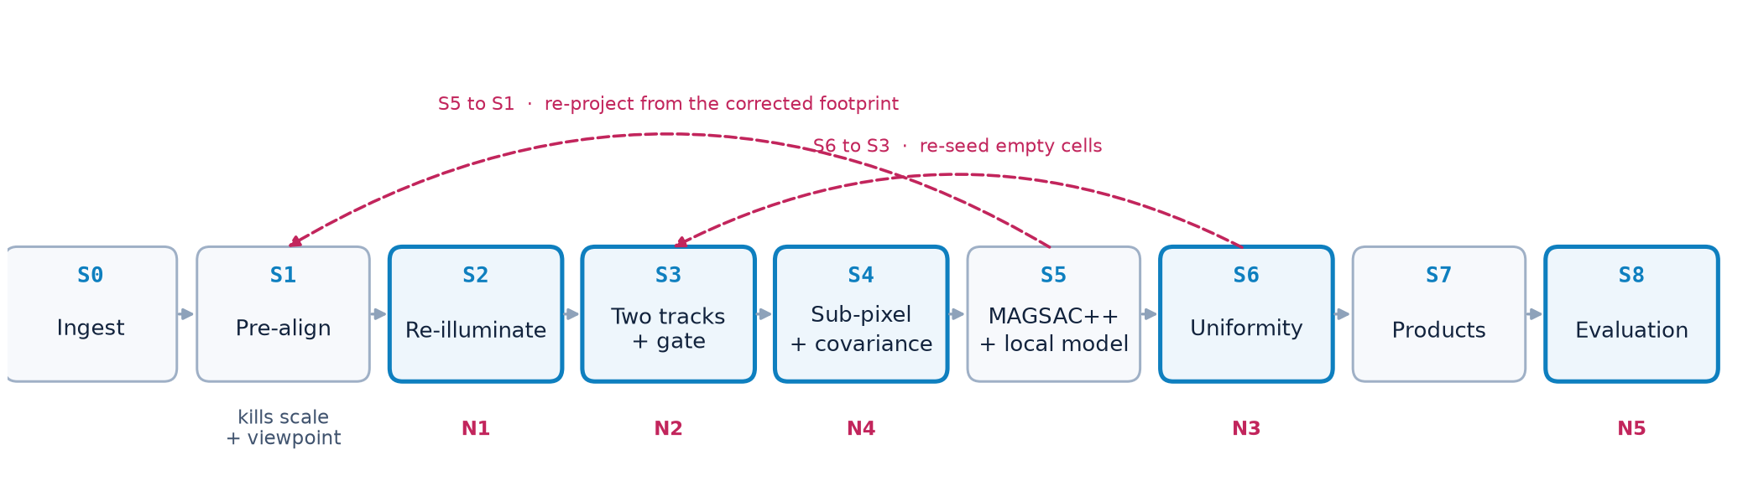
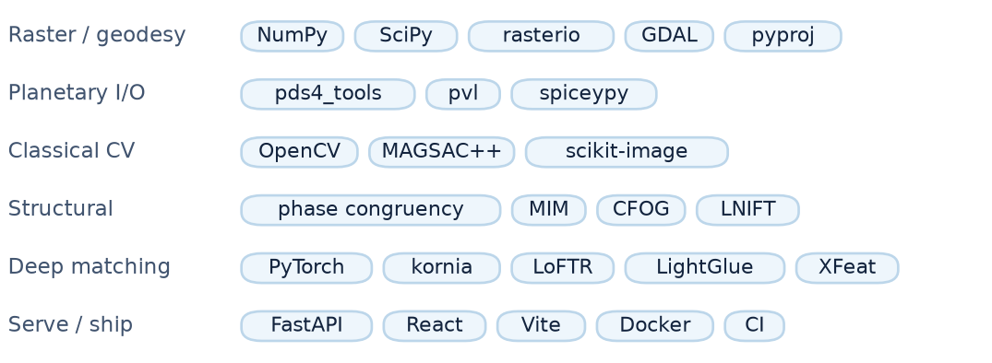
TECHNICAL APPROACH
Bugs Janta Party
THREE CHOICES THAT MATTER
• Never upsample the coarser image. Work at the coarser GSD, reach it by area-averaging.
• Parallax is not optional off-nadir. At 25° and 200 m of relief it is 373 OHRC pixels.
• Harness built before the matcher. No tuning decision was made against intuition.

Slide 4
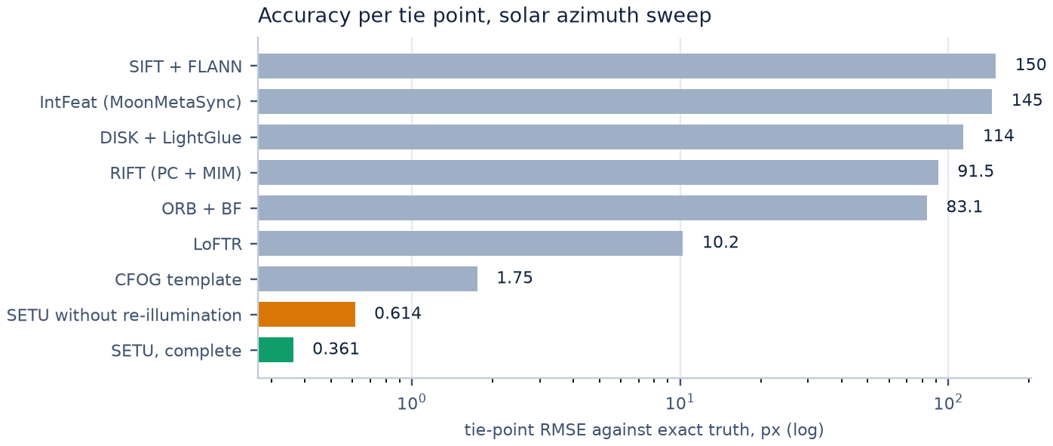
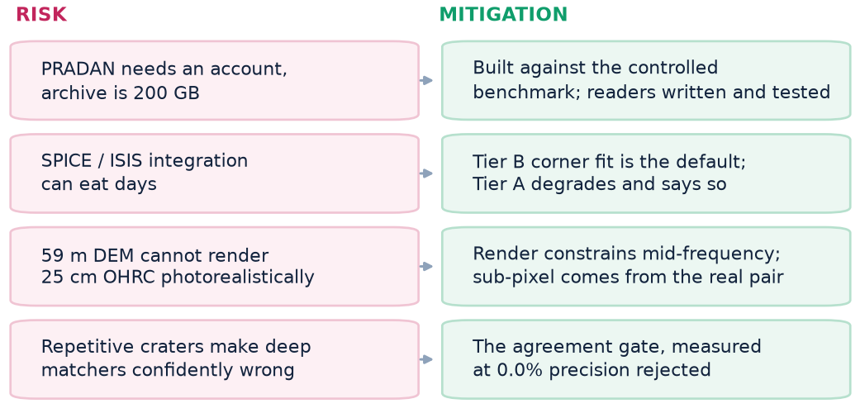
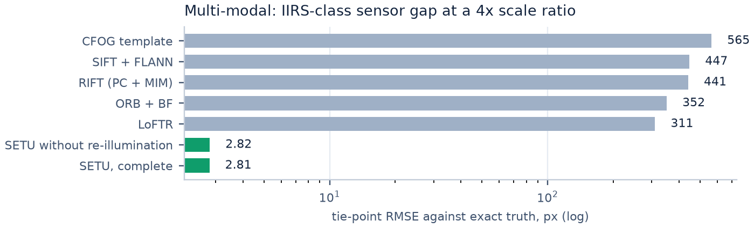
FEASIBILITY AND VIABILITY
Bugs Janta Party
AT AN 8× SCALE RATIO, SETU DECLINES RATHER THAN LIES
BUILT, NOT DESCRIBED
9 / 9
stages, both edges
41
tests, green
5.6 s
per pair, no GPU
Beyond the design target it declines again. On thermal-regime bands, which the pseudo-pan window exists to avoid, every baseline returns garbage at 0% precision and SETU registers none of the 10 pairs.

Slide 5
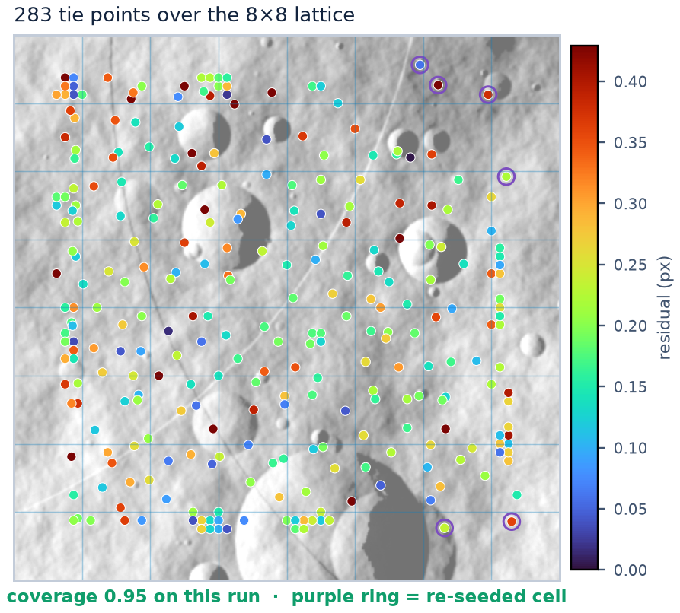

IMPACT AND BENEFITS
Bugs Janta Party
0.361 px
tie-point RMSE vs exact truth
100%
matches within 3 px of truth
100%
inlier ratio after MAGSAC++
0.81
coverage, mean over 31 pairs
416×
better per point than SIFT
WHAT THIS BUYS ISRO
• An archive that co-registers. Kilometre-level geolocation is why OHRC, TMC-2 and IIRS are hard to combine.
• A tie-point list that can be ingested. Per-point covariance, so a bundle adjustment can weight it.
• Pointing stability, for free. The per-row jitter spline falls out of registration.
• Generalises past the Moon. Any airless body with a shape model has the same problem.
TRY IT LIVE, AND READ THE CODE
https://arya-patil686.github.io/setu-sih2026/
https://github.com/Arya-Patil686/setu-sih2026
Three registrations at increasing difficulty, the pipeline played stage by stage, tie points coloured by residual, and the full leaderboard.

Slide 6
RESEARCH AND REFERENCES
Bugs Janta Party
RESEARCH THIS BUILDS ON
• He et al. MatchAnything, TPAMI 2026, arXiv:2501.07556. Track A weights.
• Li, Hu, Ai. RIFT, IEEE TIP 29:3296, 2020. Track B descriptor.
• Ye et al. HOPC, IEEE TGRS 55(5) 2017; CFOG, ISPRS 2019.
• Kovesi. Image Features from Phase Congruency, 1999. Vendored.
• Kumar et al. MoonMetaSync, arXiv:2410.11118, 2024. The lunar floor we beat.
• Tungathurthi. arXiv:2602.14993, 2026. Documents the 4 to 6 km OHRC error.
• Barker et al. SLDEM2015, Icarus 273:346, 2016. The shape model.
• Chowdhury et al. OHRC in-orbit performance, Current Science 118(4):560, 2020.
• Verma et al. IIRS thermal emission correction, Icarus 383:115075, 2022.
• Barath et al. MAGSAC++, CVPR 2020. With an adaptive threshold from our covariances.
DATA
Chandrayaan-2 L1 via PRADAN · LRO NAC and NAC DTMs via ODE · SLDEM2015 at 512 ppd · Kaguya TC via JAXA DARTS · LROC WAC
LIVE DEMO
https://arya-patil686.github.io/setu-sih2026/
https://github.com/Arya-Patil686/setu-sih2026
REPRODUCE EVERY NUMBER
python experiments/run_sweeps.py
python scripts/build_demo_bundle.py
Ground truth is exact by construction: both images of every pair are rendered from one terrain model under a known transform. Results are on that benchmark; the PDS4 and PDS3 readers and the SPICE path await archive access, not code.

