Slide 1
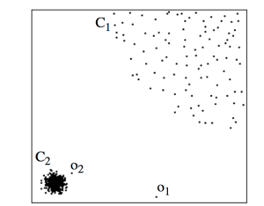
Local Outlier Factor for Anomaly detection
Properties of Local Outlier factor
Unsupervised
Anomaly detection
Density-Based
Suitable for local and global outliers
Works well on Skewed dataset

Slide 2
Algorithm
Consider a point p in a dataset D. K-Nearest Neighbours (KNNs) of p are k closest neighbours of p in the Dataset, where k (Minpts) is an input parameter. Let S represent the set of all KNNs of p in the D. Let q be a point in S such that it is located farthest from p compared to other points in S( q is the k^{th} nearest neighbour to p). Let r represent any point in S. Following is an algorithm for finding LOF for each point in the dataset.
For p find S.
Find distance between p and q. That is K-distance of p.
For every r in S find a set of its KNNs.
Find K-distance of every r in S.
Find reachability distance of p with respect to r.
Reachability distance (p, r) =max (K-distance of r, distance between p and r).
Calculate Local reachability Density (LRD) of p.
LRD is the inverse of the average reachability distance of p with every r in S. It is a measure of the density of p with respect to its neighbourhood.
Find LRD of every r in S.
Find LOF of p.
LOF of p is a defined ratio of the average LRD of every r in S to LRD of p. It is the ratio of the average density of every r in S with the density of p.
Find LOF for other points in the dataset and produce results.

Slide 3
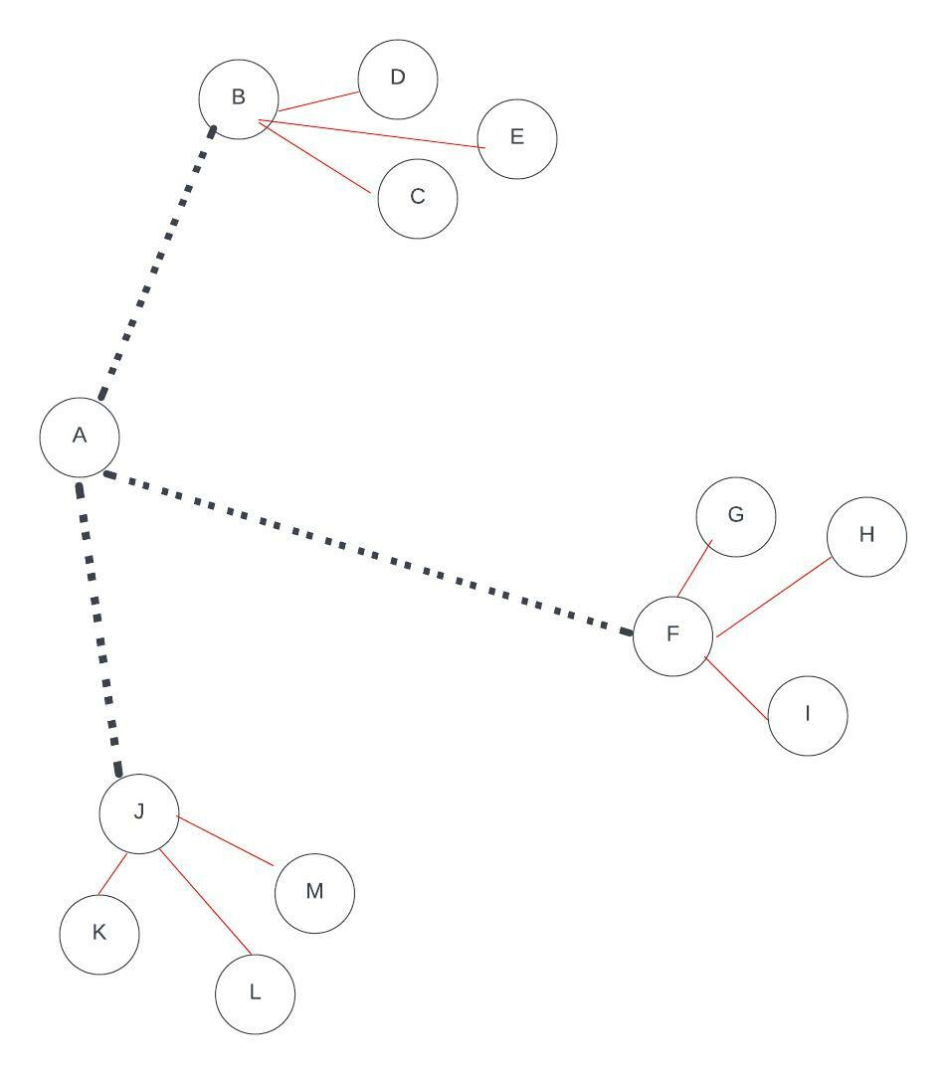

Slide 4
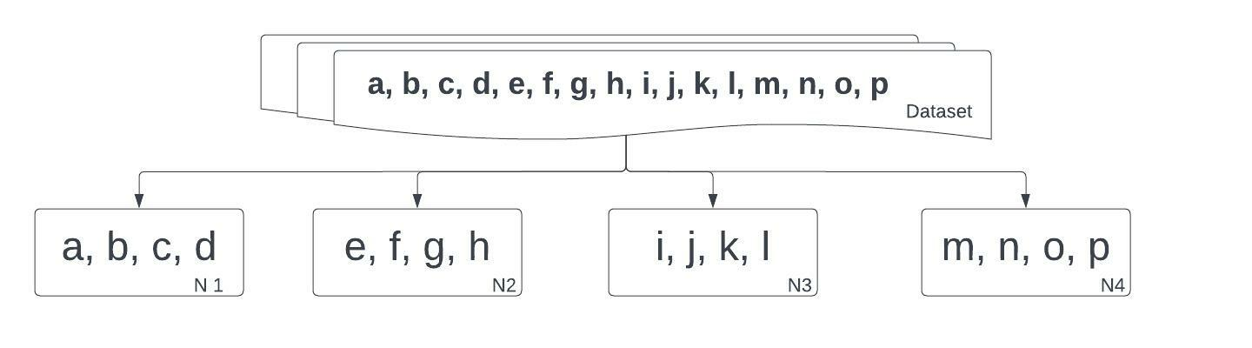

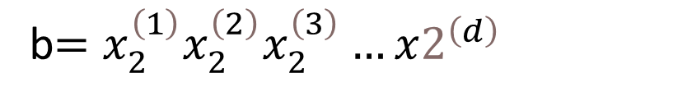
DLOF
$$a=x_{1}^{\left(1\right)}x_{1}^{\left(2\right)}x_{1}^{\left(3\right)}…x1^{\left(d\right)}$$
b$=x_{2}^{\left(1\right)}x_{2}^{\left(2\right)}x_{2}^{\left(3\right)}…x2^{\left(d\right)}$

Slide 5
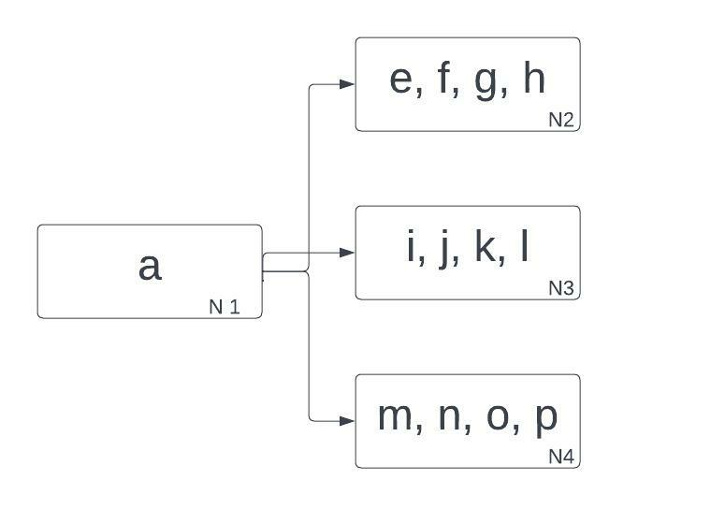
Distribute Local Outlier Factor

Slide 6
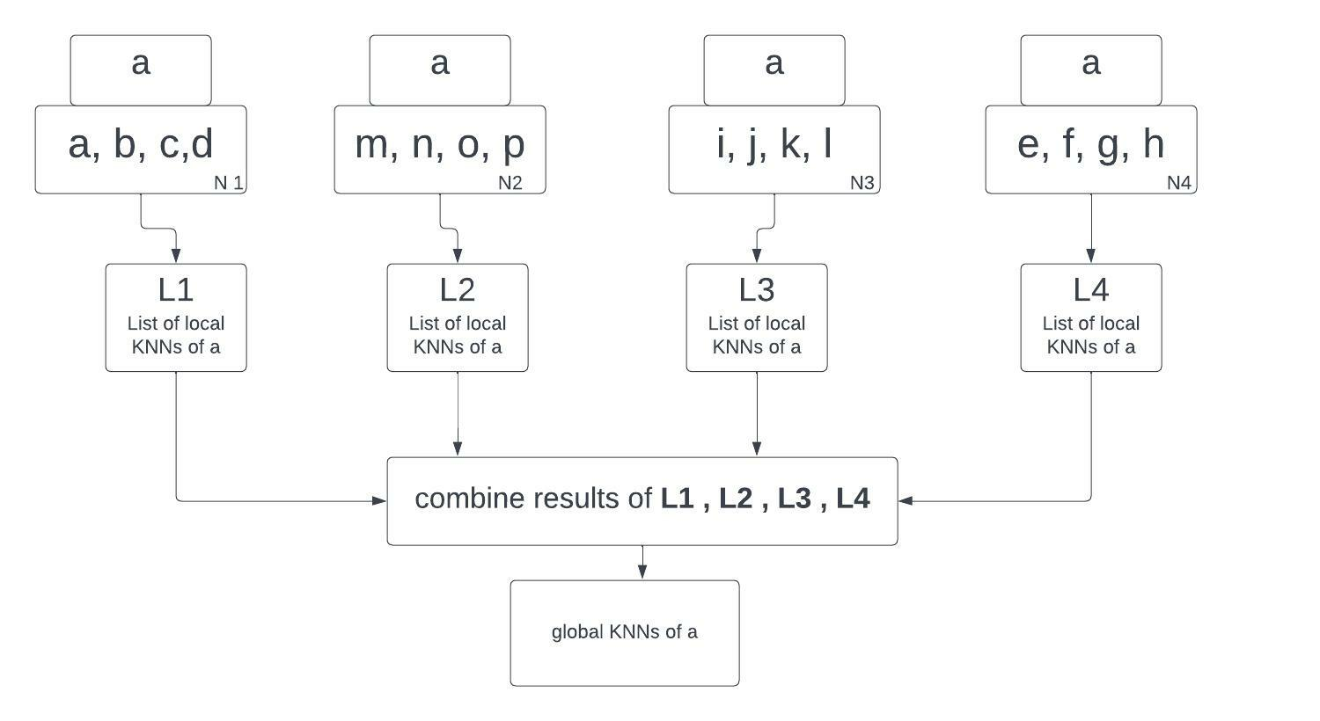

Slide 7
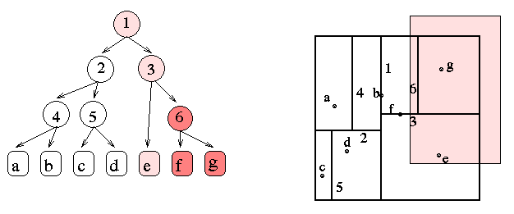

Slide 8
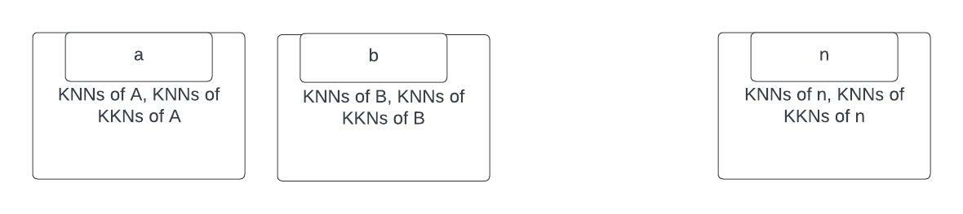
Calculate Reachability distance

Slide 9
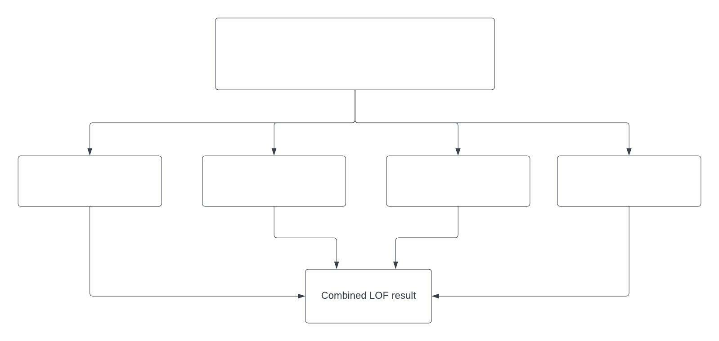





$$x^{\left(1\right)}x^{\left(2\right)}x^{\left(3\right)}……x^{\left(d\right)}$$
$$x^{\left(1\right)}x^{\left(2\right)}x^{\left(3\right)}$$
$$x^{\left(1\right)}x^{\left(4\right)}x^{\left(7\right)}$$
$$x^{\left(8\right)}x^{\left(2\right)}x^{\left(5\right)}$$
$$x^{\left(4\right)}x^{\left(7\right)}x^{\left(n\right)}$$

