Slide 1
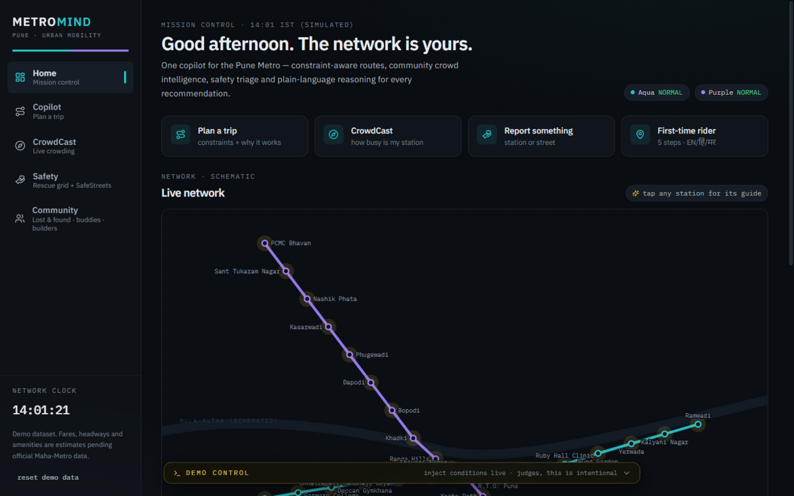
CODEX DAYLINE · URBAN MOBILITY TRACK · PUNE METRO BUILD SPRINT
METROMIND
Pune Moves. MetroMind Thinks Ahead.
An AI commute copilot that plans constraint-aware journeys, reasons over crowd reports and injected disruptions, explains every recommendation in plain language — and pairs it with safety triage, accessibility guidance and commuter community tools.
problem → solution → live demo → impact
ACTUAL BUILD · MISSION CONTROL — LIVE NETWORK, CROWD HALOS, DEMO CONTROL BAR
TEAM URBANSYNC
DEMO DATA THROUGHOUT — NO REAL-TIME FEED CLAIMED
Arya Jannawar · Siddhant Pardeshi · Avani Jannawar
github.com/Arya-jannawar/MetroMind
Notes:
OPENING (20-30s): "Good morning — we are Team UrbanSync. Pune's metro is growing faster than the information riders need. MetroMind is our answer: an AI commute copilot for the Pune Metro that plans constraint-aware journeys, reasons over crowd reports and disruptions, and explains every recommendation in plain language. Everything you will see is a working prototype built on a labelled demo dataset — no real-time Maha-Metro feed is claimed."
Point at the screenshot: this is the actual build — Mission Control home with the live network map and the Demo Control bar at the bottom.
TIP: memorize the first two sentences; look at judges, not the screen.

Slide 2
01 · THE PROBLEM
A Journey Is More Than a Route.
A route suggestion answers “where”. A commuter also has to answer when, how much, how crowded — and what to do when one of those changes mid-journey.
01
First-time riders
Which line, which exit, which gate? Station knowledge is scattered across signs, apps and word-of-mouth.
WHAT THE RIDER IS REALLY BALANCING
“Reach Deccan by 09:30.” — a deadline, not a preference
02
Daily commuters
“Stay under ₹50.” — a budget the plan must respect
How crowded will the next platform be? There is no way to see it before you commit to a departure.
“Avoid packed trains.” — comfort the route app ignores
03
When something changes
“Step-free, if possible.” — accessibility needs
A delay, a spike, a missed train — no single place explains what changed and what to do now.
“Aqua line delayed 15′?” — the plan breaks — then what?
Qualitative, honest framing — no ridership statistics are claimed.
one condition changes → the plan breaks
01 / 12 · THE PROBLEM
Notes:
PROBLEM (25s): Three commuter realities — first-time riders don't know which exit or line; daily commuters can't see platform crowding before they commit; and when something goes wrong, nothing explains what to do.
Then the right panel: a real commute is a bundle of constraints — arrive-by time, budget, crowd tolerance, accessibility. Change ONE and today's route suggestion goes stale.
HONESTY: we deliberately claim no ridership statistics — the problem framing is qualitative.

Slide 3
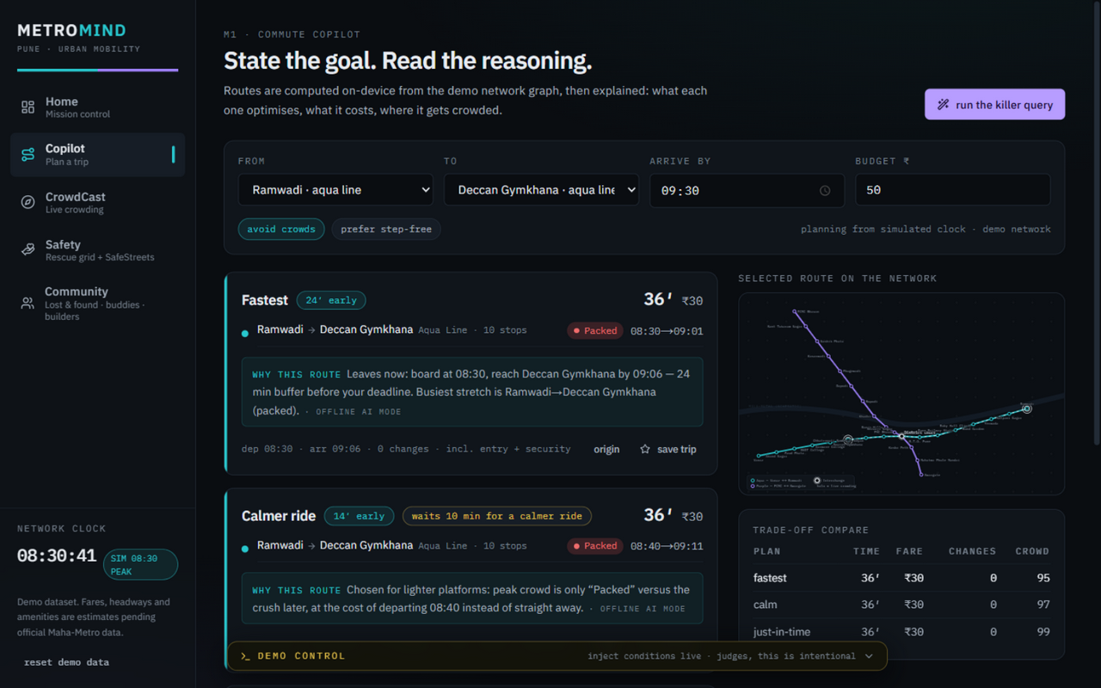
02 · THE SOLUTION
One Copilot. Multiple Travel Decisions.
STEP 1
STEP 2
STEP 3
STEP 4
USER INPUT
DECISION ENGINE
EXPLAINED PLANS
ADAPTIVE REPLY
“Reach Deccan by 9:30. Budget ₹50. Avoid crowds.”
Constraint-aware Dijkstra over the demo network graph — ride time, fare, transfers, crowd penalty.
Three timing strategies, each with fare, crowd forecast and a one-sentence why.
Inject a delay or a crowd spike — every card recomputes and explains the change.
stated as a goal, not two station names
runs on-device, no API key needed
trade-offs visible, not hidden
the demo moment, live
ACTUAL BUILD
Constraint chips, not forms arrive-by · budget · avoid crowds · step-free — one tap each.
Explained, every time each card carries a “why this route” line in plain language.
One shared state core a crowd report or a delay anywhere re-reasons the whole app.
ON-DEVICE ROUTING · EXPLAINABLE BY DEFAULT · AI OPTIONAL
02 / 12 · THE SOLUTION
Notes:
SOLUTION (35s): Walk the four steps left to right. The user states a goal, not an origin-destination query. The engine runs a constraint-aware Dijkstra on-device — routing never depends on an API. It returns three explained plans, and when conditions change, it re-reasons and explains the change.
KEY LINE: "Routing is computed on-device; AI upgrades the language, it never gates the demo."
Transition: "Let me show you the feature that makes this different."

Slide 4
03 · HERO FEATURE · EXPLAINABLE COMMUTE COPILOT
Not Just the Best Route. The Reason Behind It.
KILLER QUERY · RAMWADI → DECCAN GYMKHANA · ARRIVE 09:30 · BUDGET ₹50 — DEMO ESTIMATES
FASTEST
“Leaves now — 24 min of buffer before the deadline. Busiest stretch: Ramwadi → Deccan Gymkhana (packed).”
dep 08:30 → arr 09:06
36′ · ₹30 · 0 changes · 10 stops
CALMER RIDE
“Chosen for lighter platforms: peak crowd is ‘Packed’ versus the crush later — at the cost of departing later.”
dep 08:40 → arr 09:11
36′ · ₹30 · waits 10 min, calmer ride
JUST-IN-TIME
“Arrives exactly at the deadline — the latest safe departure the schedule allows.”
dep 08:54 → arr 09:30
36′ · ₹30 · zero buffer
THE DIFFERENTIATOR
MetroMind explains the trade-off instead of returning a route without context — every recommendation ships with its reason.
Strategies differ in WHEN you travel — honest for a two-line network where the physical path is unique. Off-peak, one honest card is shown instead of padding.
03 / 12 · HERO FEATURE
Notes:
HERO FEATURE (40s): Read ONE why-line aloud, exactly as the app shows it. Point at the trade-off table in the screenshot: fastest vs calm vs just-in-time, same ₹30 fare, different departure strategy and crowd exposure.
The why-lines come from the deterministic explain layer; with the optional GLM key they get more natural language, badged accordingly ("offline AI mode" when templated).
JUDGE PREEMPT: "Why three cards if the physical path is unique?" — because on a two-line tree network the honest differentiation is departure timing + crowd exposure, and we say so.

Slide 5
04 · PRODUCT ARCHITECTURE
Five Capabilities. One Connected Platform.
M1
COMMUTE COPILOT
M2
M3
CROWDCAST
RESCUE GRID + SAFESTREETS
The flagship. Constraint-aware route planning, comparison, plain-language explanations and live rerouting.
Station × 15-min crowd heatmap. One-tap anonymous reports — Empty / Moderate / Packed — with 15-minute half-life decay, confidence and freshness.
Incidents ranked by triage score — severity, people affected, footfall, recency — with recommended actions. Street-hazard risk map for the walk in.
▸ arrive-by · budget · avoid crowds · step-free
▸ three timing strategies with why-lines
▸ trade-off compare table
M4
M5
▸ live disruption re-planning (Demo Control)
STATION GUIDE / ACCESSWAY
COMMUNITY CONNECT
5-step first-rider guide in EN / हिंदी / मराठी. Per-station pages: exits, parking, accessibility, first/last mile, departures, crowding now.
Lost & found board with search, travel-buddy matching with a why-matched reason, ConnectIQ-style builder matching, station events.
RAMWADI ─ DISTRICT COURT ─ DECCAN
SHARED METRO-DATA + DISRUPTION-STATE CORE 29 stations · Aqua + Purple lines · District Court interchange — crowd reports, disruptions and incidents in one engine (lib/), persisted locally. A report anywhere re-reasons everywhere.
04 / 12 · FIVE MODULES
Notes:
MODULES (35s): Mission Control (home) watches the whole network; M1 Copilot is the flagship — give it the most air time. M2 CrowdCast and M3 Rescue Grid are the civic layers; M4 Station Guide carries accessibility; M5 Community Connect carries lost & found, buddies and builder matching.
THE POINT: these are not five separate apps — they share one data core, so a crowd report or an injected delay changes the same recommendation surface everywhere. That shared state is the architectural bet.

Slide 6
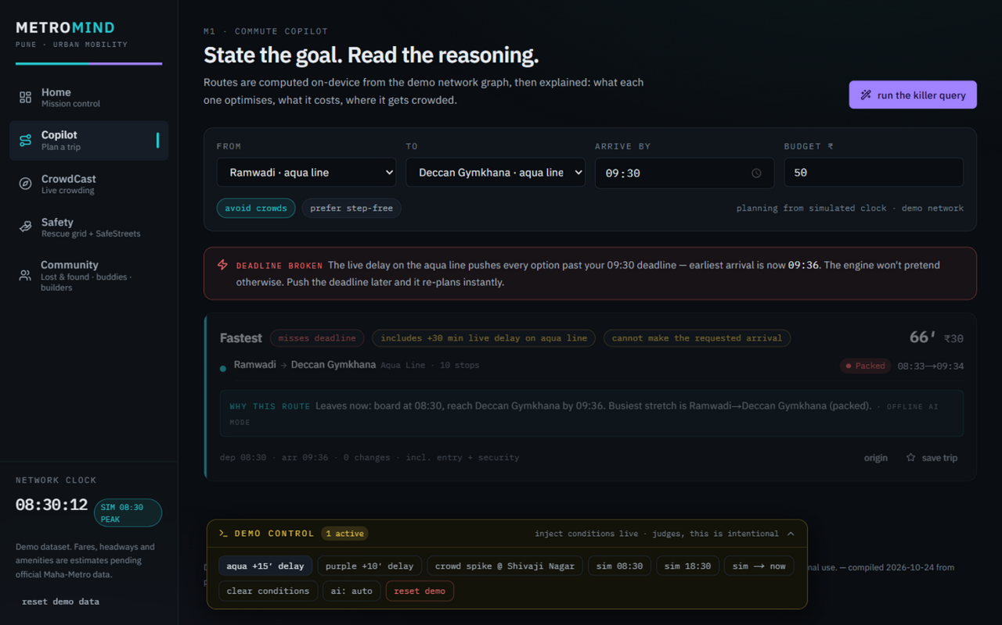
05 · THE LIVE DEMO MOMENT
When the Metro Changes, the Recommendation Changes.
BEFORE — three explained plans, Fastest recommended
AFTER — “Deadline broken”: earliest arrival 09:36
DEMO CONTROL BAR
▸ aqua +15′ delay
repeat press → +30′ total
cards recompute live, in front of the judges
Recomputed live
Honest failure state
Relax the deadline
+30′ chips, updated arrivals, re-ranked plans — no cutaway, no refresh.
“Earliest arrival is now 09:36 — the engine won't pretend otherwise.”
push 09:30 later → instant re-plan. The demo is interactive, not a recording.
SIMULATED DEMO CONDITIONS — injected by the built-in Demo Control bar. No real-time Maha-Metro feed is claimed.
05 / 12 · LIVE DEMO
Notes:
DEMO NARRATIVE (60-90s) — this is the moment:
1) Show the before-state: three plans, Fastest recommended (arr 09:06, 24 min buffer).
2) Say: "Now the aqua line runs fifteen minutes late." Click Demo Control → aqua +15′ delay. Cards recompute: +15′ chips, updated arrivals.
3) Press it AGAIN (+30′ cumulative) → the Deadline Broken panel appears: "earliest arrival is now 09:36 — the engine won't pretend otherwise." Dimmed best-effort cards, no fake route.
4) Relax the deadline → instant re-plan.
5) Optionally: crowd spike at a station → heatmap halo + Copilot badges update together.
HONESTY LINE (say it verbatim): "These are simulated demo conditions, injected by our own Demo Control bar — that label stays on screen."

Slide 7
06 · CROWD INTELLIGENCE & COMMUNITY SAFETY
Small Reports. Smarter Decisions.
M2 · CROWDCAST
M3 · RESCUE GRID + SAFESTREETS
Station × time crowd heatmap
Help gets ranked, not just logged
7:00
8:00
9:00
10:00
11:00
Vanaz
#1 LOST CHILD · Swargate score 100/100
Deccan Gymkhana
why: type +88 · 2 affected +10 · hub footfall +10 · just now +8
District Court
RECOMMENDED Freeze exits 10 min · announce on PA · review CCTV · staff lift lobbies
Shivaji Nagar
Pune Rly Stn
Swargate
▸ Triage score = severity + people affected + station footfall + recency — the queue re-ranks and explains itself.
Light
Moderate
Busy
Packed
▸ Assign team / resolve workflow in the prototype; SafeStreets adds a street-hazard risk map for the walk to the station.
▸ One-tap anonymous reports: Empty / Moderate / Packed — no account.
▸ 15-min half-life decay · confidence + freshness shown on every report.
▸ One tap re-badges Copilot route advice across the whole app.
PROTOTYPE ONLY — does not dispatch real emergency services. In a real emergency in India, call 112 or notify metro staff. Crowd reports and incidents are seeded samples labelled “sample” / “DEMO DATA” in the UI.
06 / 12 · CROWD & SAFETY
Notes:
CROWD + SAFETY (35s): CrowdCast — one tap, anonymous, no account; reports decay with a 15-minute half-life so stale data loses influence; confidence and freshness are shown. The heatmap drives route advice.
Rescue Grid — the point is ranking: severity + people affected + footfall + recency produce a queue with recommended actions, and the queue explains its own scores.
SAFETY LINE (verbatim): "This prototype does not dispatch real emergency services — in a real emergency, call 112 or notify metro staff."
JUDGE PREEMPT: "How do you prevent misleading safety info?" — recommended actions are rule-based templates per incident type; real deployment needs authority sign-off (that's on the roadmap).

Slide 8
07 · TECHNICAL ARCHITECTURE
Built Around a Shared Decision Engine.
INTERFACE
RUNS WITH NO API KEY
Next.js 15 App Router · React 19 · TypeScript · Tailwind CSS — 7 routes: home · copilot · crowd · safety · guide · community · station/[id]
Routing, crowd, triage and the full demo are complete in deterministic mode. AI is an upgrade, never a dependency.
STATE
Zustand stores × 6 (live · crowd · rescue · community · safe · prefs) — persisted to localStorage; “reset demo” wipes every key
28 TESTS · NEXT BUILD CLEAN
SHARED DATA CORE
data/pune-metro.json — 29 stations · Aqua + Purple · District Court interchange + seeded reports, incidents, hazards — labelled DEMO DATASET
Routing constraints, fare capping, crowd decay, triage ranking, persistence. Zero console errors on desktop + 390 px.
ENGINE — lib/ · PURE TYPESCRIPT, ZERO FRAMEWORK IMPORTS
Dijkstra over (station, line) states · fare ₹10 + ₹2/stop, cap ₹35 · crowd penalty + 15-min half-life decay · triage scoring · explain layer — covered by 28 vitest tests
PWA-READY SHELL
OPTIONAL AI LAYER
Manifest shipped; offline trip caching is on the roadmap — honestly marked as future work.
/api/copilot → GLM via z.ai, server-side key only · 3 s timeout · strict-JSON validation → on any failure: deterministic template explanations, badged “offline AI mode”
Engine band is the moat: pure TypeScript, framework-free, unit-tested — portable to a real feed without rewriting the app.
07 / 12 · ARCHITECTURE
Notes:
ARCHITECTURE (40s): Walk top to bottom. Interface: Next.js 15 + React 19 + TypeScript + Tailwind, 7 routes. State: six Zustand stores persisted to localStorage. Data: one demo dataset file — 29 stations, both lines, one interchange, labelled DEMO DATASET. Engine: pure TypeScript, zero framework imports — Dijkstra over (station,line) states, fare model, crowd penalty with half-life decay, triage scoring, explain layer. 28 vitest tests cover it.
AI LAYER: one server route, key stays server-side, 3-second timeout, strict JSON, instant template fallback. Kill the key and nothing breaks.
JUDGE PREEMPT: "What if the AI API fails?" — it degrades to deterministic explanations, badged "offline AI mode"; we demo that toggle deliberately.

Slide 9
08 · POSITIONING
From Route Search to Decision Support.
CAPABILITY | TYPICAL ROUTE PLANNER | METROMIND — BUILT
Route suggestions | Varies — usually a single best route | Three explained plans with visible trade-offs
Travel constraints | Varies — rarely combined | Arrive-by · budget · avoid crowds · step-free, one tap each
Disruption response | Varies | Injected delays re-plan live — with honest failure states
Crowd intelligence | Varies | Community heatmap: one-tap reports, decay, confidence
Safety support | Varies | Triage-ranked incident queue with recommended actions
Community tools | Varies | Lost & found · travel buddies · builder matching · events
Comparisons are fair by design — “varies” means capable apps exist; the claim is the combination, not that these are unique.
The combination is the differentiator: one shared state core means a crowd report, an injected delay and an incident all change the same recommendation surface — in front of the judge, live.
08 / 12 · POSITIONING
Notes:
POSITIONING (25s): Read the first three rows only; let judges scan the rest. Emphasize the fairness note — we are not claiming every planner lacks these features; capable apps exist. The claim is the combination under one shared state core.
Anticipate: "Google Maps has crowd levels" — yes, for some modes and cities; MetroMind fuses crowd reports WITH constraints and explainability, and works on a network where gate-level data does not exist yet.

Slide 10
09 · IMPACT & FEASIBILITY FOR PUNE
Designed for the Realities of Urban Commuting.
01
02
03
04
Informed decisions
Visible crowding
Accessible guidance
Structured civic voice
Time, fare and crowd trade-offs visible before you commit to a departure.
Fresh, decaying community reports give platforms a forecast they never had.
Step-free chips, lift and exit details, first-rider guide in EN / हिंदी / मराठी.
Hazards and incidents ranked and explained — not lost in a comment feed.
A PRACTICAL PATH FORWARD — PHASES AS STATIONS ON ONE LINE
PHASE 1 · NOW
PHASE 2
PHASE 3
PHASE 4
Demo on a verified station list with labelled simulated data — this build.
Validate with commuters; verify station facilities and accessibility on site.
Explore authorized metro-data integrations — GTFS / Maha-Metro — for real pilots.
Evaluate usefulness, reliability, accessibility and privacy before wider deployment.
Presented as potential benefits and future steps — not measured outcomes. No adoption or accuracy numbers are claimed.
09 / 12 · IMPACT
Notes:
IMPACT (30s): Four value areas, each tied to a built capability — nothing speculative. Then the honest path: Phase 1 is where we stand today (demo on a verified station list, labelled simulated data). Phase 2 validates with real commuters. Phase 3 explores authorized data integrations — we do NOT claim Maha-Metro partnership. Phase 4 evaluates reliability, accessibility and privacy before any wider rollout.
JUDGE PREEMPT: "What would you need from Maha-Metro?" — an authorized feed (GTFS or AFC gate counts) and sign-off on any safety-adjacent guidance.

Slide 11
10 · HONEST BUILD STATUS
A Focused Prototype With a Practical Path Forward.
BUILT & VERIFIED IN THE REPO
NEXT — IN DELIVERY ORDER
✓ Constraint-aware copilot: Dijkstra engine, 3 strategies, why-lines, trade-off table
▸ Verified official data; authorized Maha-Metro / GTFS feed integration
✓ Demo Control: inject delays (+15′ → +30′ accumulate), crowd spikes, simulated clock
▸ AFC-gate-based crowding to replace or calibrate community reports
✓ CrowdCast: heatmap, one-tap reports, 15-min half-life decay, confidence + freshness
▸ Authority dashboards for the Rescue Grid (needs operator sign-off)
✓ Rescue Grid: triage scoring + recommended actions · SafeStreets street-hazard map
▸ Full app-wide Hindi / Marathi i18n beyond the guide
✓ Station Guide: 5-step first-rider guide EN / हिंदी / मराठी + per-station pages
▸ PWA offline trip caching; multimodal PMPML / BRTS routing
✓ Community: lost & found, buddy match with reasons, ConnectIQ-style builder matching
▸ Photo verification for SafeStreets; abuse-prevention for reports
✓ AI upgrade path: GLM via z.ai, 3 s timeout, instant deterministic fallback
▸ Real commuter testing, accessibility validation, production deployment
✓ Quality gate: 28 vitest tests · clean build · zero console errors (desktop + mobile)
HONESTY POLICY Every fare, headway and amenity is labelled DEMO DATASET / ESTIMATE in-product. Simulated information is never presented as official Maha-Metro operational data.
10 / 12 · BUILD STATUS
Notes:
BUILD STATUS (30s): Left column is verifiable in the repo — tests, build cleanliness, browser walkthrough with zero console errors. Right column is the roadmap in delivery order.
Say it plainly: "We would rather show you one honest failure state than five fake wins — the Deadline Broken panel is deliberate."
If a judge asks for a live demo of anything: the whole app runs offline (npm run dev), no API key needed.

Slide 12
METROMIND
Every Commute Deserves a Smarter Decision.
Route planning, explainable AI, crowd intelligence, safety guidance and community support — one commuter-focused experience, built and demo-ready.
BUILT FOR PUNE. DESIGNED FOR SMARTER JOURNEYS.
Thank you. Questions?
TEAM URBANSYNC — ARYA JANNAWAR · SIDDHANT PARDESHI · AVANI JANNAWAR
Notes:
CLOSING (20s): "Pune is building after sunrise — we want MetroMind on it. Every commute deserves a smarter decision. Thank you — questions?"
Likely judge questions & honest answers:
1. What is the actual innovation? — The combination: constraint-aware routing + community crowd reports + honest disruption states, unified by one shared state core with explanations on every recommendation.
2. How is route selection calculated? — Dijkstra over (station,line) states; edge cost = ride + dwell + crowd penalty; transfers add 4 min; three departure-timing strategies; details are unit-tested in lib/.
3. Where does crowd data come from? — A deterministic time-of-day model seeded with sample reports; user reports are anonymous, local-only, decay with a 15-min half-life. Labelled DEMO DATA.
4. Is the metro info real-time? — No. Stations follow the operational Aqua/Purple lines from public sources; fares/headways are labelled estimates. Real-time would need an authorized Maha-Metro feed.
5. What if the AI API fails? — Instant deterministic fallback ("offline AI mode"); routing never depends on AI. There is a deliberate "ai: forced offline" toggle in Demo Control.
6. How do you prevent misleading safety info? — Rule-based recommended actions, prominent 112 / metro-staff disclaimer, prototype-only labelling; authority dashboards require operator sign-off (roadmap).
7. What must change before real deployment? — Authorized feed, verified fares/facilities, commuter validation, accessibility audit, privacy & abuse prevention, production deployment (currently local-runnable).
The repo runs with 'npm install && npm run dev' — offer a live run if the judges want it.

