Slide 1
Mental health companion
CAPSTONE PROJECT
Presented By:
ARYA SHUKLA, AKTU, AI & ML

Slide 2
OUTLINE
Problem Statement
System Development Approach
Algorithm & Deployment
Result
Conclusion
Future Scope
References

Slide 3
Problem Statement
Many students today struggle with stress, anxiety, and feelings of loneliness, often due to academic pressure and personal challenges. However, most students hesitate to open up or seek help from professional counselors because of fear, stigma, or lack of accessibility.
Problem: There is a growing need for an empathetic and secure AI-powered chatbot that can analyze Students emotion using sentiment analysis, offer motivational and supportive responses, and suggest relaxation or self-care techniques to promote mental well-being in a private and comfortable environment.

Slide 4
System Approach
Frontend | Streamlit app for user interaction (chat UI, input/output display)
Backend | Python logic to handle chat flow, model inference, and session state
Model Engine | LLaMA-based model (e.g. via HuggingFace Transformers or llama.cpp)
Data Handling | Optional logging, feedback collection, or prompt templates

Slide 5
Algorithm & Deployment
1. Privacy & Security
User conversations must be confidential and not stored without consent.
No personally identifiable information (PII) should be collected or exposed.
Secure communication using HTTPS.
2. Availability
The chatbot should be accessible 24/7 to support users during emotional distress.
Minimal downtime during updates or maintenance.
3. Performance
Response time should be under 2 seconds for typical queries.
Efficient memory usage to support low-resource devices (especially if using LLaMA locally).
4. Usability
Clean, intuitive interface with empathetic tone and easy navigation.
Mobile-responsive design for accessibility on phones and tablets.
Use of icons and emotional cues to guide user interaction.
5. Scalability
Should support increasing user load without degradation in performance.
Modular architecture to allow future integration (e.g., journaling, voice input, multilingual support).

Slide 6
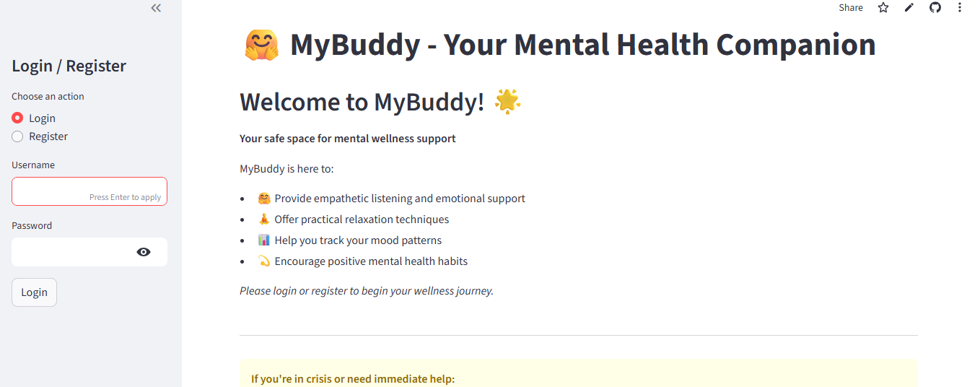
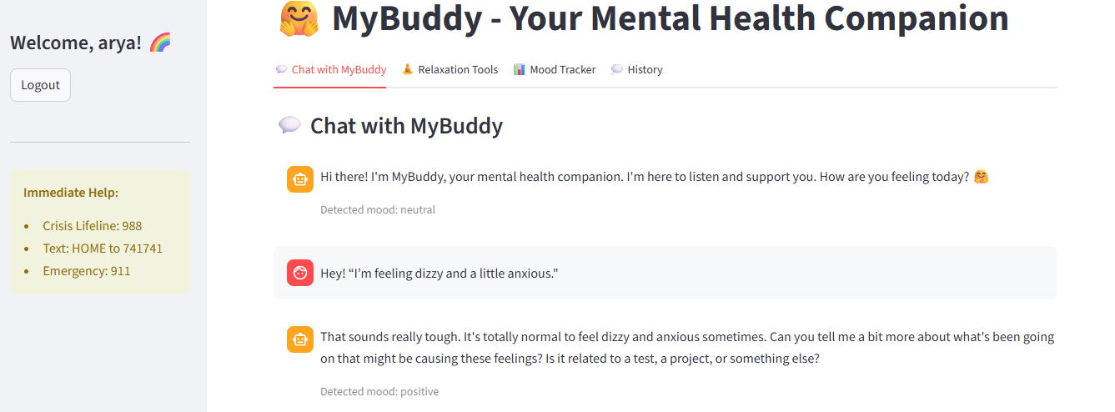
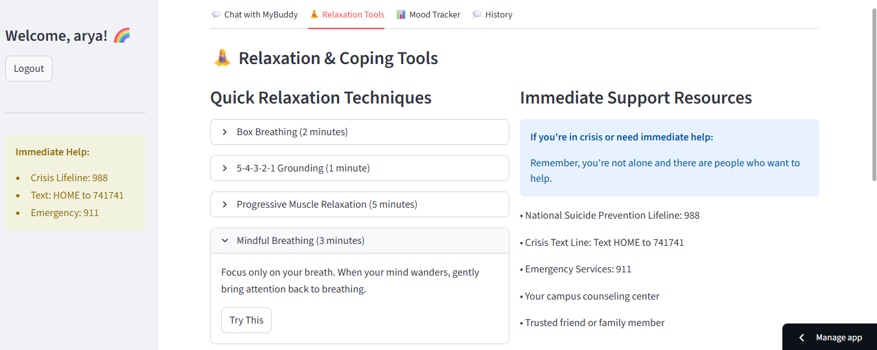
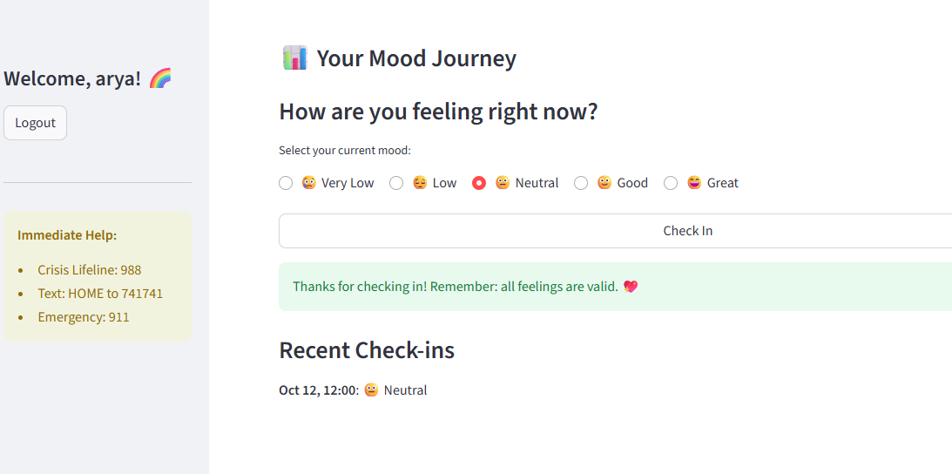
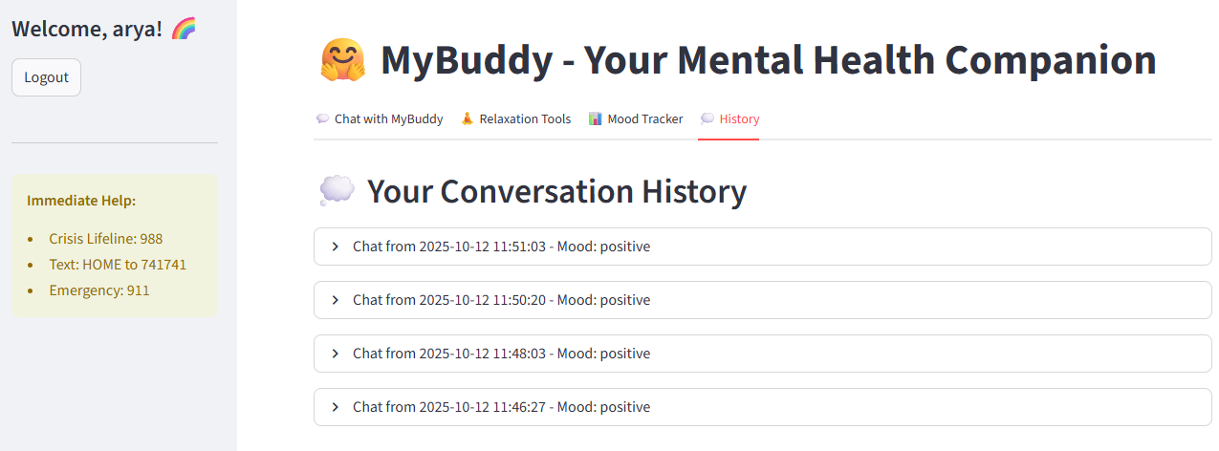
Result

Slide 7
GITHUB AND DEPLOYMNET LINK
Attach your Github Link : https://github.com/Arya068/mybuddy
Deployment link: https://mybuddyai.streamlit.app/#welcome-to-my-buddy

Slide 8
Conclusion
The development of an AI-driven mental health chatbot offers a promising solution to address the growing mental health challenges faced by students. By integrating sentiment analysis to understand user’s emotions and providing empathetic, motivational responses along with relaxation techniques ,the chatbot fosters a supportive digital environment. This approach bridges the gap between students and mental health support, encouraging emotional expression and self-care in a private, accessible, and non-judgmental space.

Slide 9
Future scope
Add voice support – enable users to speak and listen to the chatbot through voice interaction, creating A more natural, comforting, and accessible experience.
Support more languages – expand the communication to regional languages, ensuring inclusivity and cultural adaptability for diverse users.
Offline accessibility – allow users to access basic chatbot features without internet, providing mental health support anytime, anywhere.
Mood and emotion tracking – implement ai-based sentiment and emotion analysis to monitor users’ emotional patterns and suggest personalized coping strategies.
Connect to professional help – integrate an option to connect users with certified counselors or helplines when signs of severe distress are detected.
Interactive mindfulness activities – offer guided breathing, journaling, and relaxation exercises that adapt dynamically to the user’s emotional state for improved mental well-being.

Slide 10
References
NanthiniMoha/TNSDC-FWD-DIGITAL_PORTFOLIO
Get started with Bootstrap · Bootstrap v5.3
Implementation of Interactive Web Applications for Machine Learning and Data Science https://docs.streamlit.io/
Project Link : Mental Health Companion using AI https://mybuddyai.streamlit.app/#welcome-to-my-buddy

Slide 11
THANK YOU

