Slide 1
UE19CS390B – Capstone Project Phase – 2
SEMESTER - VII
END SEMESTER ASSESSMENT
Project Title : Alzheimer’s severity detection using speech and images
Project ID : PW22_JR_01
Project Guide : Dr. Jayashree R
Project Team : Darshil Shah, Muskan Kothari, Swasthi P Rao, Moulya T

Slide 2
Outline
Abstract
Team Roles and Responsibilities.
Summary of Requirements and Design (Capstone Phase - 1)
Summary of Methodology / Approach (Capstone Phase - 1)
Design Description
Modules and Implementation Details
Project Demonstration and Walkthrough
Results and Discussion
Lessons Learnt
Conclusion and Future Work
References

Slide 3
Abstract and Scope
Alzheimer's disease is a progressive neurologic disorder
causes the brain to shrink (atrophy)
continuous decline in thinking, behavioural and social skills.
The scope enables
early detection to avoid progressive reduction in effectiveness of treatment
differentiate AD with Frontotemporal Dementia(FTD) which can harm the patient if mistreated for another.
The aim is to maximise the true positive rate of detecting Alzheimer’s severity through linguistic features using speech and medical scans of MRI and PET
Speech is non-invasive, effective and cheap.

Slide 4
Functional Requirements
Processing inputs: the required input would be transcripts of speech and MRI/PET scan of the patient
Acquiring maximum number of true positives and minimum false negatives
Being able to process both speech and images with weighted accuracy
Robust prediction with reliable output on unseen data, no overfitting

Slide 5
Non-Functional Requirements
Safety and privacy of the patients’ data
Training time complexity and output on unseen data must be feasible enough to be deployed.
Scalability for different types and quantities of data
User interface must be clean, have self-explainable features and interpretability must be considerable.
System must not break or fail under unexpected conditions and gracefully degrade

Slide 6
Design Constraints, Assumptions & Dependencies
Available dataset for speech, MRI, PET scans comes from ADNI and Dementiabank on request
MRI and PET is a considerable baseline for differentiating AD and FTD
Multimodal approaches have used random forest classifiers, decision trees and stacked denoising encoders.
Reliable professional and medical opinion to go beyond mechanical validations.

Slide 7
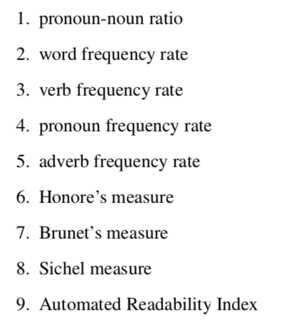
Proposed Methodology / Approach
Our proposed system would aim to maximise true positives of AD using speech modality as well as using a multimodal approach utilizing the modalities of MRI and PET scan data, which has previously not been used before.
Existing research talks about degraded linguistic abilities and hippocampus region
Validating the inferences of current research by computing measures for linguistic features using POS and utterances
To use image fusion and using wavelets between PET & MRI image.

Slide 8
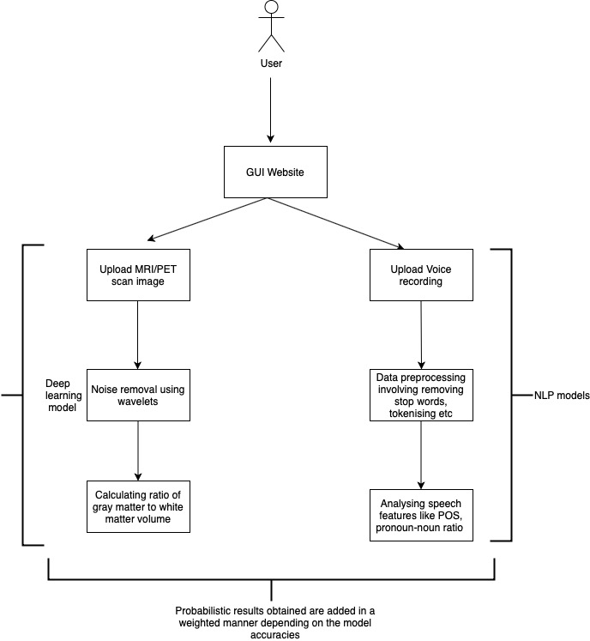
Architecture

Slide 9
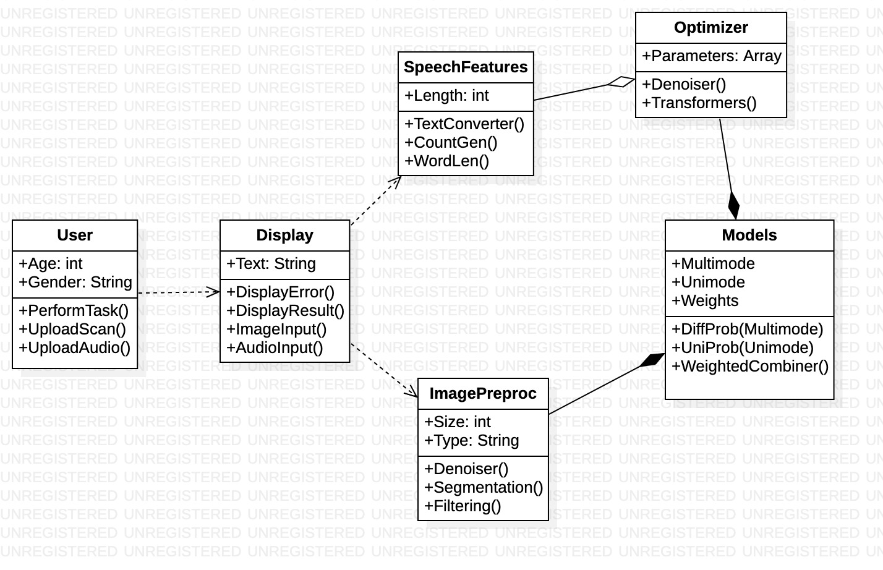
Design Description
Class Diagram

Slide 10
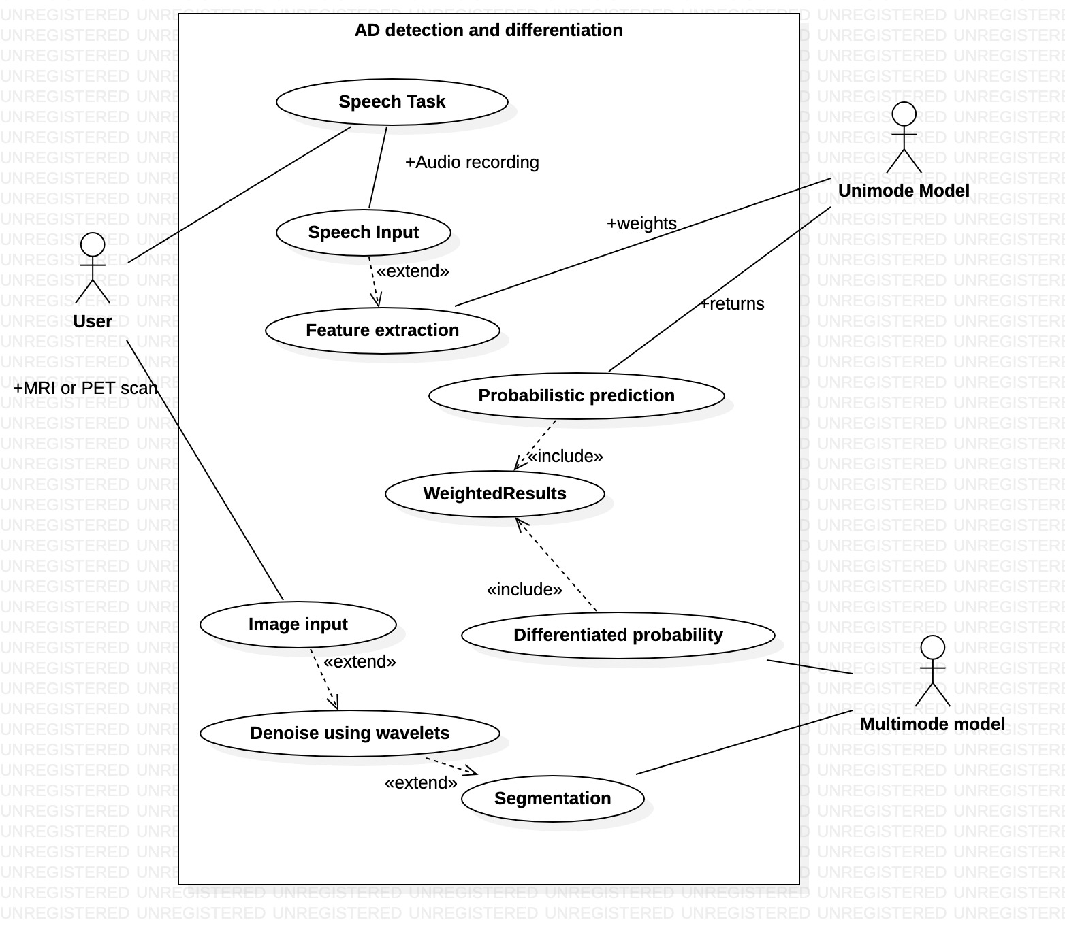
Design Description
Use Case Diagram

Slide 11
List of Tasks/Modules
Approach so far:
Speech segment -> Model #1 for detection using linguistic features
-> Model #2 for classification between AD or FTLDI
-> maximise true classification
-> if(!AD) {END}
Essentially a sequential flow between 2 models
Tasks checklist:
✅ Data Collection from DementiaBank and ADNI
✅ Data Input Analysis using CHAT protocols
✅ Data Preparation using annotations, counts, ratios, POS tags, measures of lexical diversity
✅ Training models and testing on unseen data
Comparison using image fusion and spatial wavelets for MRI and PET scans

Slide 12
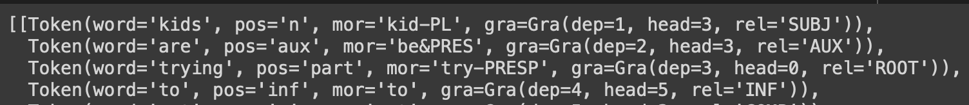
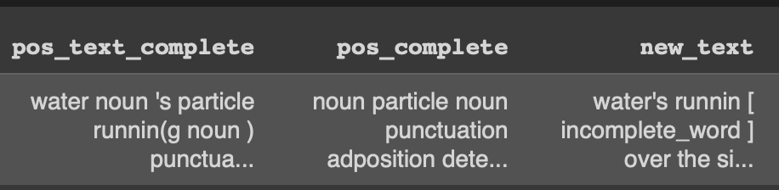
Implementation Details
spaCy, an open source library was used for Parts of speech tags which is a very important feature extraction.
Utterance -> POS tag inserted -> only POS tags -> annotations

Slide 13
Implementation Details
For POS features, 3 values were computed: pronoun-noun ratio, adverb frequency rate and verb frequency rate.
For vocabulary richness, Brunet’s and Sichel’s was computed: In Brunet’s (W), smaller the value, higher the vocabulary richness, also not sensitive to the text length.
Hapax legomena : the word types that occur once in a text
Hapax dislegomena : word types that occur twice in a text.
The other two measures used were MTLD (Measure of Textual Lexical Diversity) and MATTR (Moving Average TTR), based on TTR (Type-Token Ratio)

Slide 14
Project Demonstration
View the code and output here:
https://colab.research.google.com/drive/1toFTQeEJT0qLQoRYt-aqERLtskboVxgr?usp=sharing
Paper link: https://docs.google.com/document/d/1T0SjlgDOL04pFXBCRgxa8OgoZXsQtdhI/edit?usp=sharing&ouid=114818958946720489669&rtpof=true&sd=true

Slide 15
HOW ABOUT SOME PERCENTAGES?
15.7%
10%
35%
A
B
C
D
48%
MTLD
Adverb frequency
Incomplete sentences
P-N ratio
AD: 29.04
C: 34
AD: 0.69
C: 0.51
AD: 48.95
C: 60
AD: 8.16
C: 9.77

Slide 16
HOW ABOUT SOME PERCENTAGES?
150%
126%
196%
A
B
C
D
61.5%
Repetition
Disfluency
Incomplete sentences
Retraction
AD: 1.78
C: 0.711
AD: 2.10
C: 1.30
AD: 1.65
C: 0.73
AD: 0.51
C: 0.17

Slide 17
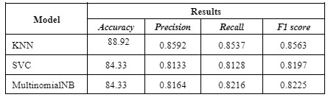
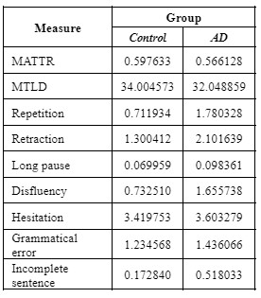
Results and Discussion
AD patients have a degraded linguistic sense of speech, higher use of adverbs and pronouns, less use of nouns and we have also identified that verbs are not that frequent in AD patients.
MATTR and MTLD for AD patients was less than normal patients which is an indication of reduced lexical diversity in the speech of AD patients.
Number of occurrences of repetition, retraction, disfluency and incomplete sentence was significantly higher among the 7 parameters calculated.

Slide 18
Image Pre-processing
176 MRI-PET image pairs extracted for each subject.
Pre-processing for MRI:
MT1, Gradwarp,N3m- corrects image distortion, non uniformity, image intensity
Pre-processing for PET:
Coregistered- six frames acquired and registered
Averaging
Standardization, Voxel Size(1.5mm)- standard 160x160x96 image grid
Uniform Resolution (8mm)- intensity normalization

Slide 19
Methodology
Image fusion integrates (complementary as well as redundant) information from multimodality images to create a fused image.
It not only provides accurate description of the same object but also helps in required memory reduction by storing fused images instead of multiple source images.
Performed image fusion of MRI and PET images to extract an area of the brain we can analyze using CNN models.
Considering transfer learning to use the pre-trained VGG-19 architecture, fine-tuning it to customize it in order for the softmax function to recognize three classes- mild AD,AD, no AD.
Several approaches of image fusion have been explored and the one with the best performance will be selected.
To refine what area of the brain should be analyzed for our purpose, our next step is to consult a known radiologist.

Slide 20
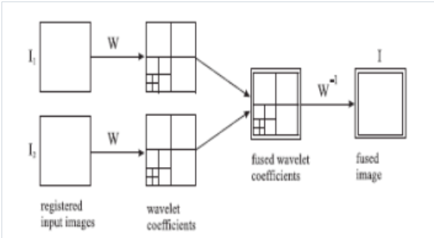
Image Fusion approaches
Discrete wavelet transform- based on sub-band which yields fast computation for transformation.
Captures limited directional information and hence are not suitable for sharp image transitions
Contourlet transform- different and flexible directions to detect the intrinsic geometrical structures
Does not provide a multiresolution representation of geometry
Combination of 1 and 2
These multiresolution schemes involve downsampling at every level which might lead to variance. This can be rectified by using a trous wavelet

Slide 21
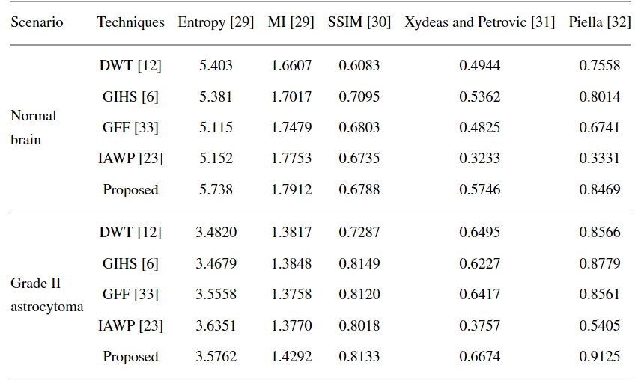
Using local features and fuzzy logic
This method extracts maximally combines the useful information in MRI and PET images by using à-trous wavelet, which introduces shift invariance, avoiding the previously discussed downsampling.
The proposed scheme first decomposes the MRI and PET images into low and high frequencies using à-trous wavelet.
High and low frequencies are then fused separately according to defined criterion.
Performs much better than the other well known transforms as shown in fig.

Slide 22
Schedule
Plan met for capstone schedule 2:
✔ Completed speech phase
✔ Implemented 4 significant lexical diversity measures
✔ Exceptional results of linguistic measures that differentiated AD and control group
✔ Completed IEEE research paper in October
✔ Submitted to international AI conference in Portugal awaiting result
✔ Obtained MRI-PET image pairs from ADNI
✔ Implemented comparison of image fusion and wavelet transform on images

Slide 23
Documentation
IEEE Format of Paper - Completed in October
Submitted to 2023 15th International Conference on Agents and Artificial Intelligence (ICAART), Portugal - Under review
Other conferences under consideration:
IEEE Conference on Artificial Intelligence (IEEE CAI) 7-8 June 2023 | Santa Clara, CA https://cai.ieee.org/2023/
IEEE COINS 2023 (Berlin, July 2023) http://coinsconf.com
2023 11th IEEE Humanitarian Technology Conference (2023 IEEE HTC) https://www.r10htc2023.org/home
2023 International Conference on Artificial Intelligence in Information and Communication (ICAIIC) - http://icaiic.org
2023 3rd International conference on Artificial Intelligence and Signal Processing (AISP) http://www.aisp.in/
2023 18th Conference on Computer Science and Intelligence Systems (FedCSIS) - http://www.fedcsis.org
2023 IEEE Conference on Computational Intelligence in Bioinformatics and Computational Biology (CIBCB)
A3 size Poster

Slide 24
Conclusion and Future work
There is some potential to include the demographic information from the transcripts and analyze the differences in the onset and changes in cognitive impairments between male and female.
In future in order to make it more complete, we want to implement Conditional Random Fields (CRF) to predict the relation between consecutive POS tags and analyze useful inferences obtained, if any.
Another addition would be to train models like t-SNE and hybrid CNN-LSTM on the prepared dataset.
Implementing image fusion models for 176 pairs of MRI and PET image data points

Slide 25
References
[1] del Castillo, M.Dolores & Serrano, J. Ignacio & Oliva, Jesús. (2015). Computational cognitive modelling of inflectional verb morphology in Spanish-speakers for the characterization and diagnosis of Alzheimer's Disease. 61-70. 10.3115/v1/W15-1208.
[2] Chen L, Dodge HH, Asgari M. Topic-Based Measures of Conversation for Detecting Mild Cognitive Impairment. Proc Conf Assoc Comput Linguist Meet. 2020 Jul;2020:63-67. PMID: 33642674; PMCID: PMC7909094.
[3] J. Islan and Y. Zhang, “A Novel Deep Learning based Multi-Class Classification Method for Alzheimer’s Disease Detection using Brain MRI Data”, (2017) 213-222. 10.1007/978-3-319-70772-3_20.
[4] Yamada Y., Shinkawa K., Kobayashi M., (2021), “Tablet-Based automatic assessment for early detection of Alzheimer’s disease using speech responses to daily life questions”, Front. Digit. Health 3:653904. doi: 10.3389/fdgth.2021.653904
[5] Vigo, I., Coelho, L., Reis, S., “Speech and language based classification of Alzheimer’s disease: a systematic review.” Bioengineering 2022, 9, 27. https://doi.org/10.3390/bioengineering9010027

Slide 26
Thank You

