Slide 1

Stress Detection using Emotion Recognition and ML
Team 17
Swasthi P Rao
TN Kaumudi
Sagar Arya

Slide 2
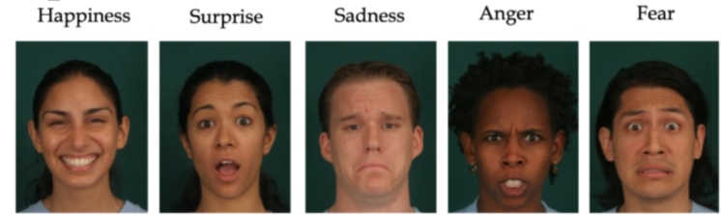
Abstract
Emotion recognition is the process of identifying human emotion.
Stress is a part of life it is an unpleasant state of emotional arousal that people experience in situations. Essentially, user's emotion using its facial expressions will be detected. These expressions can be derived from the live feed via system's camera.
We detect an individual emotion in each video frame and the decision on the stress level is made in sequential hours of the video captured.

Slide 3
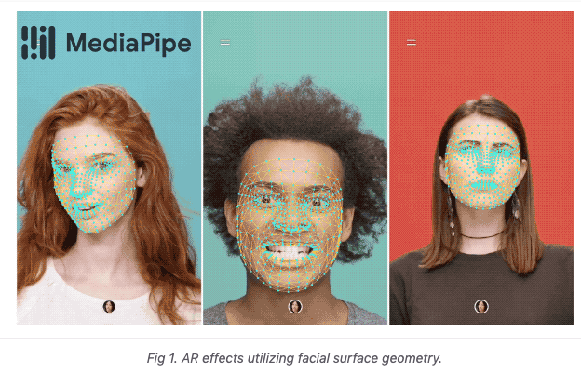
Scope
Our project classifies the facial expression into 5 expressions- sadness, anger, fear, happiness, surprise.
Estimate Face and Body poses using your Webcam and OpenCV in real time
Collect and process Joint Coordinates using Pandas
Train the ML model to classify poses from facial landmarks and poses
Libraries and dependencies used-
Mediapipe: Provides face and pose models.
OpenCV- used for image processing.
Pandas- working with tabular data as dataframes.
Scikit-Learn:Building custom ML models.

Slide 4
Methodology
The control flow would be in this order-
Install and import dependencies
Capture Landmarks and export to csv
Train custom model using Scikit-Learn
Read in collected data and process
Train machine learning classification model(here we use the random forest classifier due to its efficiency)
Evaluate and Serialize model
4. Make Detections using model
5. Detect stress based on emotions.

Slide 5
Literature Survey

Slide 6
Paper on stress detection using machine learning
Paper 1: Detection of Stress Using Image Processing and Machine Learning Techniques
Year of Publication: 2017
Authors: Nisha Raichur, Nidhi Lonakadi, Priyanka Mural
Library used: Theano
Information on the Library-
Theano is a python framework which aims at improving both the execution time and development time of the linear regression model which is used here as a deep learning algorithm.
Here, it builds a model to predict the results for the stress in a person with great precision.

Slide 7
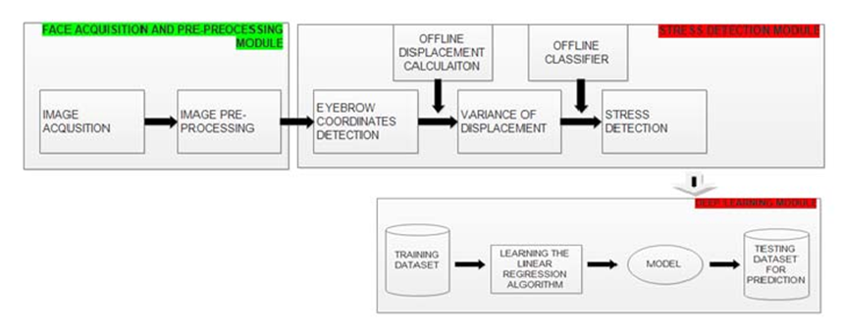
Methodology- Diagrammatic
This paper aims to provide an efficient approach to measure the stress level of a person working in front of the computer. The camera is mounted to capture the near frontal view of a person.

Slide 8
Methodology- Highlights
The face acquisition and pre-processing module pre-processes the real time captured images, which includes adjusting the brightness and contrast, conversion to binary images.
The stress detection module scans the binary image from the extreme left top to record the coordinates of the eyebrow.
The offline displacement calculation sub-module calculates the displacement of the eyebrow using the obtained eyebrow coordinates which is subsequently followed by the variance calculation of the displacement.
The classifier sub-module is trained offline are employed to determine the presence of emotion. The integrated decision of individual frames eventually determines the level of stress involved.
Optimizing results using machine learning, Theano has been used in training the linear regression algorithm to predict the desired behaviour.

Slide 9
Approach and Techniques Employed
Image Pre-processing- The image frames are extracted and the pre-processing of the images for the subsequent analysis in the further modules is done.The modified image after pixel transformation is subjected to binary transformation..
Eyebrow Detection-. The image converted to binary form is used for the pixel value analysis technique, which produces the (i, j) coordinates of the eyebrow.
Stress Detection- Stress detection is based on the rigid transformations shown by the eyebrows which are used as the major facial area if interest in its subsequent process of analysis. The first sub-module offline displacement calculation, calculates the displacement of the eyebrow position using the obtained coordinates in the previous steps. The second sub-module is calculation of the variance.
Deep Learning- The training dataset is prepared from the results obtained by previous modules. Theano trains the supervised linear regression algorithm and uses it to train a model prepared for prediction. Linear regression uses gradient descent which helps in optimization.

Slide 10
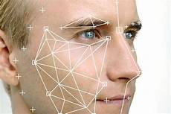
Paper 2: Emotion and Stress Recognition Related Sensors and Machine Learning Technologies
Year of Publication: 2021
Authors: Kyandoghere Kyamakya , Fadi Al-Machot , Ahmad Haj Mosa , Hamid Bouchachia , Jean Chamberlain Chedjou and Antoine Bagula
Methodology- Highlights
Intelligent sociotechnical systems range from driver-assistance systems, to medical-patient monitoring systems, to emotion-aware intelligent systems, to complex collaborative robotics systems.
They are built around (i) intrusive technologies such as EEG, ECG etc and(ii) nonintrusive technologies that use piezo-vibration sensors, facial images etc

Slide 11
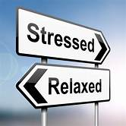
There are a number of issues relating to the design and development of such systems, as they rely on emotion and stress classification from physiological signals.
The Special Issue includes 25 impactful papers that present scientific concepts, frameworks, architectures and ideas on sensing technologies and machine-learning techniques.
These papers are grouped into four categories/groups: 1. Stress level recognition 2. Wearable body sensors 3. Dermatological sensors 4. Facial expression recognition.
Approach and Techniques Employed
1. Stress Detection:
The system used by the authors pre-processes noisy physiological signals, extracts features and applies machine-learning techniques to classify the levels of stress.

Slide 12

The paper used the stress detection dataset AffectiveROAD, which contained data gathered using Empatica E4 sensor and also continuous target variables. The two classification models used for stress detection were Random Forest and Bagged tree based ensemble.
2. Facial Expression Recognition:
The analysis of pain-related facial expressions was done by a method that combined both spatial and temporal aspects of facial expressions through a weighted aggregation of attention based neural networks’ outputs that use sequences of Motion History Images (MHIs) and Optical Flow Images (OFIs).
The dataset used for human-computer (HCI) setting consists of an experimental mobile and interactive scenario design .The work consisted of six experimental sequences inducing Interest, Overload, Normal, Easy, Underload and Frustration.

Slide 13
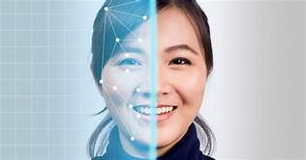
In Facial-landmark the first stage was to obtain local pixel-level accuracy for local-context information. The second stage was to with integrate obtained information with knowledge of spatial relationships between each key point in a whole image for global-context information.
A comparison of machine-learning algorithms applied to the recognition of emotion intensities was proposed.
The work compared several algorithms that include (i) Gabor filters, a Histogram of Oriented Gradients (HOG),and Local Binary Pattern (LBP) for feature extraction and (ii) Support Vector Machine (SVM), Random Forest (RF),and Nearest Neighbour Algorithm (KNN) for classification.

Slide 14
Code

