Slide 1
VoxMate
Friendly college chatbot
Name : Arya K Rajesh
Roll No : 17
Class : S3 MCA
Guide : Ms . Banu Sumayya
Assistant Professor,
Department of Computer Applications
Date of Review : 13.10.2025

Slide 2
Introduction
Low-cost voice-enabled system for college information.
Hands-free interaction through voice commands.
Uses retrieval-augmented generation (RAG) model.
Fetches data from pdfs, excel sheets, and databases.
Offline functionality after deployment.
Equipped with mic and speaker for user-friendly experience.
Suitable for receptions, help desks, and kiosks.
Reduces administrative workload.
Enhances user experience for students, parents, and visitors.

Slide 3
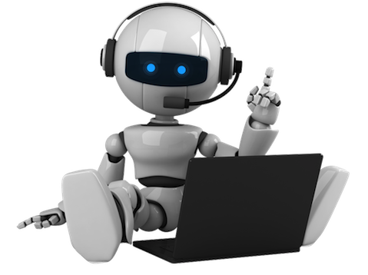
2
Abstract
Voxmate is a low-cost, portable, voice-interactive college information bot running on raspberry pi, using RAG with stored data to give instant, accurate, multilingual-ready responses about admissions, courses, fees, faculty, and facilities via a user-friendly offline interface..

Slide 4
Scope
.
Low-cost solution for providing college information.
Voice-enabled for hands-free interaction.
Offline operation to work without internet.
Natural Language Processing for understanding queries.
Uses Retrieval Augmented Generation (RAG) model.
Integrates with static data sources (PDF, Excel, database).
Provides details on admissions, courses, fees, faculty, and facilities.
Suitable for reception desks, help centers, and kiosks.
Reduces administrative workload.
Enhances user experience for students, parents, and visitors.

Slide 5
Objectives
• Design and Develop a Voice-Interactive System
• Integrate Retrieval-Augmented Generation (RAG) Model
• Enable Real-time Information Access
• Develop for Offline Functionality
• Improve User Experience and Reduce Administrative Load
• Plan for Future EnhancementsKeep the architecture flexible to support future features

Slide 6
Feasibility Study
8
:
Technical feasibility:
Uses flask, tesseract OCR, scikit-learn, sqlite/mysq
Open-source and student-friendly
OCR for report data, ML for disease prediction
2.Legal & Ethical:
Works with voluntary uploads
Minimal concerns now; future focus on privacy and encryption
3.Operational:
Simple interface for non-technical users
Admins can track usage and trends
Useful in remote or rural areas
4.Time:
Works with voluntary uploads
Minimal concerns now, future focus on privacy and encryption
5.Economic:
No major costs; free tools and libraries
Runs on basic systems
No need for commercial licenses

Slide 7
Existing System
3
Benefits:
Drawbacks:
Easy to deploy –No special hardware needed .
Quick Access to information.
Reduces manual workload .
Supports only text output.
Limited to the quality of local data sources.
No real-time web updates or API integration .
Data must be Structured and Limited .
No Support for voice input .
Limited language Supports.
Not fully interactive – The system replies but there’s no conversational memory.
Does not remember query history.

Slide 8
Proposed System
Benefits :
Drawbacks:
Real –time audio response.
Security and admin access control .
Alert for outdated or missing data.
Works offline after setup .
Easy to update college data.
Uses low-cost and accessible 24/7.
Data from PDFs ,Excel or database.
Reduces staff workload .
Voice – based user interaction.
Initial Setup Required.
No Live Agent Handoff.
Outdated Information Risk.
Data must be Structured and Limited.

Slide 9
LITERATURE REVIEW
7
AUTHOR | YEAR | SOURCE | TITLE | WORK
Kumar Shivam; Khan Saud; Manav Sharma; Saurav Vashishth & Sheetal Patil | 2020 | IJCAT | Chatbot for College Website | Developed a chatbot using Artificial Intelligence Markup Language (AIML) to help students get college-related info efficiently..
Kumar, R., & Das, S. | 2022 | SPRINGER | Ofline AI- Based Voice Bot for Campus Helpdesk | Proposed an ofline voice bot system using Raspberry Pi and local speech-to-text processing to reduce admin workload.
Patel, V., & Singh, R. | 2020 | ELSEVIER | Intelligent Kiosk System Using Raspberry Pi | Designed a cost- effective kiosk using Raspberry Pi for automating student inquiries with a local database.
Roy, M., & Khan, T. | 2023 | IEEE | Document- Retrieval Based QA System Using RAG | Implemented RAG- based model to fetch answers from structured and unstructured documents like PDFs and Excel sheets.
Joshi, D., & Verma, L. | 2021 | SPRINGER | Multilingual Voice Interface for Rural Education | Developed a multilingual voice interface for ofline environments using lightweight STT and TTS models.

Slide 10
System requirements
Software Requirements :
Operating System: Windows 10 / 11, Linux (Ubuntu 18.04+), or macOSProgramming
Language: Python 3.7 or above
Libraries/Frameworks:
1. Flask (Backend framework)
2. pyttsx3 / gTTS (Text-to-Speech)
3. spaCy, Transformers (NLP)
4. pandas, openpyxl, PyMuPDF (Data handling)
5. LangChain / Haystack (RAG model implementation)
6. SQLite3 (Local database)
Development Environment: Anaconda (optional)
IDE: VS Code, Jupyter Notebook, or any Python-compatible IDE

Slide 11
System requirements
Hardware Requirements:
Processor: Intel i3 / AMD Ryzen 3 or higher (i5/Ryzen 5 recommended)
RAM: Minimum 8GB (Recommended 16 GB for faster performance)
Storage: Minimum 256 GB (Recommended 512 GB SSD for faster data access)
Audio Output: Basic speakers or headphones for voice response
Peripherals: Display monitor, keyboard, and mouse
Internet: Optional – only required for online TTS or updates; system can work offline

Slide 12
System specifications
6
Frontend: HTML, CSS, javascript, bootstrap
Backend: python (flask)
TTS engine: pyttsx3, gtts, or any Compatible TTS library
Database: sqlite, excel, pdfs
Platform: desktop or web

Slide 13
Modules of Proposed system
User Module (Students / Visitors) :
Text-based query input.
Text and voice response output.
Admin Module :
Secure admin login.
Upload/update data sources (PDFs, Excel, etc.).
Control voice settings
3. NLP & RAG Engine Module :
Query intent classification.
Generate answers using RAG (Retrieval-Augmented Generation).
Data Management Module :
import PDFs, Excel files, Word documents, etc.
Extract and structure text content.
Support versioning and data freshness alerts.
5 . Analytics & Reporting Module:
Track system usage, identify frequent queries, and monitor performance.

Slide 14
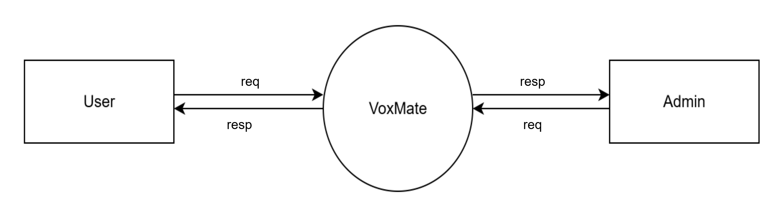
Data flow diagram
In Data Flow Diagram, we show that flow of data in our system. In level 0 DFD, we display that base DFD in which rectangle present input and output and circle show our system.

Slide 15
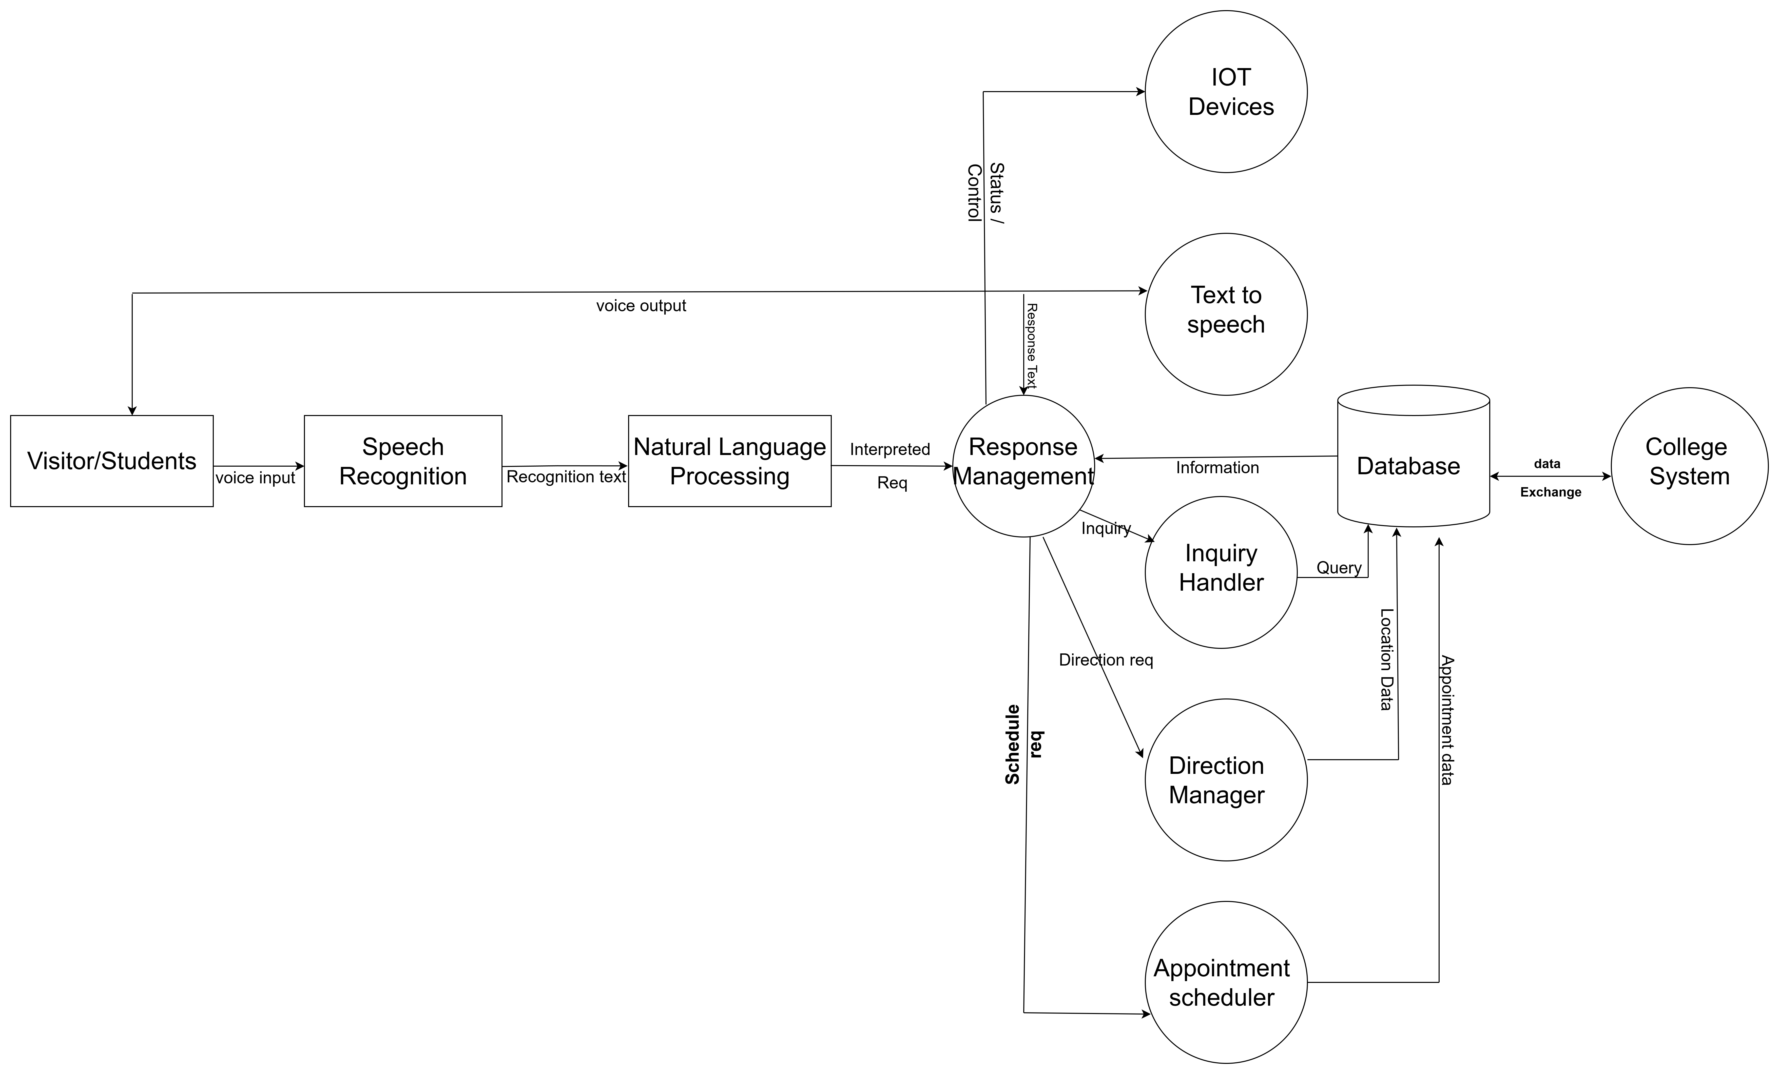
Data flow diagram
In level 1 DFD, we show the actual input and output of the system. The input of our system is text or image, and the output is rumor identified.

Slide 16
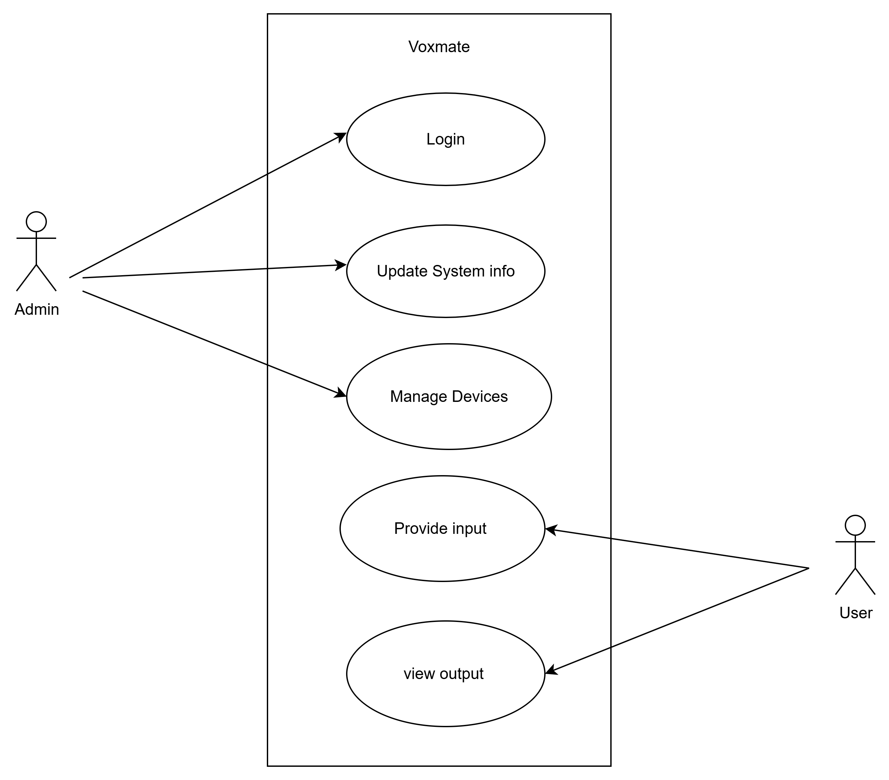
USE CASE DIAGRAM

Slide 17
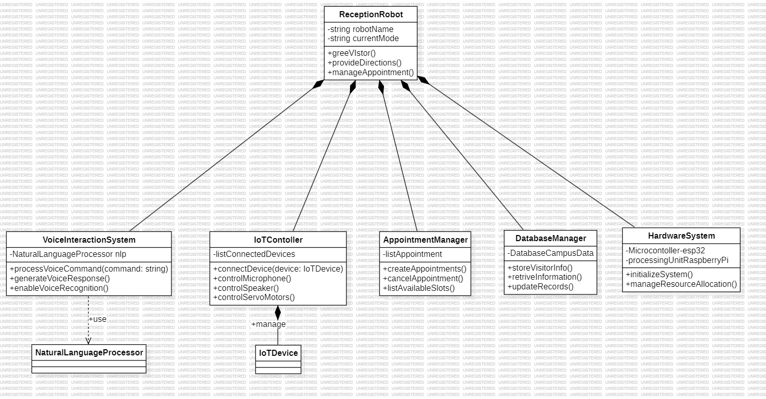
Class Diagram

Slide 18
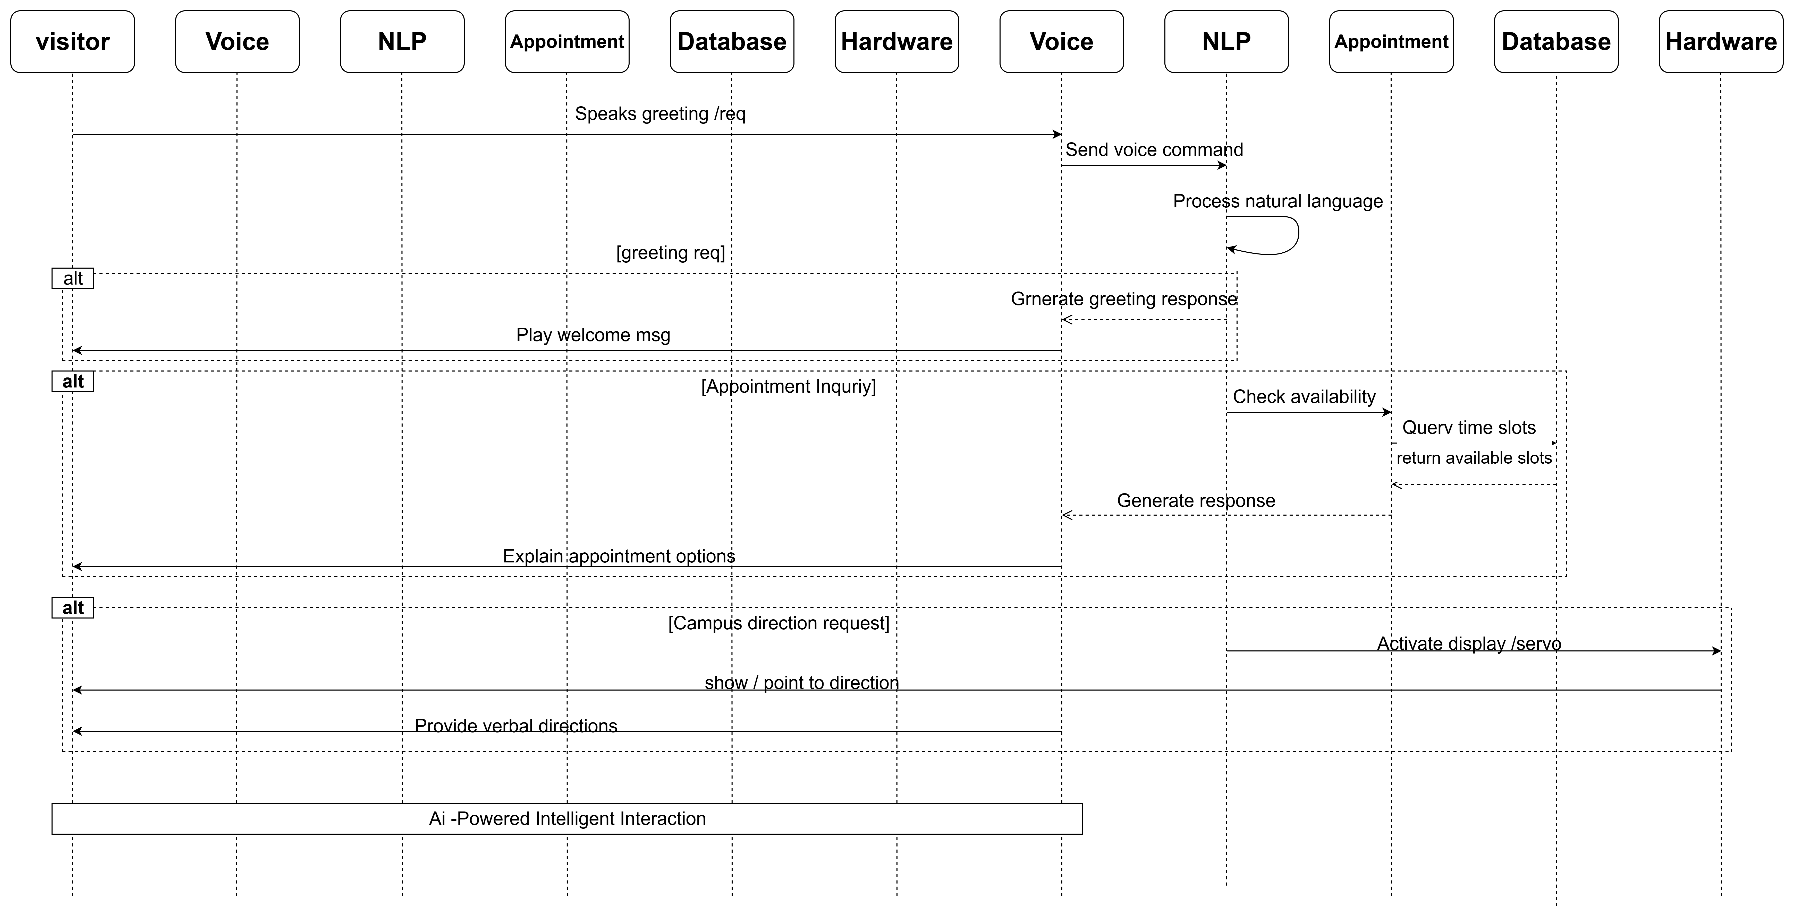
Sequence Diagram

Slide 19
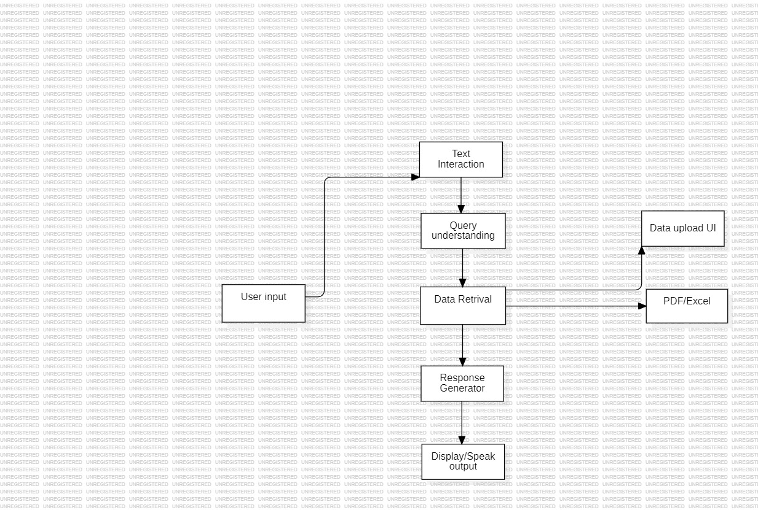
SYSTEM ARCHITECTURE

Slide 20
Result Analysis
Successful Query Handling
Natural Interaction
User-Friendly Interface
Response Accuracy
Real-Time Processing
Data Retrieval Efficiency

Slide 21
Conclusion
The Voice-Enabled College Information Bot is not just a technical project but a visionary step toward the digital transformation of educational campuses. It reflects a deep understanding of user-centric design, technical innovation, and practical implementation. The system’s current performance and future adaptability make it a promising solution for smart campuses, capable of revolutionizing how institutions interact with students and visitors while simplifying day-to-day information management.

Slide 22
Future Scope
Conversion into a Physical Robot
Mobile Application Development
AI-Powered Personalization
Cloud Integration and Scalability
Emotion and Voice Recognition
IoT and Smart Campus Integration

Slide 23
References
• Winkler, R., & Söllner, M. (2018). Chatbots in education: A systematic review of the literature. Educational Technology & Society, 21(4), 1-16. •
Pereira, M., & Díaz, J. (2019). The role of AI-powered chatbots in education: Benefits, challenges, and future prospects. International Journal of Educational Technology in Higher Education, 16(1), 1-10. •
Ramesh, S., & Rao, S. (2020). Multilingual chatbot systems in educational institutions: A case study. Journal of Educational Technology Development and Exchange, 13(2), 40-58. •
Gupta, S., Kumari, P., & Sharma, V. (2021). Design and implementation of a multilingual chatbot for student support in Indian universities. International Journal of Advanced Computer Science and Applications, 12(5), 74-82. •
Bhatia, S., & Ritchie, L. (2021). Code-switching and multilingual communication in Indian chatbots. Journal of Linguistic Research, 32(3), 182-196. •
Kumar, P., Shah, N., & Mittal, R. (2021). The role of bilingual voice assistants in enhancing student engagement in India. Journal of Educational Computing Research, 58(2), 289-311. •
Sharma, A., & Choudhary, V. (2022). Voice-activated chatbots in education: Bridging the digital divide for students with disabilities. Assistive Technology Journal, 14(1), 33-45. •
Patil, R., & Joshi, M. (2020). Challenges in speech recognition for Indian languages and accents in AIdriven educational tools. Journal of Artificial Intelligence in Education, 26(1), 55-68.

Slide 24
Thank you…
15

