Slide 1



TCS & AMD AI HACKATHON
AI-Assisted Complaint Intake & Smart Ticket Categorization
Fine-tuning Qwen2.5-7B on the CFPB Consumer Complaint Database to convert unstructured banking complaints into structured, system-ready ticket metadata.
Team Name - Westpac Gradients
Team No - 2826
Arya Chakraborty - Research, Model Training & Evaluation
Neha Malik - Business Case, Data Engineering & Presentation

Slide 2




PROBLEM & CONTEXT
Why Complaint Triage Breaks at Scale
PROBLEM STATEMENT
WHO THIS IMPACTS
Financial institutions process thousands of customer complaints across digital, branch, and contact-center channels every day. Because complaints are submitted as free-form narratives, agents must manually interpret and categorize each case before it can be routed to the appropriate operations team. This process is slow, inconsistent, and prone to misclassification, creating operational bottlenecks at scale.
Frontline
Agents
Operations
Teams
Compliance
Officers
End
Customers
WHY IT MATTERS
Every misrouted complaint introduces avoidable operational cost and resolution delay. Manual triage limits scalability, creates inconsistent customer experiences, and increases compliance risk when complaints are not accurately classified. Automating complaint understanding enables faster routing, improved agent productivity, and more consistent regulatory reporting.
MAPPED CHALLENGE
Track 3 – Fine Tuning (Advanced Users)

Slide 3




SOLUTION OVERVIEW
From Raw Complaint to Structured metadata
CFPB Consumer Complaints
Dataset
Raw 8 GB > dataset
Data Preprocessing
Train set : 12k
Test set : 500
Val set : 500
Base Model Test
Test the Qwen/Qwen2.5-7B-Instruct model on test data to find base metrics
Fine Tuning the model
Training the model on train dataset using QLoRA + PEFT
F.T. model Test
Evaluating the F.T model on various metrics on test data
Final Inference
Merge the LoRA adapters with base model and Inference on new input
AI APPROACH
TECH STACK
QLoRA-based supervised fine-tuning transforms Qwen2.5-7B into a domain-specialized complaint understanding model. The system converts unstructured banking complaint narratives into structured CFPB-compliant metadata (Product, Sub-Product, Issue, Sub-Issue) in a single inference call, eliminating manual categorization and routing delays.
Qwen2.5-7B-Instruct
QLoRA / PEFT
Transformers + TRL
AMD ROCm 7.2.4
AMD Instinct MI300X
Polars + JSONL

Slide 4
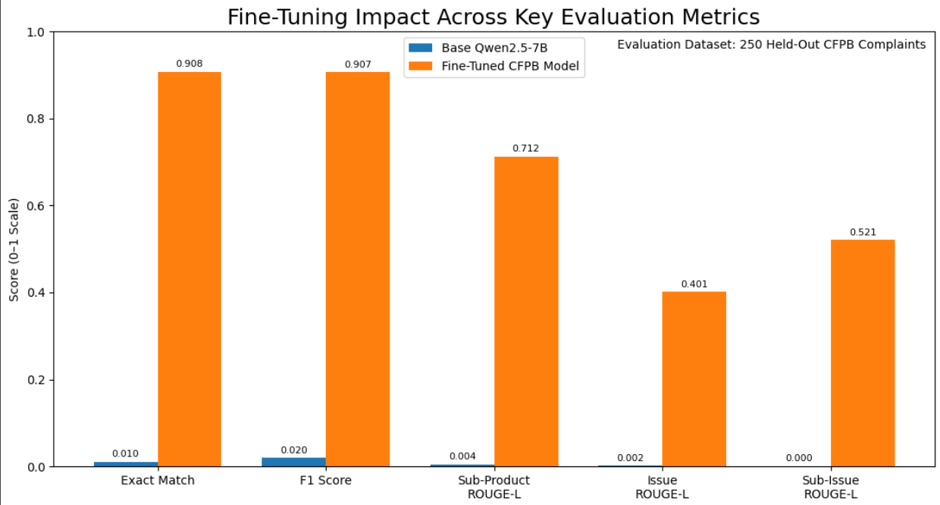
MODEL INSIGHTS & IMPACT
From 1% to 91% Exact Match
1.0% → 90.8%
1.96% → 90.7%
~45 min
~50 MB
Product Classification
Exact Match
Product Classification
F1 Score
Fine-Tuning Time on
AMD Instinct MI300X
Inference Overhead
LoRA Adapter Only
ROUGE-L: BASE vs FINE-TUNED
MODEL & DATA
Base: Qwen2.5-7B-Instruct | Link
Fine-Tune: QLoRA (rank 16, alpha 32) | Link
Dataset: CFPB Consumer Complaint DB - 5 products, stratified by Product × Issue| Link
Latency : 6765.3 ms for processing ~ 420 Tokens
Maximum number of Input tokens : 1024
GPU Usage (Including memory) : 16.24 GB

Slide 5








INNOVATION, DEMO & WHAT'S NEXT
Built to Plug Straight Into Operations
KEY INNOVATIONS
DEMO FLOW
FUTURE ROADMAP
Taxonomy-Aware Fine-Tuning - 80+ CFPB issue labels learned as a portable LoRA adapter
1
Raw complaint narrative goes in – no proper product names or issues are identified.
Routing & Priority Engine
2
Base model returns free-form text with wrong field names
Voice-to-Complaint Workflows
TF-IDF Constrained Decoding - snaps outputs to canonical labels, no hallucinated categories
3
Fine-tuned model returns clean, taxonomy-aligned JSON
Real-Time API Deployment
Single-Call Extraction - one inference returns all 4 ticket fields at once
4
Side-by-side run shows near-identical latency & memory
Multi-Language Support
Thank You
Project Repository

